Slide 1
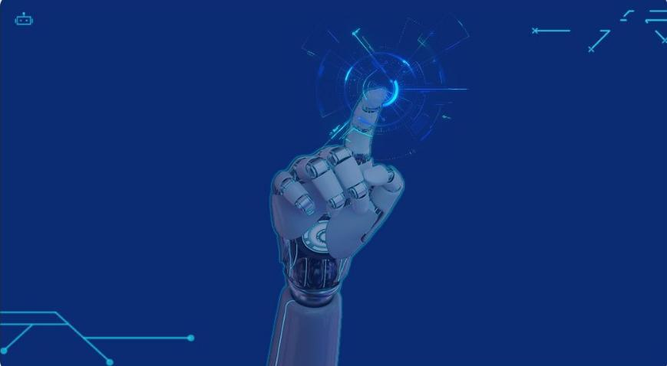

AURA
NEURAL INTELLIGENCE PLATFORM
Presented by: Ghinwa Allaoui & Riam Abbas
Tutor: Mulham Fetna · Mentor: Hala Dagher · 2026
YOLOv8
FastAPI
SQLite
OpenCV
Groq LLM
Chart.js

Slide 2
OBJECTIVES
Project Objectives & Goals
AURA (Strategic Neural Auditor) is a comprehensive AI-powered security intelligence platform. It combines YOLOv8, FastAPI, Groq LLM and OpenCV to analyze images, videos, and text for threat detection in real time.
01
Local AI Deployment
04
LLM Text Analysis
Run YOLOv8 object detection fully on-device via FastAPI — no cloud needed.
Groq llama-3.3-70b for multi-language semantic threat scoring.
02
Multi-Modal Analysis
05
Secure Authentication
Detect threats in images, videos, live camera, and Arabic/English text.
JWT + bcrypt login, role-based access (admin/analyst/viewer).
03
Real-Time Processing
06
Full-Stack Platform
Live camera stream analyzed at ~3 FPS with instant YOLO overlay.
3-tier: AI → FastAPI → Responsive dashboard with PDF reports.
AURA — Neural Intelligence Platform · Ghinwa Allaoui & Riam Abbas · 2025

Slide 3
PROBLEM / SOLUTION
Problem Statement & Proposed Solution
THE PROBLEM
THE SOLUTION — AURA
Security teams face massive volumes of live footage with no real-time AI support
Live camera streams processed at ~3 FPS with instant YOLO detection
Manual threat detection is slow, inconsistent, and error-prone
AI classification replaces manual review with 80%+ confidence
Existing tools handle only one input type (camera only, or text only)
Single platform: images, videos, text, and live camera in one dashboard
▶
No unified dashboard for detection, analytics, and reporting
Unified dark-mode dashboard with charts, history, and PDF reports
Text threats in Arabic and multiple languages go undetected
Groq LLM analyzes Arabic, English, French text with entity extraction
TARGET AUDIENCE:
Security ops teams · Campus & facility managers · Law enforcement · Any organization needing real-time AI threat monitoring
AURA — Neural Intelligence Platform · Ghinwa Allaoui & Riam Abbas · 2025

Slide 4
ADVANTAGE
Competitive Advantage
Feature
AURA
Generic CCTV
Cloud AI Tools
Multi-modal: image + video + text + camera
YES
Cam only
Partial
On-device / offline processing
YES
YES
NO — cloud
LLM Arabic text threat analysis
YES
NO
Partial
Real-time YOLO camera overlay
YES
Basic
YES
JWT Auth + role-based access
YES
NO
YES
PDF security report generator
YES
NO
Partial
Open source / no API cost
YES
YES
NO
Contextual escalation (weapon+person→CRITICAL)
YES
NO
Partial
AURA — Neural Intelligence Platform · Ghinwa Allaoui & Riam Abbas · 2025

Slide 5
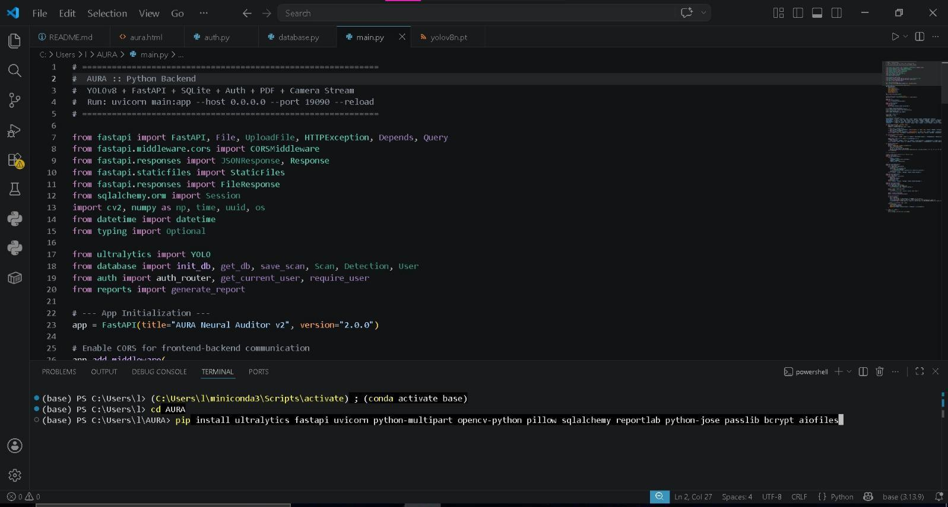
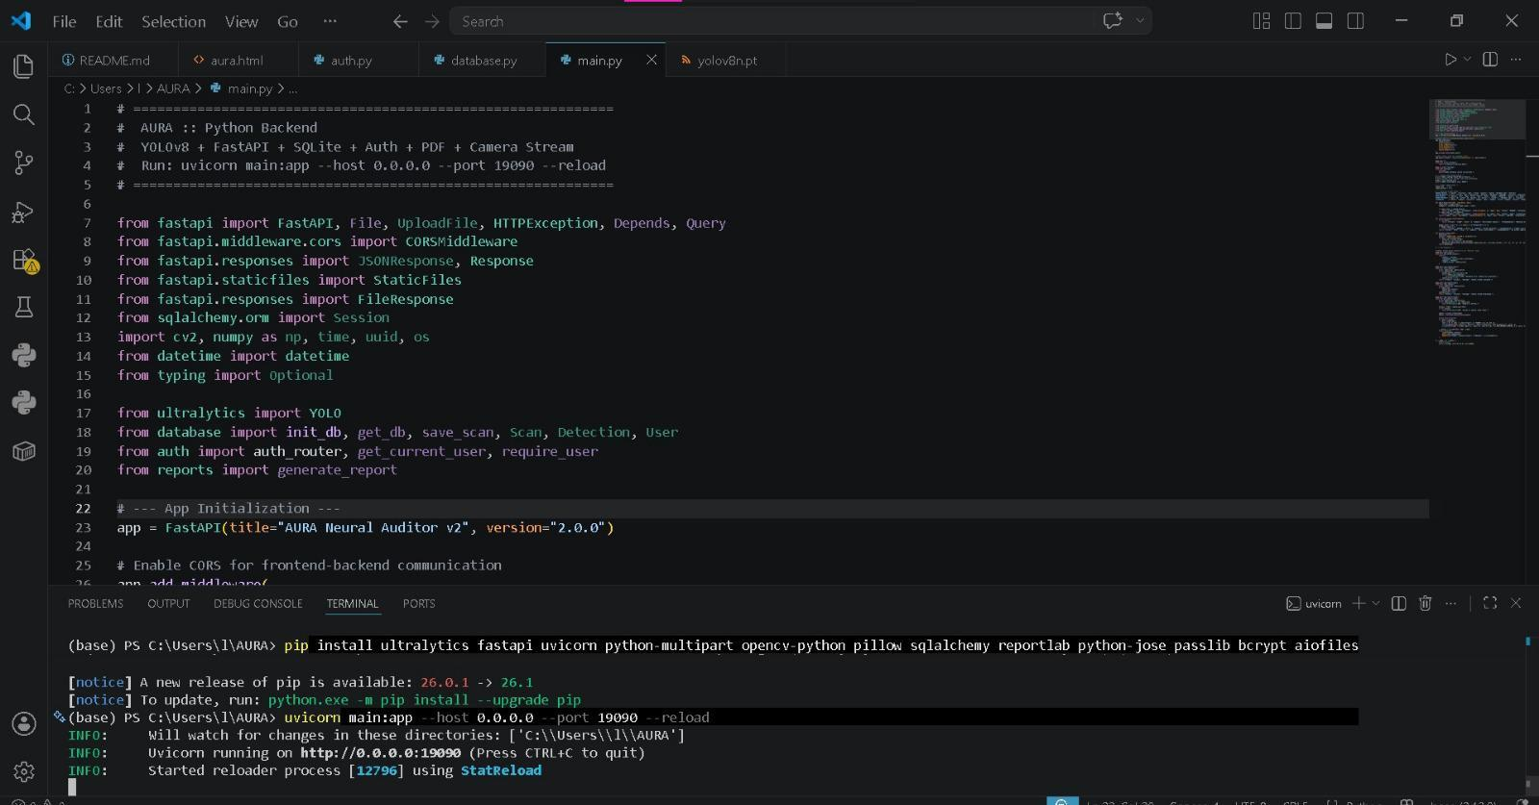
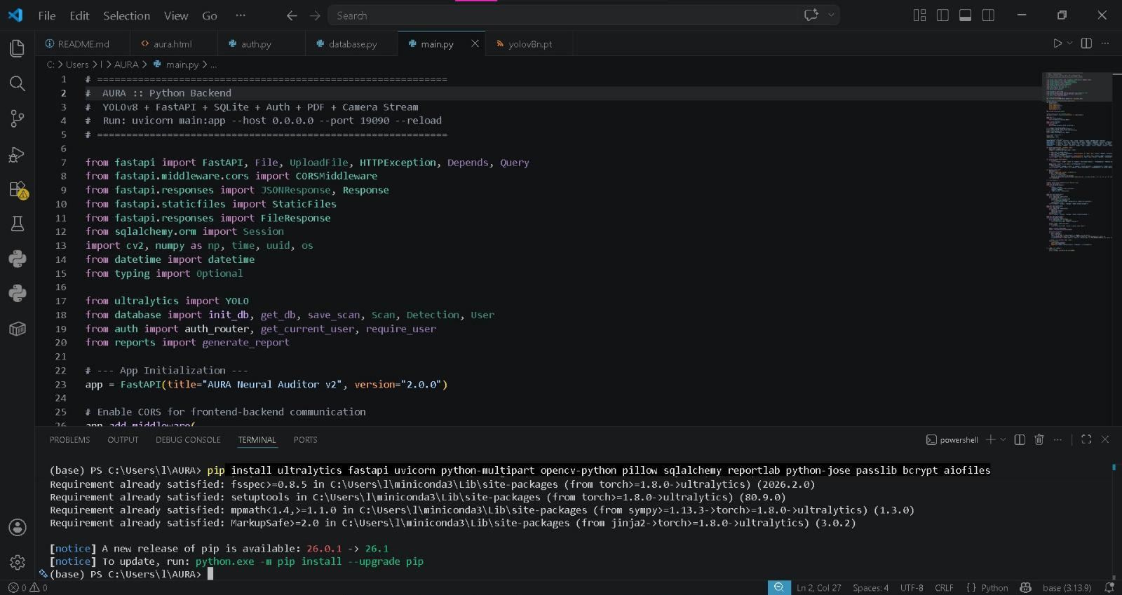
METHODOLOGY
Methodology & Technologies Used
FRONTEND LAYER
HTML5 · CSS3 · JavaScript ES6+ · Chart.js · Tailwind CSS · AURA Dashboard UI
▼
API LAYER
FastAPI · SQLAlchemy · JWT Auth · ReportLab PDF · Uvicorn · SQLite Database
▼
AI / PROCESSING LAYER
YOLOv8n (Ultralytics) · OpenCV · Groq LLM (llama-3.3-70b) · NumPy
Python 3.10
FastAPI
YOLOv8n
OpenCV
Groq LLM
ReportLab
SQLite
JWT/bcrypt
Chart.js
AURA — Neural Intelligence Platform · Ghinwa Allaoui & Riam Abbas · 2025

Slide 6
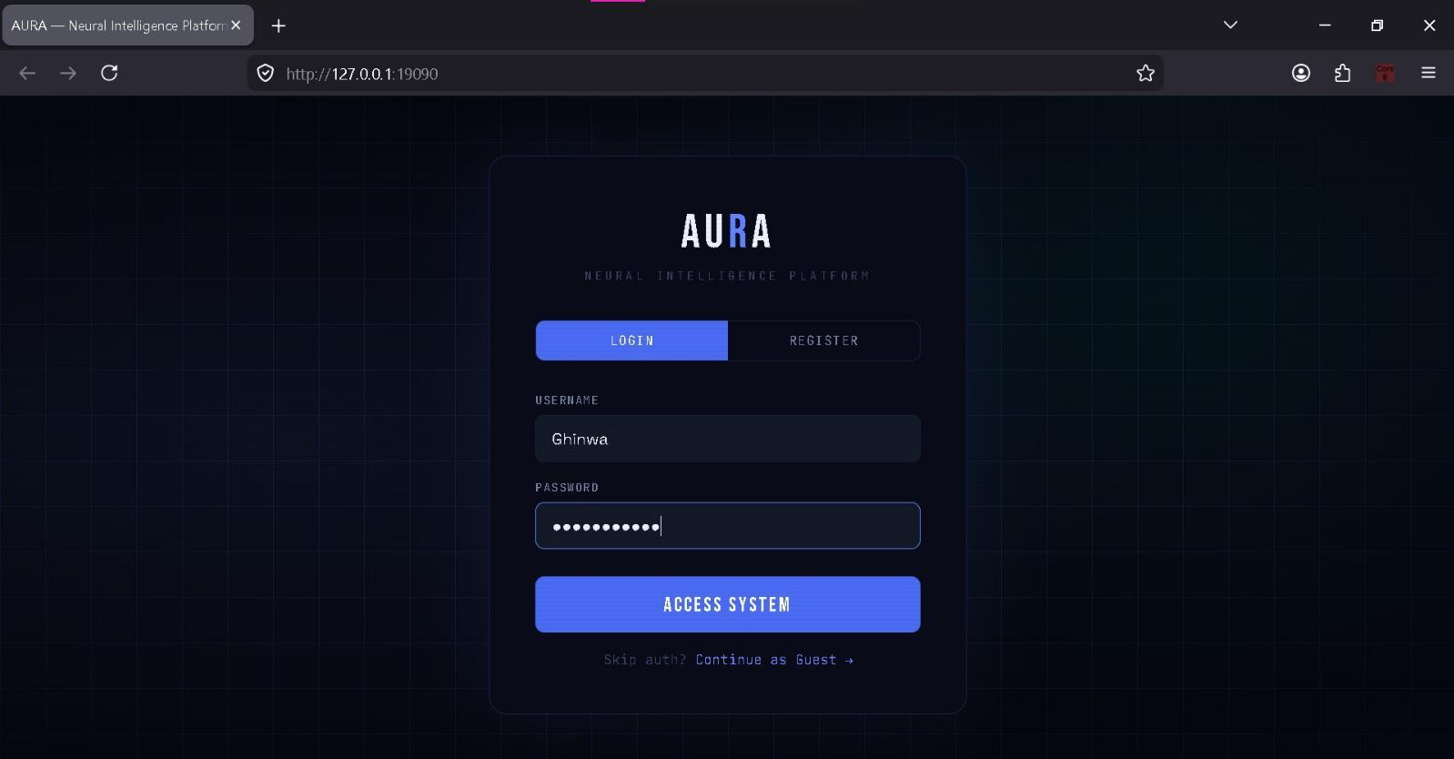
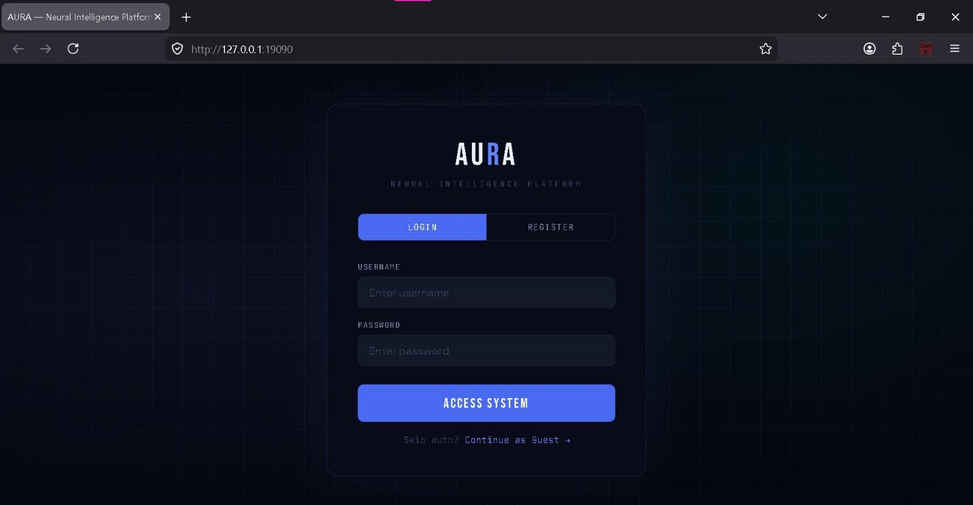
FEATURES
Key Features — Authentication & Dashboard
🔐
JWT Authentication
Register / Login / Guest mode with 24h token expiry
🛡
bcrypt Password Hashing
Industry-standard secure password storage via passlib
👤
Role-Based Access
Admin / Analyst / Viewer roles stored in SQLite
📊
Live Dashboard
Real-time threat charts, scan stats, and intelligence log
AURA — Neural Intelligence Platform · Ghinwa Allaoui & Riam Abbas · 2025

Slide 7
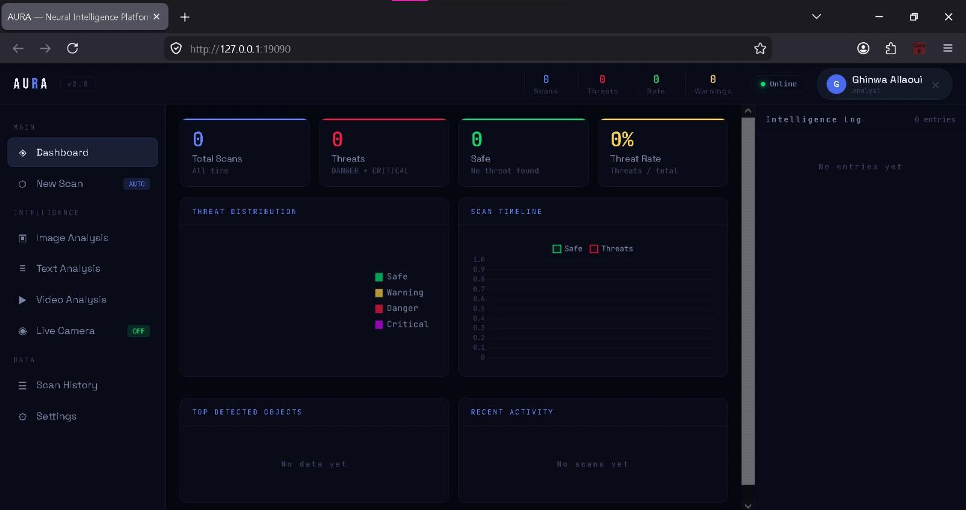
FEATURES
Live Dashboard — Real-Time Intelligence
Online Status
Threat Stats
User Profile
Threat Charts
Intelligence Log
AURA — Neural Intelligence Platform · Ghinwa Allaoui & Riam Abbas · 2025

Slide 8
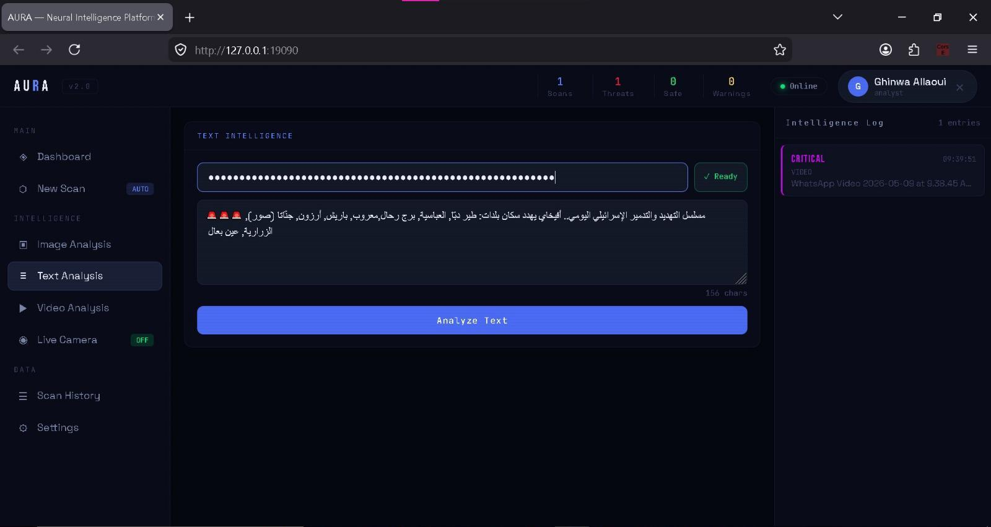
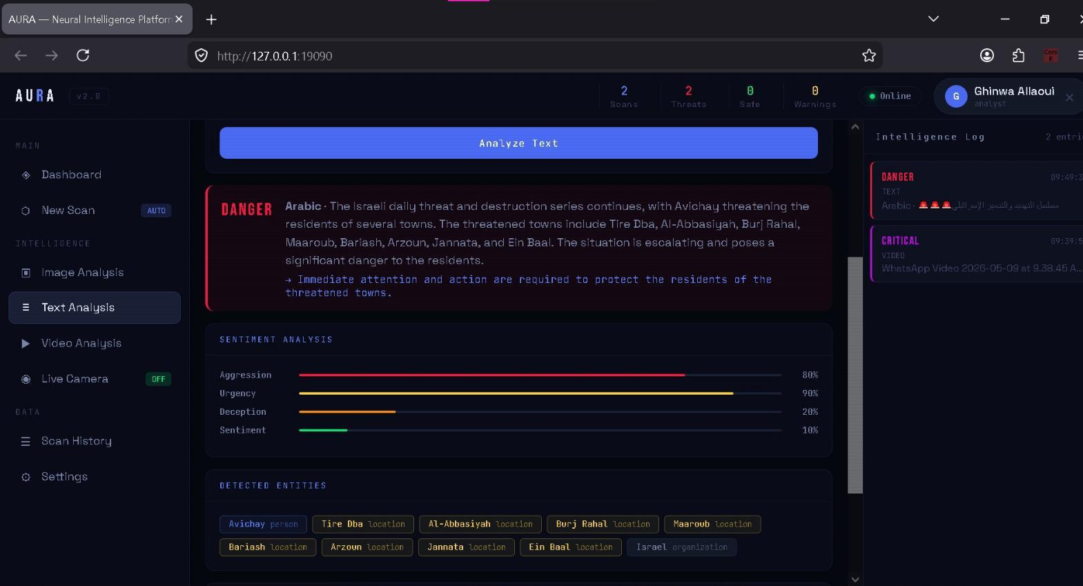
FEATURES
Key Features — Text Intelligence (Arabic/English)
Arabic threat text input + Groq API key
DANGER result: aggression 80%, urgency 90%, entities extracted
Any language — Arabic, English, French, and more
Groq llama-3.3-70b model — fast & free API
Sentiment scores: Aggression · Urgency · Deception
Named entity extraction: persons, locations, organizations
4-level threat output: SAFE / CAUTION / DANGER / CRITICAL
AURA — Neural Intelligence Platform · Ghinwa Allaoui & Riam Abbas · 2025

Slide 9
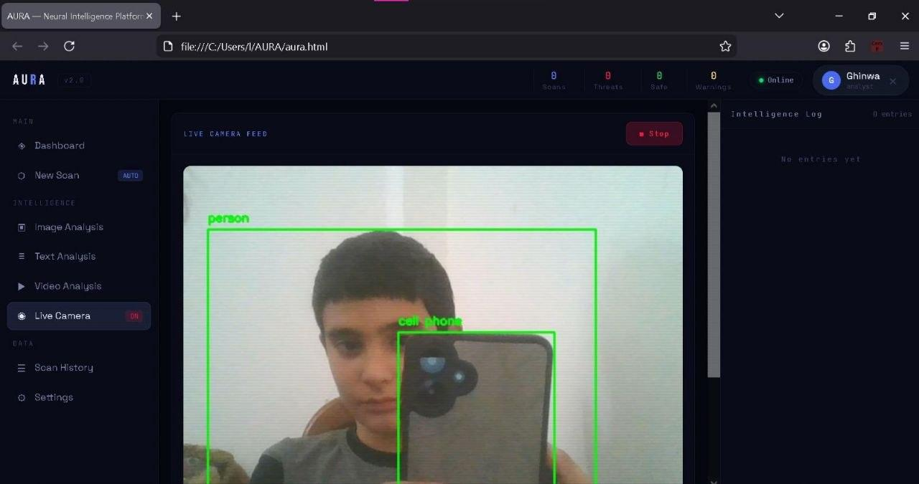

Slide 10
FEATURES
Key Features — Image & Video Intelligence
IMAGE INTELLIGENCE
VIDEO INTELLIGENCE
knife 87%
THREAT TIMELINE
person 91%
250
5
CRIT
25
FRAMES
THREATS
PEAK
FPS
[ YOLO Detection Preview — PNG/JPG/WEBP ]
PNG / JPG / WEBP upload
MP4 / AVI / MOV support
80+ COCO object classes
1 frame/sec analysis
Bounding boxes + confidence %
Color-coded threat timeline
SAFE / CAUTION / DANGER / CRITICAL
Click segment for frame detail
Weapon + person → auto CRITICAL
Peak threat across full video
AURA — Neural Intelligence Platform · Ghinwa Allaoui & Riam Abbas · 2025

Slide 11
CLASSIFICATION
Threat Classification System
SAFE
TRIGGER:
All objects are benign — person, laptop, chair, cat, book...
→ No escalation required
CAUTION
TRIGGER:
Suspicious context — backpack, vehicle, suitcase, umbrella...
→ Monitor situation
DANGER
TRIGGER:
Confirmed threat — knife, scissors, gun, sword, baseball bat...
→ Trigger security protocol
CRITICAL
TRIGGER:
Weapon + person in same frame / 2+ danger objects / fear emotion detected
→ Immediate response required
⚠ Contextual Escalation: Weapon + Person → CRITICAL automatically · 2+ Danger objects → CRITICAL · Fear emotion → CRITICAL
AURA — Neural Intelligence Platform · Ghinwa Allaoui & Riam Abbas · 2025

Slide 12
CHALLENGES
Challenges & How We Overcame Them
CHALLENGE
SOLUTION
YOLO latency on CPU was too slow
Used YOLOv8n (nano) — ~87ms per frame vs 400ms+ with larger models
CHALLENGE
SOLUTION
CORS errors blocking the camera feed
Added FastAPI CORSMiddleware with expose_headers=["*"] for X-Threat custom headers
CHALLENGE
SOLUTION
Delivering camera frames to browser
Encoded frames as JPEG via HTTP Response with threat metadata in custom headers
CHALLENGE
SOLUTION
JWT + bcrypt compatibility issues
Used python-jose for JWT and passlib with a 71-char password cap to avoid truncation
CHALLENGE
SOLUTION
Arabic text misclassified by basic AI
Switched to Groq llama-3.3-70b which natively understands Arabic and extracts entities
AURA — Neural Intelligence Platform · Ghinwa Allaoui & Riam Abbas · 2025

Slide 13
INNOVATION
Added Value & Innovation
4
80+
87%
24h
Analysis Modes
Object Classes
Avg Confidence
JWT Token Life
Contextual AI Escalation
Fully Offline Capable
Goes beyond basic detection — weapon near a person auto-escalates to CRITICAL. Real threat reasoning, not just classification.
YOLOv8 and the full detection pipeline run locally — no cloud, no privacy concerns, no recurring costs.
Multi-Language LLM Analysis
Unified 4-Mode Platform
Groq llama-3.3-70b processes Arabic, English, French text natively — a first for affordable security tools.
One dashboard for images, video, text, and live camera. No tool-switching, no context loss.
AURA — Neural Intelligence Platform · Ghinwa Allaoui & Riam Abbas · 2025

Slide 14
DEMO
Live Demonstration Plan
01
Backend Launch
30s
Run: uvicorn main:app --host 0.0.0.0 --port 19090 --reload · Show Swagger at /docs
02
Authentication
40s
Open aura.html → Register → Login as Ghinwa Allaoui → Show JWT token issued
03
Text Intelligence
50s
Paste Arabic threat text → Enter Groq key → Analyze → Show DANGER, entities, scores
04
Image Analysis
45s
Upload image with person + knife → Analyze → Show CRITICAL escalation + bounding boxes
05
Video Analysis
45s
Upload short MP4 → Analyze → Show threat timeline → Click segments for frame detail
06
Live Camera
40s
Activate camera stream → Show real-time YOLO detection + threat badge + FPS counter
07
Reports & History
30s
Go to Scan History → Download PDF report → Show professional dark-themed output
AURA — Neural Intelligence Platform · Ghinwa Allaoui & Riam Abbas · 2025

Slide 15
FUTURE
Future Enhancements
Phase 2
Phase 3
Phase 4
IP camera / RTSP stream support
Multi-camera unified dashboard
Custom YOLO model fine-tuning
Custom threat rule builder
Cloud deployment: AWS / Azure
Audio threat analysis
Mobile-responsive PWA version
Export analytics to Excel / CSV
Active Directory / SSO login
Real-time SMS / email alerts
Arabic full UI localization
Automated patrol report scheduling
AURA — Neural Intelligence Platform · Ghinwa Allaoui & Riam Abbas · 2025

Slide 16
AURA
Neural Intelligence Platform
Thank You
Multi-modal AI — images, videos, Arabic/English text, and live camera in one platform
YOLOv8 + FastAPI + Groq LLM — fully local, secure, role-based, with PDF reporting
Built from scratch by Ghinwa Allaoui & Riam Abbas for Women in Tech ·

Slide 17
REFERENCES
References & Resources
AI / ML
Ultralytics YOLOv8 — https://github.com/ultralytics/ultralytics
Groq API (llama-3.3-70b) — https://console.groq.com/docs
OpenCV Documentation — https://docs.opencv.org
Backend
FastAPI Documentation — https://fastapi.tiangolo.com
SQLAlchemy ORM — https://docs.sqlalchemy.org
Python-Jose (JWT) — https://python-jose.readthedocs.io
ReportLab PDF — https://www.reportlab.com/docs
Frontend
Chart.js — https://www.chartjs.org/docs
Tailwind CSS — https://tailwindcss.com/docs
Google Fonts (Orbitron, Share Tech Mono) — fonts.google.com
Datasets
COCO Dataset (80 classes) — https://cocodataset.org
YOLOv8n pre-trained weights (COCO) — Ultralytics Hub
AURA — Neural Intelligence Platform · Ghinwa Allaoui & Riam Abbas · 2025

