Slide 1

LROP Delay Prediction
OTOPENI
Predicting 15+ minute departure delays at Bucharest Henri Coandă Airport with classic ML.
Phase 1
Andreea-Ioana GHITA
Intermediary presentation

Slide 2
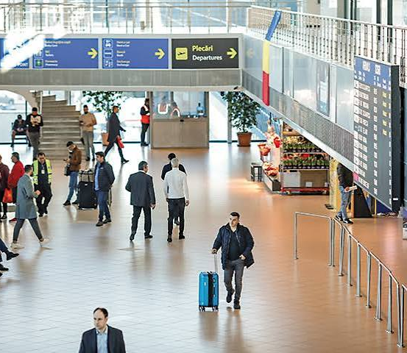
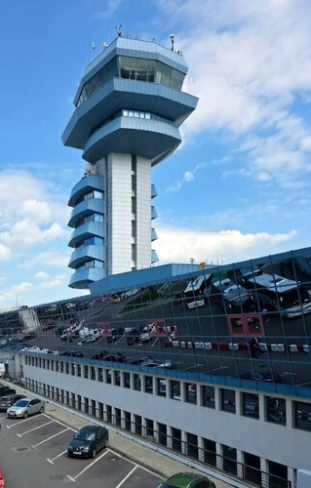
LROP Delay Prediction
PROJECT OVERVIEW
What is the probability that a departure from Otopeni leaves 15+ minutes late? 15 minutes is the standard EUROCONTROL definition of a delay.
TARGET: DELAY ≥ 15 MIN
SCOPE: DEPARTURES, LROP
DATA: CNAB ARCHIVE
MODELS: CLASSIC ML

Slide 3



LROP Delay Prediction
DATA SOURCES
  FLIGHTS
  HOLIDAYS
  AIRPORTS
  WEATHER
  AIRCRAFT
Collected: CNAB flight archive, METAR weather, Wikidata airports. Planned: Romanian holidays, airport specific data (for now only under paid wall APIs).

Slide 4


LROP Delay Prediction
DATA COLLECTION
01 - JSON API
02 - SCRIPTS
03 - SELENIUM
04 - EXPORT
Exported manually: 62,652 records.
RAW DATA
Found the site's JSON API, but both crawlers (requests and Selenium) were blocked by Cloudflare.

Slide 5


LROP Delay Prediction
DATA CLEANING
FROM RAW TO CLEAN
MIDNIGHT FIX
23:20 → 00:29 is +69 min, not −23 h.
FILTERING
Otopeni only, no duplicates, cancellations set aside.
TARGET
1 if the delay is 15 minutes or more.
FROZEN STATUSES
Dropped flights with no actual departure time.

Slide 6
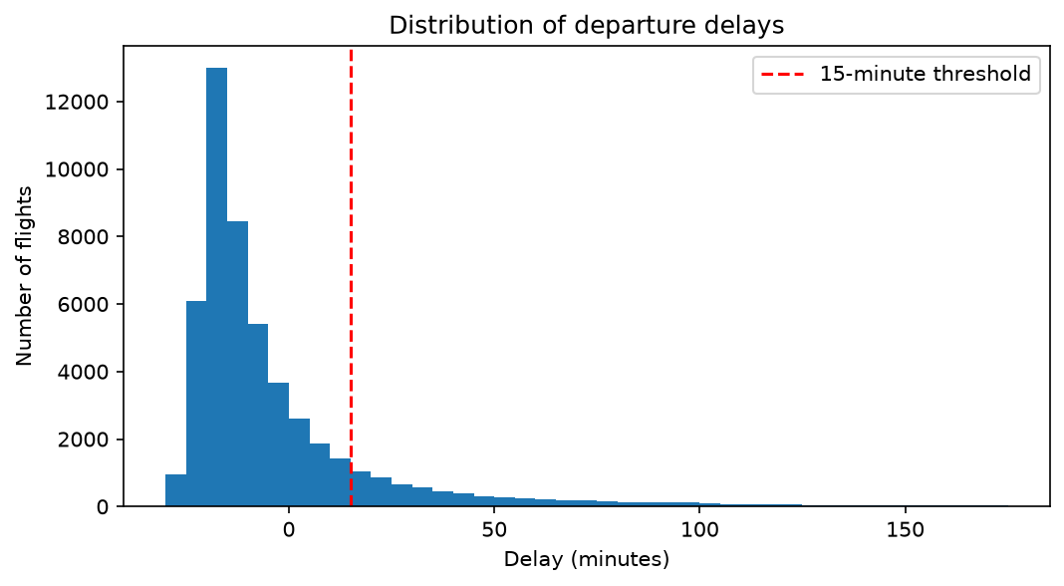
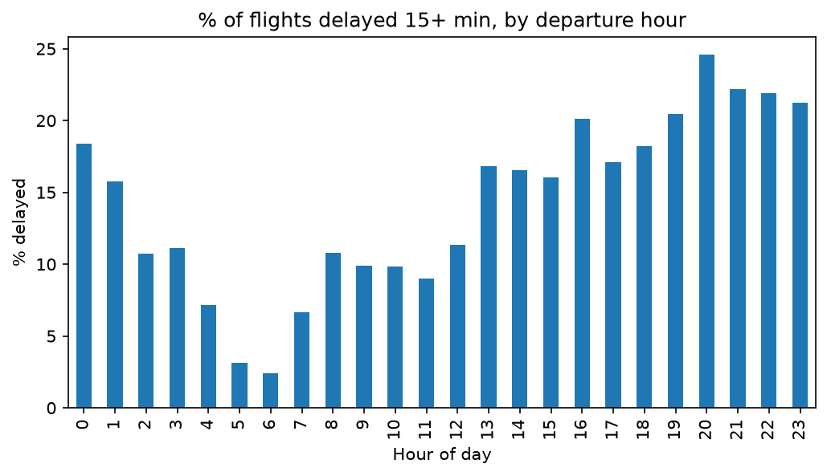
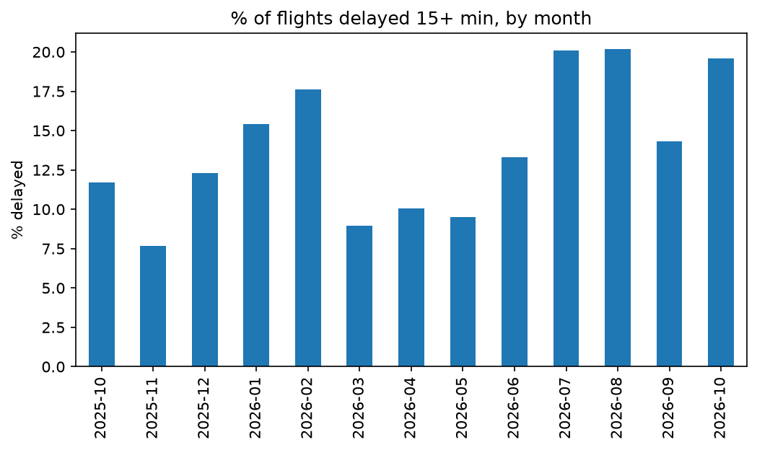
LROP Delay Prediction
WHEN ARE FLIGHTS
DELAYED?
DELAY DISTRIBUTION
BY HOUR OF DAY
BY MONTH
The delay distribution here is misleading. Such a big number of flights departing tens of minutes earlier than scheduled would be an operational nightmare

Slide 7

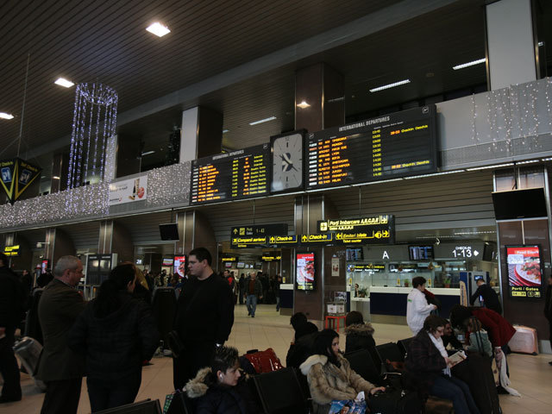
LROP Delay Prediction
PLANNED FEATURES
AIRLINE
ROUTE
TIME
WEATHER
HOLIDAYS
WEATHER TYPES: K-MEANS & GMM
METAR reports are clustered into weather types (e.g. clear, fog, snow); each flight gets the type at its departure time.

Slide 8


LROP Delay Prediction
INTENDED ANALYSES
CLASSIFICATION (MAIN TASK)
Delayed 15+ min or not? Logistic Regression, Random Forest and SVM, compared with a baseline.
REGRESSION ON DELAY MINUTES
How many minutes late? Gradient Boosting Regressor (MAE).
ASSOCIATION RULES (APRIORI)
Patterns like “Friday + evening + low-cost → delayed”.

Slide 9

LROP Delay Prediction
THANK
YOU
Andreea-Ioana GHITA
IAPD – SD1-A - 2026
https://github.com/GhitaAndreea/delay_prediction

