Slide 1
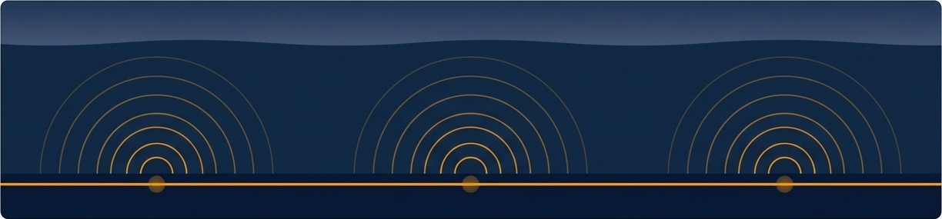
The Unseen Fleet
Detecting Dark Ships with Distributed Acoustic Sensing
A Proof-of-Concept for Persistent Maritime Surveillance

Slide 2
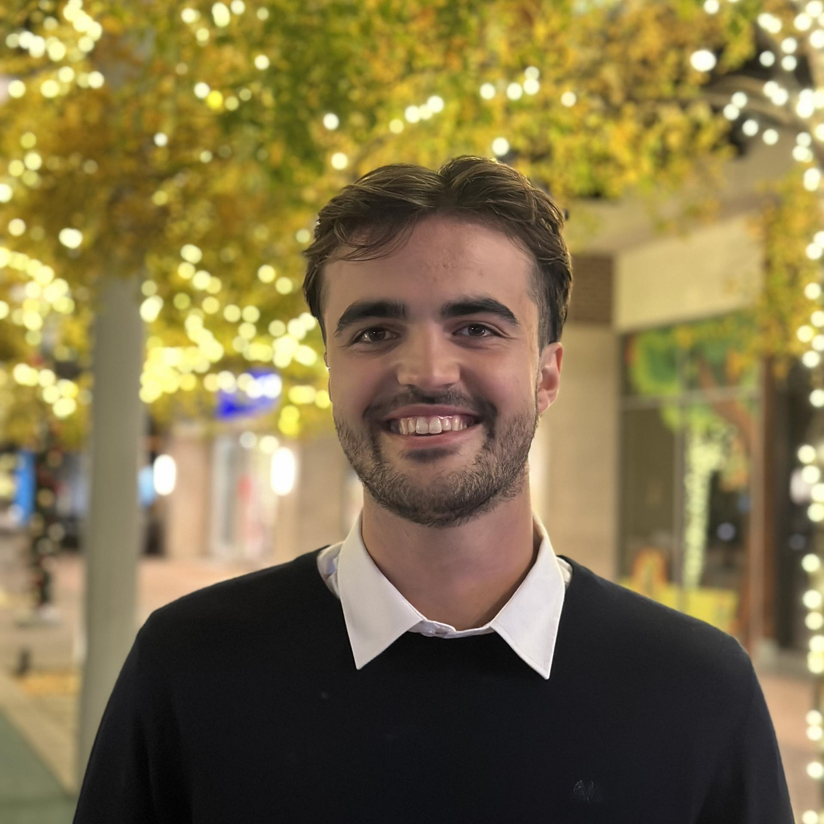

Gustav Hylsberg Jacobsen
MSc in Human-Centered Artificial Intelligence
Specialization in Machine Learning at Scale
BSc in Electrical Engineering
Interests in Signal Processing, Statistics, Applied Machine Learning

Slide 3
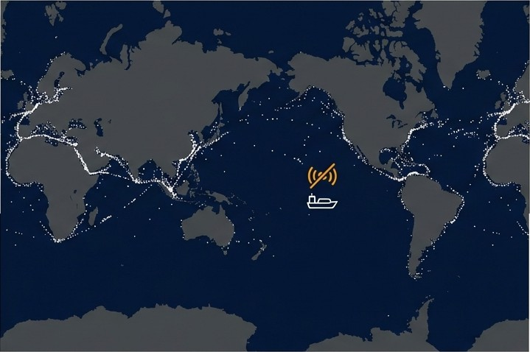
Today's Maritime
Surveillance
Has a Blind Spot
The global standard is the Automatic Identification System (AIS), which requires ships to broadcast their identity and position.
This system is cooperative. It can be turned off, creating “Dark Ships.”
These vessels pose significant risks: illegal fishing, smuggling, and threats to national security

Slide 4
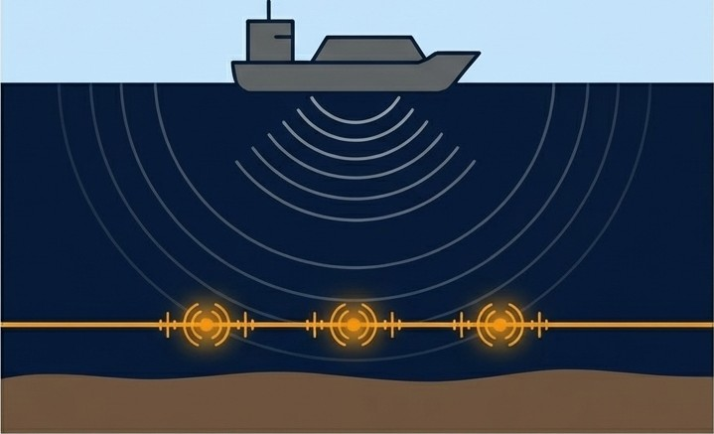
We Can Turn Seabed Fiber Optic Cables into a Vast Acoustic Array
Distributed Acoustic Sensing (OAS) transforms existing fiber optic cables into a dense network of sensors.
It continuously measures acoustic vibrations along the entire length of the cable.
This provides a non-cooperative monitoring solution—it detects vessels based On the physical sounds they generate, not signals they transmit.

Slide 5
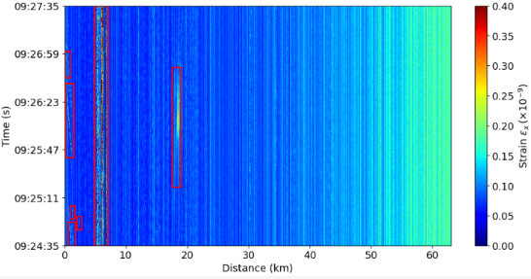
Raw DAS Data is Complex and Filled with Noise
The system captures 1-dimensional time-series signals at a high frequency (625Hz).
The data is contaminated by static noise
Our goal: Isolate the faint, diagonal energy burst that signifies a moving vessel.

Slide 6

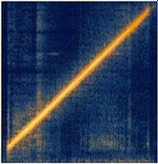
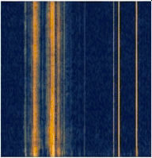

Approach: Framing Anomaly Detection as an Image Recognition Task
We converted 30-second windows of raw data into 2D time-distance images (spectrograms).
Using this visual data, we manually labeled a dataset into two classes: 'Anomaly‘ and 'Noise' .
We then trained a Convolutional Neural Network (CNN) to automatically classify these images.
Anomaly
”Noise"

Slide 7
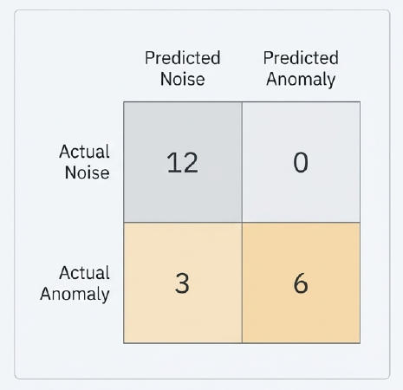
The Model Reliably Identified True Ship Signatures

Slide 8

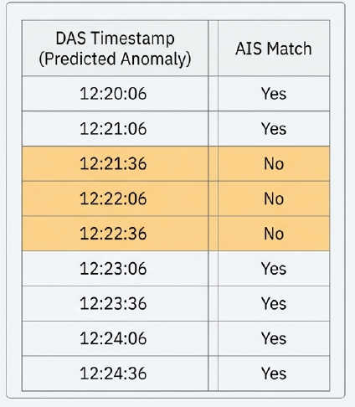
We Found Acoustic Signatures with AIS Broadcast
We cross-referenced 9 of the model's high-confidence detections with AIS records from the same time period.
6 detections were successfully matched to known vessels broadcasting on AIS.
3 detections were potential “Dark Ships”: a clear acoustic signature was present, but no AIS signal was recorded within a
+2 minute window.

Slide 9
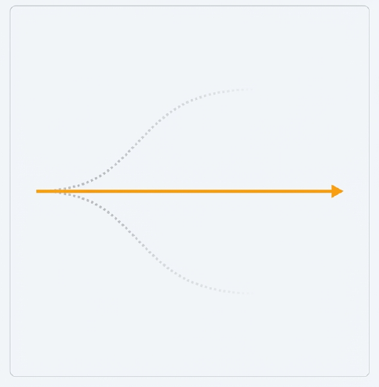
Our CNN Approach Was
One Path of Many Explored
The successful CNN classifier represents a pragmatic solution shaped by the project's real-world constraints.
Our final methodology was driven by data availability and computational feasibility.
Exploring alternative, more complex models was a crucial part of our research process.

Slide 10
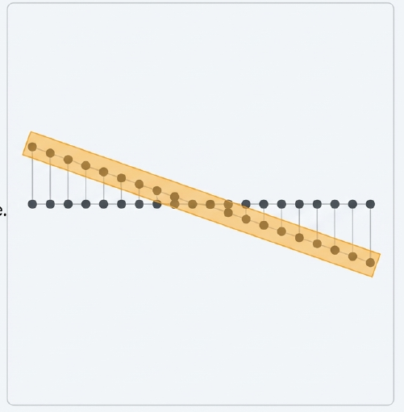
Explored Path #1: Spatiotemporal Graph Diffusion
Concept: Model the fiber optic cable as an interconnected network, with each sensor point as a node in a graph. This would explicitly model how a ship's diagonal
signature propagates across channels over time.
Potential: A highly sophisticated method for capturing the specific spatiotemporal patterns of vessels.
Constraint: This approach requires massive, long-term training data (e.g., two years in the reference study) to be effective. This was unfeasible for our proof-of-concept scope.
Notes:
this approach constructs a graph where nodes represent sensors and edges represent physical proximity (e.g., Euclidean distance in a dual-fiber fence setup). A two-layer Graph Convolutional Network (GCN) extracts spatial embeddings, allowing the model to learn inter-channel dependencies and vibration propagation path
A Map (Graph Neural Network): To understand where the sensors are located physically.
• The Method: The researchers treat every sensor channel as a "node" (a dot) on a graph. They draw connecting lines (edges) between sensors that are physically close to each other in the real world, not just close on the cable.
• Why it matters: This helps the system understand "spatial correlations." If a vibration hits one spot, the model knows which neighboring sensors should also feel it, even if they are far apart on the fiber spool
2. A Restoration Tool (Diffusion Model): To understand how normal vibrations change over time. This part handles the time aspect (how the signal changes). A "Diffusion Model" is a type of generative AI (similar to those used to generate images) that is trained to remove noise from data.
• Training (Learning "Normal"): The model is fed only normal data (e.g., wind blowing, background noise). It takes a clean signal, adds "static" (Gaussian noise) to it until it is unrecognizable, and then practices removing that noise to get the clean signal back,.
• The "Condition": Crucially, when the model tries to clean the signal, it "peeks" at the Map (from the GNN) to guide its work. It uses the spatial layout to help decide how to fix the temporal signal
Part 3: How It Detects Anomalies
Once the model is trained to be an expert at "cleaning" normal data, it is used to test new data.
1. The Test: The system takes a new, unknown signal and adds noise to it.
2. The Attempt: The model tries to "clean" (reconstruct) it, assuming it is normal data.
3. The Result:
◦ If the data is Normal (e.g., wind): The model recognizes the pattern and reconstructs it perfectly. The "reconstruction error" is low.
◦ If the data is an Anomaly (e.g., digging): The model has never learned how to "clean" a digging signal. It tries to force it to look like wind/background noise and fails. The resulting reconstruction looks very different from the input. The "reconstruction error" is high,.

Slide 11
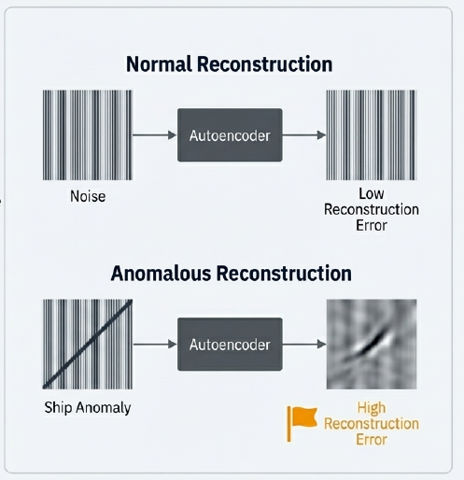
Explored Path #2: Unsupervised Autoencoders
Concept: Train a model (an autoencoder) exclusively on background noise. The model learns to perfectly reconstruct “normal” data. Anomalies like ships are then detected because the model fails to reconstruct them accurately, resulting in a high “reconstruction error.”
Potential: A powerful, label-free detection method that could discover novel types of anomalies automatically.
Constraint: Like the graph model, this requires vast amounts of “pure noise” data and signihcant computational resources for training.
Notes:
This was used for DAS signalling a high speed train, to see if wall clmbing or breaking of the rails.
he K-means clustering algorithm establishes feature centers for normal data. During testing, the system calculates the distance between a new signal's features and these centers; if the distance exceeds a threshold defined by the validation set, the window is flagged as an anomaly
To reduce false alarms caused by short-duration noise, the method employs a window accumulation mechanism. It retrospectively checks prior windows, and an alarm is only confirmed if a specific number of recent windows are also classified as abnormal

Slide 12
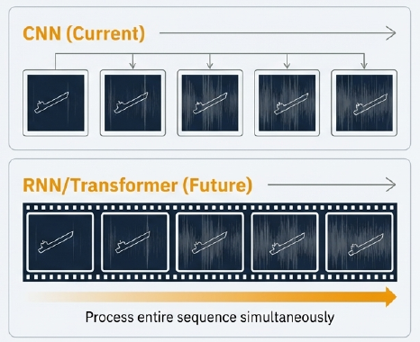
Future Models Must Evolve to Understand Time and context.
Our CNN sees the world in isolated 30-second snapshots. It has no memory or long-term context.
The Next Step: Implement
sequence-aware architectures like Recurrent Neural Networks (RNNs) or Transformers.
These models analyze data as a
continuous sequence, allowing them to
learn vessel dynamics and adapt to evolving noise patterns over hours and days.

Slide 13
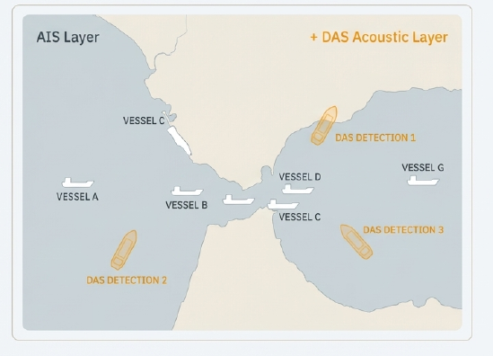
The Vision: An Always-On, Adaptive Layer for Total Maritime Awareness
Continuous, high-resolution DAS data streams are processed in real time.
Sequence-aware AI models continuously
detect and classify alt acoustic events.
This provides an independent, non- cooperative surveillance layer that augments AIS, effectively closing the “dark ship” blind spot.

Slide 14


Project Code: github.com/ghjacobsen/DASProject

