Slide 1


Dynamic Flux Balance Analysis (DFBA)
with SBML (core, comp, fbc)
Matthias König, Leandro Watanabe & Chris Meyers
LiSyM Systems Medicine of the Liver
Humboldt University Berlin, Institute for Theoretical Biology
livermetabolism.com

Slide 2
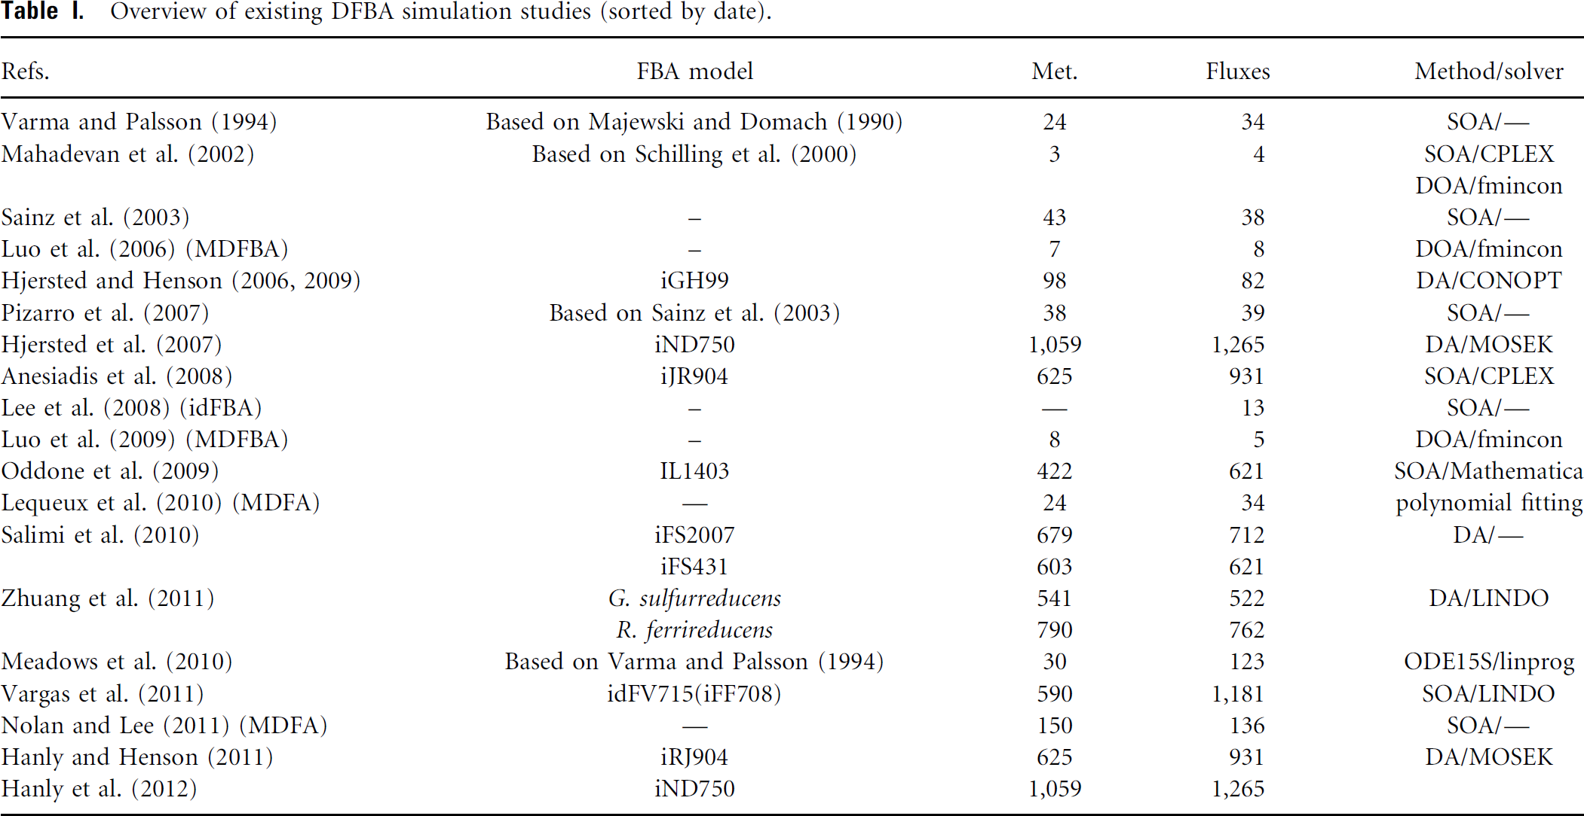
Examples
Coupling of dynamical model parts to steady state networks (FBA)
Subset of general problem of coupling models with different simulation frameworks
Logical/boolean models
Stochastic simulations
...
Whole-cell model (Karr et al)

Slide 3
Applications & Use cases
Circadian Liver metabolism
Coupling circadian blood metabolite & gene/protein expression patterns to FBA model of liver metabolism (HepatoNet1)
Whole-body PKPD
Coupling of tissue specific FBA models to whole body PKPD
Glucose regulation (liver, muscle, fat, pancreas, stomach)
Cori cycle & other multi-tissue physiological cycles
Glucose – alanine/pyruvate shuttle
Model embedding
Coupling ODE pathway models to genome-scale metabolic models (liver)

Slide 4
Dynamic FBA (DFBA)
Approaches
Resource allocation (creating large optimization problem based)
Very large optimization problems
Coupling to arbitrary ODEs not possible
(normally optimization boundary conditions like biomass(24h) = k *biomass(0h)
Coupling of ODE to FBA model
Direct embedding of LP-Solver in ODE solver
execution in every time step
complex implementation (high level expertise on ODE solver design)
Stiffness of system at borders of flux-cone
Stationary Optimization Approach (SOA)
Dynamic Optimization Approach (DOA)
Challenges
Uniqueness of solution (parsimonous FBA, minimal Flux)
Setting exchange boundaries based on availability of resources

Slide 5
SBML
De facto standard for Systems Biology Models (ODE, FBA, mixed compartments)
Good description for kinetic and FBA models, but no implementation of DFBA in standard
Core language (core) & extension packages
core
Kinetic models (Compartments, Parameters, Species, Reactions, RateRules, AssignmentRules, Events, FunctionDefinitions)
fbc
FBA encoding (objective functions, upper & lower bounds, GPR encoding)
comp
Coupling of models (ExternalModelDefinitions, ModelDefinitions replacements, replacedBy, deletions, ports, submodels, )

Slide 6
Encoding
https://github.com/matthiaskoenig/dfba
https://github.com/matthiaskoenig/dfba/blob/master/DFBA%20models%20in%20SBML.md
Basic coupling
Exchange reactions (boundaryCondition=True species) which provide information about changes on FBA boundary
What is taken up, what is imported, how unbalanced are metabolites?
TOP, BOUNDS, UPDATE, FBA
Rules

Slide 7
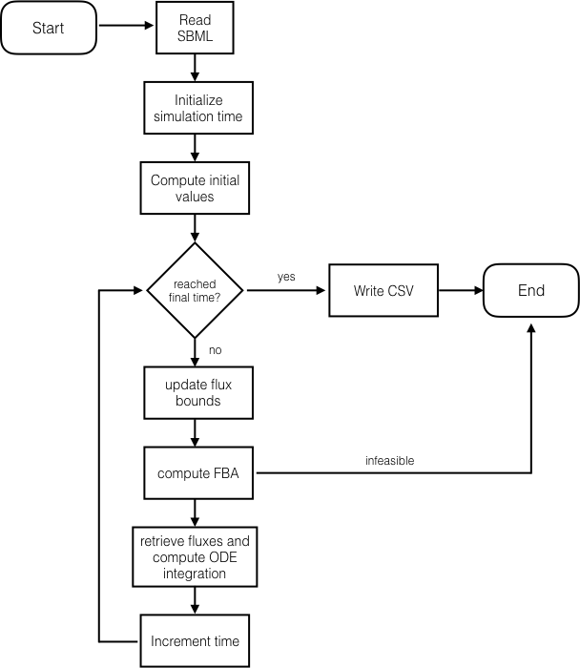
Simulation Algorithm
Implementations
sbmlutils
https://github.com/matthiaskoenig/sbmlutils
iBioSim
http://www.async.ece.utah.edu/ibiosim
Challenges
standardized encoding of DFBA models
uniqueness of FBA solutions
bounds limitations based on species amounts/concentrations
the (in)famous hack
if (c<0): c = 0

Slide 8
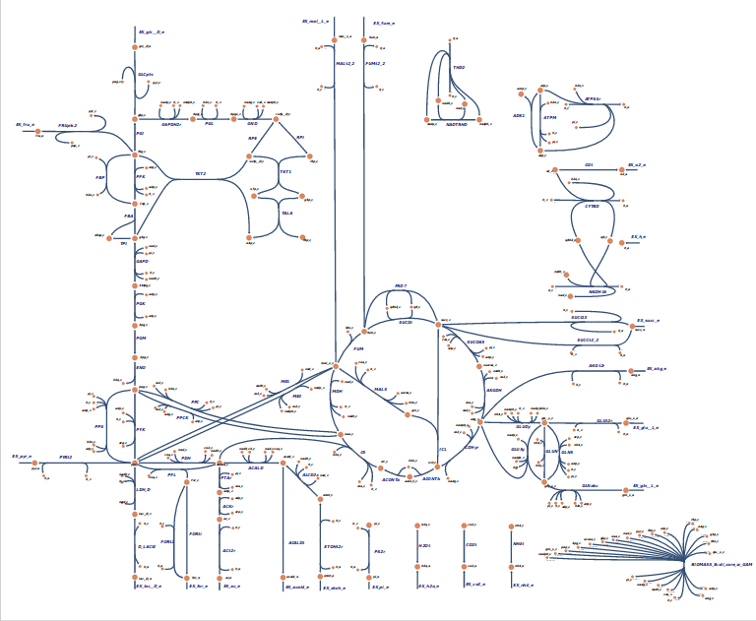
Example Models
Toy model (3 reactions, linear chain, 2 exchange reactions)
Diauxic growth (4 effective reactions, 4 exchange reactions)
E.coli core (95 reactions, 72 metabolites, 137 genes, 4 exchange reactions)
http://bigg.ucsd.edu/models/e_coli_core
https://escher.github.io/builder/index.html?enable_editing=true&map_name=e_coli_core.Core%20metabolism

Slide 9
