Slide 1


Dynamic Flux Balance Analysis (DFBA)
with SBML (core, comp, fbc)
Matthias König, Leandro Watanabe & Chris Meyers
LiSyM Systems Medicine of the Liver
Humboldt University Berlin, Institute for Theoretical Biology
livermetabolism.com

Slide 2
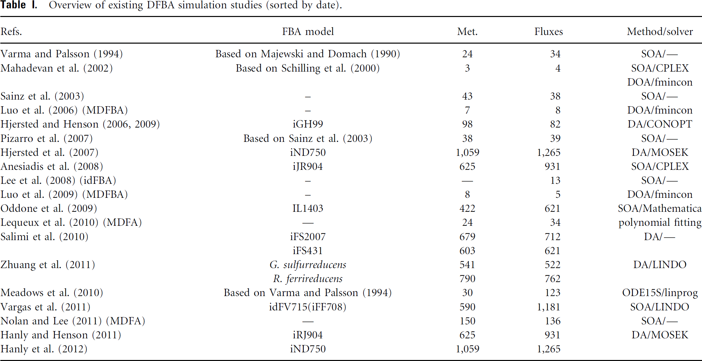
Examples
Whole-cell model (Karr et al)

Slide 3
Applications & Use cases
Circadian Liver metabolism
Coupling circadian blood metabolite & gene/protein expression patterns to FBA model of liver metabolism (HepatoNet1)
Whole-body PKPD
Coupling of tissue specific FBA models to whole body PKPD
Glucose regulation (liver, muscle, fat, pancreas, stomach)
Cori cycle & other multi-tissue physiological cycles
Glucose – alanine/pyruvate shuttle
Model embedding
Coupling ODE pathway models to genome-scale metabolic models (liver)

Slide 4
Dynamic FBA (DFBA)
Coupling of dynamical model parts to steady state networks (FBA)
Subset of general problem of coupling models with different simulation frameworks
Logical/boolean models
Stochastic simulations
Approaches
Resource allocation (creating large optimization problem based)
Very large optimization problems
Coupling to arbitrary ODEs not possible
Dynamic achieved via optimization boundary conditions like biomass(24h) = k *biomass(0h) in combination with resource variables
Coupling of ODE to FBA model
Direct embedding of LP-Solver in ODE solver
execution in every time step
complex implementation (high level expertise on ODE solver design)
Stiffness of system at borders of flux-cone
Stationary Optimization Approach (SOA)
Dynamic Optimization Approach (DOA)

Slide 5
SBML
De facto standard for Systems Biology Models (ODE, FBA, mixed compartments)
Good description for kinetic and FBA models, but no implementation of DFBA in standard
Core language (core) & extension packages
core
Kinetic models Compartments, Parameters, Species, Reactions, RateRules, AssignmentRules, Events, FunctionDefinitions)
fbc
FBA encoding objective functions, upper & lower bounds, GPR encoding
comp
Coupling of models ExternalModelDefinitions, ModelDefinitions replacements, replacedBy, deletions, ports, submodels,

Slide 6
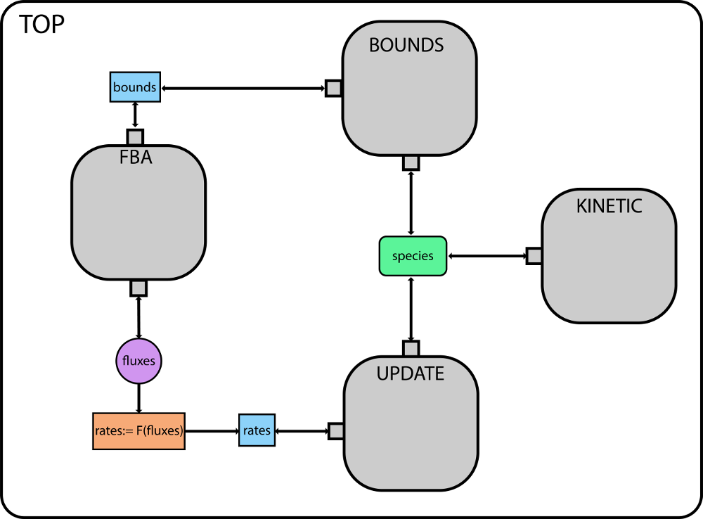
Encoding
https://github.com/matthiaskoenig/dfba
https://github.com/matthiaskoenig/dfba/blob/master/DFBA%20models%20in%20SBML.md
TOP
kinetic part & coupling of submodels
BOUNDS
kinetic bounds calculation
UPDATE
kinetic update of species from FBA
FBA
FBA problem (interface via exchange reactions)
Interface
exchange reactions (boundaryCondition=True species)
What is taken up, what is imported, how unbalanced are metabolites?
update kinetics
How does flux effect metabolites (scaling by biomass, …)
bound kinetics
How do kinetic players effect bounds & resource limitation of FBA

Slide 7
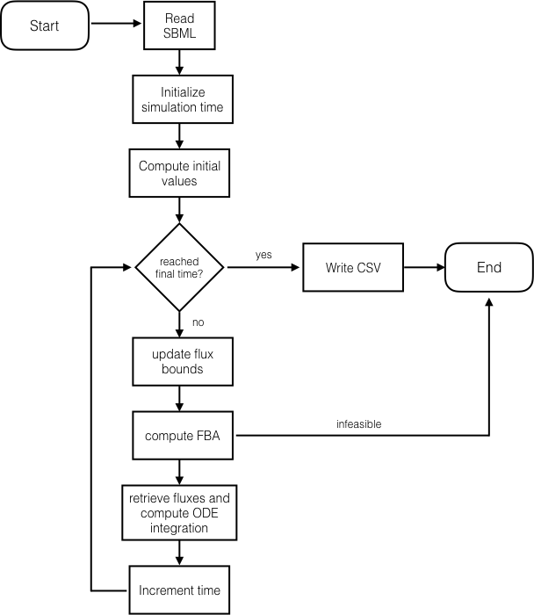
Simulation Algorithm
Implementations
sbmlutils
https://github.com/matthiaskoenig/sbmlutils
iBioSim
http://www.async.ece.utah.edu/ibiosim
Challenges
standardized encoding of DFBA models
uniqueness of FBA solutions
bounds limitations based on species amounts/concentrations
the (in)famous hack
if (c<0): c = 0

Slide 8
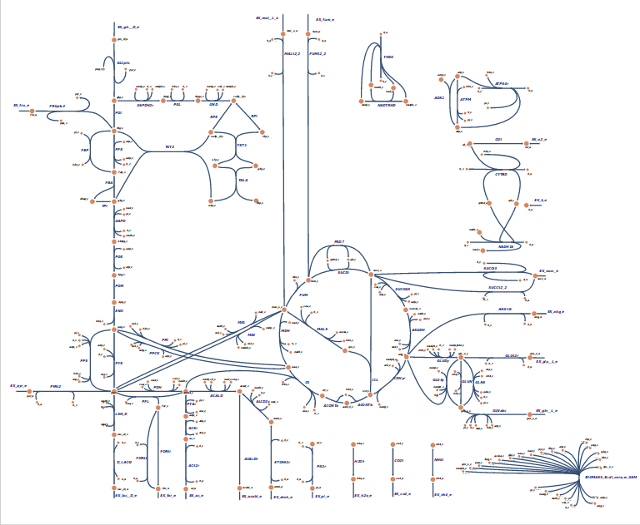
Example Models
Toy model 3 reactions, linear chain, 2 exchange reactions
Diauxic growth 4 effective reactions, 4 exchange reactions
E.coli core 95 reactions, 72 metabolites, 137 genes, 4 exchange reactions)
http://bigg.ucsd.edu/models/e_coli_core
https://escher.github.io/builder/index.html?enable_editing=true&map_name=e_coli_core.Core%20metabolism

Slide 10
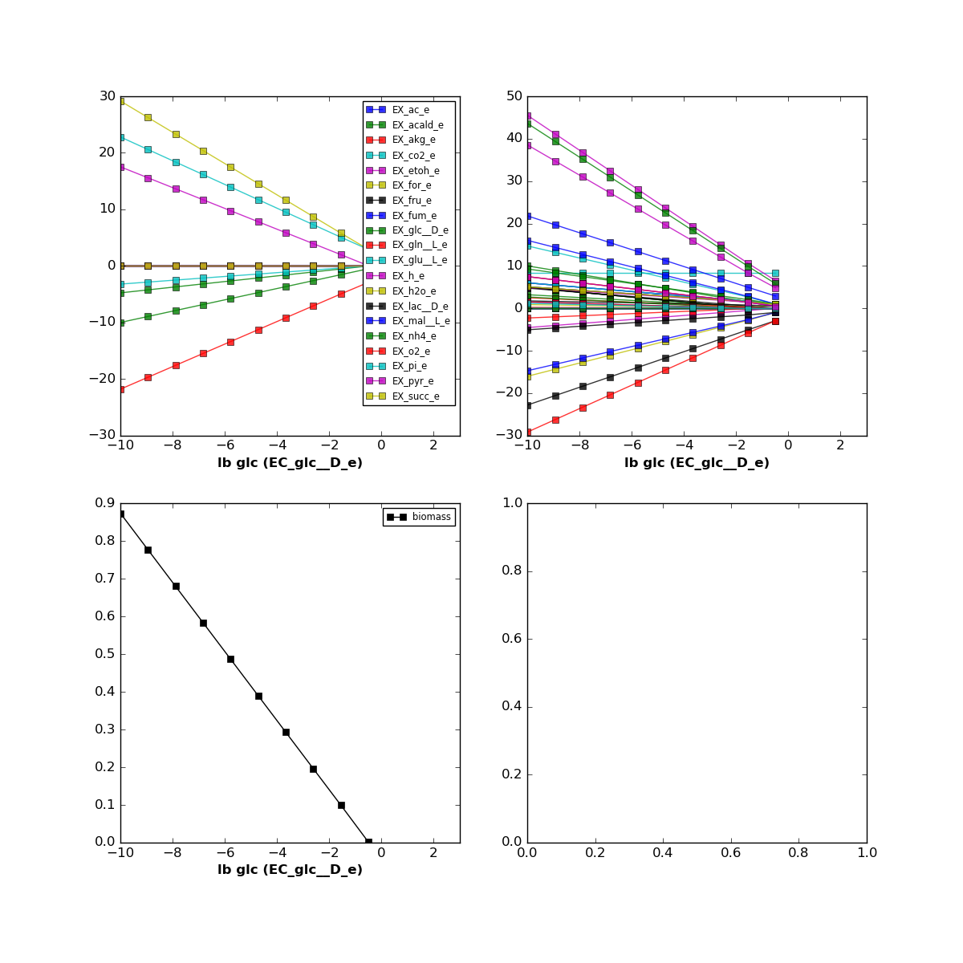
E.coli core

