Slide 1

WIPRO NGA Program – DWS
Capstone Project Presentation – 17th June & 18th June 2025
Project Title Here – Add File Association via Msi
Presented by – Ghanshyam Govind Murbadkar
www.rpsconsulting.in

Slide 2

INTRODUCTION
Slide details hereModify MSI to add custom file extension (Example: .gha).
Double-clicking a .gha files will automatically lauch Firefox.
This will be done with the help of Orca Tool
2024 - RPS Consulting all rights reserved

Slide 3


INTRODUCTION TO TOOLS
Orca - MSI table editor.
Notepad - For creating custom .gha file.
Firefox.msi - Installer to modify.
2024 - RPS Consulting all rights reserved

Slide 4

WHAT IS MSI ?
MSI stands for Microsoft installer also known as windows installer. It is a file format (.msi) used to install, maintain, and remove software on windows.
Example: Firefox.msi installs Firefox using windows installer service
FirefoxSetup.msi
2024 - RPS Consulting all rights reserved

Slide 5
WHAT IS FILE ASSOCIATION?
File association links a file type to a supported application.
Example, a Word document may be associated with Microsoft Word. This means when we double-click a Word document, Microsoft Word will open the file.
WHAT IS ORCA?
Orca is a free Windows Installer package editor from Microsoft which is part of WindowSDK
Orca is a table editor for .msi (Microsoft Installer) files.
It lets you view and modify the internal database tables of an MSI package
2024 - RPS Consulting all rights reserved

Slide 6
PREREQUISITES
Windows Operating System (Windows 10 or 11)
Windows SDK (to install the Orca tool)
Orca Tool (used to edit the MSI file)
Firefox MSI File (eg: Firefox.msi)
Notepad (to create a .gha test file)
2024 - RPS Consulting all rights reserved

Slide 7
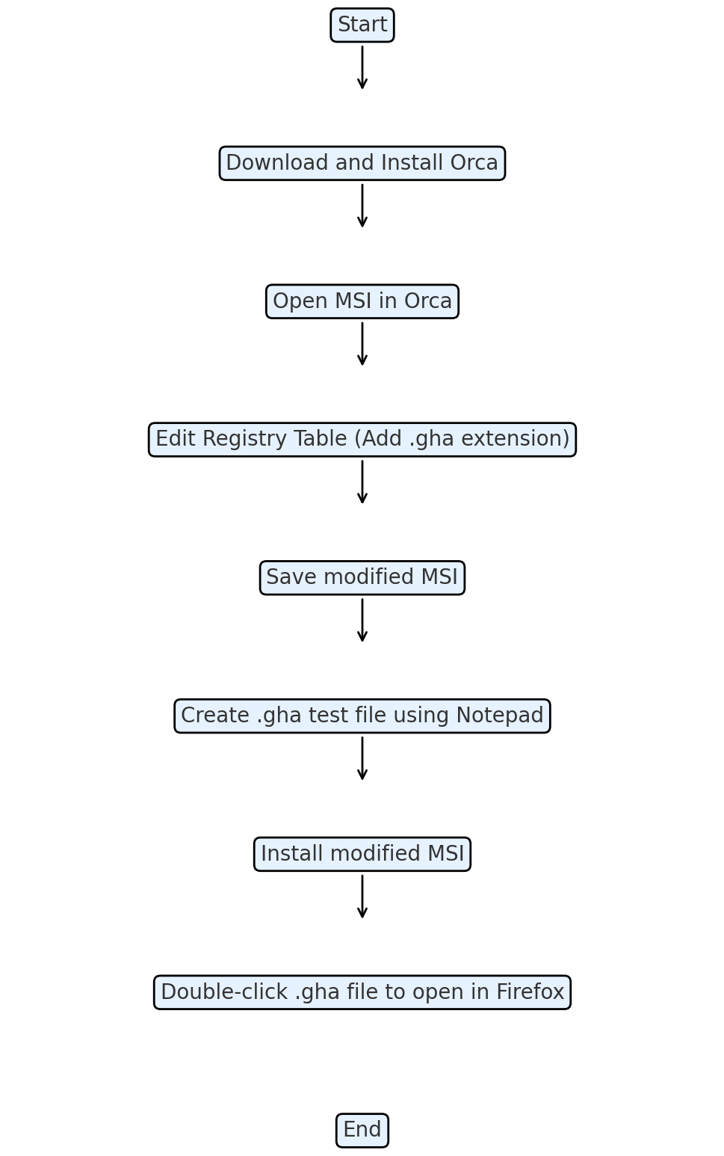
FLOWCHART
1. Install Orca via Windows SDK.
(C:\Program Files (x86)\Windows Kits\10\bin\10.0.26100.0\x86 and install the Orca-x86_en-us.msi)
2. Open Firefox.msi in Orca.
3. Modify Registry table with custom extension.
4. Save and install new MSI.
5. Create a .gha extension file using Notepad.
6. Test .gha file association.
2024 - RPS Consulting all rights reserved

Slide 8
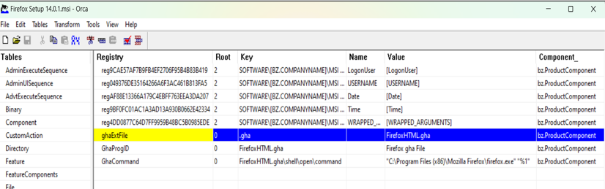
EXECUTION OVERVIEW STEPS
Step 1: Open msi file in Orca and then open the Registry Table
Step 2: Add 3 rows in Registry table
• ghaExtFile -> .gha
• GhaProgID -> FirefoxHTML.gha
• GhaCommand ->
"C:\Program Files (x86)\Mozilla Firefox\firefox.exe" "%1“
%1 represents the file the user double-clicked
2024 - RPS Consulting all rights reserved

Slide 9
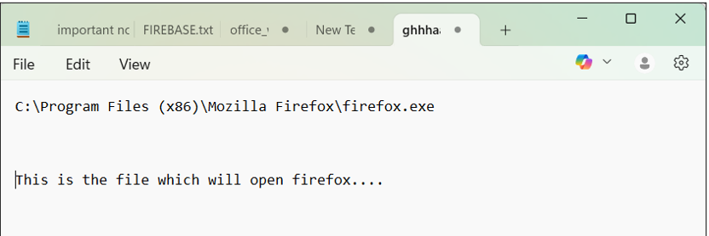
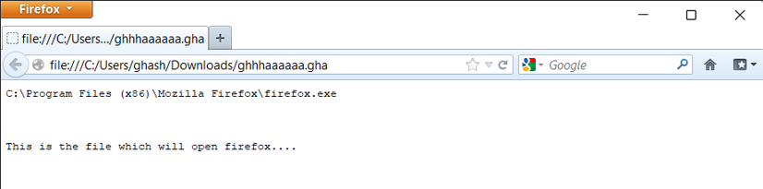
Step 3: Save new MSI and install it
Step 4: Create a file with extension .gha using notepad
Step 5: Double-click on the .gha file it should open Firefox automatically
2024 - RPS Consulting all rights reserved

Slide 10
CONCLUSION
We successfully changed an MSI file using the Orca tool.
Orca simplifies editing .msi files
We add a custom file extension (.gha) with Firefox msi.
After installing the modified MSI, the .gha file opens in Firefox automatically.
2024 - RPS Consulting all rights reserved

Slide 11
REFERENCE LINKS
Windows SDK:
https://developer.microsoft.com/en-us/windows/downloads/windows-sdk/
FirefoxMsi:
https://www.exemsi.com/downloads/packages/Firefox/Firefox%20Setup%2014.0.1.msi
2024 - RPS Consulting all rights reserved

Slide 12
THANK
YOU
2024 - RPS Consulting all rights reserved

