Slide 1

WIPRO NGA Program – DWS
Capstone Project Presentation – 17th June & 18th June 2025
Project Title Here – Edit Custom Tables in Orca
Presented by – Ghanshyam Govind Murbadkar
www.rpsconsulting.in

Slide 2

INTRODUCTION
Edit MSI to add or modify custom tables.
Add Environment Table – set environment variables.
Add RemoveFile Table – delete files/folders.
Add Registry Table – modify registry entries
2024 - RPS Consulting all rights reserved

Slide 3
PREREQUISITES
Windows Operating System (Windows 10 or 11)
Windows SDK (to install the Orca tool)
Orca Tool (used to edit the MSI file)
Firefox MSI File (eg: Firefox.msi)
Notepad (to create a .txt test file)
2024 - RPS Consulting all rights reserved

Slide 4
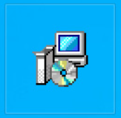
WHAT IS MSI ?
MSI stands for Microsoft installer also known as windows installer. It is a file format (.msi) used to install, maintain, and remove software on windows.
Example: Firefox.msi installs Firefox using windows installer service
FirefoxSetup.msi
2024 - RPS Consulting all rights reserved

Slide 5

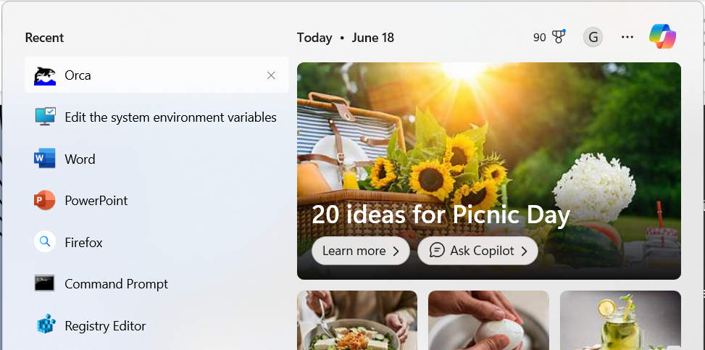
WHAT IS ORCA?
Orca is a free Windows Installer package editor from Microsoft which is part of WindowSDK
Orca is a table editor for .msi (Microsoft Installer) files.
It lets you view and modify the internal database tables of an MSI package
Useful for adding custom logic to installation process
2024 - RPS Consulting all rights reserved

Slide 6
PREREQUISITES
Windows Operating System (Windows 10 or 11)
Windows SDK (to install the Orca tool)
Orca Tool (used to edit the MSI file)
Firefox MSI File (eg: Firefox.msi)
Notepad (to create a .gha test file)
2024 - RPS Consulting all rights reserved

Slide 7
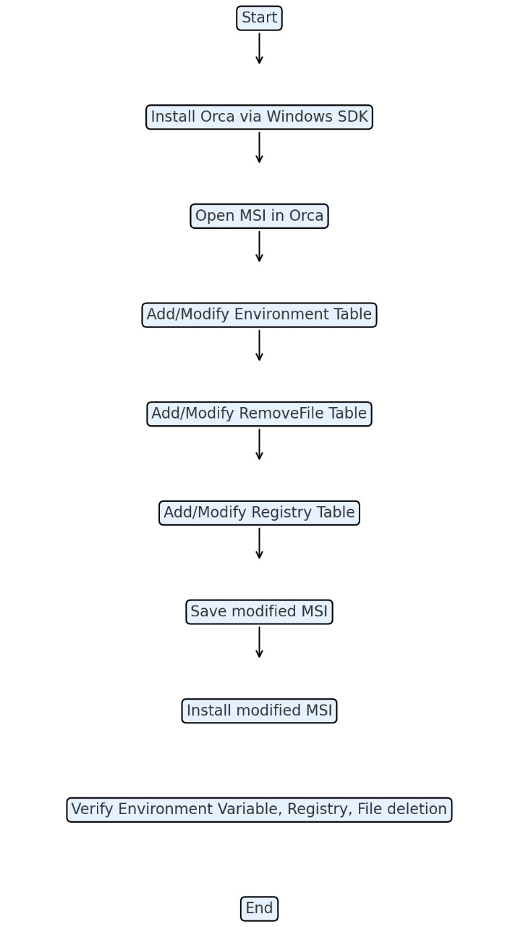
FLOWCHART
1.Install Orca via Windows SDK.
(C:\Program Files (x86)\Windows Kits\10\bin\10.0.26100.0\x86 and install the Orca-x86_en-us.msi)
2.Open the MSI file (e.g: Firefox.msi) in Orca.
3.Add Environment table to set variables (e.g., PATH).
4.Add RemoveFile table to delete files during uninstall.
5.Add Registry table to modify registry keys.
6.Save the modified MSI (e.g: Firefox_Custom.msi).
7.Uninstall old version (if any), then install the new MSI.
8.Verify changes in Environment Variables, Registry, and file deletion.
2024 - RPS Consulting all rights reserved

Slide 8
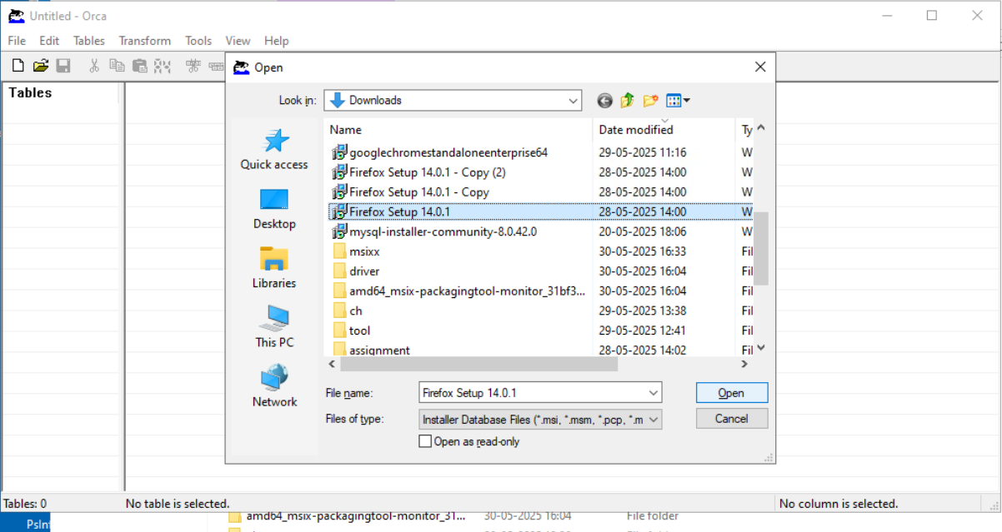
EXECUTION OVERVIEW STEPS
Step 1: Open Orca from the Start Menu.
Step 2: Click File > Open and select your MSI file (e.g: Firefox Setup 14.0.1.msi).
2024 - RPS Consulting all rights reserved

Slide 9
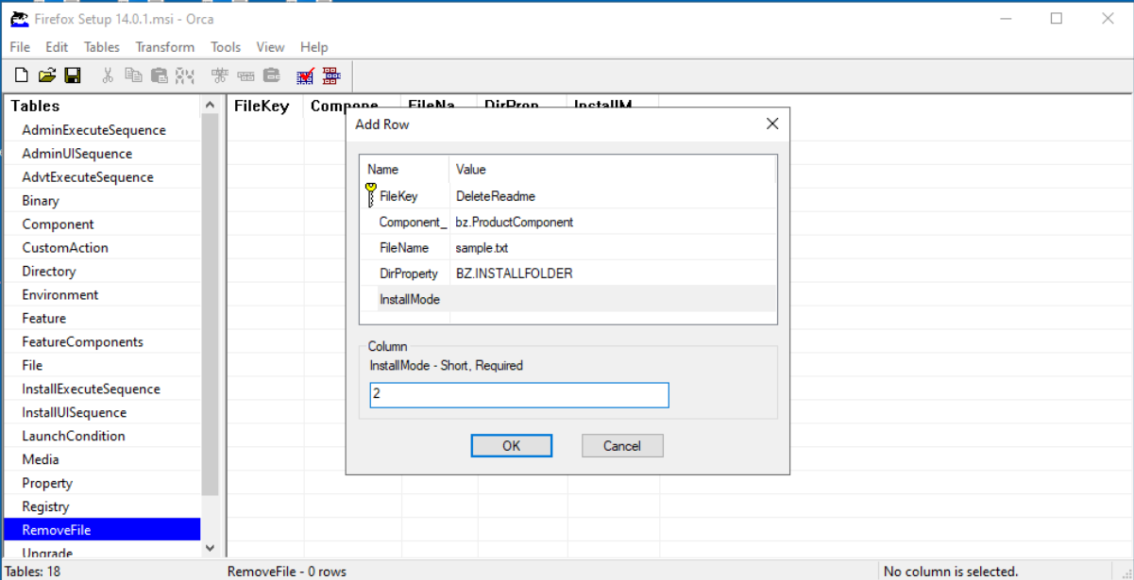
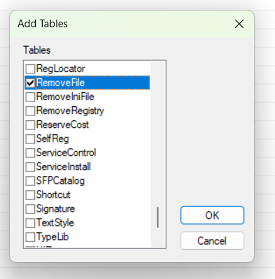
Step 3: Click Tables > Add Tables...Add Environment.idt, Registry.idt ,RemoveFile.idt. Skip if already present. This is for RemoveFile Table
Column | Value
FileKey | DeleteReadme
Component | bz.ProductComponent
FileName | sample.txt
DirProperty | BZ.INSTALLFOLDER
InstallMode | 2 (Remove on uninstall only)
Note: The sample.txt file should be in the C:\Program Files (x86)\Mozilla Firefox
2024 - RPS Consulting all rights reserved

Slide 10
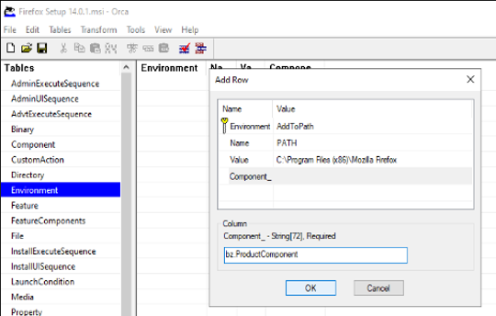
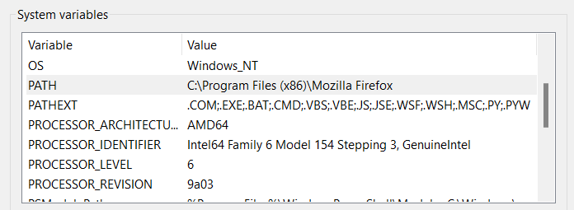
Step 4: This is for Environment Table
Column | Value
Environment | AddToPath
Name | PATH
Value | C:\Program Files (x86)\Mozilla Firefox
Component | bz.ProductComponent
Action | set
2024 - RPS Consulting all rights reserved

Slide 11
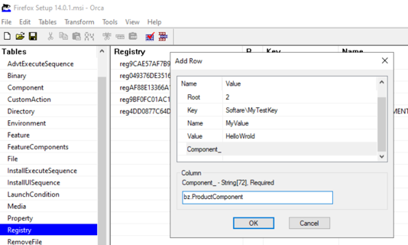
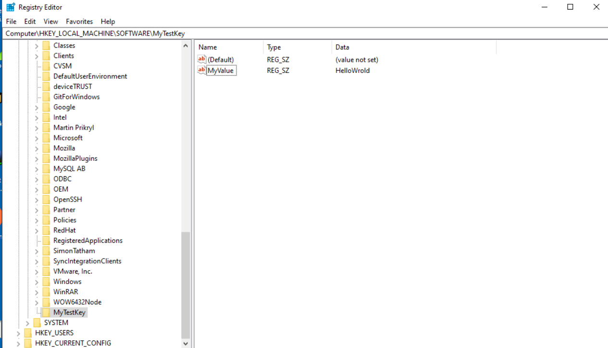
Step 5: This is for Registry Table
Column | Value
Registry | AddTestRegistry
Root | 2
Key | Software\MyTestKey
Name | MyVlaue
Value | HelloWorld
Component | bz.ProductComponent
Root Number |  | Hive
0 | HKEY_CLASSES_ROOT
1 | HKEY_CURRENT_USER
2 | HKEY_LOCAL_MACHINE
3 | HKEY_USERS
2024 - RPS Consulting all rights reserved

Slide 12
CONCLUSION
Orca enables powerful MSI customization.
We edited Environment, RemoveFile, and Registry tables.
Useful for deployment and enterprise setup.
2024 - RPS Consulting all rights reserved

Slide 13
REFERENCE LINKS
Windows SDK:
https://developer.microsoft.com/en-us/windows/downloads/windows-sdk/
FirefoxMsi:
https://www.exemsi.com/downloads/packages/Firefox/Firefox%20Setup%2014.0.1.msi
2024 - RPS Consulting all rights reserved

Slide 14
THANK
YOU
2024 - RPS Consulting all rights reserved

