Slide 1
RFQ-2185 · FLUOR CORPORATION — PROPULSION DIVISION
Zr
Project Kick-Off
Development of a Multiscale Simulation Methodology
for Irradiation-Induced Defect Evolution in Zirconium
Principal Investigators
Dr. Giacomo Po & Dr. Nasr Ghoniem
Multiscale Modeling Solutions, MMS
May 2026

Slide 2
PROGRAM OBJECTIVE
Develop a multiscale R&D methodology capable of simulating irradiation-induced defect evolution and subsequent deformation behavior in Zirconium alloy systems across multiple time and length scales.
Phase 1 — In-Pile Microstructure
Phase 2 — Mechanical Deformation
Irradiation damage accumulation, dislocation loop nucleation & growth, coupled cluster/dislocation dynamics, and annealing recovery
Post-irradiation and in-pile deformation under varied strain rates, temperatures, and neutron flux rates
Core Tool: "Great White" — Spatially-Resolved Cluster Dynamics (CD) + Discrete Dislocation Dynamics (DDD)

Slide 3
THE "GREAT WHITE" SIMULATION FRAMEWORK
Collision Cascade
(MD / BCA)
Spatial Cluster Dynamics
(CD)
Nucleation
Criterion – Homogeneous CD
Discrete Dislocation
Dynamics (DDD)
Mechanical
Properties
Primary damage
production (PKA)
Defect cluster
evolution in space
⟨a⟩ & ⟨c⟩ loop formation
Loop & network
evolution
Yield, hardening,
density fields
CD handles spatial defect fields · DDD handles discrete dislocation segments · Coupling at loop nucleation & growth interfaces
Spatially-resolved defect concentration fields
Thermally activated dislocation climb (annealing)
Vacancy & interstitial loop nucleation and growth
In-pile & post-irradiation mechanical deformation
Loop–loop elastic interactions (loop network formation)
Validated against TEM and mechanical test data

Slide 4
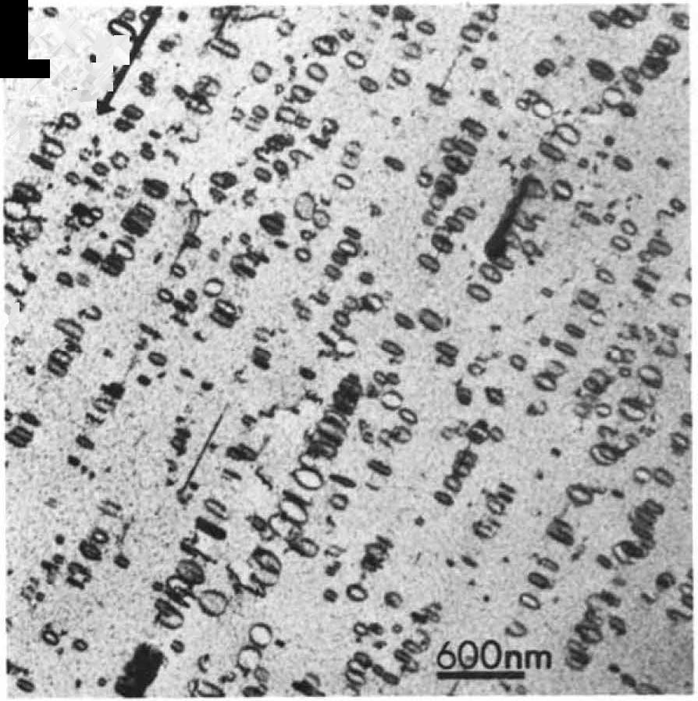
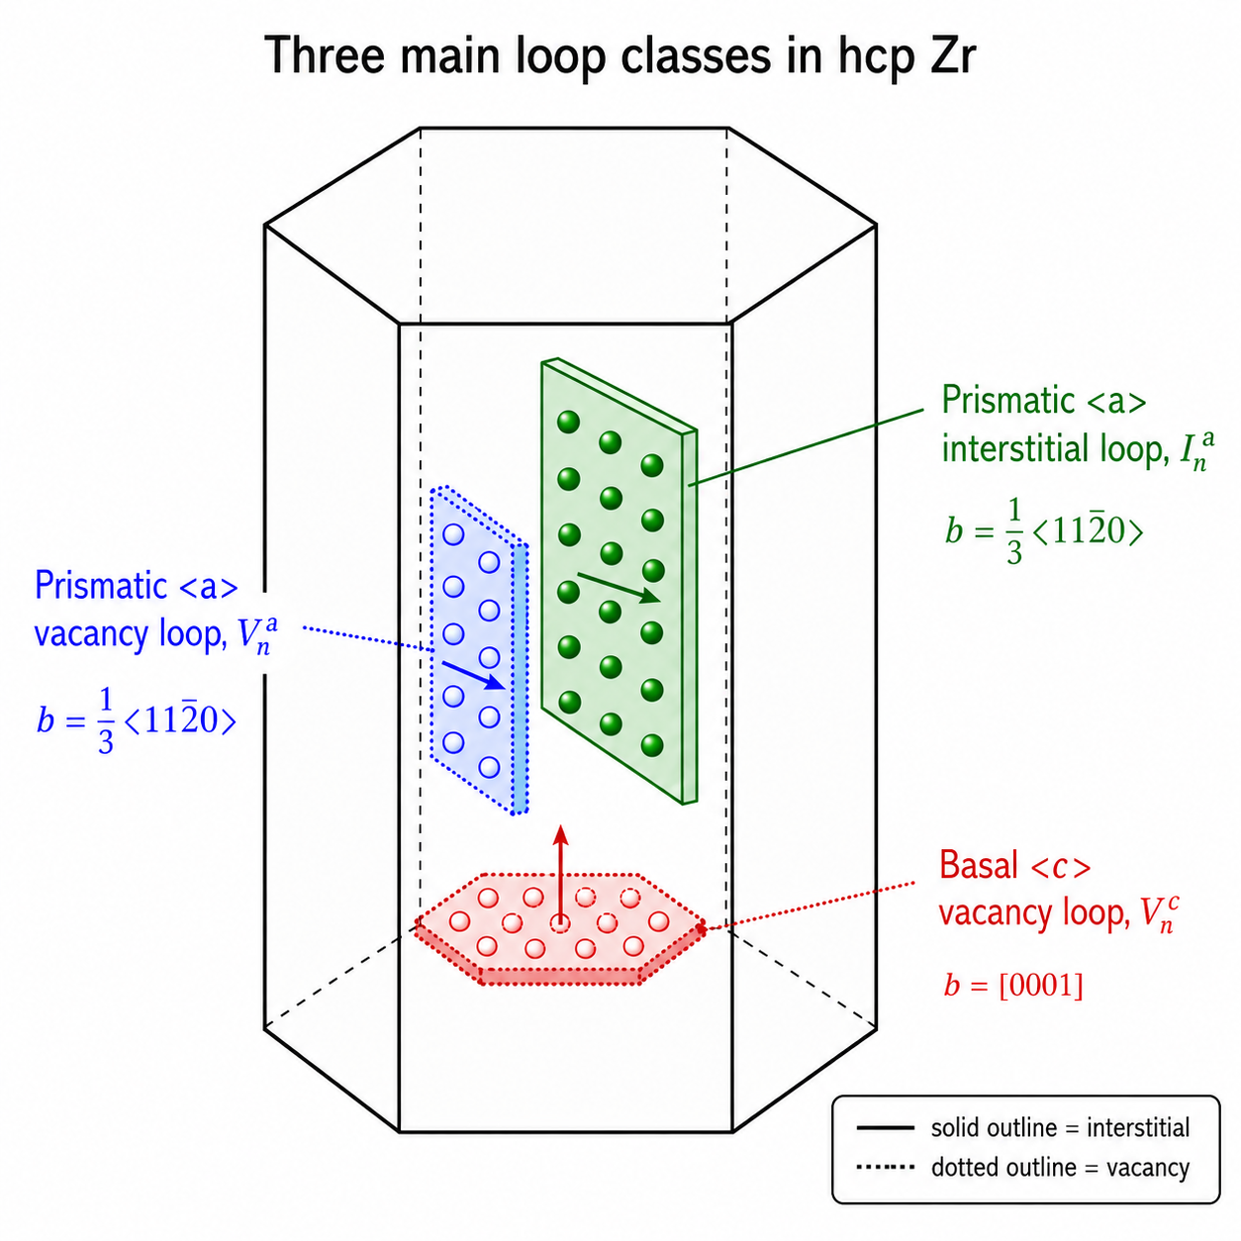
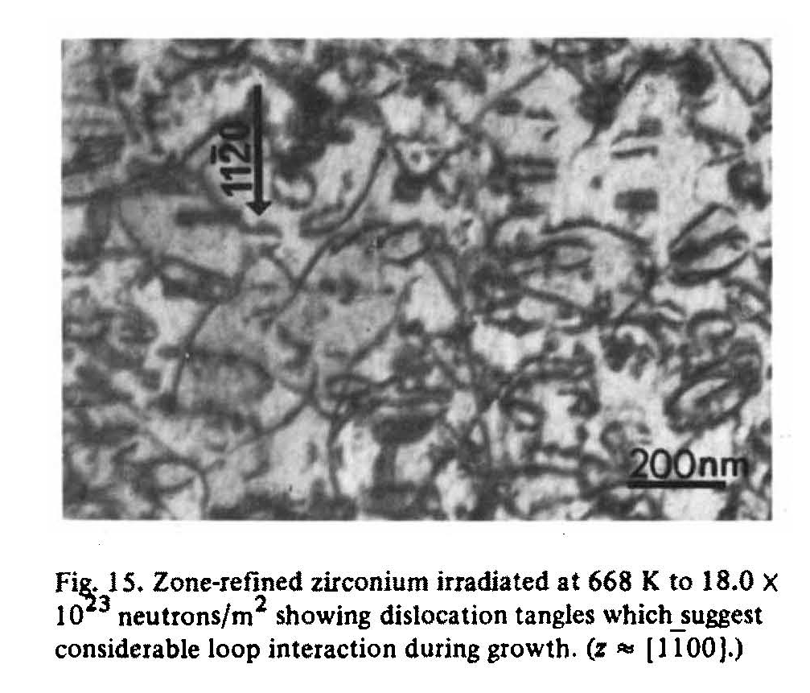
SUMMARY OF EXPERIMENTAL DATA ON ZR MICROSTRUCTURE

Slide 5
Typical loop population fractions in irradiated zirconium
Irradiation regime | a-loops (all) | c-component basal loops | a-loop character / habit
Low dose (<~0.1 dpa; ~450–600 K) | ~90–100% | absent to ~5% | Mostly prismatic / near-prismatic <a> loops
Intermediate dose (~0.1–1 dpa; ~550–650 K) | ~80–95% | ~5–20% | <a> loops remain mainly prismatic; vacancy fraction may rise
Higher dose / fluence (~1–10 dpa; ~600–700 K) | ~65–90% | ~10–35% | c-component basal vacancy loops become significant
Breakaway-growth regime (high fluence; alloy-dependent) | coexisting; often numerous | important by strain/area contribution | Basal c-component vacancy loops correlate with accelerated growth
High-temperature recovery (>~700 K; condition-dependent) | density decreases; size coarsens | can persist if high fluence | Loop coarsening and annealing are important
1

Slide 6
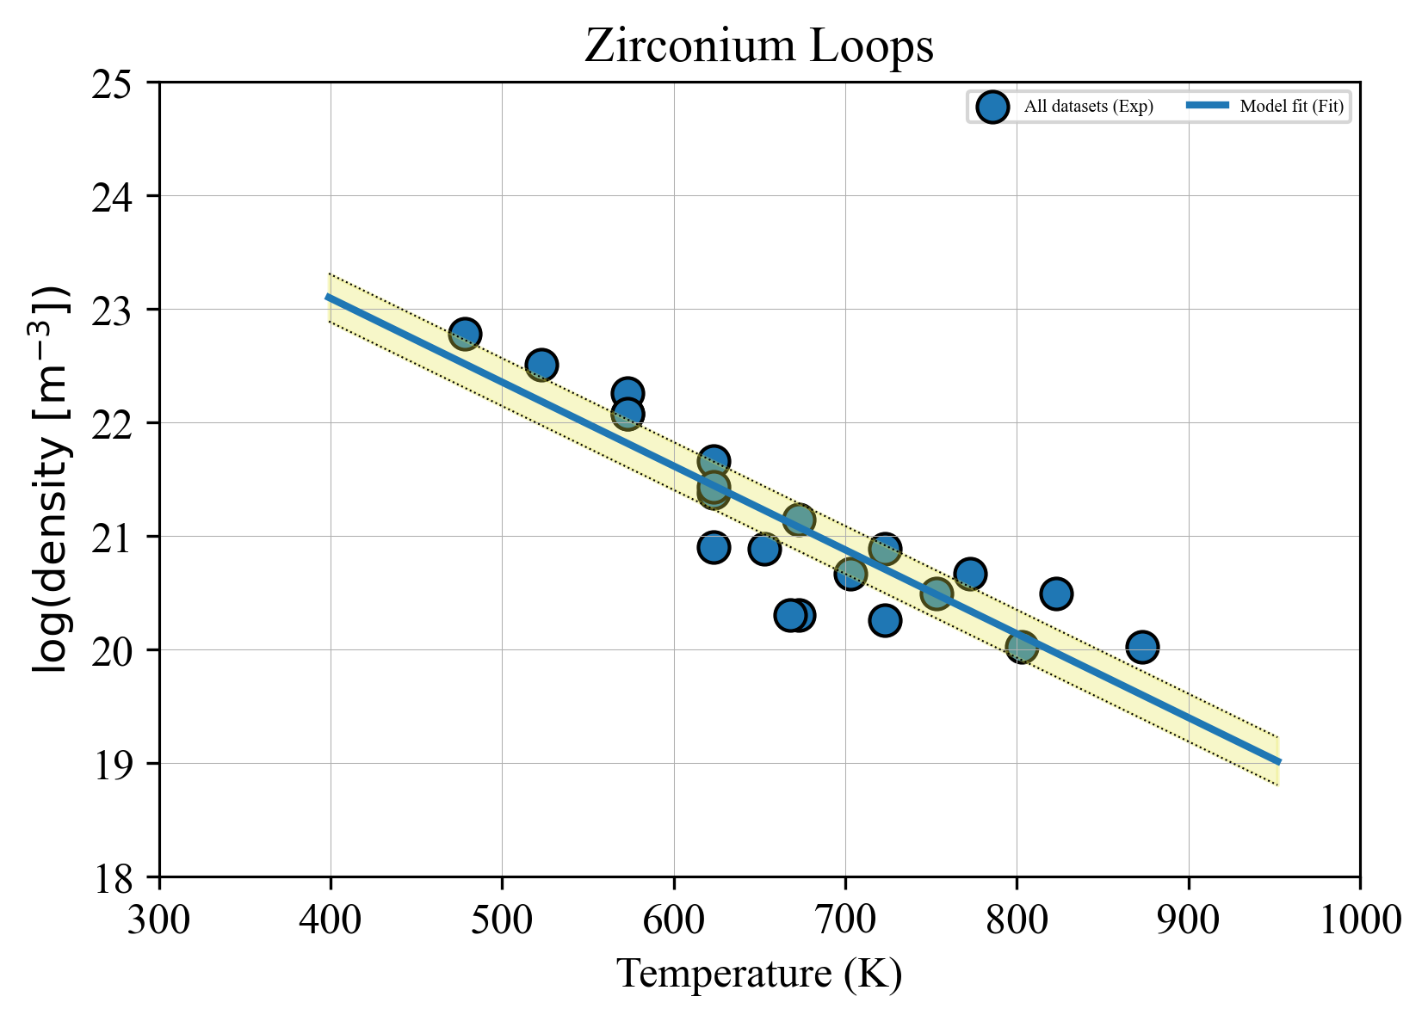
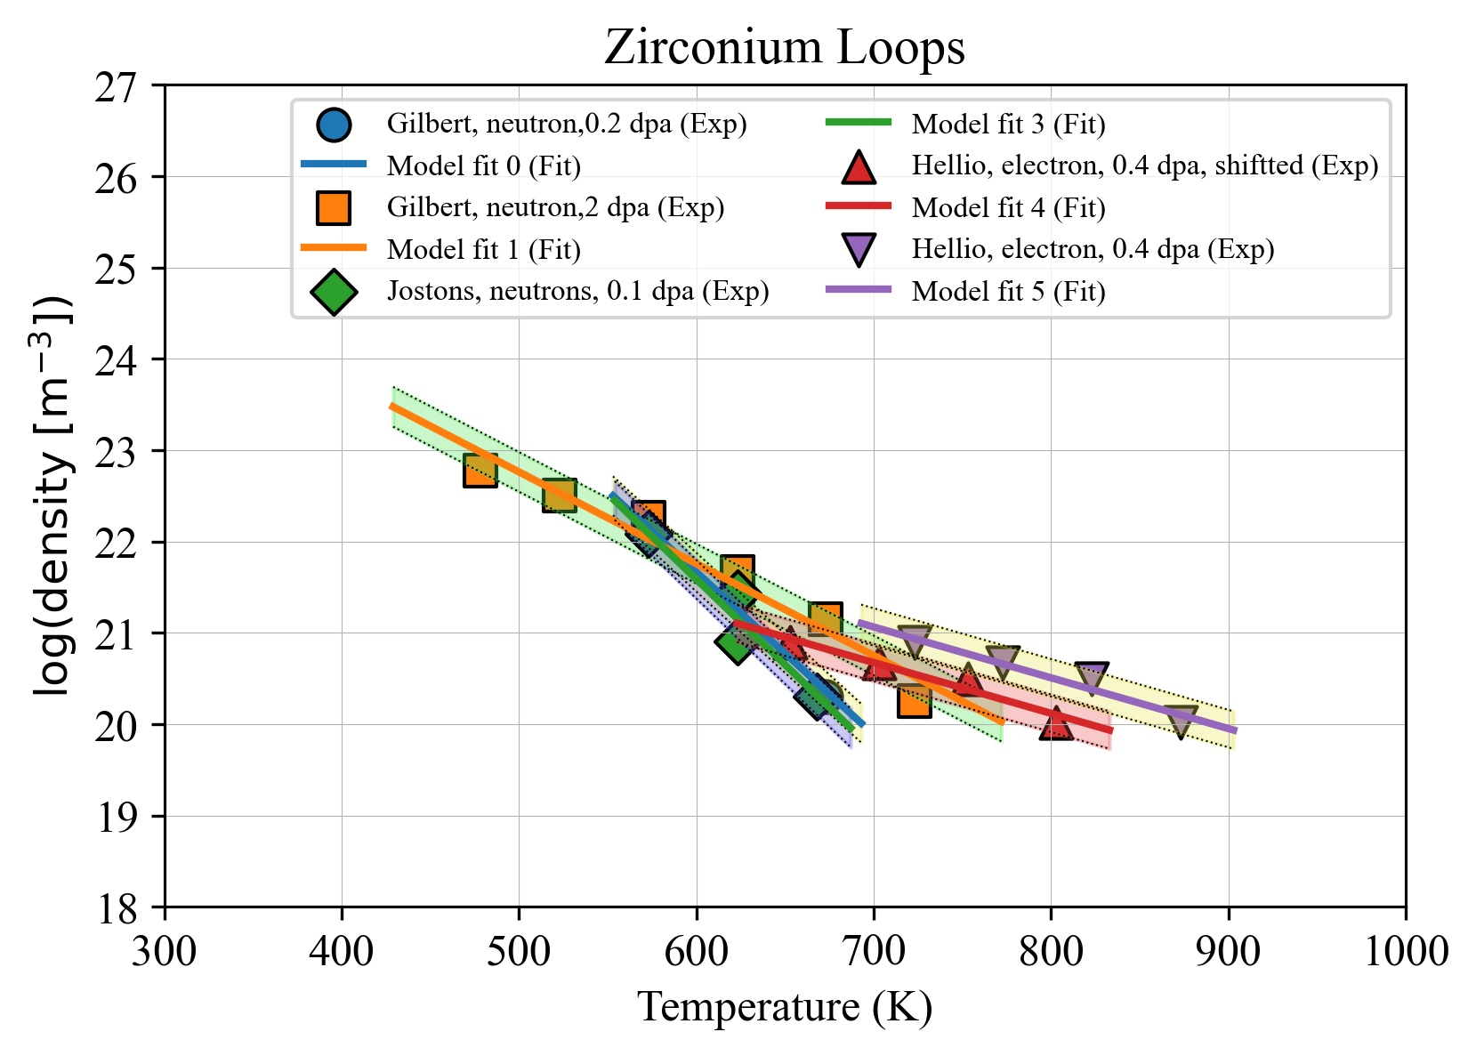

Slide 7
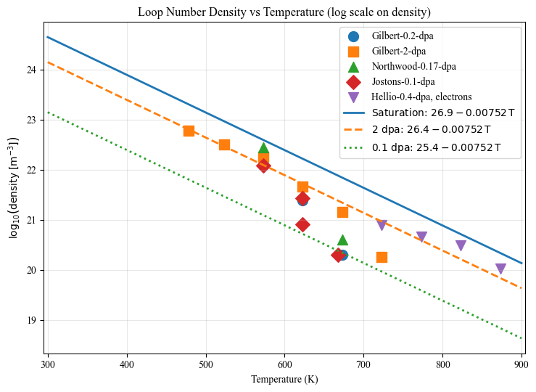

Slide 8
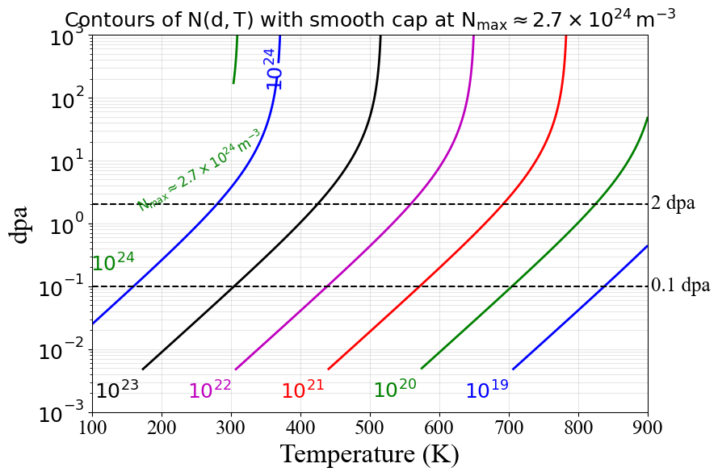

Slide 9
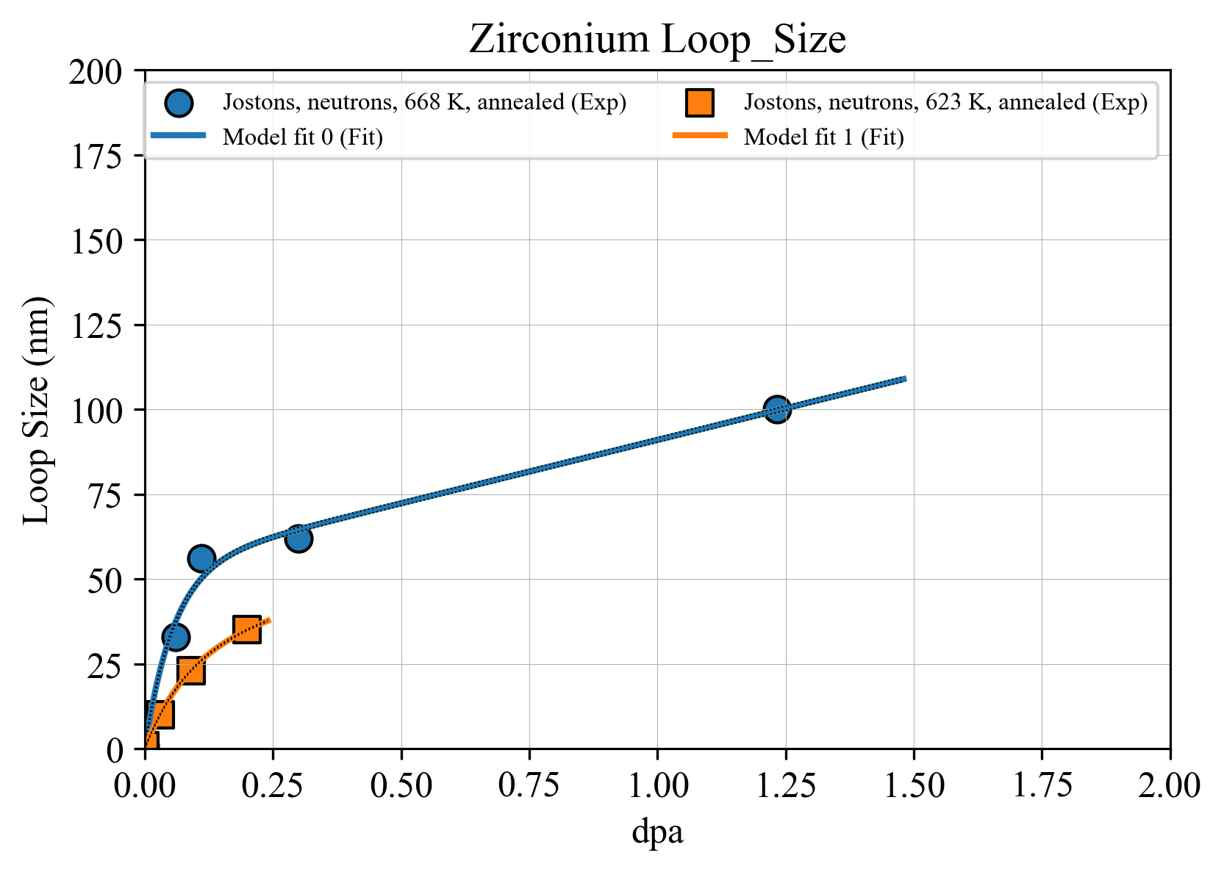
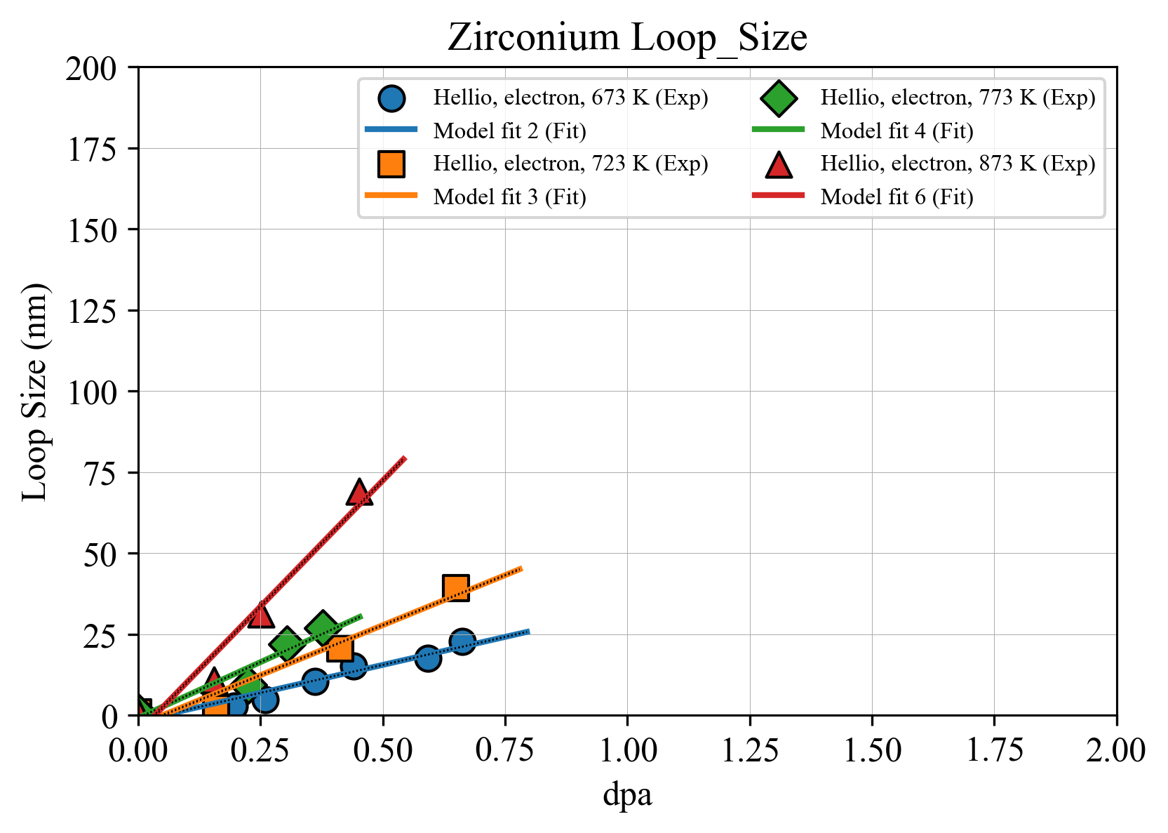

Slide 10
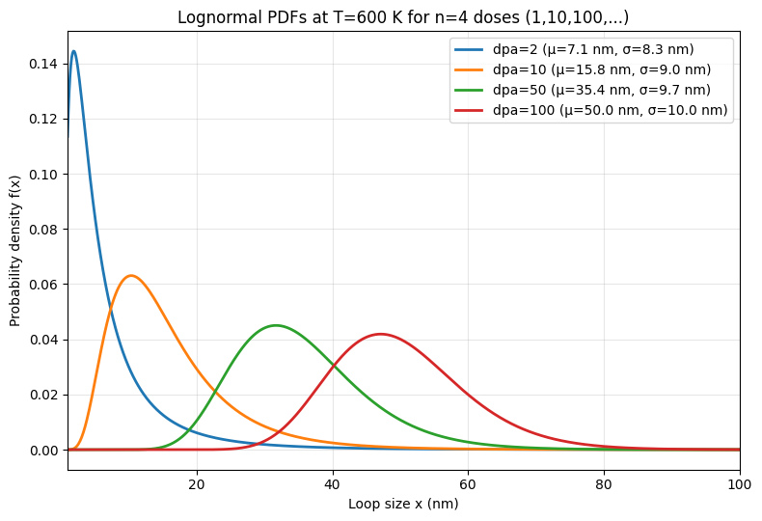

Slide 11
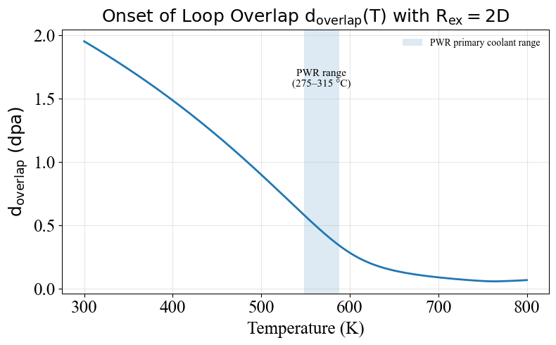

Slide 12
PHASE 1 — IN-PILE MICROSTRUCTURE EVOLUTION
3 Deliverables · 6 Milestones · 12 Months
D1 · Multiscale Simulation Methodology
D2 · Coupled CD–DDD Dynamics
D3 · Annealing & Recovery
D1M1 · ~2 mo after award
D2M1 · ~6 mo after award
D3M1 · ~10 mo after award
Initial irradiation damage — spatially resolved CD fields of defect cluster concentrations
Coupled capability demo — loop–loop interactions, connected dislocation network formation
Post-irradiation annealing — thermally activated diffusion & dislocation climb
D1M2 · ~4 mo after award
D2M2 · ~8 mo after award
D3M2 · ~12 mo after award
Dislocation loop growth — nucleation of ⟨a⟩ & ⟨c⟩ loops, discretized into DDD as sessile loops
Validation — loop density, size, and distribution vs. experimental TEM database
Recovery model validation — dissolution kinetics vs. experimental data

Slide 13
PHASE 2 — IRRADIATION EFFECTS ON MECHANICAL DEFORMATION
3 Deliverables · 21 Months
Goal: Benchmark in-pile vs. out-of-pile deformation characteristics of irradiated Zr alloys via multiscale DDD simulations
D4 · ~15 months
D5 · ~18 months
D6 · ~21 months
Post-Irradiation Mechanical Deformation
In-Pile Mechanical Deformation
Final Code Release & Documentation
Start from Phase 1 evolved microstructure
Simulate at varied strain rates, temperatures, & neutron flux
Technical report: physical model coupling CD + DDD
Network dislocations interact with irradiation loops
Combine dislocation climb and glide (DDD)
Code documentation: architecture & inline comments
Uniaxial loading: single & polycrystalline samples
Compare in-pile vs. out-of-pile deformation behavior
Documented examples reproducing Phase 1 & 2 results
Outputs: yield strength, work-hardening, dislocation density
Great White framework: coupled CD + DDD under load
Basic tutorials for future NNL use

Slide 14
DELIVERABLES SCHEDULE
ID
Deliverable
Timing
Type
D1M1
Simulation of Initial Irradiation Damage
~2 months
Report + Presentation
D1M2
Dislocation Loop Growth Under In-Pile Conditions
~4 months
Report + Presentation
D2M1
Demonstration of Coupled CD–DDD Capability
~6 months
Report + Presentation
D2M2
Validation Against Experimental Microstructure
~8 months
Report + Presentation
D3M1
Simulation of Post-Irradiation Annealing
~10 months
Report + Presentation
D3M2
Validation of Recovery Model
~12 months
Report + Presentation
D4
Post-Irradiation Mechanical Deformation
~15 months
Report + Presentation
D5
In-Pile Mechanical Deformation
~18 months
Report + Presentation
D6
Final Code Release & Documentation
~21 months
Report + Presentation
MPR
Monthly Progress Briefing
Monthly
Slide-based status, schedule & risk
Phase 1
Phase 2
Monthly

Slide 15
PROJECT MANAGEMENT & TEAM
Dr. Nasr Ghoniem
Dr. Giacomo Po
Principal Investigator
Principal Investigator
Professor of Mechanical & Aerospace Engineering
University of California, Los Angeles
Assistant Professor, University of Miami
(MoDELib developer)
Responsibilities
Responsibilities
Technical quality & scientific direction
DDD framework development & integration
Microstructure & rate theory modeling
Coupled CD–DDD Great White code
Milestone acceptance support
Software architecture & documentation
NNL customer communication
Code release & tutorials (D6)
Supported by graduate students and research engineers with direct experience in computational defect mechanics

Slide 16
IMMEDIATE NEXT STEPS
Zr
Path Forward
1
Confirm contract award & establish NNL communication channels
2
Finalize parameter baseline for Zr CD model (vacancy & interstitial migration energies)
3
Set up spatially-resolved CD simulation domain for D1M1
4
Define validation dataset for D1M1 (experimental TEM loop data)
5
Submit D1M1 report & presentation at ~2 months after award
RFQ-2185 · Fluor Corporation — Propulsion Division · MMS

