Slide 1
Study on fracture toughness and ductile-brittle transition based on interaction of cracks and dislocations
Tokyo University of Science
Keitaro Watanabe
Akiyuki Takahashi
Notes:
I am
The title

Slide 2
Background
Objectives
Analysis procedure
Numerical results
Consideration of fracture types
Conclusions
Notes:
This slide is the table of contents for my presentation

Slide 3
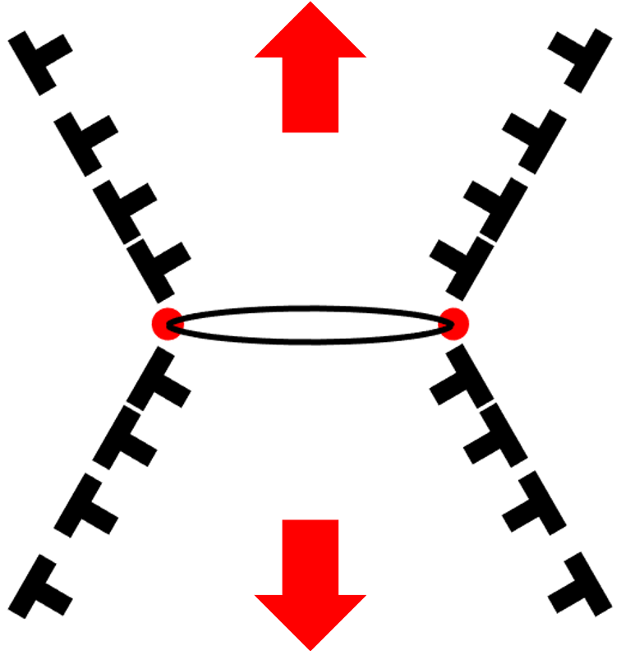
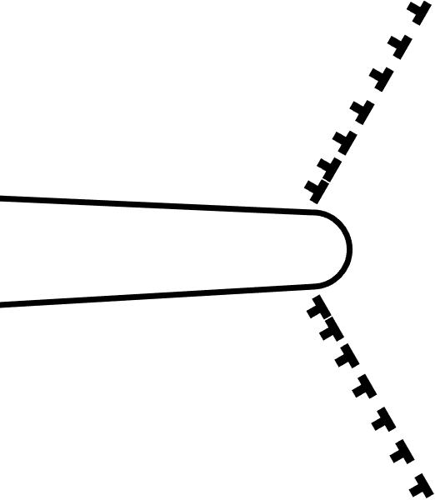
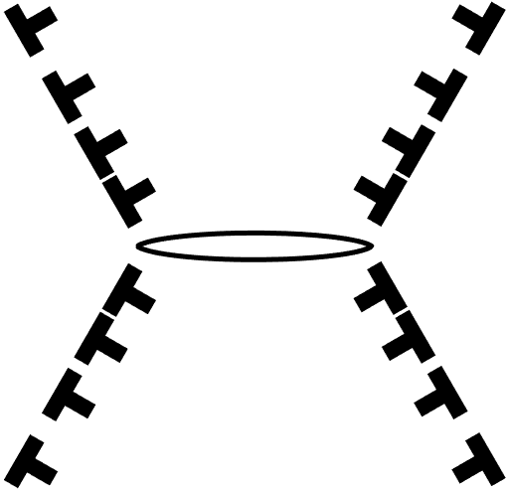




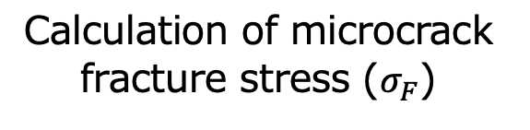

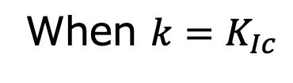


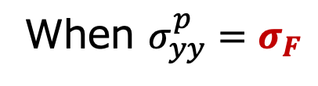
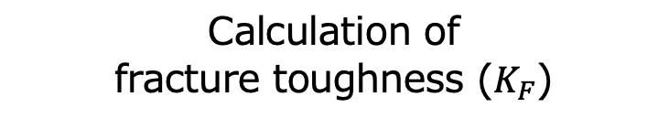



2D dislocation simulation of BDT
[1]
[1] S.J. Noronha, N.M. Ghoniem Metall. Mat. Trans. vol. 37 (2006) 539.
Decoupled model
  Define macrocrack and microcrack in separate models
① Microcrack simulation
② Macrocrack simulation
Calculation of microcrack fracture stress ($σ_{F}$)
Calculation of
fracture toughness ($K_{F}$)
$$σ_{yy}$$
$${\dot{K}}_{app}$$
$σ_{yy}^{p}$
$$k→$$
$$σ_{F}$$
$$X_{p}$$
$$y$$
$$x$$
When $k=K_{Ic}$
→
$$σ_{yy}=σ_{F}$$
When $σ_{yy}^{p}=σ_{F}$
→
$$K_{app}=K_{Ic}$$

Slide 4
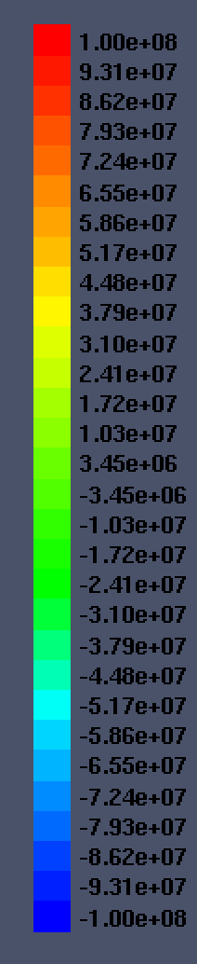
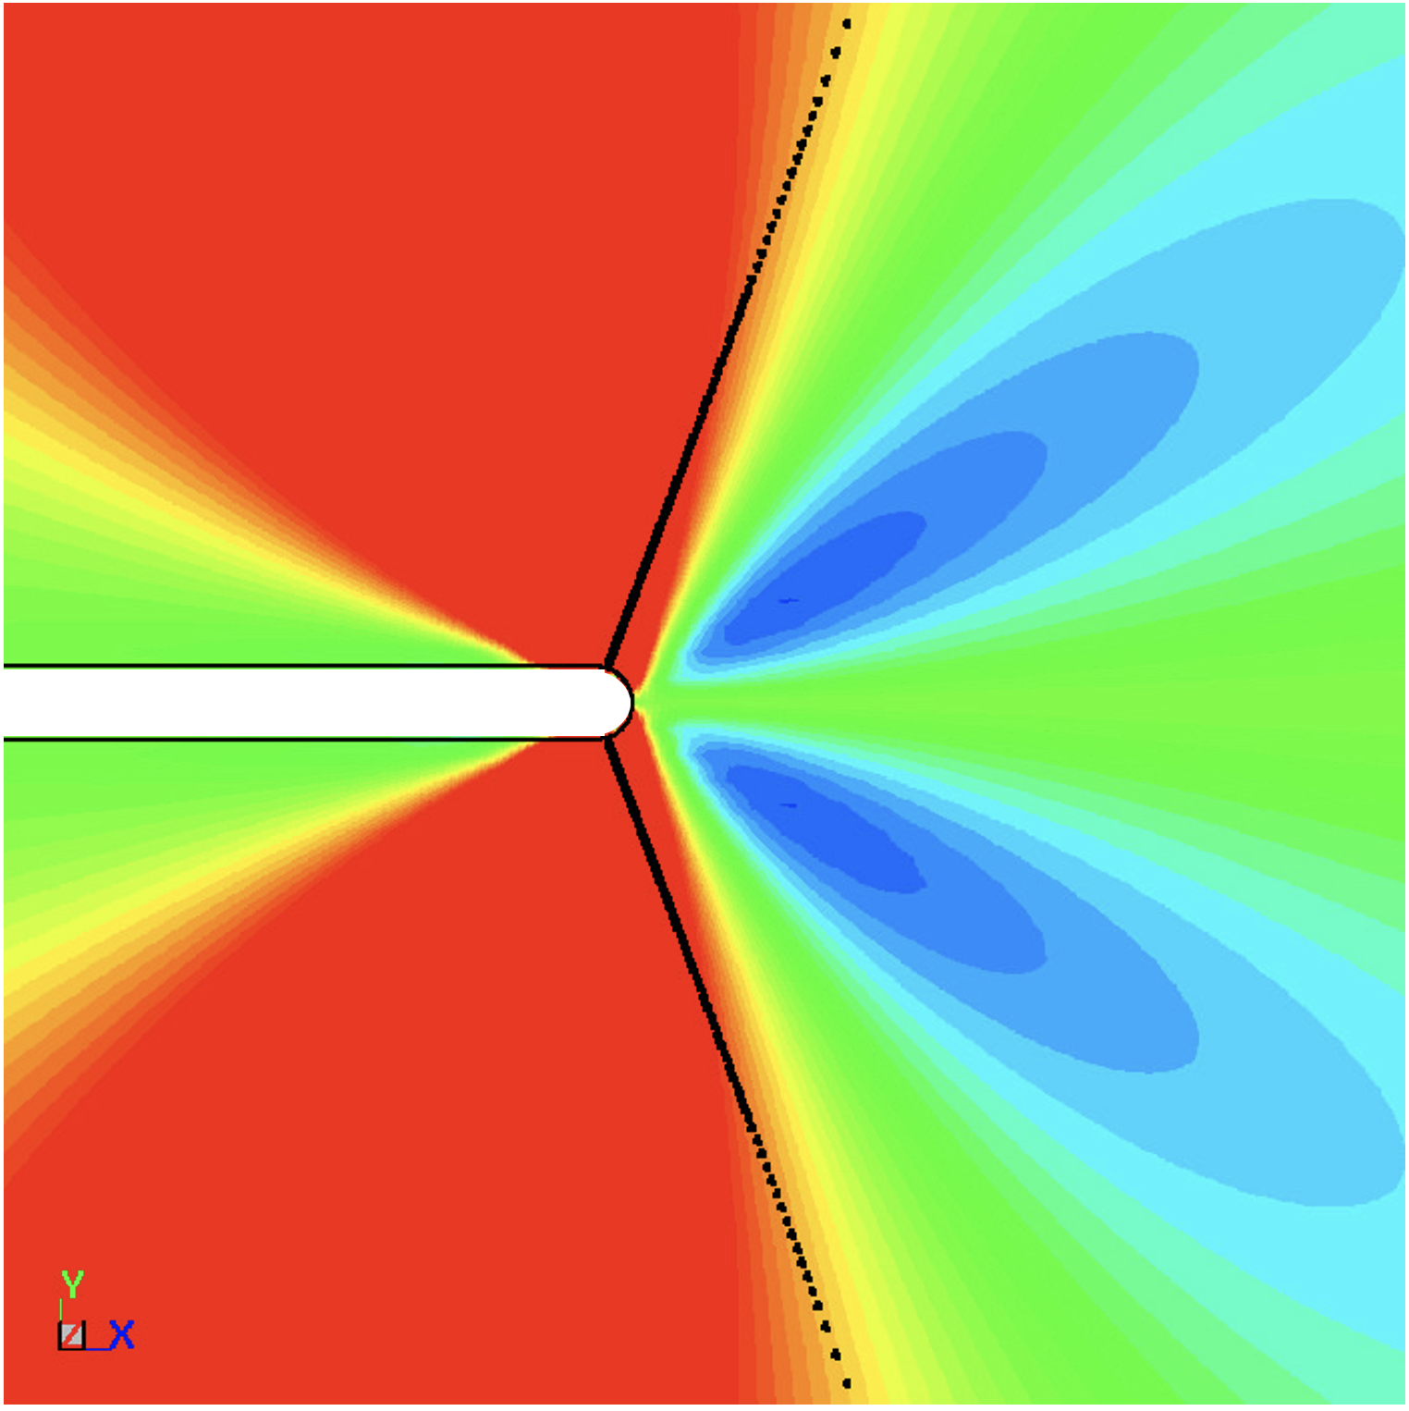
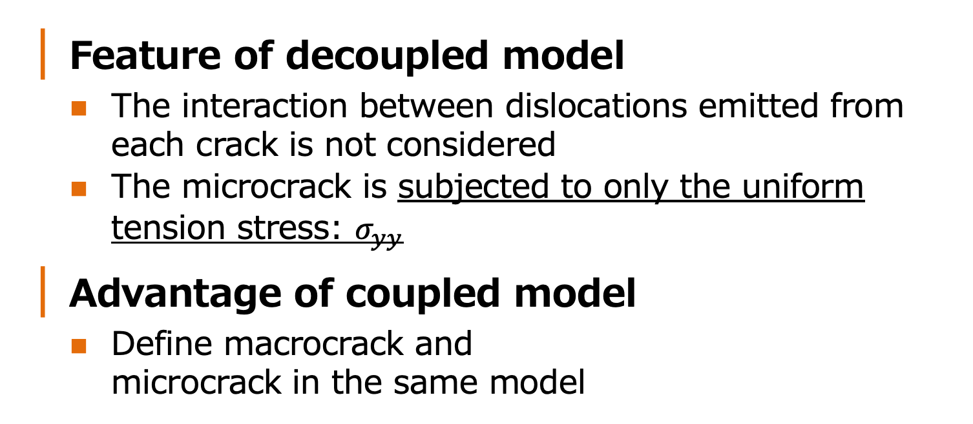

Decouple model and coupled model
Feature of decoupled model
  The interaction between dislocations emitted from each crack is not considered
  The microcrack is subjected to only the uniform tension stress: $σ_{yy}$
Advantage of coupled model
  Define macrocrack and
  microcrack in the same model
Stress field of Macrocrack
and dislocations of emitted from macrocrack
$$τ_{70.5°}$$
① Macrocrack
② Microcrack
③ Emitted dislocations
All interactions
can be considered

Slide 5
Objectives
Investigate the detailed mechanism of fracture of microcracks near the macrocrack-tip using coupled model
Calculate the fracture toughness and ductile-brittle transition temperature

Slide 6
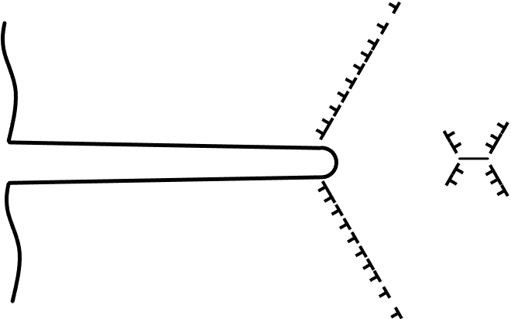
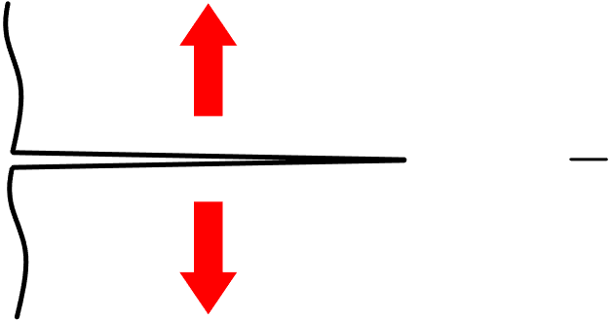
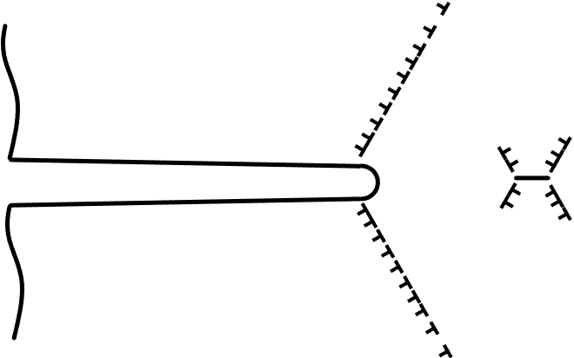
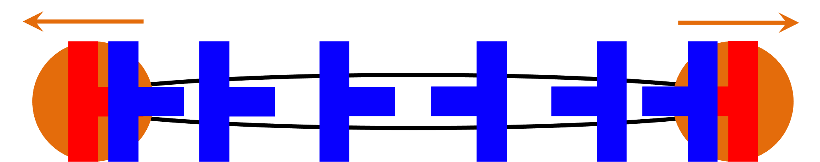
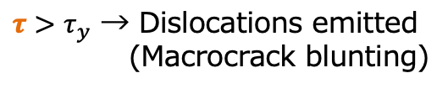
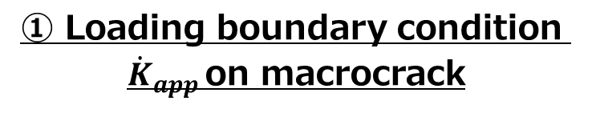



Analysis procedure
① Loading boundary condition
${\dot{K}}_{app }$on macrocrack
② Emission of
dislocations at crack-tip
Calculation of macrocrack stress field
$τ>τ_{y}$ → Dislocations emitted
(Macrocrack blunting)
$${\dot{K}}_{app}$$
$$τ$$
:Dislocation source
③ Calculation of
force on dislocations
④ Calculation of
stress intensity factor
All interaction considered
Calculate stress intensity factor from
Peach-Koehler force at crack-tip
$$F_{x}$$

Slide 7

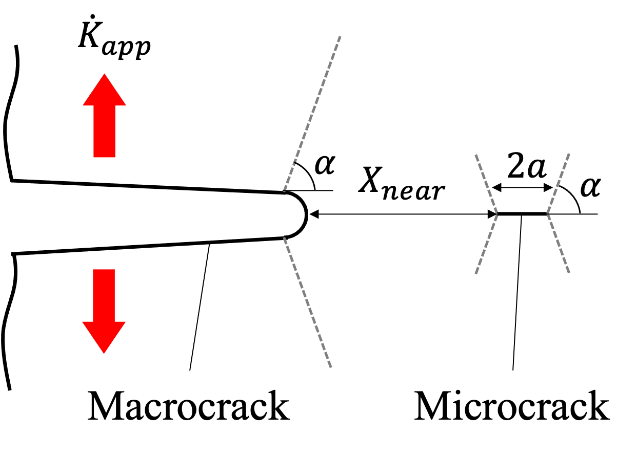
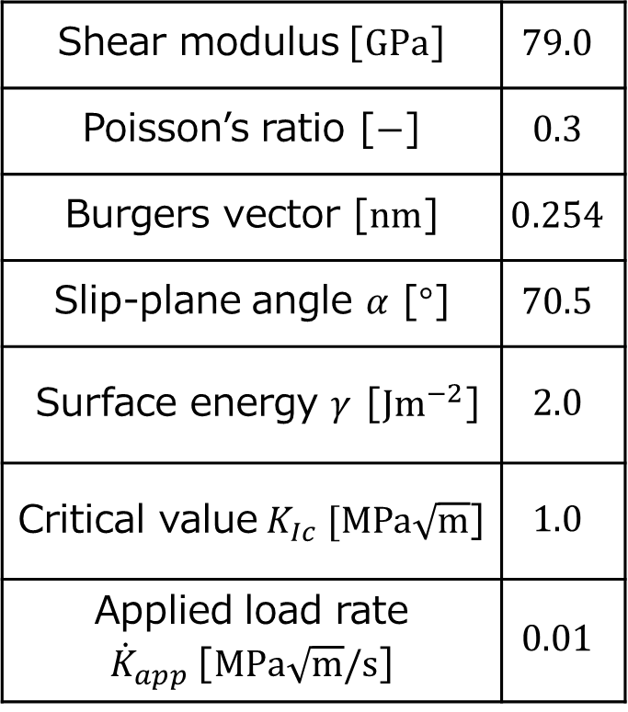
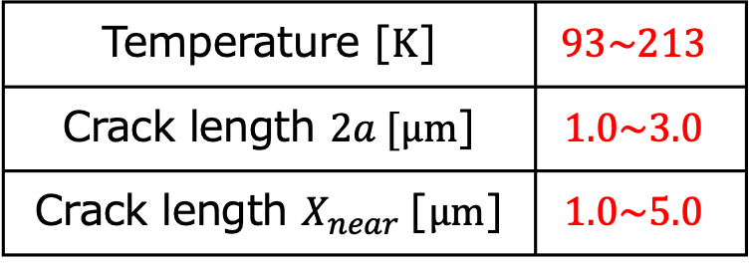
Coupled model
Analysis condition
K_{tip near}
K_{tip far}
Shear modulus [$GPa$] | $$79.0$$
Poisson’s ratio [$−$] | $$0.3$$
Burgers vector [$nm$] | $$0.254$$
Slip-plane angle $α$ [$°$] | $$70.5$$
Surface energy $γ$ [${Jm}^{−2}$] | $$2.0$$
Critical value$K_{Ic} [MPa\sqrt{m}$] | $$1.0$$
Applied load rate ${\dot{K}}_{app}$[$MPa\sqrt{m}/s$] | $$0.01$$
Temperature [$K$] | $$93\sim 213$$
Crack length $2a [μm$] | $$1.0\sim 3.0$$
Crack length $X_{near}$[$μm$] | $$1.0\sim 5.0$$

Slide 8
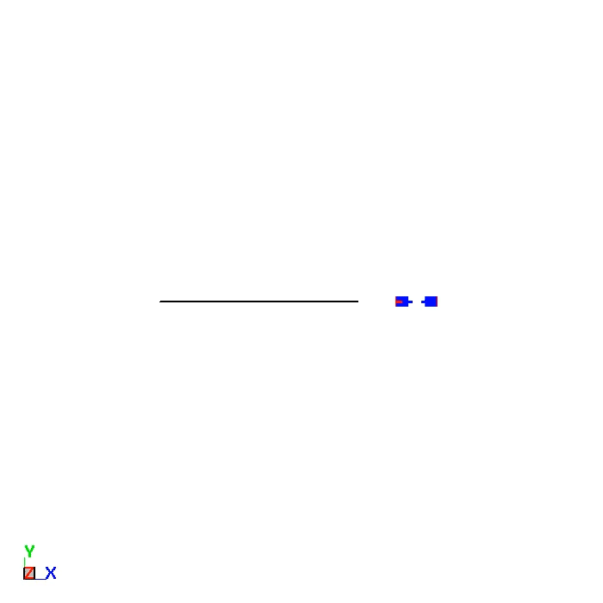
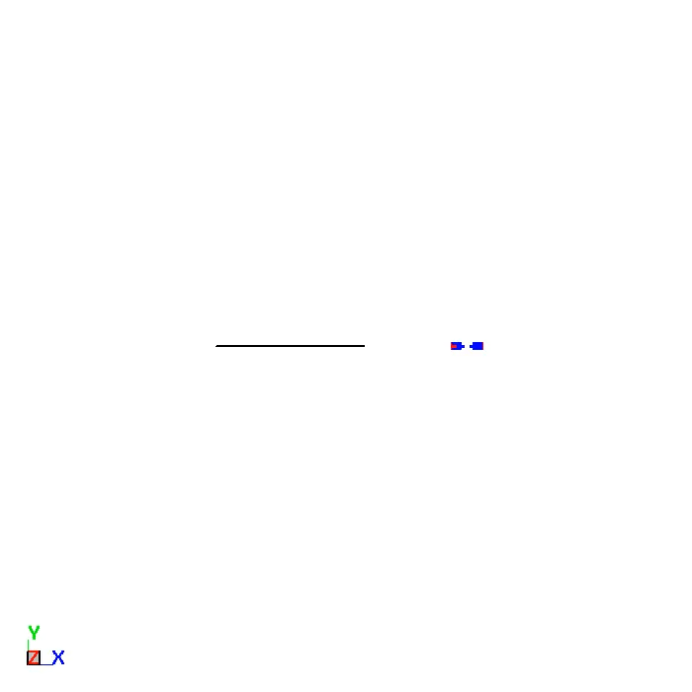
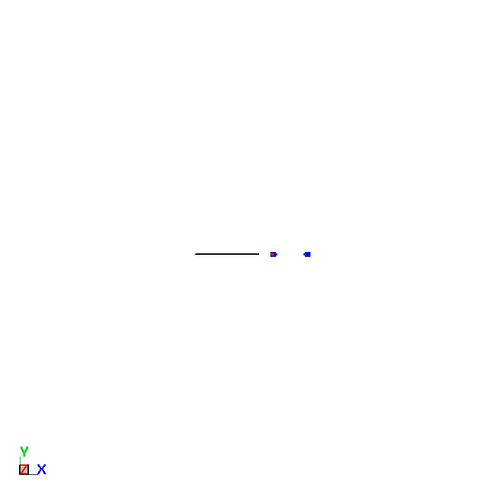

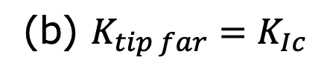
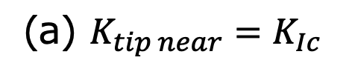


Three fracture types of microcrack
(a) $K_{tip near}=K_{Ic}$
(b) $K_{tip far}=K_{Ic}$
(c) Crack closing
$$2a=1.0, X_{near}=1.0$$
$$2a=1.0, X_{near}=3.0$$
$$2a=3.0, X_{near}=1.0$$

Slide 9
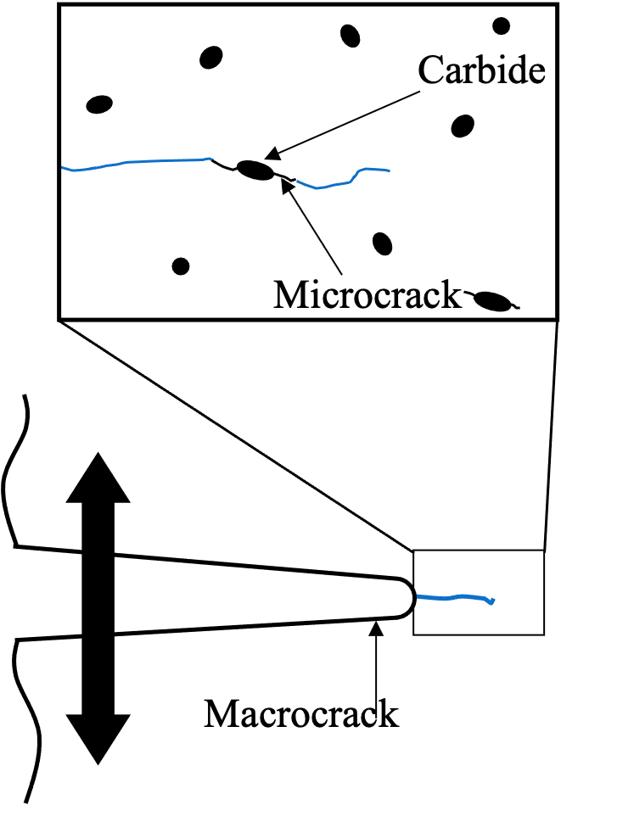
Classification of fracture type
[1] P.Bowen, S.G.D Druce, J.F.Knott Acta Mattall.
Vol. 34, No.6, pp.1121-1131, (1986)
[1]
Brittle fracture process
Microcracks exist in material,
mainly due to precipitates
Loading
① Blunting of macrocracks
② Microcracks cleave and
propagate to macrocrack
Brittle fracture requires microcracks propagate to macrocrack

Slide 10

Three fracture types of microcrack
(a) $K_{tip near}=K_{Ic}$
(b) $K_{tip far}=K_{Ic}$
(c) Crack closing
$$2a=1.0, X_{near}=1.0$$
$$2a=1.0, X_{near}=3.0$$
$$2a=3.0, X_{near}=1.0$$
Brittle fracture requires microcracks propagate to macrocrack
(a) $K_{tip near}=K_{Ic}$ has brittle feature
(b),(c) no propagation to macrocrack

Slide 11
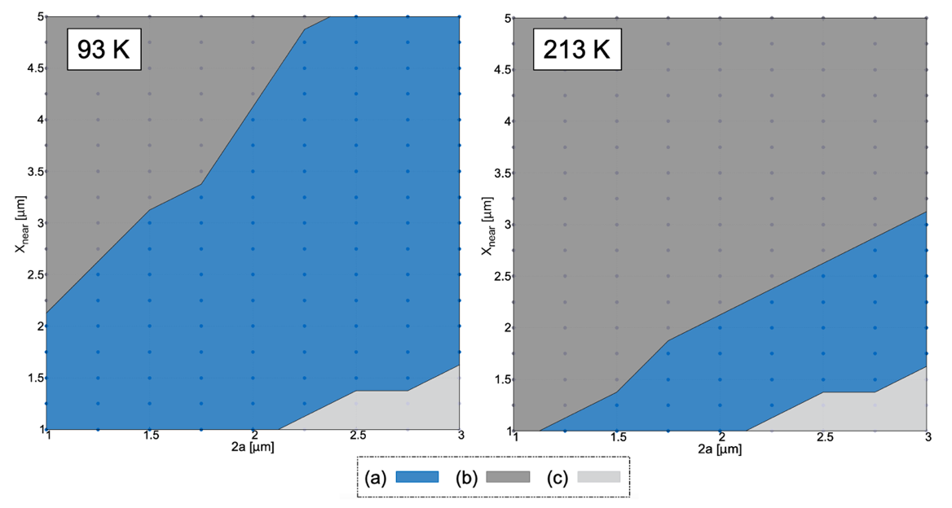
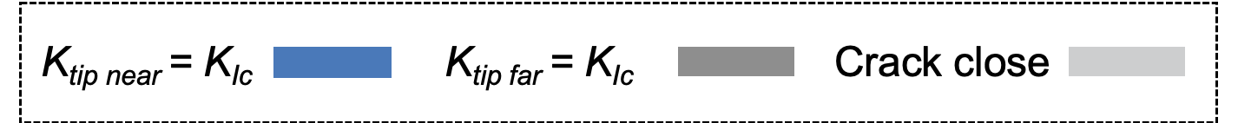
Fracture type mapping
Increasing temperature decreases the area of brittle fracture
Microcracks, which are the starting point
of brittle fracture, are reduced

Slide 12
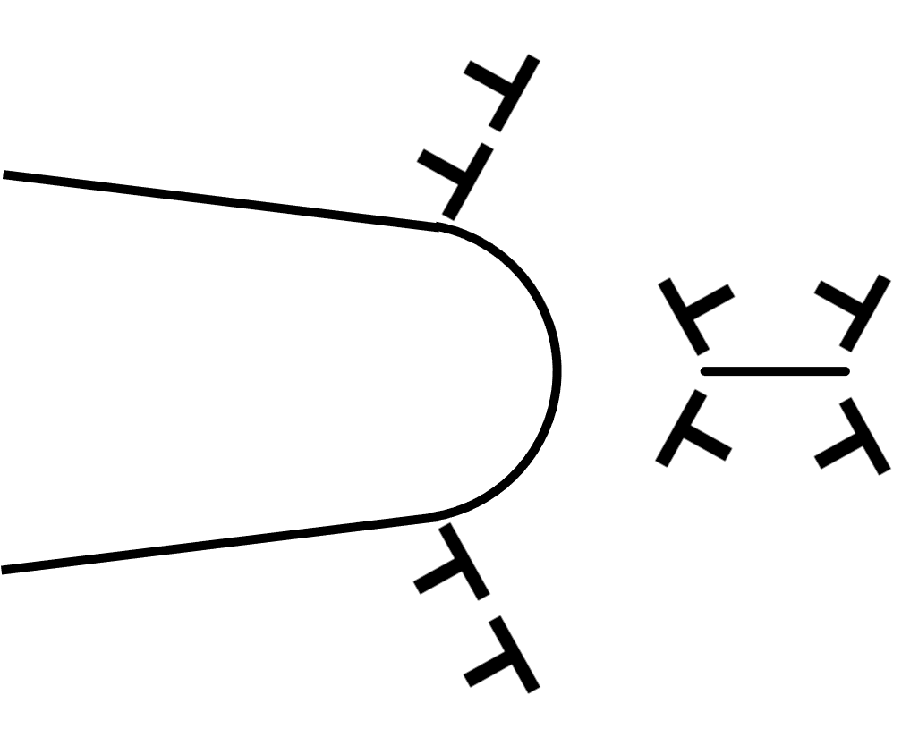



BDTT
Fracture toughness vs. temperature
(a) Contribute to brittle fracture
$$2a=1.0, X_{near}=1.0$$
(a)
(b)
(b) Valid fracture toughness
value cannot be estimated
$$2a=1.0, X_{near}=1.25$$
(a)
(b)
$$2a=1.0, X_{near}=1.5$$
Fracture type shifts
at certain temperature
It is the limit temperature
for fully brittle fracture
(a)
(b)

Slide 13
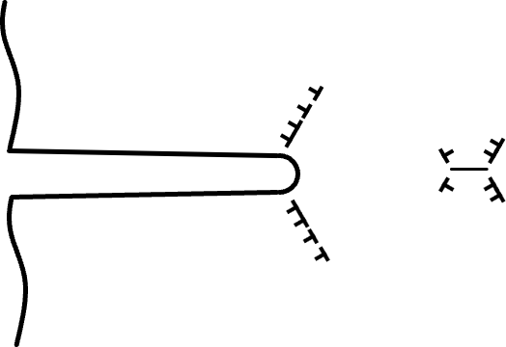
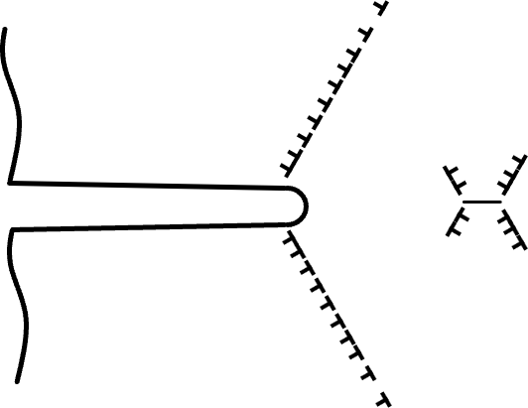
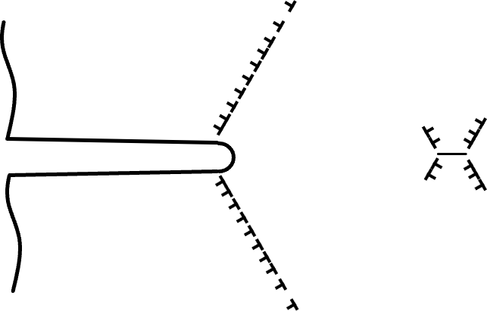
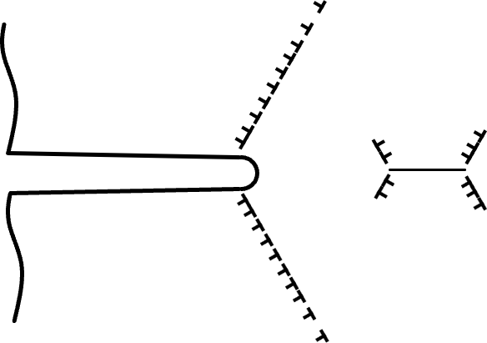













Why does fracture type shift?
Situations where the fracture type shifts
Temperature $T$
Crack length $2a$
Crack position $X_{near}$
$$T=93 K$$
$$2a=1.0 μm$$
$$X_{near}=1.0 μm$$
$2a$
$$X_{near}$$
$$T=213 K$$
$$2a=3.0 μm$$
$$X_{near}=3.0 μm$$
$2a$
$$X_{near}$$
Consider the main factors
by checking four separate components
①Macrocrack, ②Macro dislocations,
③Micro dislocations near, ④Micro dislocations far

Slide 14
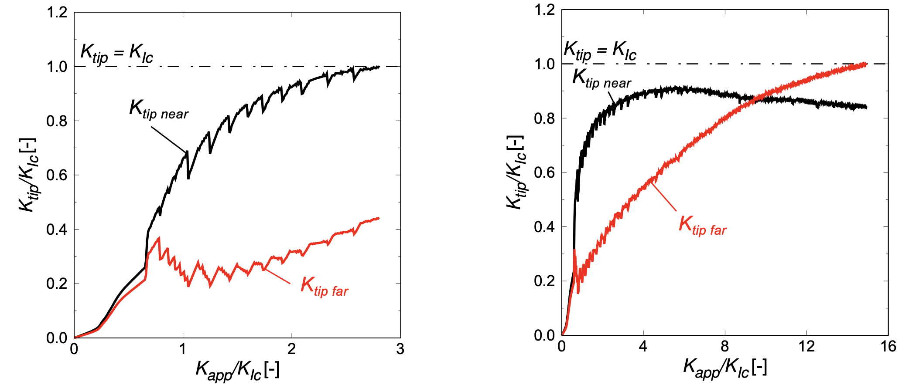


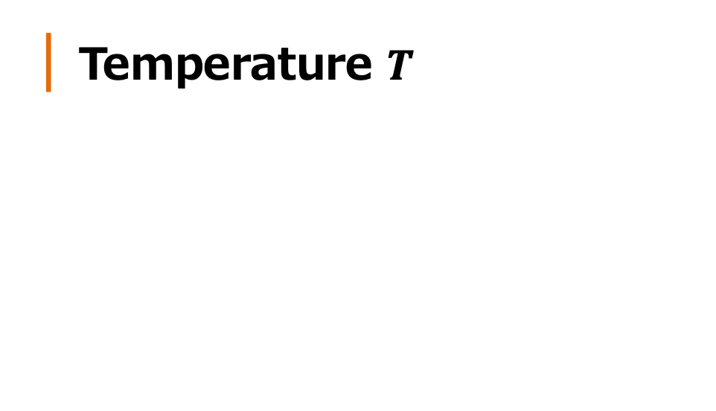


Main factors that shift the type of fracture
Temperature $T$
$$T=93 K$$
$$T=93 K$$
$$T=213 K$$
$$T=213 K$$
    Blunted macrocracks cause numerous dislocations to be emitted from microcrack-tip
    At high temperature, dislocations are emitted easily and macrocrack blunts more rapidly

Slide 15
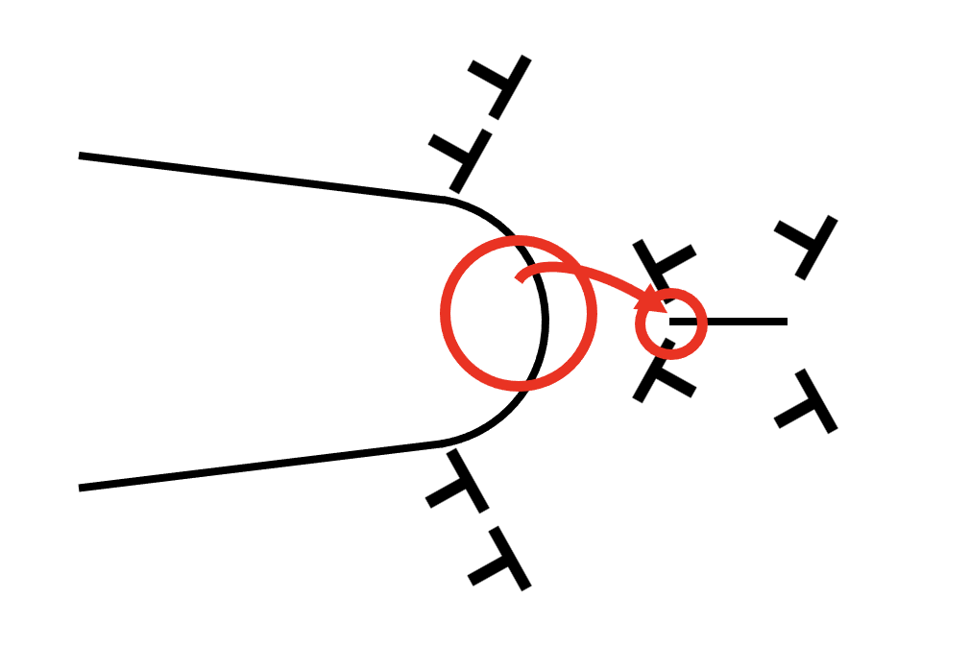
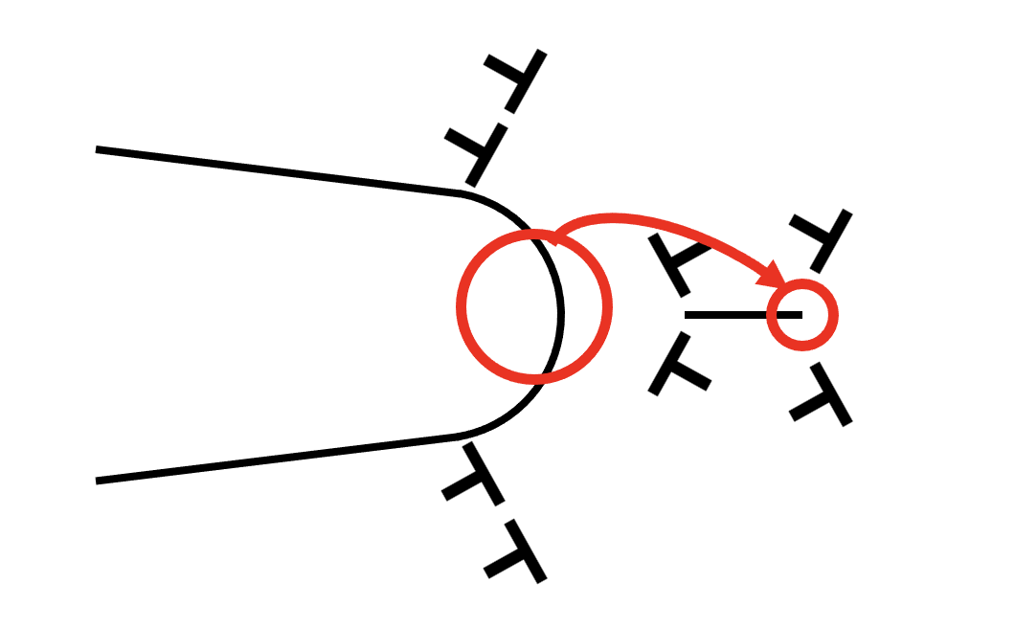
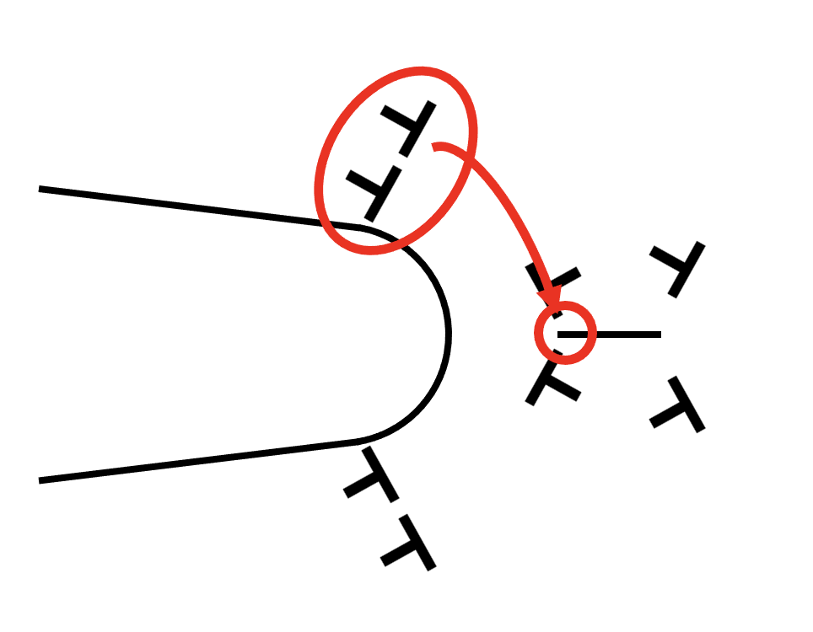
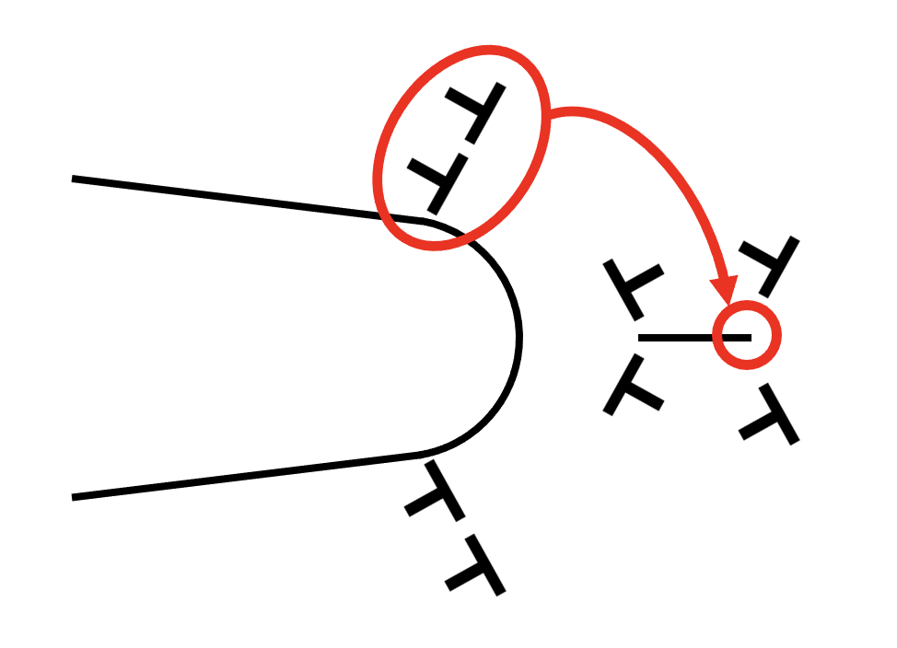

Temperature $T$
At high temperature, microcrack is not subjected to strong tension from
dislocations emitted from macrocrack

Slide 16
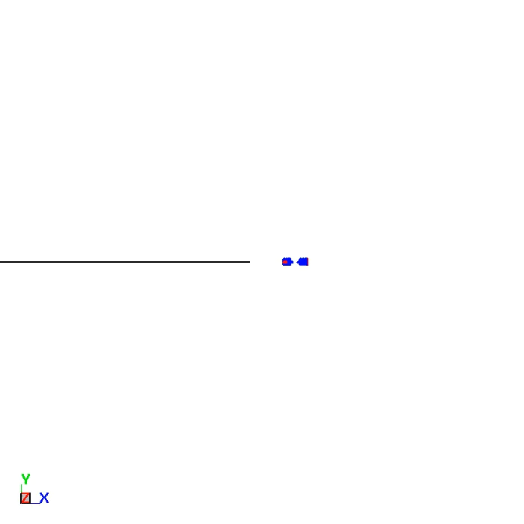
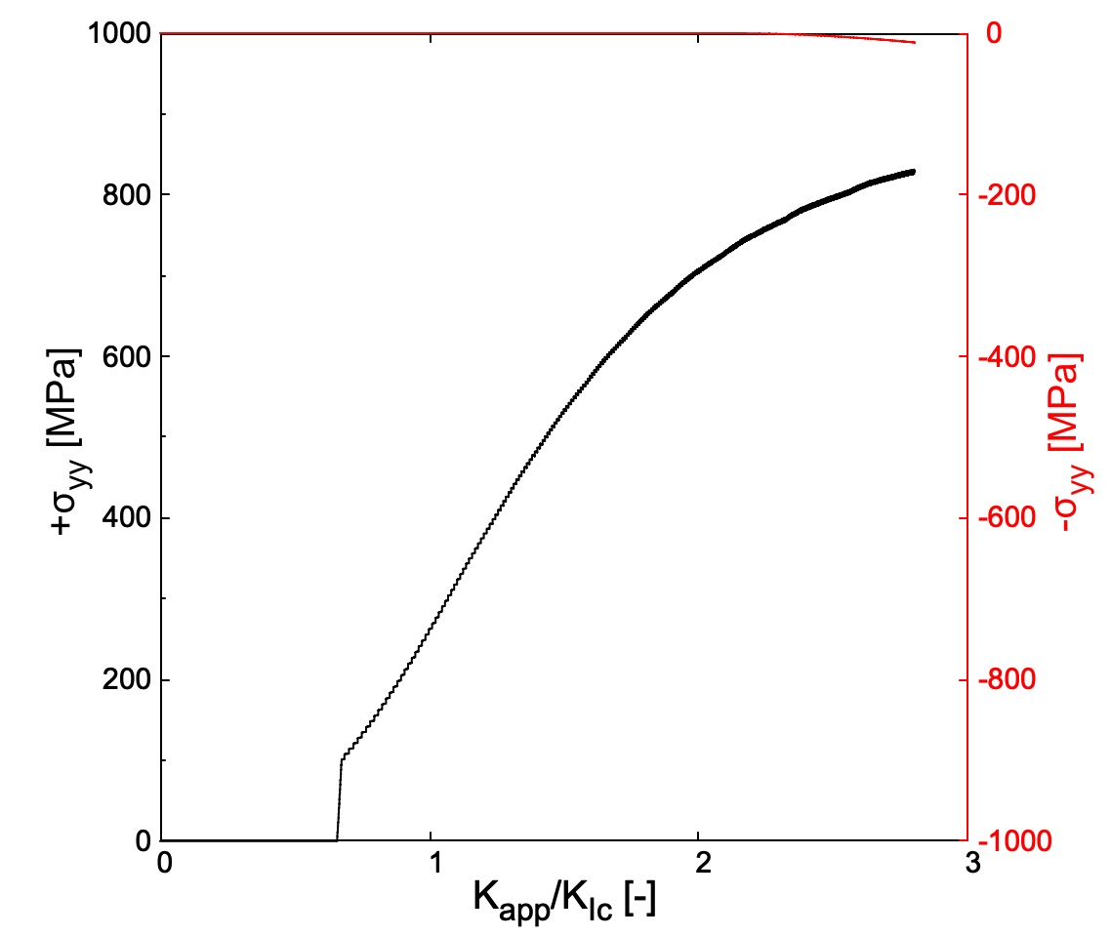
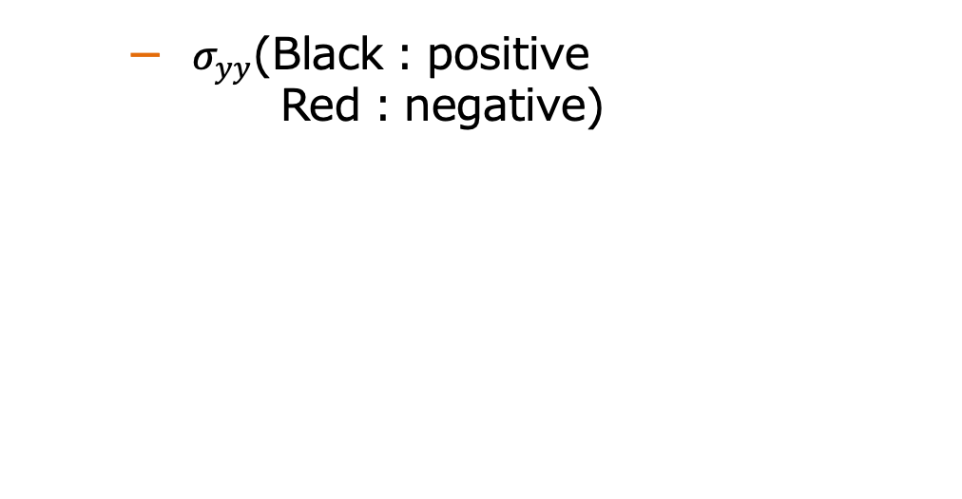
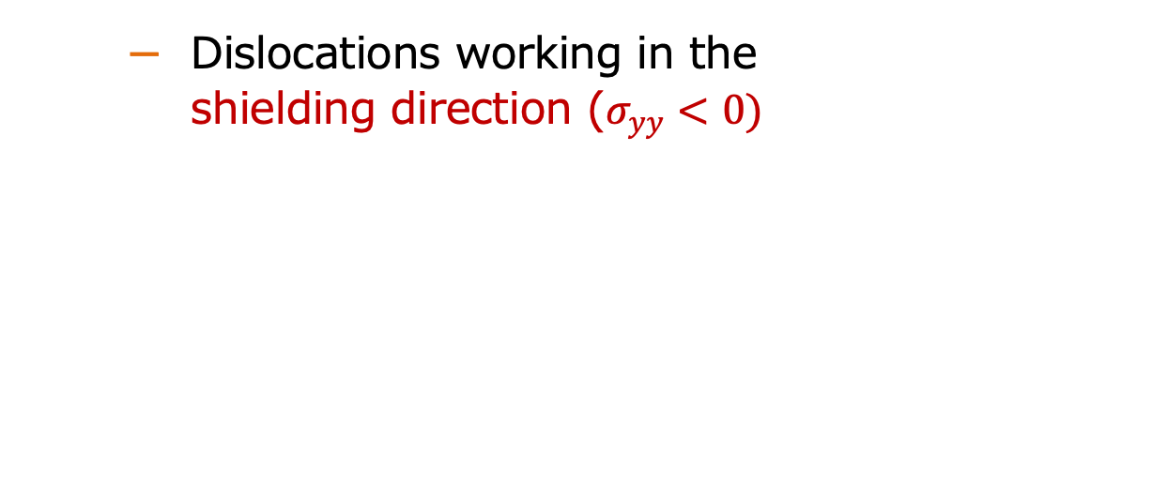

Temperature $<T=93 K>$
Effects from dislocations emitted from macrocrack
    Dislocations working in the
    shielding direction ($σ_{yy}<0)$
    $σ_{yy}$(Black：positive
    Red：negative)

Slide 17
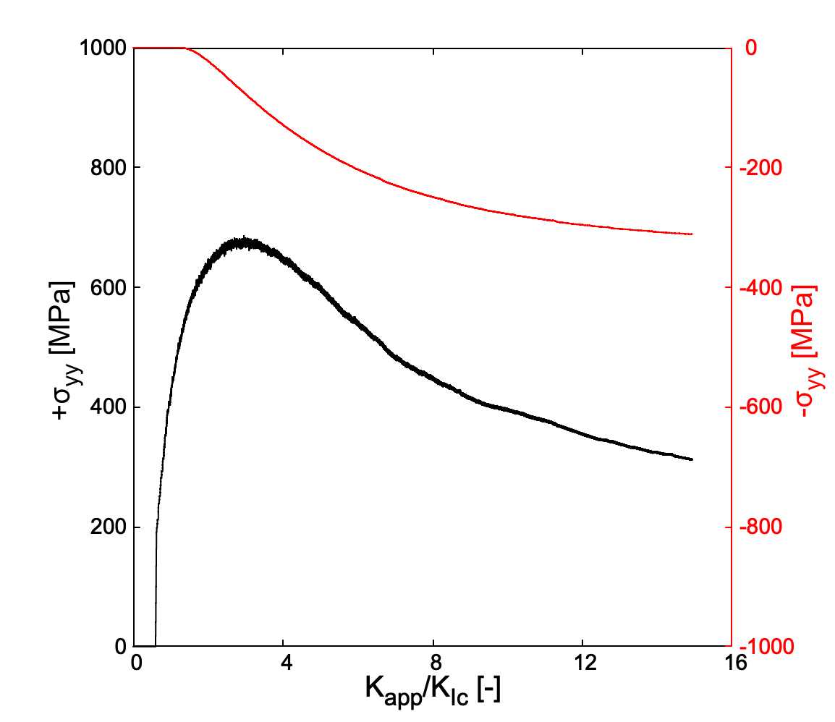
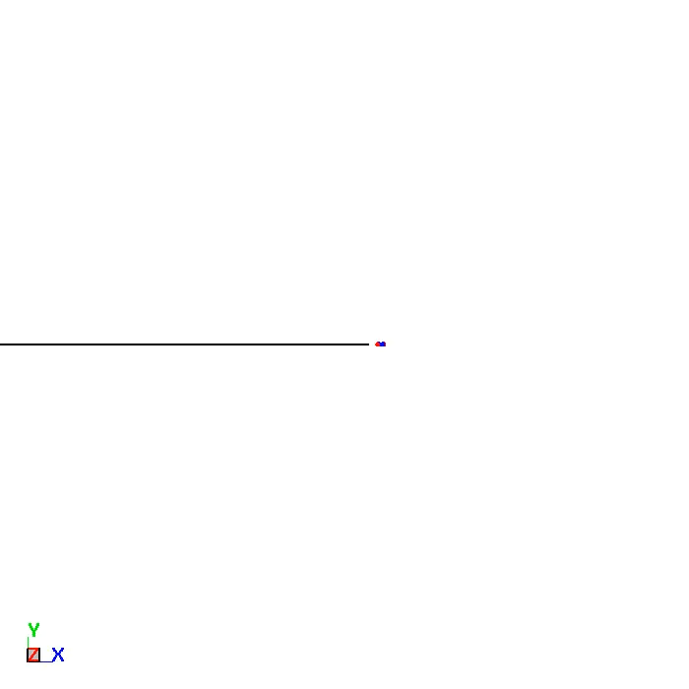
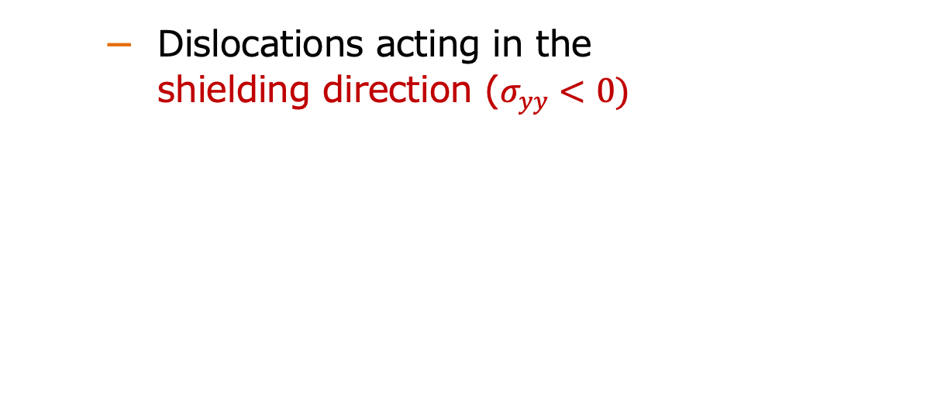

Temperature $<T=213 K>$
Effects from dislocations emitted from macrocrack
    Dislocations acting in the
    shielding direction ($σ_{yy}<0)$
    $σ_{yy}$(Black：positive
    Red：negative)
Dislocations acting in the
shielding direction increase

Slide 18
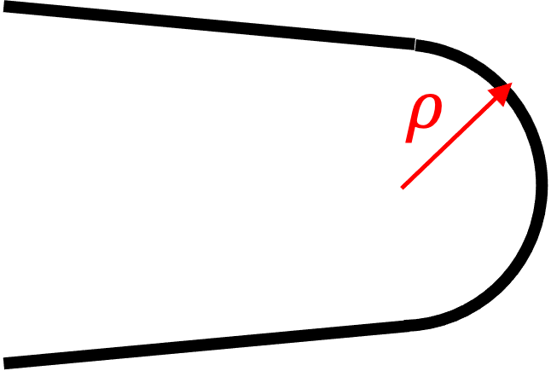

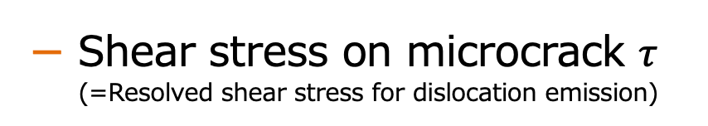


Temperature $T$
Effects from the macrocrack
    Shear stress on microcrack $τ$
    (=Resolved shear stress for dislocation emission)
    Blunting amount $ρ$
High temperature
macrocrack blunted rapidly
Blunted
macrocrack-tip
increase $τ$
    Blunting of the macrocrack-tip causes numerous dislocations to be emitted from the microcrack-tip

Slide 19

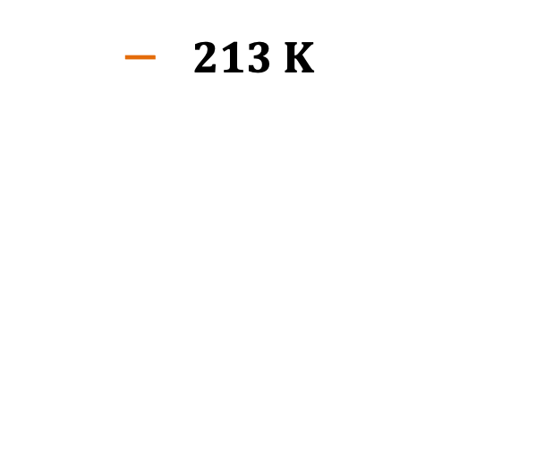

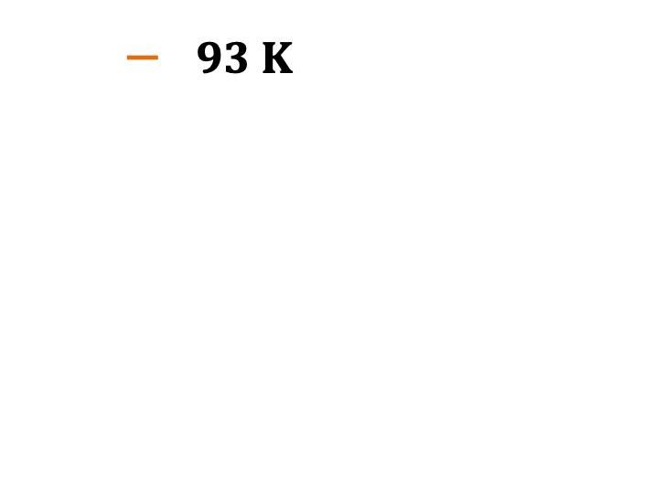
Temperature $T$
：Far dislocation emitted
：Near dislocation emitted
$τ$ at microcrack-tip
：$τ={2τ}_{f}$
    $93 K$
    $213 K$
Same range
Same range
    At high temperature, dislocations are emitted easily

Slide 20








Main factors that shift the type of fracture
Crack length $2a$
$$2a=1.0 μm$$
$$2a=1.0 μm$$
$$2a=3.0 μm$$
$2a$
$$2a=3.0 μm$$
    Dislocations emitted from far side microcrack-tip shield the near side microcrack-tip
    Larger cracks have less
    this shielding effect
$2a$

Slide 21




Crack length $2a$
The macrocrack and dislocations emitted from macrocrack have little effect on the fracture

Slide 22

Crack length $2a$
The effect of dislocations emitted microcrack-tip far side from macrocrack is strong

Slide 23


Crack length $2a$
Effect of dislocations emitted from
microcrack on crack-tip
    $2a=1.0$
    $2a=3.0$
The shielding effect decreases as the crack size increases

Slide 24









Main factors that shift the type of fracture
Crack position $X_{near}$
$$X_{near}=1.0 μm$$
$$X_{near}=1.0 μm$$
$$X_{near}=3.0 μm$$
$$X_{near}$$
$$X_{near}=3.0 μm$$
    Cracks near the macrocrack are subjected to strong tension and fracture before dislocations emitted from microcrack-tip
    Cracks near the macrocrack,
    the ratio of shielding effect to load
    is small
$$X_{near}$$

Slide 25


Crack position $X_{near}$
    Microcrack near the macrocrack are subjected to strong tension

Slide 26




Crack position $X_{near}$
Effects from the macrocrack
    Shear stress on microcrack $τ$
$$X_{near}=1.0 μm$$
The macrocrack fracture
before it can sufficiently blunt
under strong tensile loading
Blunted
macrocrack-tip
increase $τ$
$$X_{near}=3.0 μm$$
The macrocrack becomes
sufficiently blunted and releases numerous dislocations from the microcrack

Slide 27

Conclusions
Coupled analysis was carried out for each
crack length, position, and temperature
  Three different fracture types were obtained
Fracture toughness and
transition temperatures were calculated
  Fracture toughness and transition temperature
  by assuming the conditions of a certain microcrack were obtained
Main factors that shift the type of fracture
  Temperature $T$
    Blunted macrocracks cause numerous dislocations to be emitted from microcrack-tip
    At high temperature, dislocations are emitted easily and macrocrack blunted more rapidly

Slide 28


Conclusions
  Crack length $2a$
    Dislocations emitted from far side microcrack-tip shield the near side microcrack-tip
    Larger cracks have less this shielding effect
  Crack position $X_{near}$
    Cracks near the macrocrack are subjected to strong tension and fracture before dislocations emitted from microcrack-tip
    Cracks near the macrocrack, the ratio of shielding effect to load is small
Future perspective
  Extension of microcracks to 3D models
  assuming cracking of carbide particles (penny-shaped crack)

Slide 29



Low-temperature embrittlement
[1] Tanaka, M., Sadamatsu, S.,
Journal of Materials Research,Vol 26, (2011)
[2] McMeeking, R.M. et.a, J. Mech. Phys. Solids 25, 1977
Brittle-Ductile Transition:BDT
  Transition to ductile or brittle
  with temperature change
  Rapid decrease in fracture
  toughness at lower than
  the transition temperature
Main factors of BDT
  Crack-dislocation interaction
  Crack blunting
[1]
[2]

Slide 30







Crack-dislocation interaction
Shielding effect
[1] Tanaka, M., Tarleton, E. and Roberts,S.G., Acta Materialia, Vol.56 (2008), pp.5123-5129.
$$σ_{yy}$$
Total stress field
External stress
Emitted Dislocation
=
+
    $K_{tip}:$Stress intensity factor at crack-tip
    $K_{app}$:Stress intensity factor due to external stress
    $K_{dis}$:Stress intensity factor due to emitted dislocations (-)
[1]
$$K_{tip}=K_{app}+K_{dis}$$
Shielding effect reduces stress concentration at crack tip
BDT occurs at temperature where cleavage fracture does not occur

Slide 31



Crack-tip blunting
[1] X.H. Zeng. et al,Acta Materialia , 2009
[1]
Blunting process
Dislocations are emitted from the crack-tip
Emitted dislocations become part of the crack-tip
Crack-tip spread with curvature
Blunted cracks have high fracture toughness
Microcracks fracture first and combine with macrocracks
to progressively fracture

Slide 32


Macrocrack model
[1] McMeeking, R.M. et.al, J. Mech. Phys. Solids 25, 1977
[1]
Representation of crack-tip blunting
  Radius of curvature
Stress field near macrocrack tip
𝜌=𝑁𝑏𝑠𝑖𝑛𝛼
$N$ : Number of dislocations
$b$ : Burgers vector
$θ$ : Slip-plane angle
[6]
$$σ_{xx}= \frac{K_{app}}{\sqrt{2πr}}cos\frac{θ}{2}\left(1−sin\frac{θ}{2}sin\frac{3}{2}θ\right) −\frac{K_{app}}{\sqrt{2πr}} \frac{ρ}{2r} cos\frac{3}{2}θ$$
$$σ_{yy}= \frac{K_{app}}{\sqrt{2πr}}cos\frac{θ}{2}\left(1+sin\frac{θ}{2}sin\frac{3}{2}θ\right) +\frac{K_{app}}{\sqrt{2πr}} \frac{ρ}{2r} cos\frac{3}{2}θ$$
$$σ_{xy}= \frac{K_{app}}{\sqrt{2πr}}sin\frac{θ}{2}cos\frac{θ}{2}cos\frac{3}{2}θ +\frac{K_{app}}{\sqrt{2πr}} \frac{ρ}{2r} sin\frac{3}{2}θ$$

Slide 33







Temperature dependence of dislocation
Dislocation emitted conditions
$$τ_{f}=\frac{σ_{y}}{2}$$
$$τ>2τ_{f}$$
$τ$ : Shear stress
at dislocation source
Velocity of dislocations
$$v= \left(\frac{\left|τ\right|−τ_{f}}{\left|τ\right|}\right){\left(\left|τ\right|\right)}^{m}Aexp\left(\frac{−E_{a}}{kT}\right)$$
$$m={400}/T−1.2$$
$$A=3.14×{10}^{−4} m/{{s(MPa)}^{−m}}$$
$E_{a}=0.316$ $eV$
$$k=8.617×{10}^{−5} {eV}/K$$
$$\left|τ\right|< τ_{f}→v=0$$

Slide 34














Microcrack model
Creation of crack surface and calculation of stress intensity factor
$$σ_{app}$$
$$σ_{y}^{D_{i}}$$
Creation of crack surface
$$σ_{y}= σ_{app}+\sum_{i}{σ_{y}^{D_{i}}}$$
$2a$ : Crack length
$σ_{y}^{D_{i}}$: Stress of crack
dislocations
Condition on crack surface： $σ_{y}=0$
$$y$$
：Move to a balanced position
$$2a$$
：Fixed dislocation (crack-tip)
$$z$$
$$x$$
Calculation of stress intensity factor
$$K_{tip}=\sqrt{\frac{2μF_{x}}{1−ν}}$$
Determination of facture
$$K_{tip }=K_{Ic}$$
$$K_{Ic}=\sqrt{\frac{4μγ}{1−ν}}$$
$F_{x}$:Peach-Koehler force
at crack-tip
$μ$ : Shear modulus
$ν$ : Poisson’s ratio
Fracture begins
$K_{Ic}$ : Critical value
$γ$ : Surface energy

Slide 35



Crack position $X_{near}$
Effects from the macrocrack
    $σ_{yy}$
    $τ$
Blunted
macrocrack-tip
increase $τ$

Slide 36

Crack position $X_{near}$

Slide 37


Crack position $X_{near}$
：Far dislocation emitted
：Near dislocation emitted
Shear stress in microcrack
  Dislocation source on the near side from the macrocrack
：$τ={2τ}_{f}$
    $X_{near}=1.0$
    $X_{near}=3.0$

Slide 38
Crack position $X_{near}$
：Far dislocation emitted
：Near dislocation emitted
Shear stress in microcrack
  Dislocation source on the far side from the macrocrack
：$τ={2τ}_{f}$
    $X_{near}=1.0$
    $X_{near}=3.0$

Slide 39


Crack position $X_{near}$
Stresses exerted by dislocation emitted from macrocrack on microcrack
    $σ_{yy}$
    $τ$

Slide 40
Temperature $T$
Stresses exerted by dislocation emitted from macrocrack on microcrack
    $σ_{yy}$
    $τ$

Slide 41
Temperature $T$
：Far dislocation emitted
：Near dislocation emitted
Shear stress in microcrack
  Dislocation source on the far side from the macrocrack
：$τ={2τ}_{f}$
    $93 K$
    $213 K$

Slide 42

Temperature $T$

Slide 43




Crack position $<X_{near}=1.0 μm>$
Effects from dislocations emitted from macrocrack
    Dislocations working in the
    shielding direction ($σ_{yy}<0)$
    $σ_{yy}$(Black：positive
    Red：negative)

Slide 44



Crack position $<X_{near}=3.0 μm>$
Effects from dislocations emitted from macrocrack
    Dislocations working in the
    shielding direction ($σ_{yy}<0)$
    $σ_{yy}$(Black：positive
    Red：negative)
Dislocations acting in the
shielding direction increase

Slide 45


Crack position $X_{near}$
$$σ_{app}=σ_{yy}^{macrocrack}+σ_{yy}^{macro dislocations}$$
σ_{app} [MPa]
σ_{app} [MPa]
    When microcrack is far away from macrocrack,
    the ratio of shielding effect to load is large

