Slide 1
How are crime rates affected by size of population?
Lewis Lye Cheng See DIT/2B/23
[ST0248] Programming for Data Science CA2

Slide 2
Resources
Datasets
Mobile Data Usage
Usage of Mobile Devices for Media Activities
Overall Crime Cases & Crime Rate + Sorted by Crime Type
World Bank - Singapore Population from 2008
Desktop vs Mobile vs Tablet Market Share Singapore from 2008 to 2015
Libraries
Pandas (for handling datasets)
Numpy
PyMongo (for handling interactions with MongoDB
OS
Glob
Jupyter Notebook hosted here on MyBinder!

Slide 3
DESCRIBE EACH DATASETS
Datasets
Mobile Data Usage
Usage of Mobile Devices for Media Activities
Overall Crime Cases & Crime Rate + Sorted by Crime Type
World Bank - Singapore Population from 2008
Desktop vs Mobile vs Tablet Market Share Singapore from 2008 to 2015
Libraries
Pandas (for handling datasets)
Numpy
PyMongo (for handling interactions with MongoDB
OS
Glob
Jupyter Notebook hosted here on MyBinder!

Slide 4
Data Extraction and Storage
Extracting data from csv and storing into MongoDB

Slide 5
PROCESS
Reading of files with Pandas’ read_csv() function
Describe each dataset with .info()
Cleaning of data
Storing of data into MongoDB

Slide 6
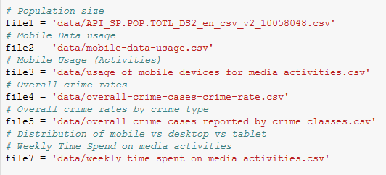
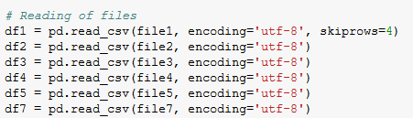
Reading of files

Slide 7
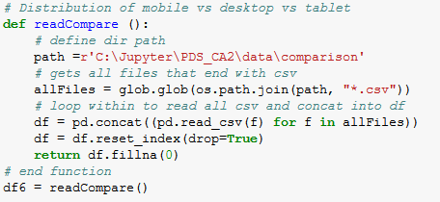
HIGHLIGHT

Slide 8
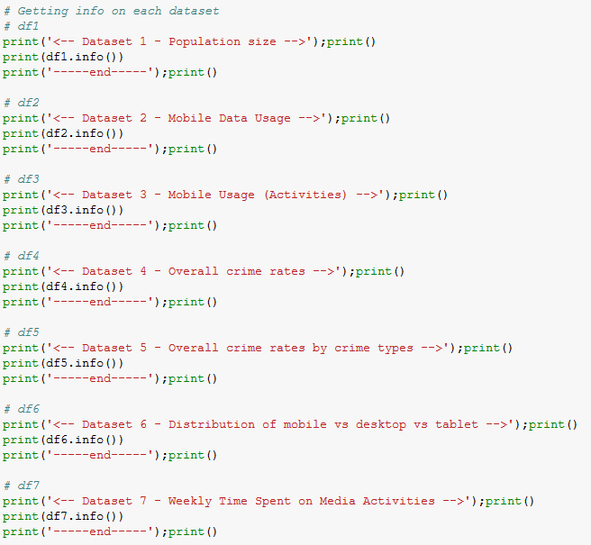
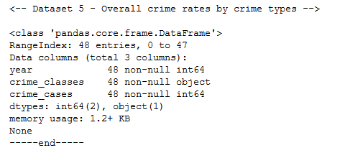
Describing datasets
Sample Output

Slide 9
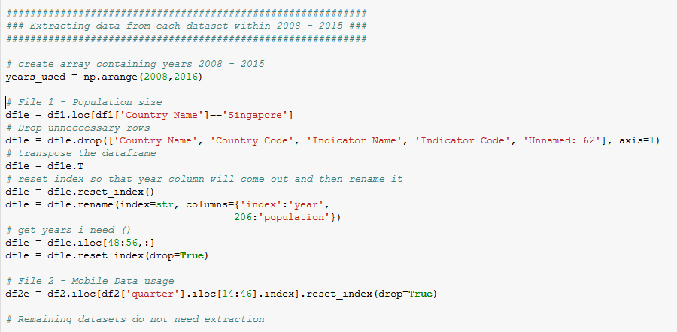
Cleaning data

Slide 10
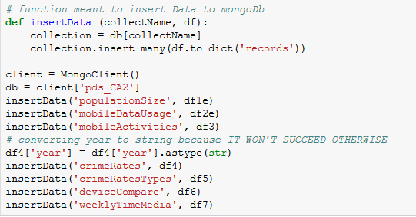
Storing data into MongoDB

Slide 11
Population Size
To find out how the population has been growing

Slide 12
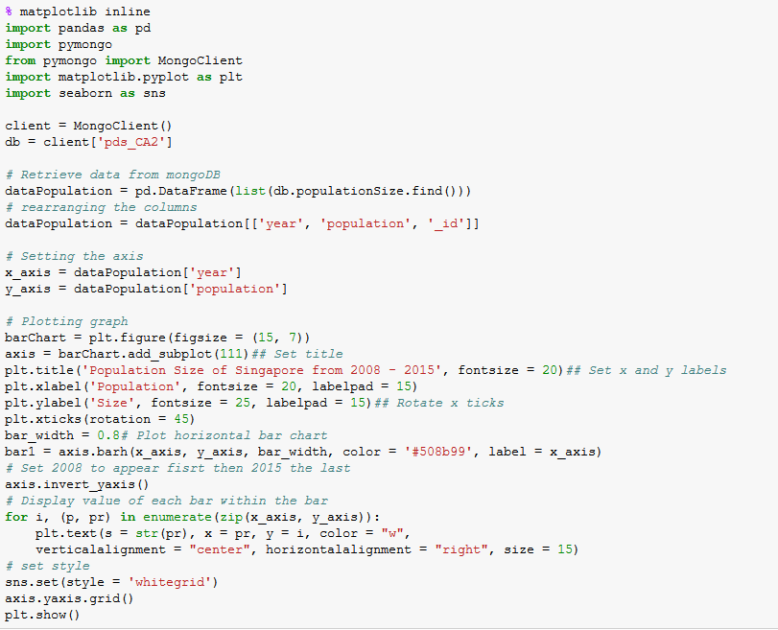
PROCESS

Slide 13
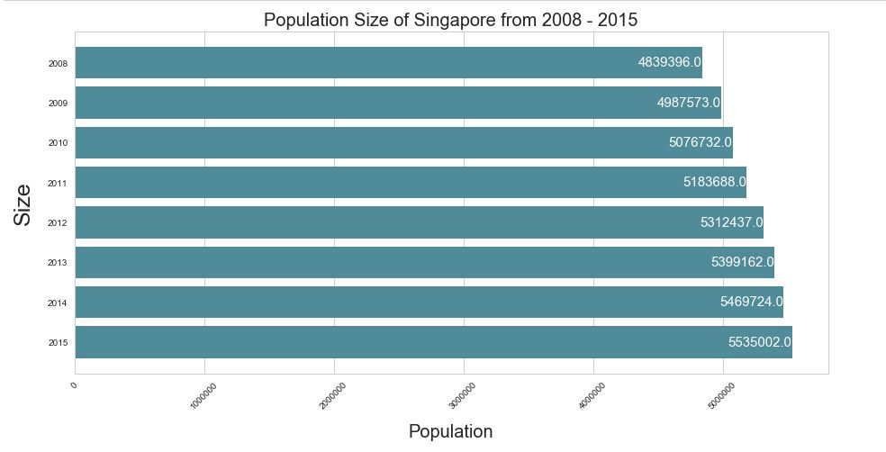
Plot

Slide 14
What does it mean?
Singapore’s population is growing

Slide 15
Total Recorded crime cases from 2008 - 2015
To observe the trend of crimes

Slide 16
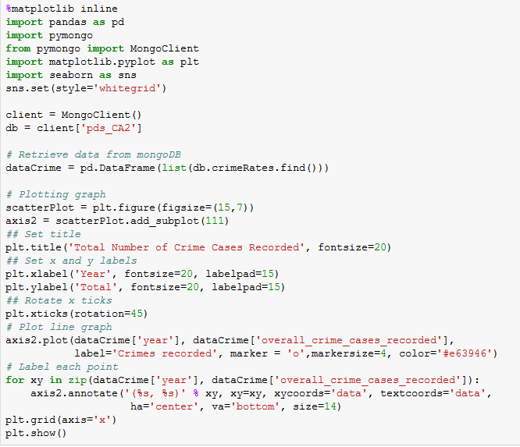
Process

Slide 17
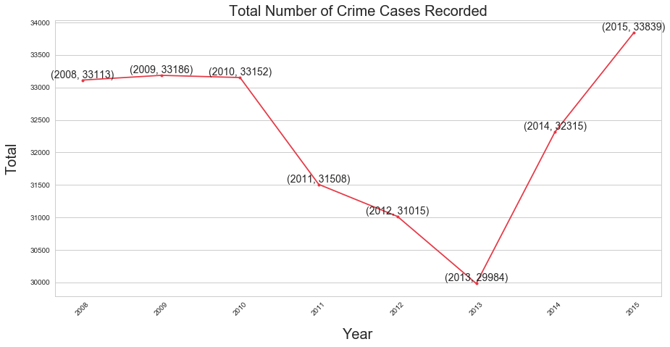
Plot

Slide 18
What does it mean?
Although there was a slight dip in crimes from 2011 to 2013
There was a sharp increase afterwards, that shot past previous years

Slide 19
Crime Rates from 2008 – 2015
To see if there is a correlation between an increase in population and crime rates

Slide 20
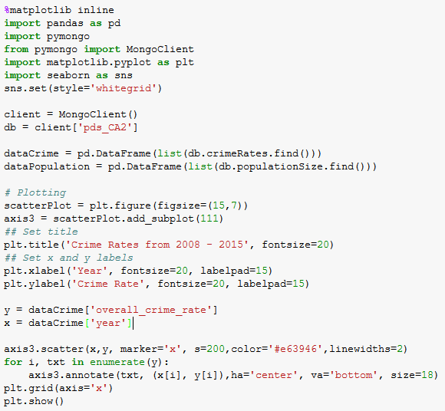
Process

Slide 21
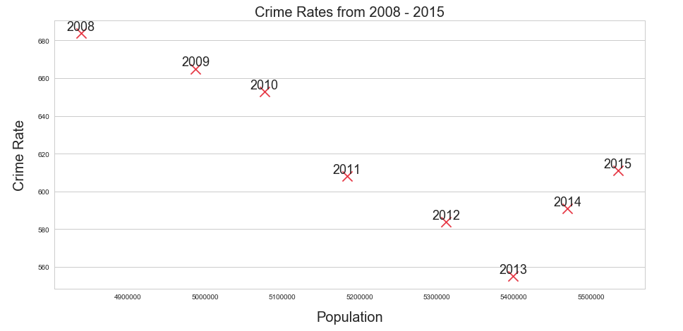
Plot

Slide 22
What does it mean?
There isn’t a correlation between population and crime rates
HOWEVER,
It is undeniable that crime is on a rise again
To find out why…

Slide 23
Recorded Crime Activities from 2008 – 2015
Observe how criminal activities have been moving
What is causing the rise?

Slide 24
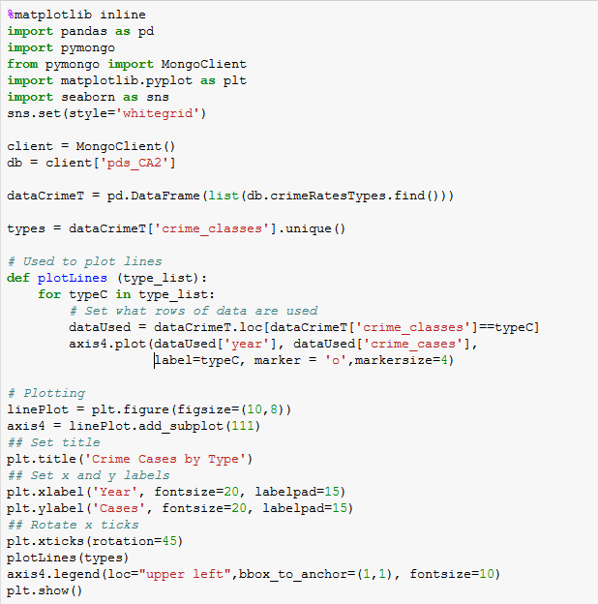
Process

Slide 25
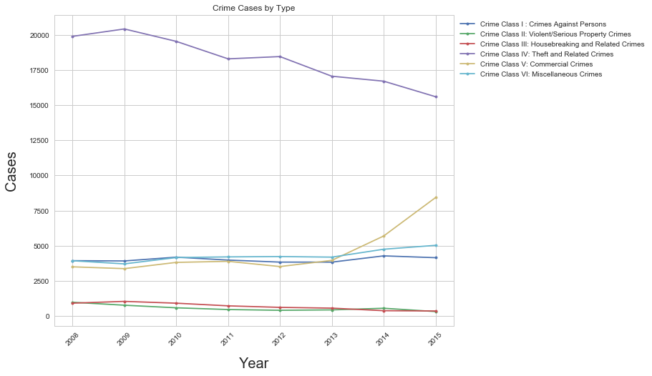
Plot

Slide 26
What does it mean?
Corresponding sharp increase in commercial crime at the same time the number of crimes recorded shoots up
Such crimes include
Pay-for-sex services
Internet Love scams
Based on an article here
Most are online based

Slide 27
Market Share of Devices from 2009 – 2015
To compare how market share of 3 device platforms (desktop, mobile, tablet) has been changing

Slide 28
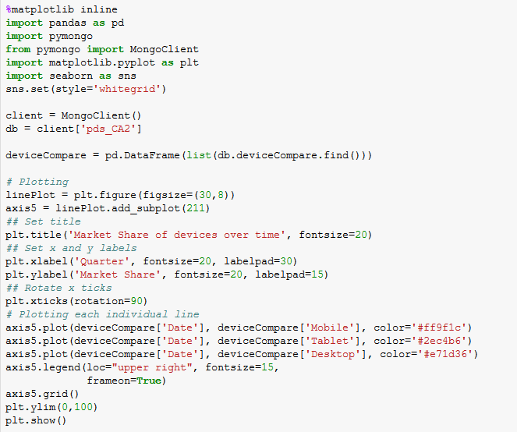
Process

Slide 29
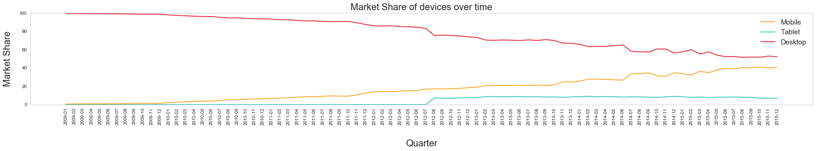
Plot 1

Slide 30
Plot 1 (zoomed)

Slide 31
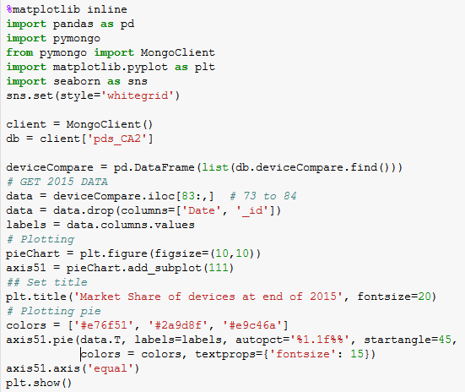
Process

Slide 32
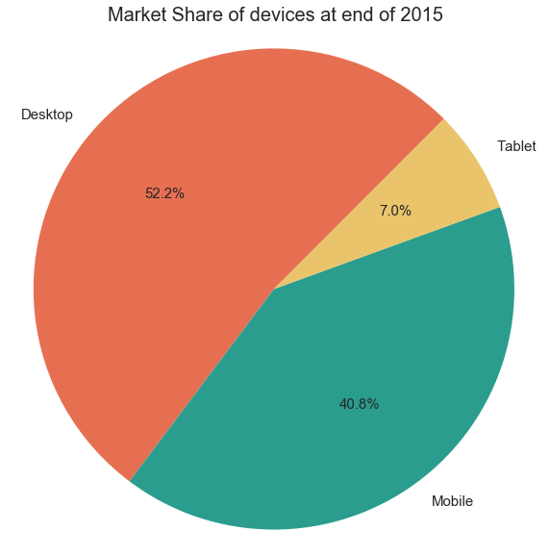
Plot 2

Slide 33
What does it mean?
Mobile shares has been increasing as years go on
Likely to overtake desktop shares
Note: Tablet shares are 0 at the start as data source only started recording them in August 2012
Therefore, focus on mobile platform

Slide 34
Mobile Data Usage 2008 – 2015
Observe trend of mobile data usage

Slide 35
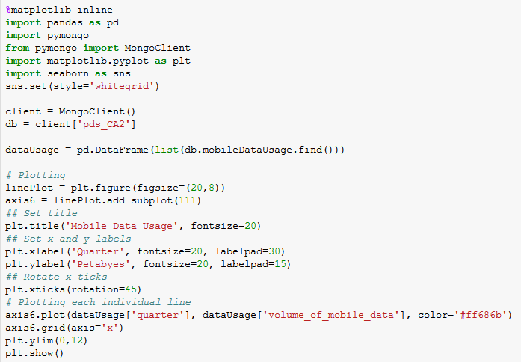
Process

Slide 36
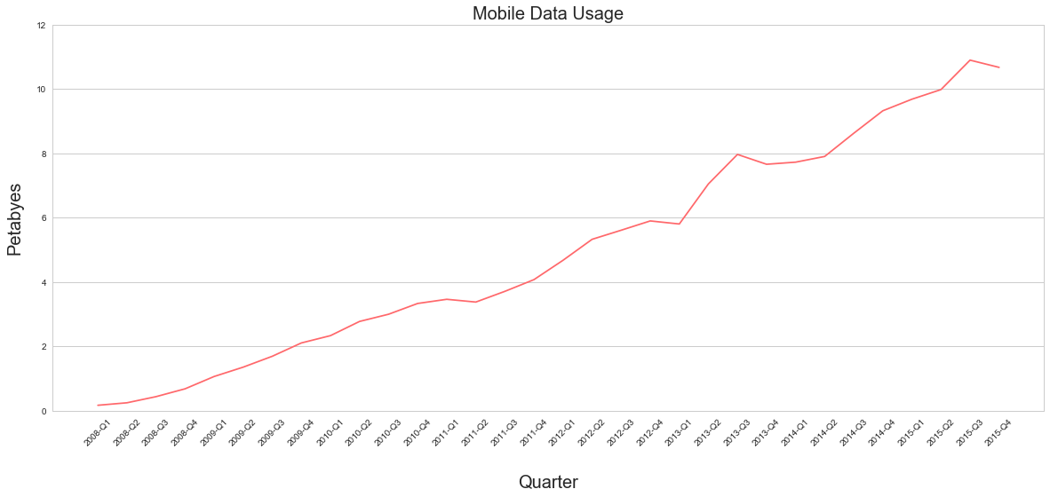
Plot

Slide 37
What does it mean?
There is a sharp increase between 2013 Q1 and Q2
Steady increase in mobile data usage
Could mean that people are spending more time online

Slide 38
Weekly time spent on Media Activities from 2011 – 2015
Learn how long Singaporeans spend on media activities (mobile)

Slide 39
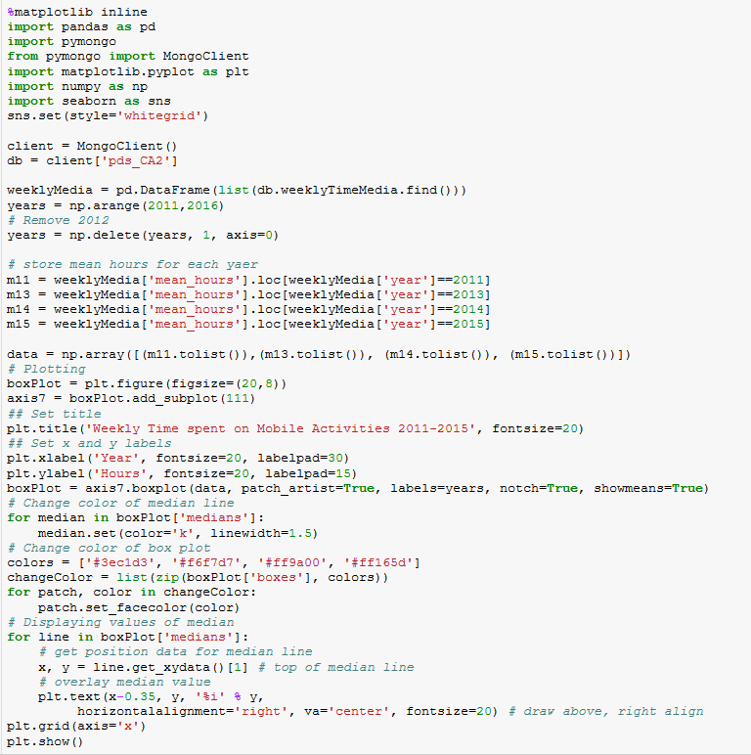
Process

Slide 40
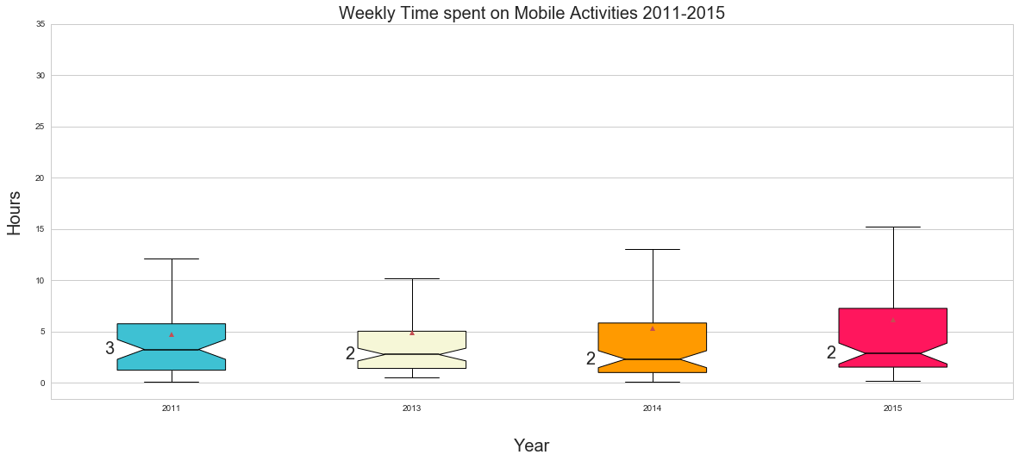
Plot

Slide 41
What does it mean?
Median is stable
However,
Max values are increasing to over 15 hours spent
IQR is increasing
Means that there is an increasing range of hours spent

Slide 42
Weekly time spent on Media Activities from 2011 – 2015
Observe frequency of data to get a clearer view

Slide 43
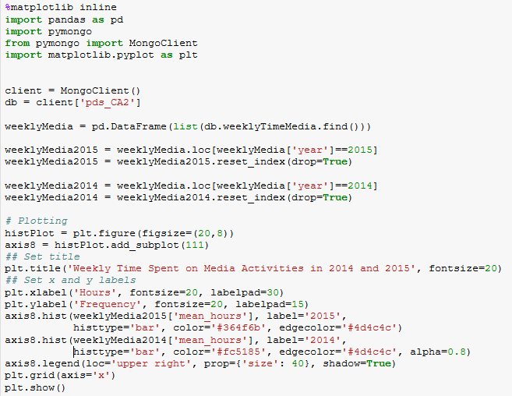
Process

Slide 44
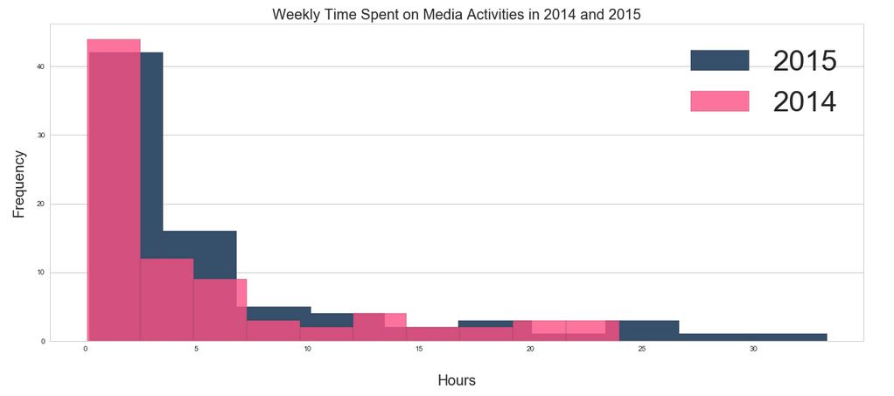
Plot

Slide 45
What does it mean?
From 2014 → 2015,
Range of hours spent has increased
People are spending more time on media activities
This might expose them to more threats online, such as scams

Slide 46
Conclusion
What did I learn from the datasets?

Slide 47
Conclusion
Although a larger population size does affect amount of crimes,
It is more accurate to say that as the amount of time spent online increases, the chances of getting involved in an online based commercial crime increases as well

Slide 48
What can be done?
Just as polytechnics have compulsory information literacy modules,
The government might want to invest in educating citizens on online scams more
i.e. teach in schools, make infographics
Current measures included police posters of crimes

Slide 49


Slide 50
THANKS!

