Slide 1
How are crime rates affected by size of population?
Lewis Lye Cheng See DIT/2B/23
[ST0248] Programming for Data Science CA2

Slide 2
Resources
Datasets
World Bank - Singapore Population from 2008
Mobile Data Usage
Usage of Mobile Devices for Media Activities
Overall Crime Cases & Crime Rate + Sorted by Crime Type
Desktop vs Mobile vs Tablet Market Share Singapore from 2008 to 2015
Weekly Time spent on Media Activities
Libraries
Pandas (for handling datasets)
Numpy
PyMongo (for handling interactions with MongoDB
OS
Glob
Jupyter Notebook hosted here on MyBinder!

Slide 3
World Bank – Singapore Population
Contains data on population size of numerous countries in the world from 1960 - 2017
Columns
Country Name
Country Code
Indicator Name
Indicator Code
59 Columns of years, 1960 – 2017
Rows : 264

Slide 4
Mobile Data Usage
Contains data on mobile data usage (in petabytes) from 2008 – 2015
Columns
Quarter
Volume of Mobile Data
Rows : 53

Slide 5
Usage of Mobile Devices for Media Activities
Contains data on media activities engaged by those surveyed
Columns
Year
Age Range
Activity
Sample Size
Ever Used
Rows : 234

Slide 6
Usage of Mobile Devices for Media Activities
Contains data on media activities engaged by those surveyed
Columns
Year
Age Range
Activity
Sample Size
Ever Used
Rows : 234

Slide 7
Desktop vs Mobile vs Tablet Market Share Singapore from 2008 to 2015
Contains data on market share of the 3 platforms
Merged multiple datasets together
Columns
Month
Desktop
Mobile
Tablet
Rows : 84

Slide 8
Weekly Time Spent on Media Activities
Contains data similar to Usage of Mobile Devices, but has mean hours spent instead
Columns
Year
Age Range
Media Activity
Sample Size
Mean Hours
Rows : 300

Slide 9
Data Extraction and Storage
Extracting data from csv and storing into MongoDB

Slide 10
PROCESS
Reading of files with Pandas’ read_csv() function
Describe each dataset with .info()
Cleaning of data
Storing of data into MongoDB

Slide 11
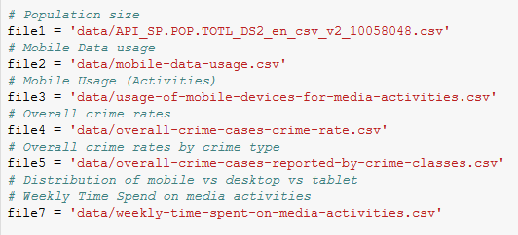
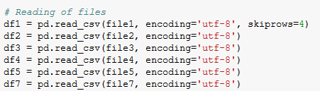
Reading of files

Slide 12
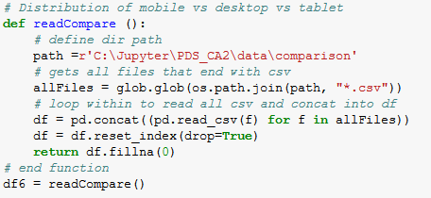
HIGHLIGHT

Slide 13
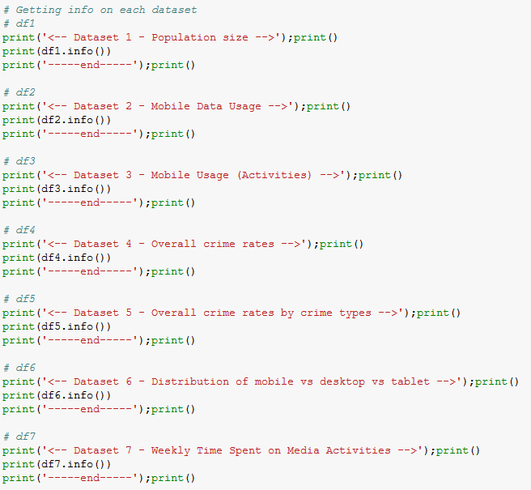
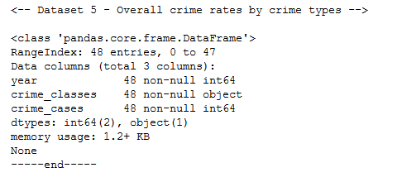
Describing datasets
Sample Output

Slide 14
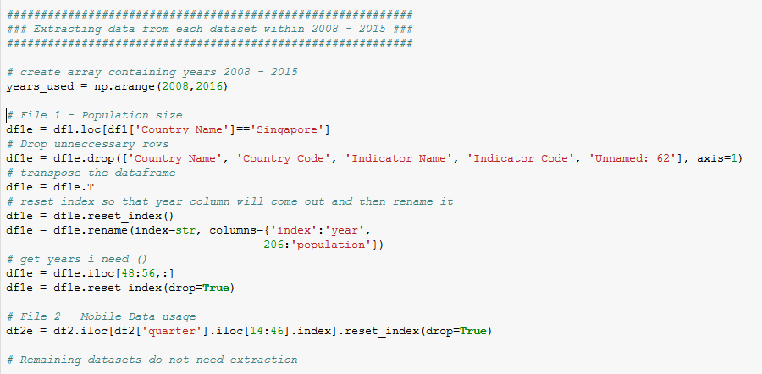
Cleaning data

Slide 15
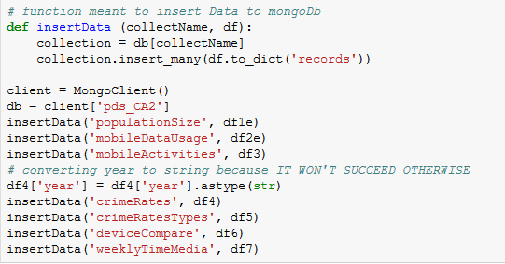
Storing data into MongoDB

Slide 16
Population Size
To find out how the population has been growing

Slide 17
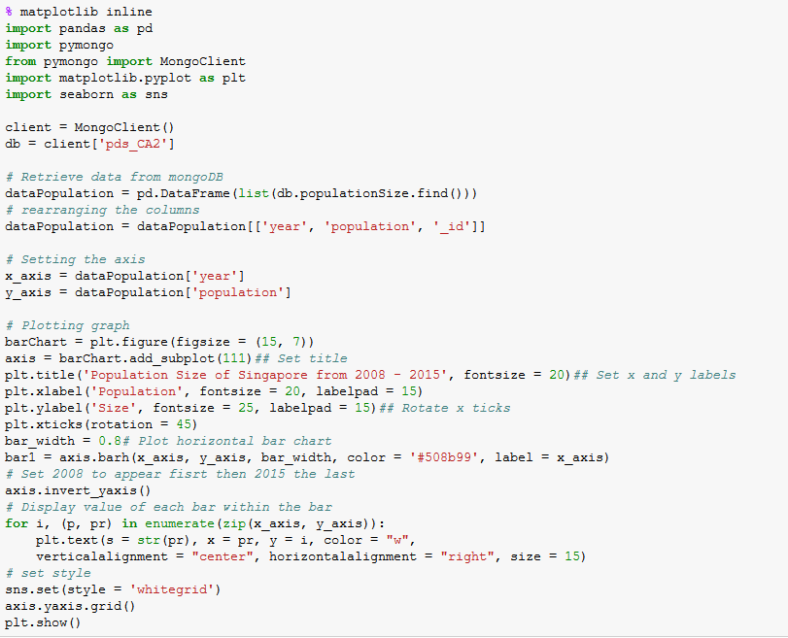
PROCESS

Slide 18
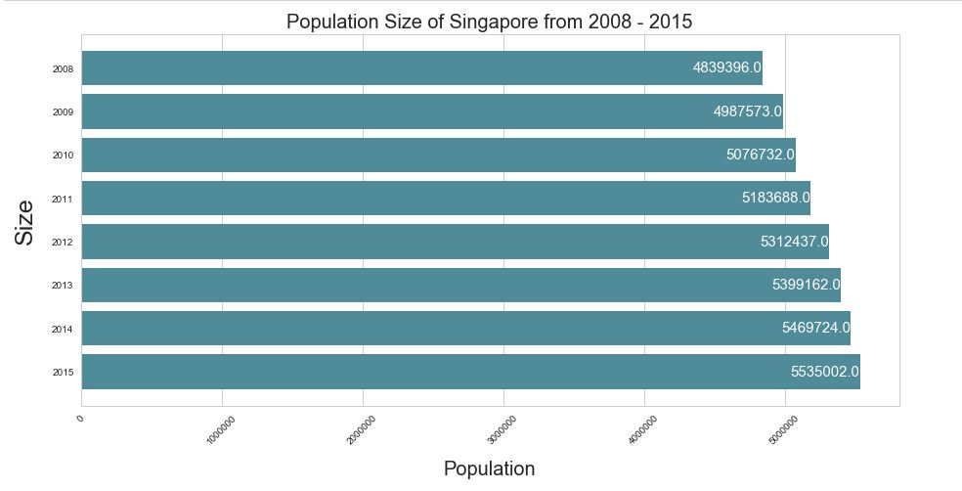
Plot

Slide 19
What does it mean?
Singapore’s population is growing

Slide 20
Total Recorded crime cases from 2008 - 2015
To observe the trend of crimes

Slide 21
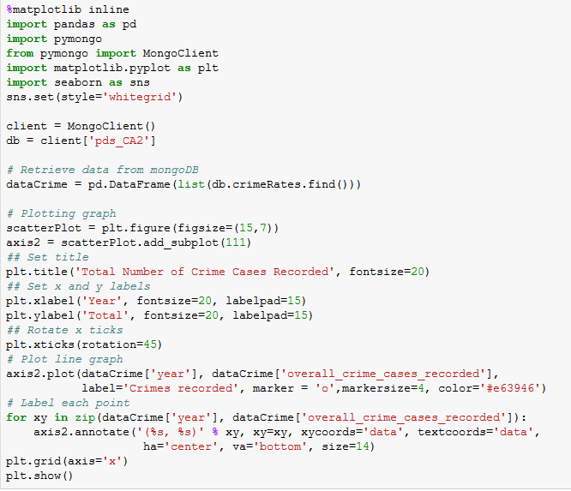
Process

Slide 22
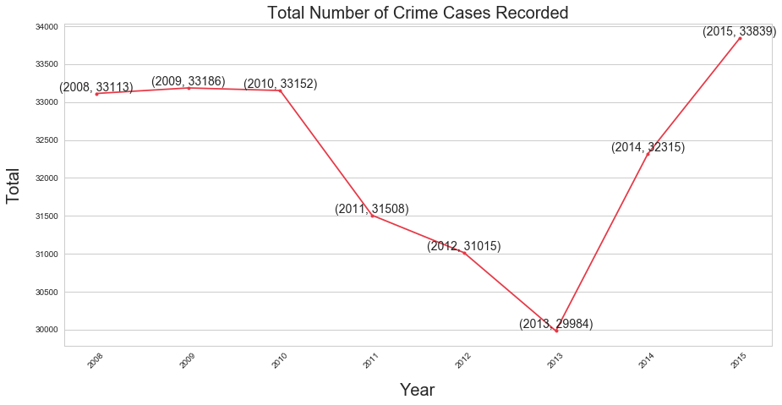
Plot

Slide 23
What does it mean?
Although there was a slight dip in crimes from 2011 to 2013
There was a sharp increase afterwards, that shot past previous years

Slide 24
Crime Rates from 2008 – 2015
To see if there is a correlation between an increase in population and crime rates

Slide 25
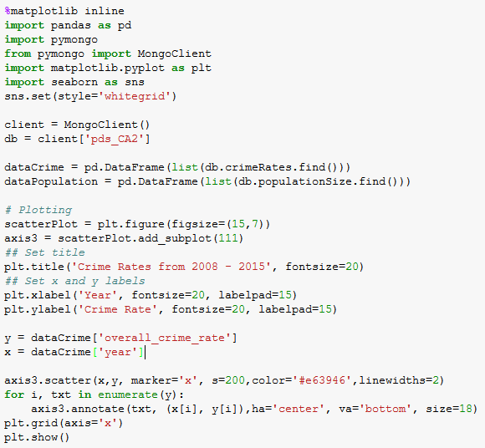
Process

Slide 26
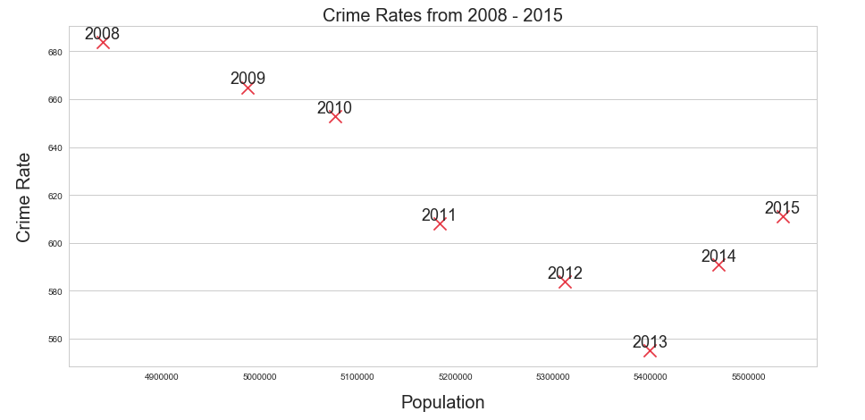
Plot

Slide 27
What does it mean?
There isn’t a correlation between population and crime rates
HOWEVER,
It is undeniable that crime is on a rise again
To find out why…

Slide 28
Recorded Crime Activities from 2008 – 2015
Observe how criminal activities have been moving
What is causing the rise?

Slide 29
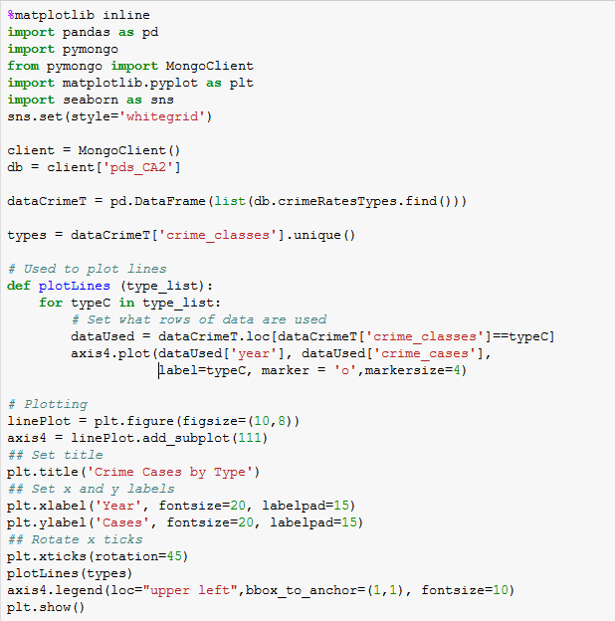
Process

Slide 30
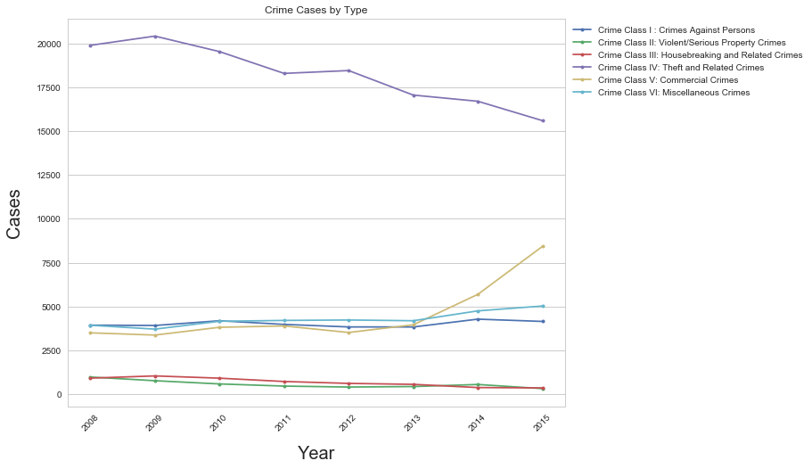
Plot

Slide 31
What does it mean?
Corresponding sharp increase in commercial crime at the same time the number of crimes recorded shoots up
Such crimes include
Pay-for-sex services
Internet Love scams
Based on an article here
Most are online based

Slide 32
Market Share of Devices from 2009 – 2015
To compare how market share of 3 device platforms (desktop, mobile, tablet) has been changing

Slide 33
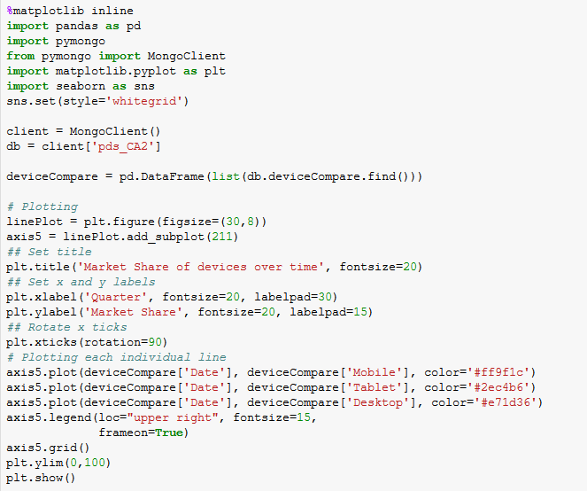
Process

Slide 34
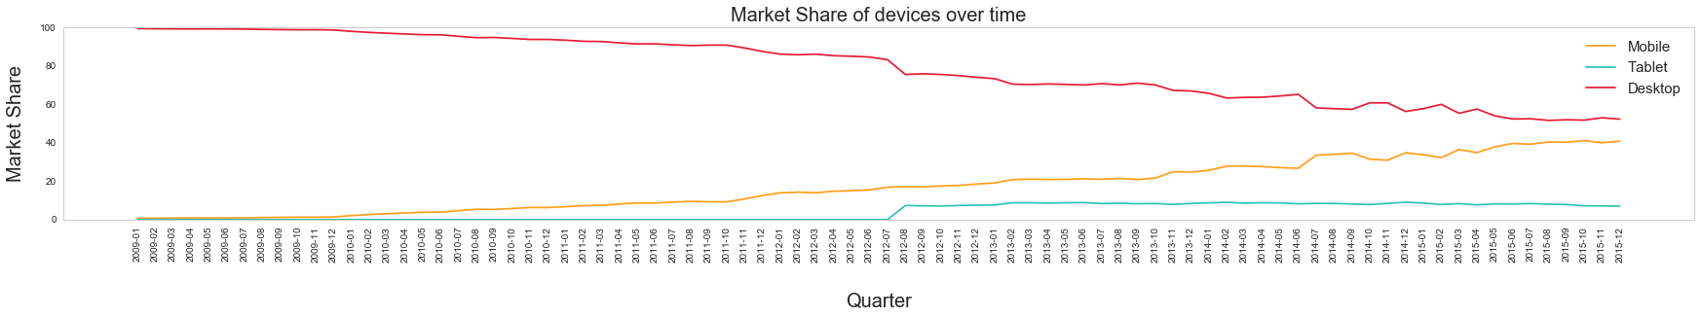
Plot 1

Slide 35
Plot 1 (zoomed)

Slide 36
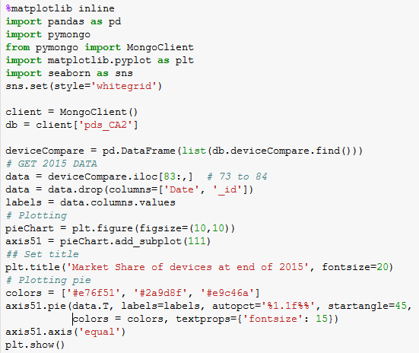
Process

Slide 37
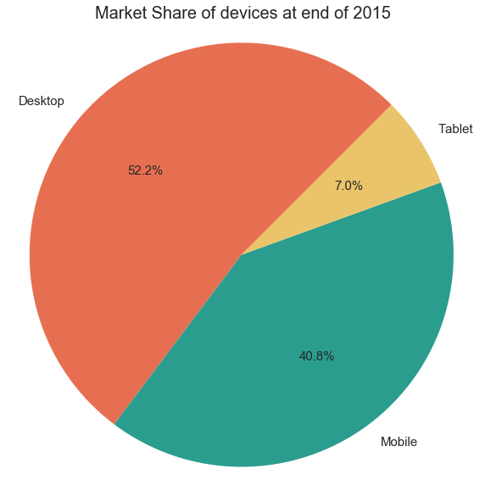
Plot 2

Slide 38
What does it mean?
Mobile shares has been increasing as years go on
Likely to overtake desktop shares
Note: Tablet shares are 0 at the start as data source only started recording them in August 2012
Therefore, focus on mobile platform

Slide 39
Mobile Data Usage 2008 – 2015
Observe trend of mobile data usage

Slide 40
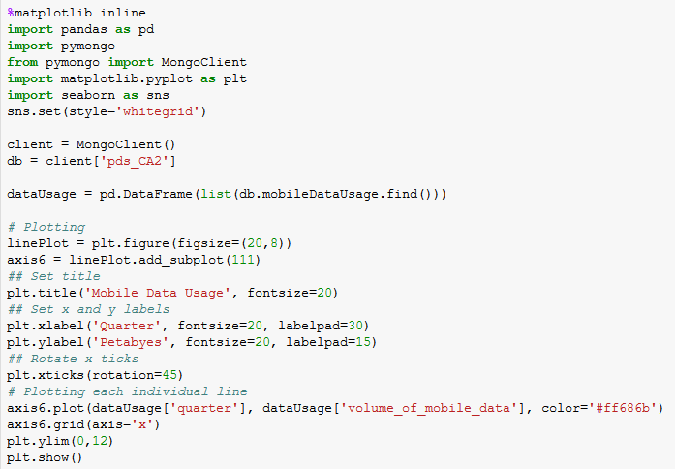
Process

Slide 41
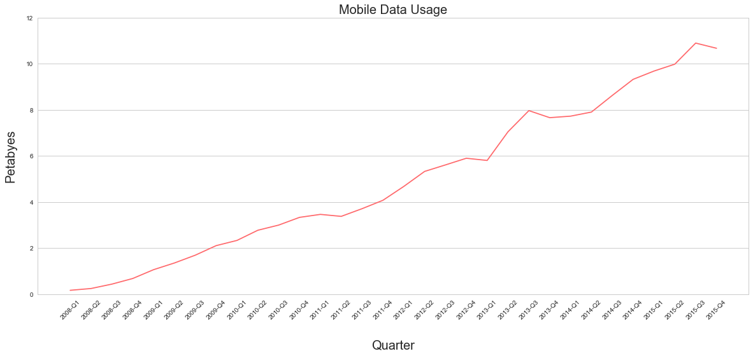
Plot

Slide 42
What does it mean?
There is a sharp increase between 2013 Q1 and Q2
Steady increase in mobile data usage
Could mean that people are spending more time online

Slide 43
Weekly time spent on Media Activities from 2011 – 2015
Learn how long Singaporeans spend on media activities (mobile)

Slide 44
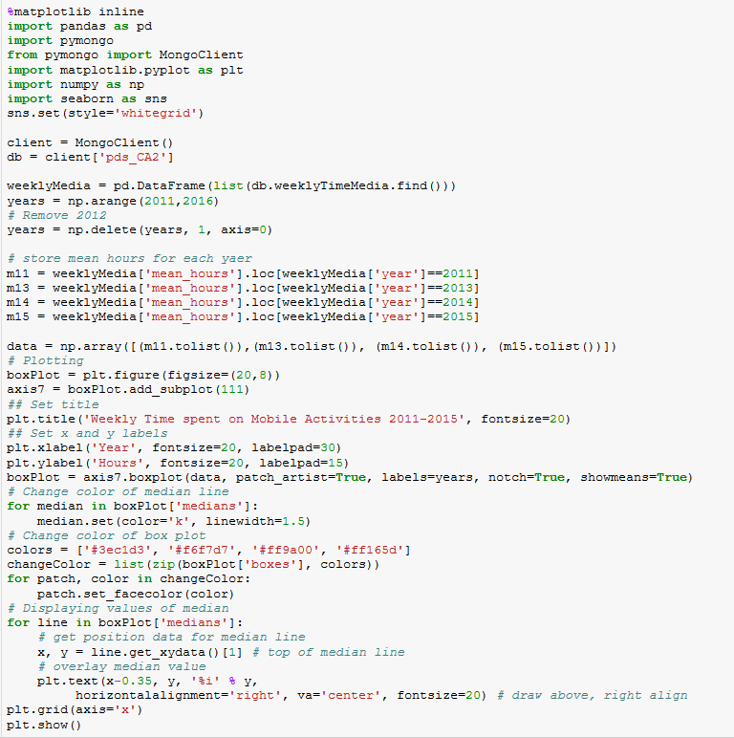
Process

Slide 45
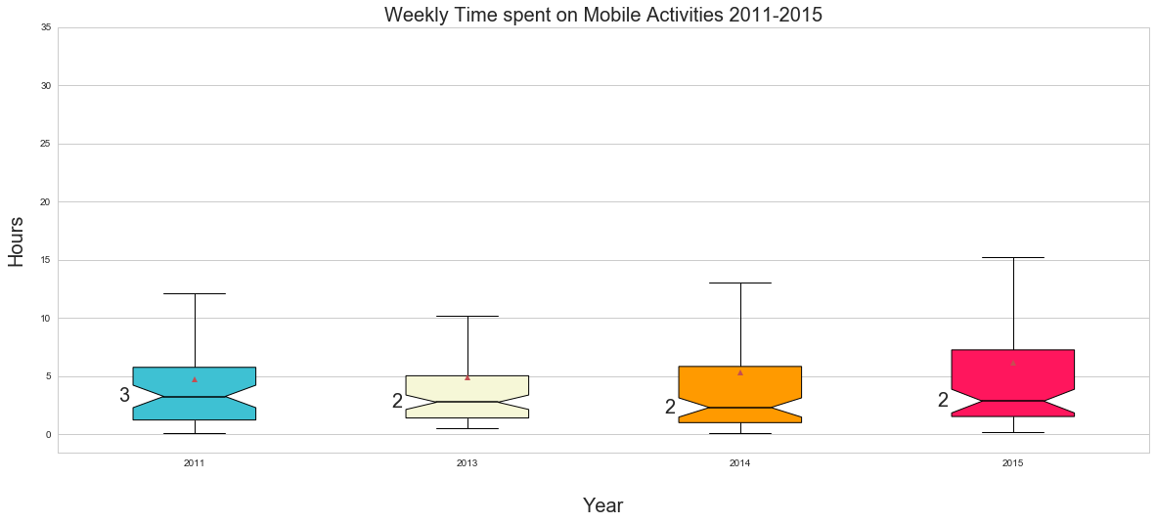
Plot

Slide 46
What does it mean?
Median is stable
However,
Max values are increasing to over 15 hours spent
IQR is increasing
Means that there is an increasing range of hours spent

Slide 47
Weekly time spent on Media Activities from 2011 – 2015
Observe frequency of data to get a clearer view

Slide 48
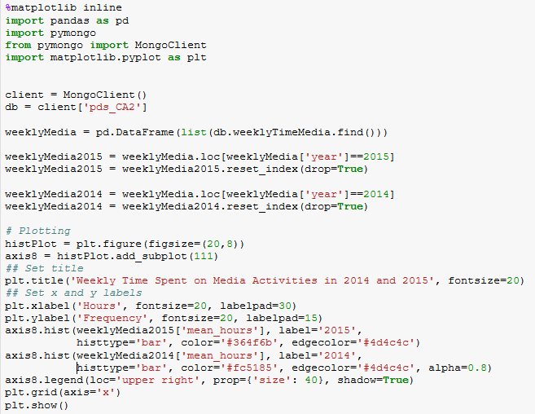
Process

Slide 49
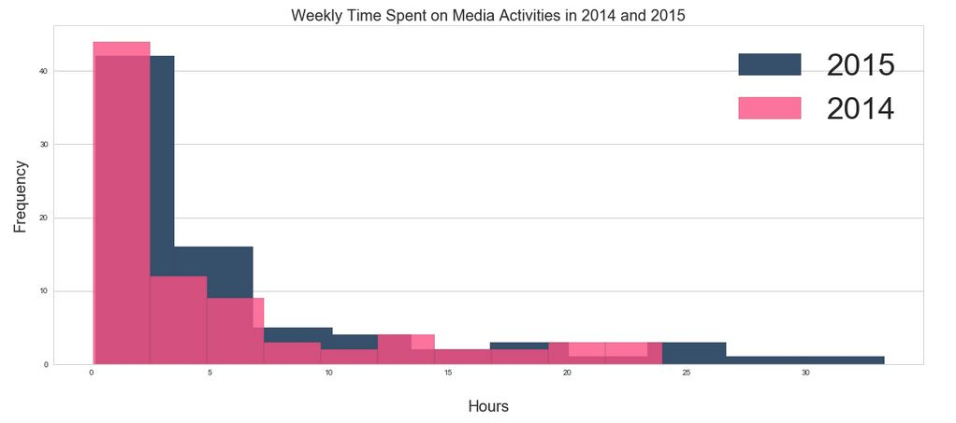
Plot

Slide 50
What does it mean?
From 2014 → 2015,
Range of hours spent has increased
People are spending more time on media activities
This might expose them to more threats online, such as scams

Slide 51
Conclusion
What did I learn from the datasets?

Slide 52
Conclusion
Although a larger population size does affect amount of crimes,
It is more accurate to say that as the amount of time spent online increases, the chances of getting involved in an online based commercial crime increases as well

Slide 53
What can be done?
Just as polytechnics have compulsory information literacy modules,
The government might want to invest in educating citizens on online scams more
i.e. teach in schools, make infographics
Current measures included police posters of crimes

Slide 54


Slide 55
THANKS!

