Slide 1
Predictive Life Expectancy Model
Submitted by:
Anujit Ghosh 22122106 Keegan Fernandes 22122124 Karan Punjabi 22122140 Reena 22122144

Slide 2
Aim of Study
Finding a suitable model for predicting life expectancy, improving accuracy by creating, training and testing multiple models.
Finding the factors that have the greatest impact on the prediction of life expectancy among the attributes, by finding the correlation between each attribute and the life expectancy. Thus, whoever has a high correlation has a significant impact on the prediction of life expectancy.

Slide 3
About the Dataset
The life expectancy dataset consists of 22 columns , and 2938 rows , with multiple null values and outliers , after cleaning of the respective data set and going through multiple levels of data pre-processing, correcting the outlying values and removing outliers , we finalised a data set which includes the variables which have the maximum correlating values with respect to life expectancy , the final dataset used in the training and testing of our model consists of 2914 rows and 9 columns.

Slide 4
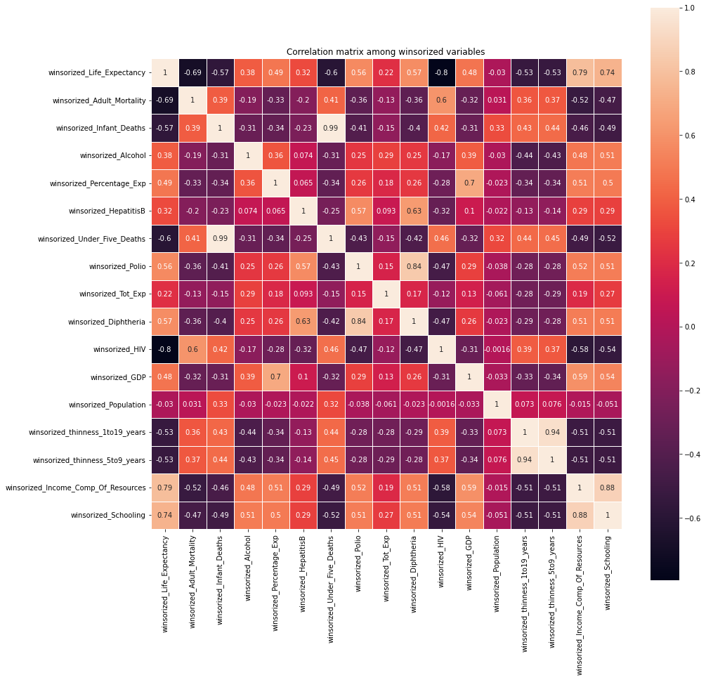
EDA
Shows the correlation of the variables between each other.

Slide 5
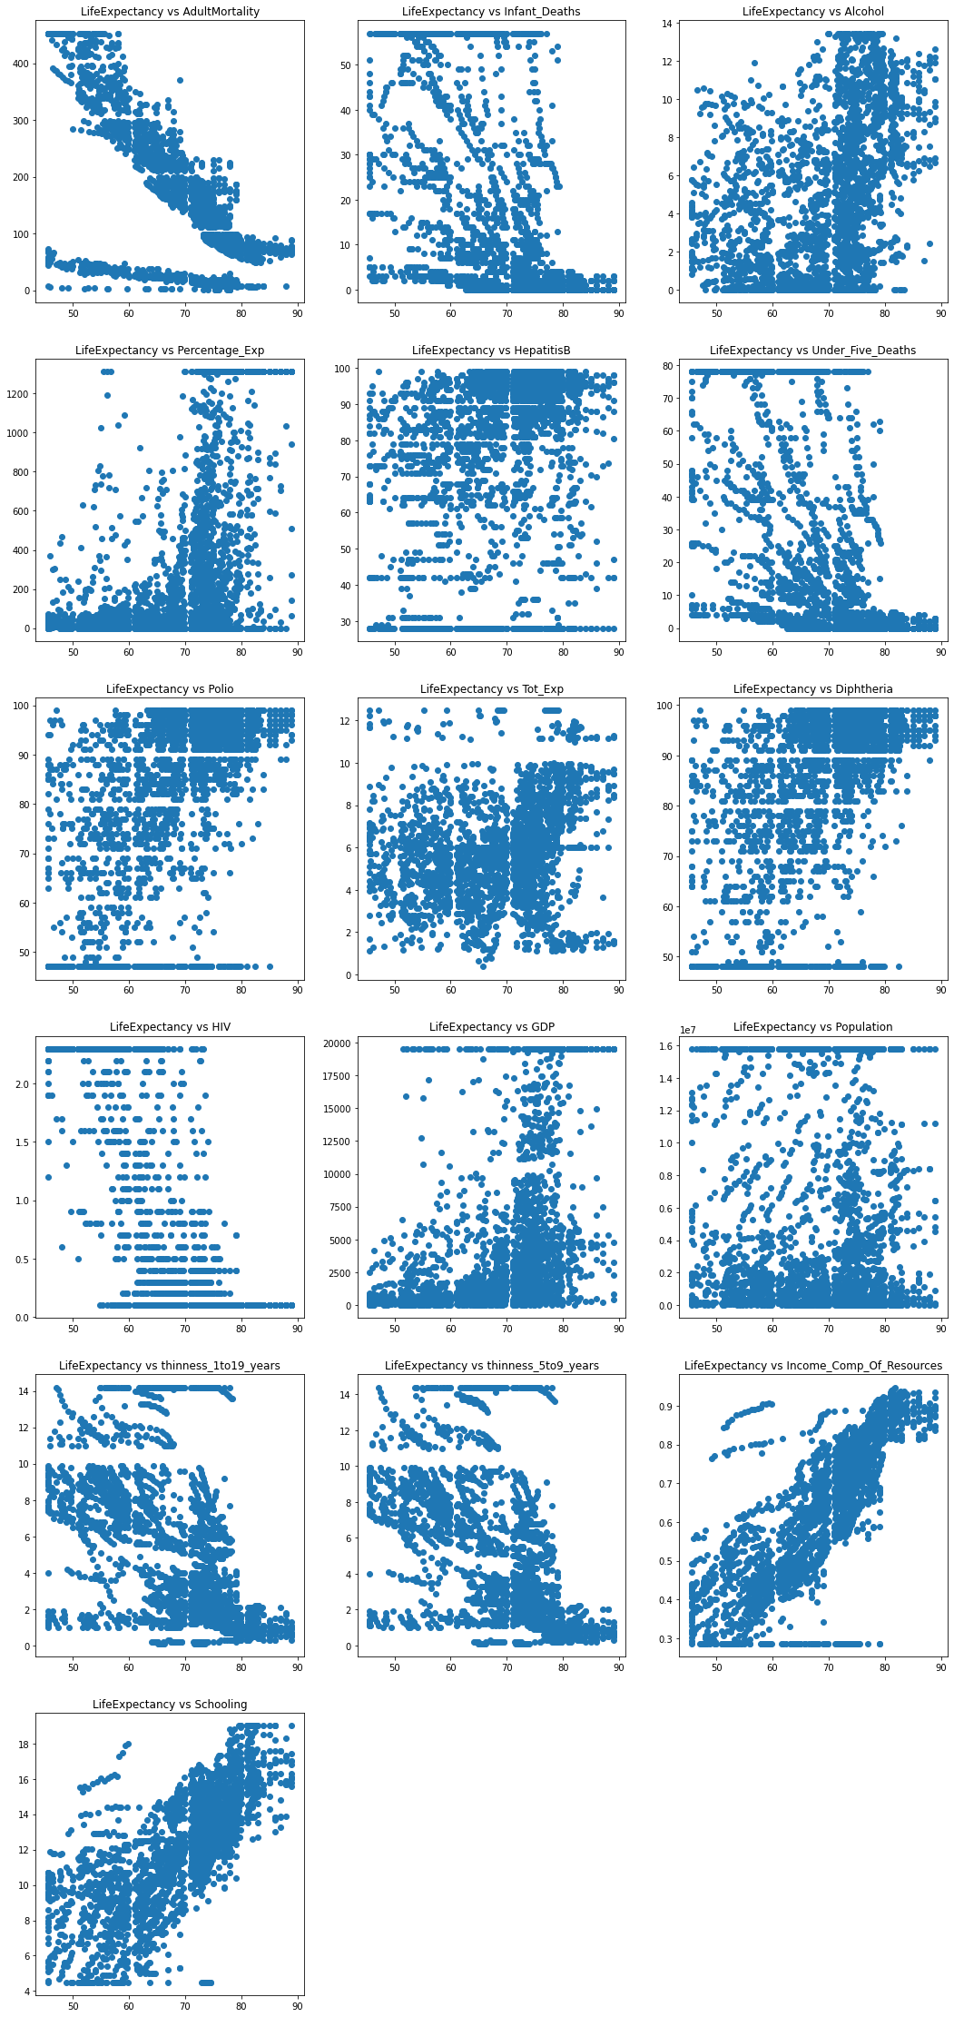
Correlation between life expectancy and different variables represented through scatter plots .

Slide 6
Approach
1. Random Forest Regression
2. Ridge Regression
3. XG Boost

Slide 7
Design
HIV , Year and Country were over fitting the model therefore, our model did not use these features
K-fold cross validation for training and evaluation
Z-test to evaluate total expense of country with relation to life expectancy.
Graphs to understand correlation and impact of independent variables and the life expectancy.

Slide 8
Tests Results
Model | Accuracy | R2 Score
Baseline_random_forests_regressor | 0.895651449 | 0.849044387
ridge_regression | 0.999999983 | 0.999999983
Baseline_random_forests_regressor_2 | 0.820119583 | 0.714489414
ridge_regression_2 | 0.795877039 | 0.754899399
xgboost | 0.944345864 | 0.941036641

