Slide 1
A Steganographic Algorithm for Identification of the Author of Photographs from Cropped Stolen Photos
Souradeep Nanda
Dr. P Nithyanandam

Slide 2
Abstract
In this paper, we present a blind steganographic algorithm which can be used for identification of the author of the photographs which were copied without permission. Most modern smartphones have fingerprint sensors, as the cameraman clicks the image, his fingerprint will be embedded in the image. This would be very useful for getting a hard evidence for copyright claims on images. The algorithm can also be used by web crawlers searching for identifying unauthorized use of intellectual property. Our algorithm is robust enough to work even if the copyright violator crops out a part of the image. Since it a blind steganographic algorithm, it does not need anything other than the cropped image to reproduce the hidden data.

Slide 3
Introduction
The proposed algorithm is designed while keeping in mind that when the image is clicked, the fingerprint of the photographer is immediately embedded into the image. This fingerprint can then be used as evidence. If the author is not interested in embedding his fingerprint, he can also opt to embed any other string like a hash in the photograph. This is also supported.

Slide 4
Methodology - Embedding
The pixels from the biometric (bit depth = 2) are taken in raster format and then they are put in the 2nd and 3rd least significant bits of the carrier image. The colour channels are alternated. The 1st least significant bit will be used for storing guidelines because changes in the 1st LSB are the least detectable.
The position of the pixel whose LSB is to be replaced is determined by a pseudo-random generator.

Slide 5
Methodology - redundancy
The redundancy should be sufficient to have all the information to reconstruct the hidden image in any cropped part of the photo while not being so excessive that the quality of the carrier image is compromised.
This problem is solved by having redundancy of data and this is achieved by running multiple passes on the carrier image.
In a very rare occasion, the PRG may generate the same x, y pair twice. A majority voting system is used to counter this rare event.

Slide 6
Methodology - guidelines
The sequence that the PRG would generate is relative to the origin of the original, un-tampered image. As soon as the image is cropped, the origin of the cropped image differs from the origin of the original image.
The process of finding this offset automatically and efficiently without having the original image at hand is the most challenging aspect of this problem.
Therefore, some additional data has to be bundled with the embedded image such that the extractor is able to automatically figure out the starting coordinates of the cropped image.

Slide 7
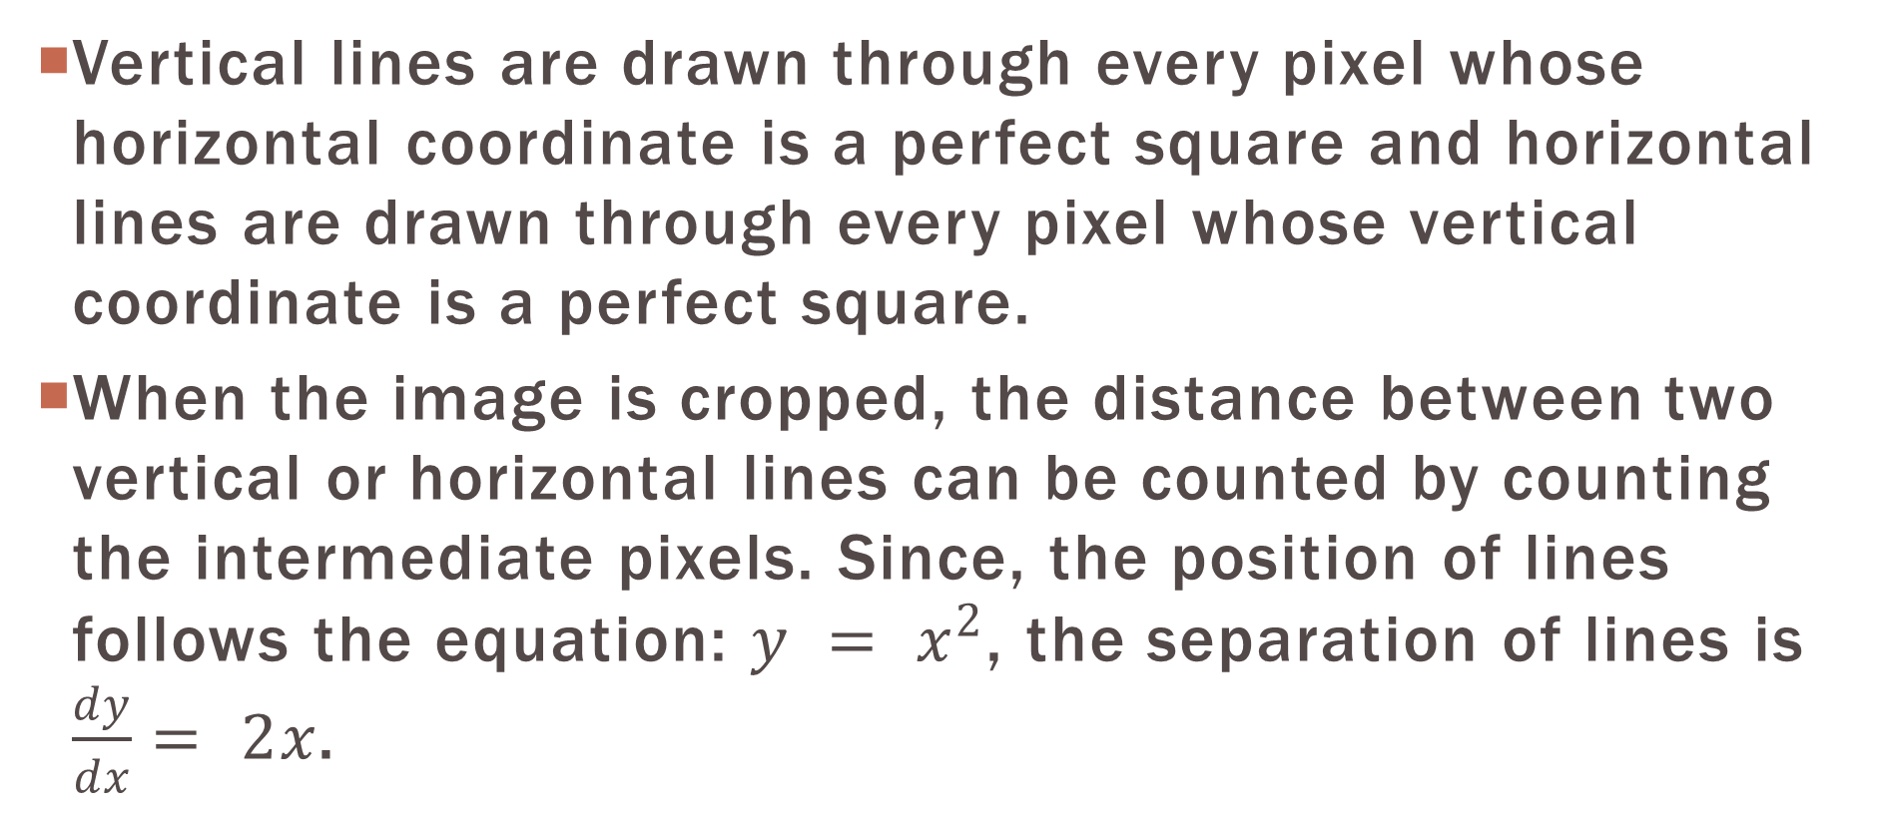
Methodology - guidelines
Vertical lines are drawn through every pixel whose horizontal coordinate is a perfect square and horizontal lines are drawn through every pixel whose vertical coordinate is a perfect square.
When the image is cropped, the distance between two vertical or horizontal lines can be counted by counting the intermediate pixels. Since, the position of lines follows the equation: $y = x^{2}$, the separation of lines is $\frac{dy}{dx}= 2x$.

Slide 8
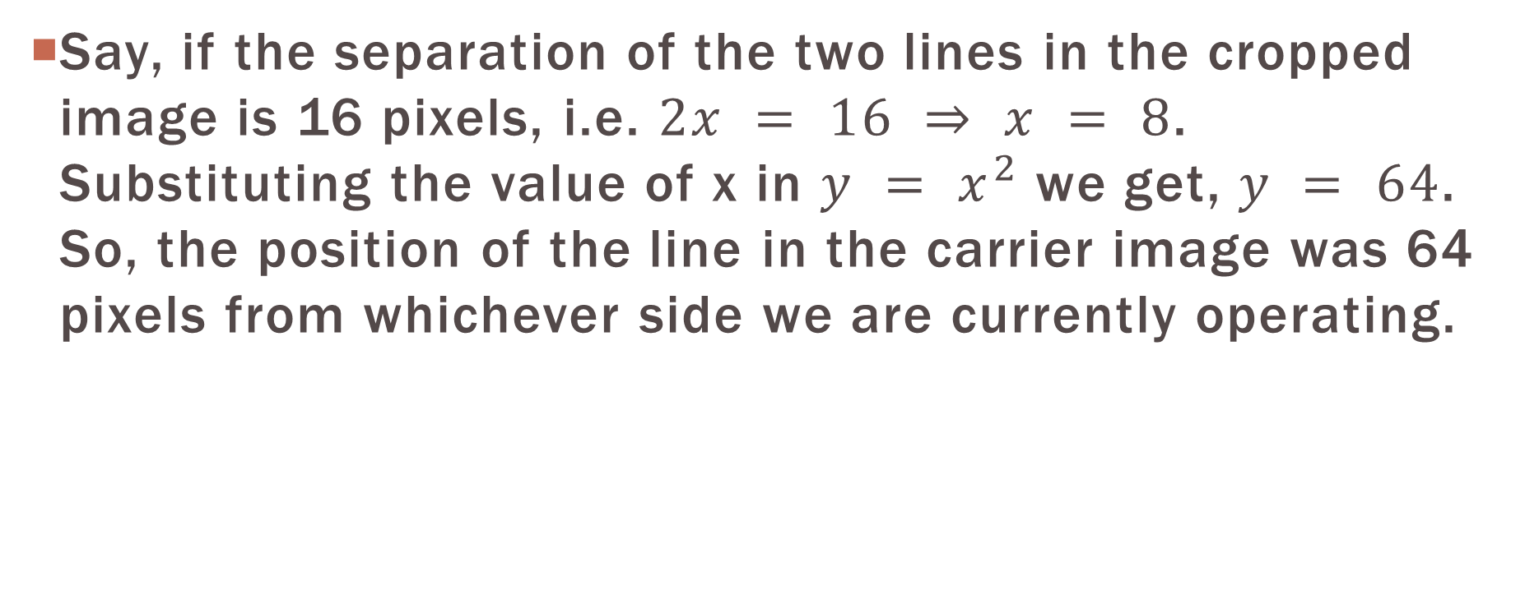
Methodology - guidelines
Say, if the separation of the two lines in the cropped image is 16 pixels, i.e. $2x = 16 ⇒ x = 8$. Substituting the value of x in $y = x^{2}$ we get, $y = 64$. So, the position of the line in the carrier image was 64 pixels from whichever side we are currently operating.

Slide 9
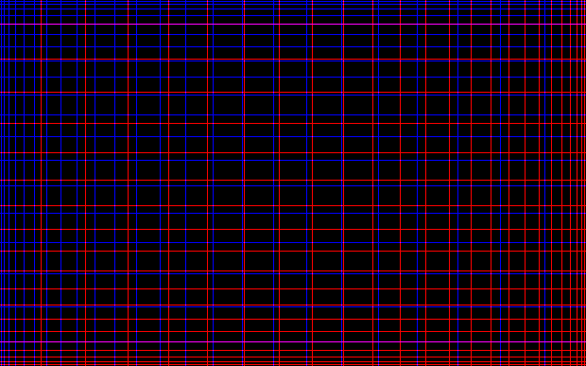
Methodology - guidelines

Slide 10
Methodology - extraction
After finding the actual offset of the line, we find the offset of the origin. In order to do that, the position of the line in the cropped image is subtracted from the position of the line in the original image.
Since PRGs generate the same sequence every time for the same seed, it can be used to recover the positions of the hidden data by extracting all the pixels residing in the positions given by the PRG. In the case of a cropped image, the given coordinate could be outside the carrier image. In that case, it is safely ignored.

Slide 11

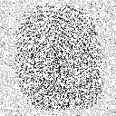
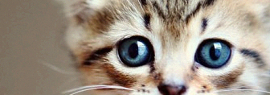
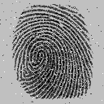
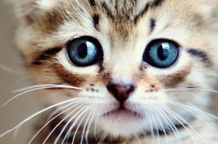
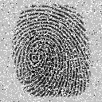
Extraction
(32 passes) As the number of passes are increased, more pixels can be recovered.
(8 passes) Larger the size of the cropped image, more embedded data is recovered

Slide 12
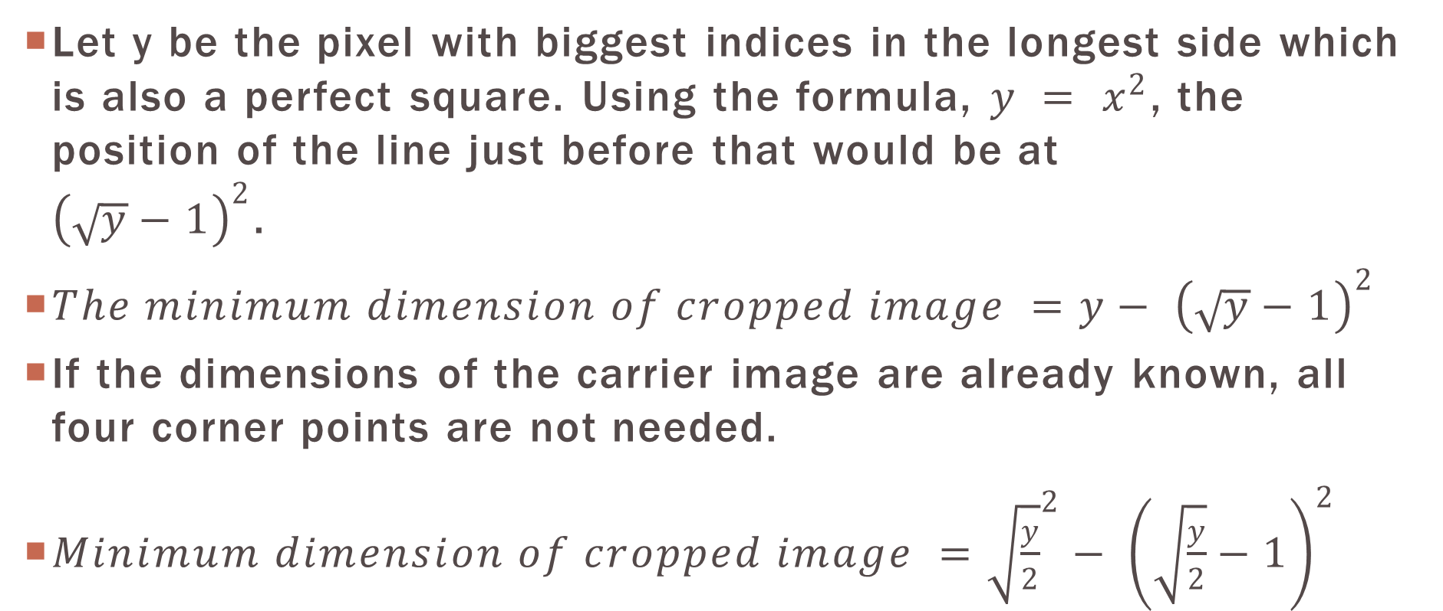
Robustness
Let y be the pixel with biggest indices in the longest side which is also a perfect square. Using the formula, $y = x^{2}$, the position of the line just before that would be at ${\left(\sqrt{y}−1\right)}^{2}$.
$The minimum dimension of cropped image ={y− \left(\sqrt{y}−1\right)}^{2}$
If the dimensions of the carrier image are already known, all four corner points are not needed.
$Minimum dimension of cropped image ={\sqrt{\frac{y}{2}}}^{2}{− \left(\sqrt{\frac{y}{2}}−1\right)}^{2}$

Slide 13
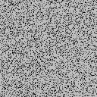
Robustness
Illustration of the failure state when the dimension of cropped image is lesser than equation

Slide 14
JPEG and Lossy Compression
JPEG uses Discrete Cosine Transform to remove most high-frequency data from the image because it is not easily visible to the human eye. Unfortunately, the proposed method relies heavily on storing the hidden data in the high-frequency domain.
However, JPEG does not remove all the high-frequency data. So, if the data is embedded and the carrier image is recompressed multiple times then each time a little bit of high-frequency data is left behind. After sufficient iterations, the hidden image can be recovered with a good enough visual fidelity.

Slide 15

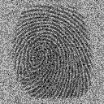
JPEG and Lossy Compression
(32 passes) Extraction process on JPEG file

Slide 16
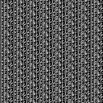
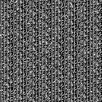
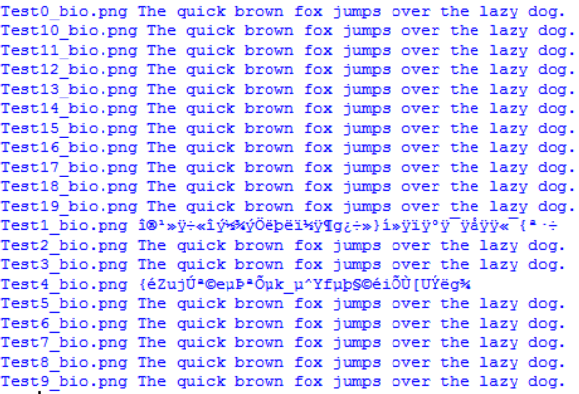
Storing Textual Data
Left, the text “The quick brown fox jumps over the lazy dog.” Encoded as an image. Right, the same image upon recovery

Slide 17
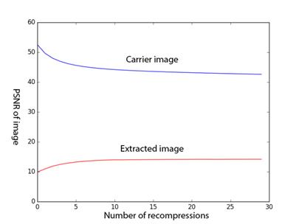
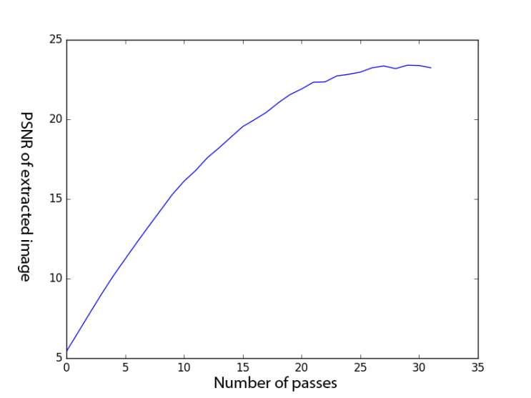
PSNR and quality
(32 passes) The PSNR of both the carrier image and the extracted image flattens out and converges with multiple iterations.
The PSNR of the extracted image increases monotonically with increasing number of passes.

Slide 18
Conclusion
In this paper we have dealt with the problem of cropping attacks on the carrier media. We have also explored the pitfalls when dealing with JPEG and its lossy compression.
The source code is available for download at Github (https://goo.gl/GEwXTt). The procedure for reproduction is also bundled along.

