Slide 1
Cancer-Targeting
Peptides for
Lung Cancer
2014 – 2025
A literature survey of 19 papers tracing the evolution of
peptide-based strategies for targeting, therapy, and drug delivery
Notes:
Good morning/afternoon. Today I'll be presenting a literature survey on cancer-targeting peptides for lung cancer — spanning a decade of research from 2014 to 2025.

Slide 2
CONTENTS
01
Peptide Discovery & Targeting
6 papers
02
Anticancer Peptides with Direct Activity
2 papers
03
Peptide-Drug Conjugates & Delivery
2 papers
04
Nanoparticles & Delivery Platforms
2 papers
05
Computational & AI-Driven Design
2 papers
06
Reviews & Landscape Papers
5 papers
07
Cross-Cutting Analysis
Synthesis
Cancer-Targeting Peptides for Lung Cancer | Literature Survey 2014–2025
Notes:
Here's the roadmap. We'll move through seven sections covering discovery, direct activity, drug conjugates, nanoparticles, AI design, reviews, and cross-cutting analysis.

Slide 3
01
Peptide Discovery
& Targeting
How do we find peptides that specifically recognize lung cancer cells?
Cancer-Targeting Peptides for Lung Cancer | Literature Survey 2014–2025
Notes:
Let's start with the foundation — how do we find peptides that specifically recognize and bind to lung cancer cells? The primary workhorse has been phage display biopanning.

Slide 4
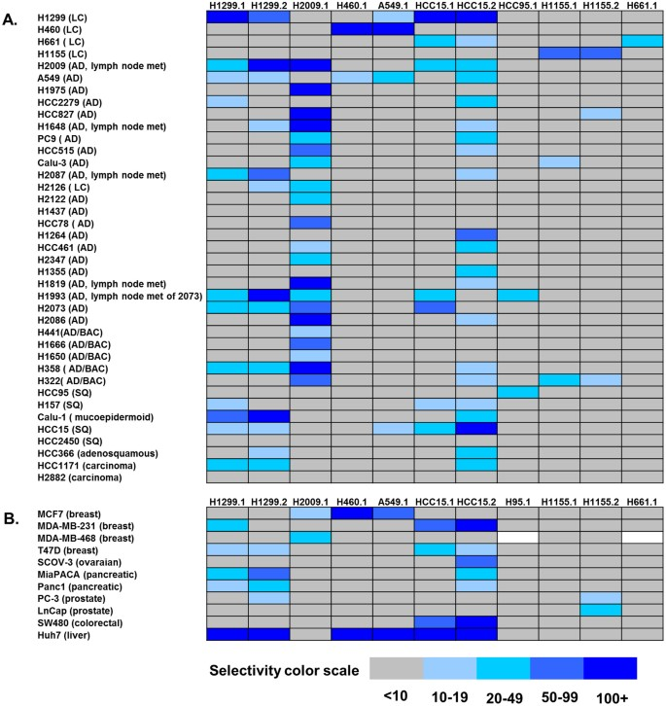
McGuire et al. (2014)
Tumor Targeting Peptides
for NSCLC
Phage display: 3 libraries (7-mer, 12-mer, C7C) on live NSCLC cells
11 novel peptides with distinct binding profiles across 40 cell lines
Tetramer KD as tight as 7 picomolar — binding correlates with EGFR/KRAS genotype
In vivo tumor homing confirmed; validated on patient tumor samples
Foundation paper — same group optimized MGS4 a decade later (Allred 2023)
Binding profiles of NSCLC-targeting peptides across 40 cell lines (McGuire et al. 2014)
McGuire et al. (2014) | Cancer-Targeting Peptides Literature Survey
Notes:
The story starts in 2014 with McGuire at SRI International. They screened three phage display libraries and identified 11 novel peptides with binding affinities as tight as 7 picomolar.

Slide 5
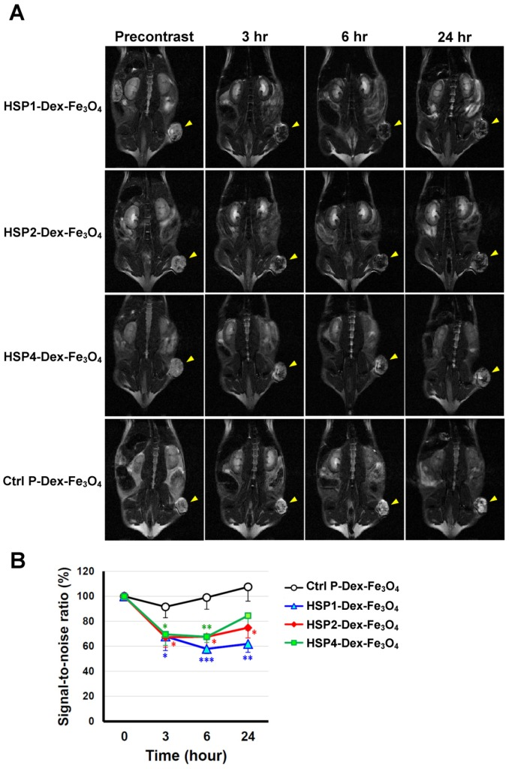
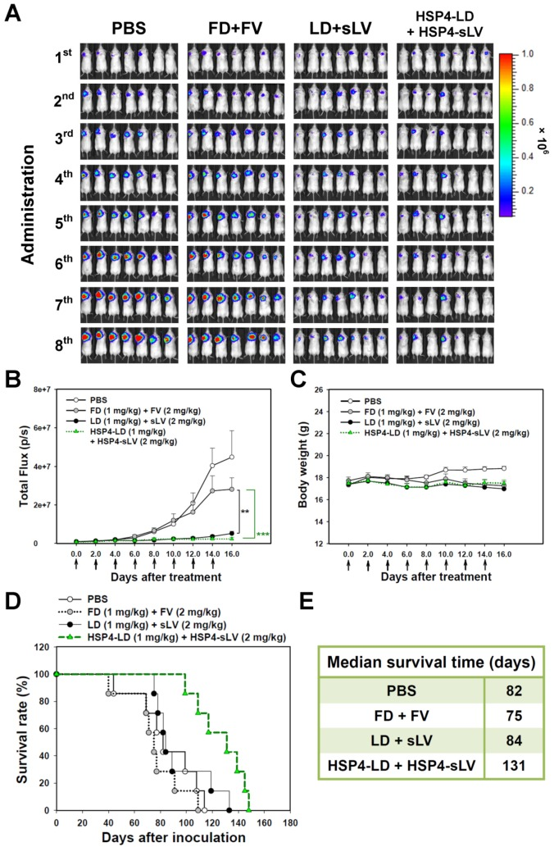
Chi et al. (2017)
Multi-Subtype Targeting
& Theranostics
Phage display on H460 cells → HSP1, HSP2, HSP4
Targets SCLC + NSCLC (4 subtypes) — rare in this field
HSP4-liposomal dox: survival 131 vs 84 days (+47 d)
Theranostic: MRI imaging with ~42% signal reduction
Only orthotopic lung model in entire 19-paper survey
MRI tumor imaging with HSP peptides (Chi 2017)
Survival curves: 131 vs 84 days (Chi 2017)
Chi et al. (2017) | Cancer-Targeting Peptides Literature Survey
Notes:
Chi et al. identified peptides that work across both SCLC and NSCLC. HSP4-liposomal doxorubicin extended survival by 47 days. They also demonstrated theranostic MRI imaging.

Slide 6
Bakhshinejad et al. (2018)
Novel Tumor-Binding
Peptide LCP1
Ph.D.-7 phage display (7-mer library), 3 rounds on A549
LCP1 (AWRTHTP) — 170-fold phage enrichment
Selectivity index 5.1 over normal lung WI-38 cells
No binding to liver, esophageal, or breast cancer
In vitro only; receptor unknown; early-stage discovery
5.1x
Selectivity index
A549 vs WI-38
normal lung cells
Bakhshinejad et al. (2018) | Cancer-Targeting Peptides Literature Survey
Notes:
Bakhshinejad identified LCP1, a short 7-mer peptide with a selectivity index of 5.1 for A549 lung cancer over normal lung cells.

Slide 7
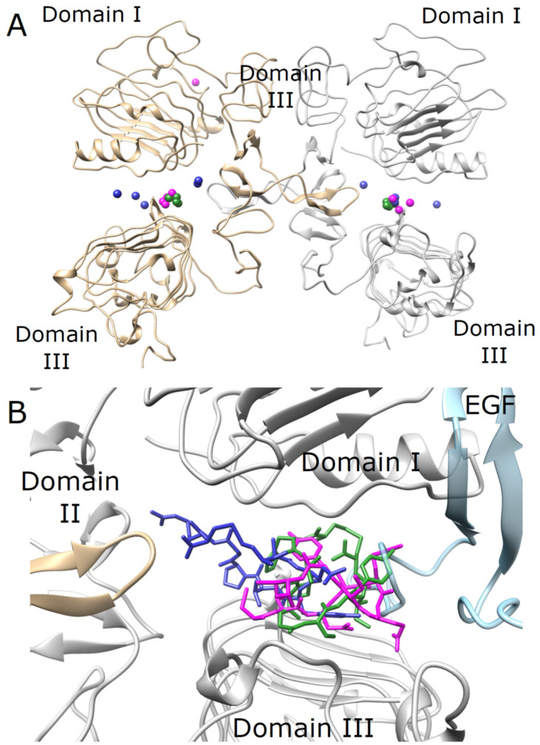
Furman et al. (2022)
Cyclic Peptides for
EGFR / EGFRvIII
First to combine phage display + NGS: 617,503 sequences
Cyclic peptides P6 (NSCLC) and P9 (glioblastoma)
P9-camptothecin: 2-3x more cytotoxic than free drug
Targets EGFR wild-type and EGFRvIII mutant
Massive parallel screening replaces colony picking
Molecular docking of cyclic peptides to EGFR (Furman 2022)
Furman et al. (2022) | Cancer-Targeting Peptides Literature Survey
Notes:
Furman et al. combined phage display with next-generation sequencing — screening over 617,000 sequences. Their cyclic peptide P9 conjugated to camptothecin was 2-3x more cytotoxic than the free drug.

Slide 8
Zhou et al. (2022)
NKTP-3: Dual-Targeting
Cyclic D-Peptide
Structure-based computational design + virtual screening
Cyclic D-peptide: protease-resistant, cell-permeable
First dual-target: NRP1 (surface) + KRAS G12D (intracellular)
Selective for G12D over wild-type, G12C, G12V
Strong in vivo activity; no obvious toxicity
Paradigm: simultaneous surface + intracellular targeting
DUAL
First peptide targeting
a surface receptor AND
an intracellular oncoprotein
Zhou et al. (2022) | Cancer-Targeting Peptides Literature Survey
Notes:
Zhou et al. achieved dual targeting — NKTP-3 binds NRP1 on the cell surface and targets intracellular KRAS G12D. First peptide to simultaneously target a surface receptor and intracellular oncoprotein.

Slide 9
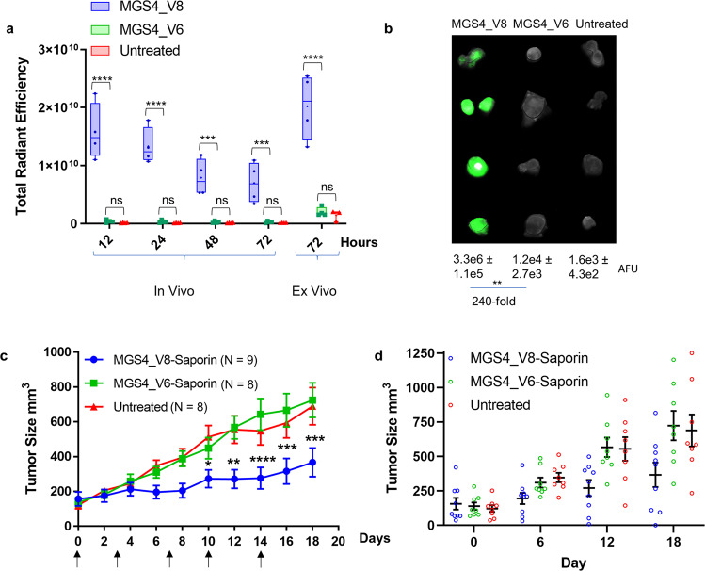
Allred et al. (2023)
Peptide-Guided Saporin
Delivery to NSCLC
Continuation of McGuire 2014 — same group (SRI International)
MGS4_V8 (Ac-FHAVPQSFYT): 10-aa monomer, N-terminal acetylation
EC50 < 40 nM on 4 NSCLC lines
With saporin toxin: IC50 9.4 nM
In vivo: 25-40x tumor accumulation; ~50% tumor reduction
Textbook iterative optimization over a decade
240-fold tumor accumulation (NIR) & tumor growth inhibition (Allred 2023)
Allred et al. (2023) | Cancer-Targeting Peptides Literature Survey
Notes:
Same group as McGuire 2014, nearly a decade later. Optimized to MGS4_V8 with IC50 9.4 nM with saporin. 25-40x tumor accumulation and 50% tumor reduction in vivo.

Slide 10
02
Anticancer Peptides
with Direct Activity
The peptide IS the drug — killing cancer through membrane disruption and apoptosis
Cancer-Targeting Peptides for Lung Cancer | Literature Survey 2014–2025
Notes:
Now let's shift from peptides that target to peptides that kill. These are anticancer peptides where the peptide itself is the therapeutic.

Slide 11
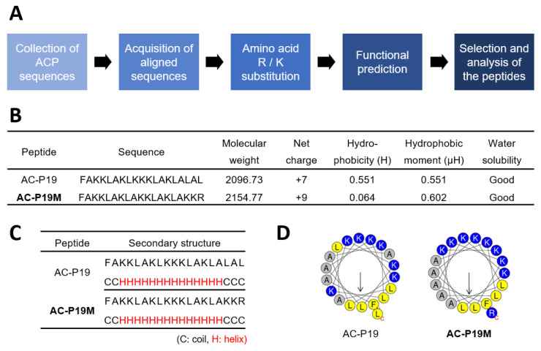
Shin et al. (2022)
AC-P19M: AI-Designed
Anticancer Peptide
AI tools: mACPpred, ACPred, ENNACT for de novo design
AC-P19M: net charge +9, alpha-helical structure
IC50 ~10-15 uM on A549/H460
Zero toxicity at 100 uM in normal cells
Multi-mechanism: apoptosis + membrane disruption + VEGFR2 suppression + anti-EMT
De novo design pipeline with AI prediction (Shin 2022)
Shin et al. (2022) | Cancer-Targeting Peptides Literature Survey
Notes:
Shin et al. used AI to design a peptide from scratch. AC-P19M kills lung cancer cells at 10-15 micromolar with zero toxicity to normal cells up to 100 micromolar. Remarkable multi-mechanism activity.

Slide 12
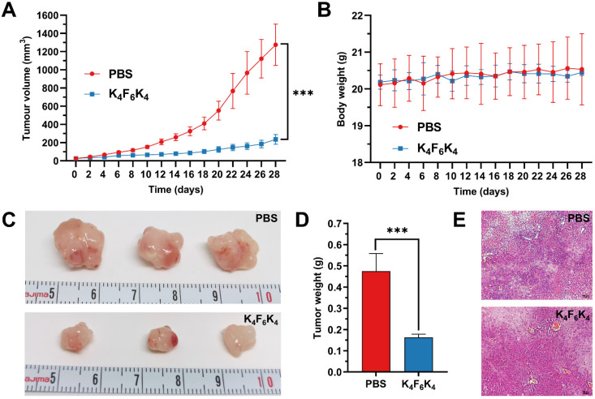
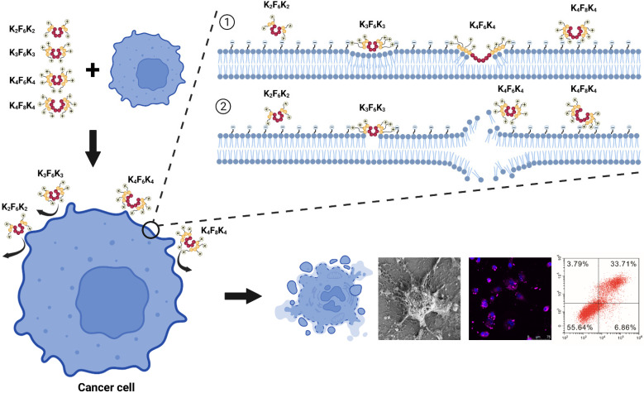
Yang et al. (2022)
K4F6K4: Elegant Simplicity
in Peptide Design
Rational triblock: KKKK-FFFFFF-KKKK — just 14 residues
Cationic blocks + hydrophobic core = selective membrane disruption
81.6% tumor volume reduction at Day 28 in vivo
12.9x selectivity over normal MRC-5 fibroblasts
Fundamentally different from receptor-based targeting
81.6% tumor reduction in BALB/c nude mice (Yang 2022)
Amphiphilic self-assembly and membrane disruption (Yang 2022)
Yang et al. (2022) | Cancer-Targeting Peptides Literature Survey
Notes:
Yang et al. designed a simple 14-residue triblock peptide. In vivo, 81.6% tumor volume reduction with 12.9-fold selectivity. The simplicity is the point.

Slide 13
03
Peptide-Drug Conjugates
& Delivery
Guided missiles: peptides delivering cytotoxic payloads at a fraction of antibody size
Cancer-Targeting Peptides for Lung Cancer | Literature Survey 2014–2025
Notes:
Peptide-drug conjugates — the peptide equivalent of antibody-drug conjugates, but at a fraction of the size.

Slide 14
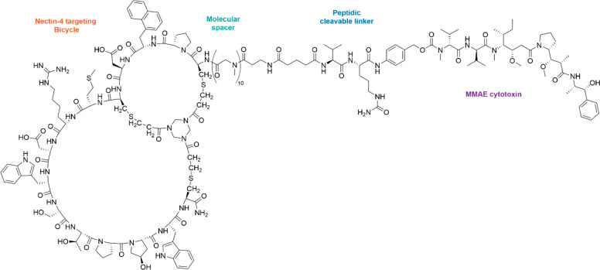
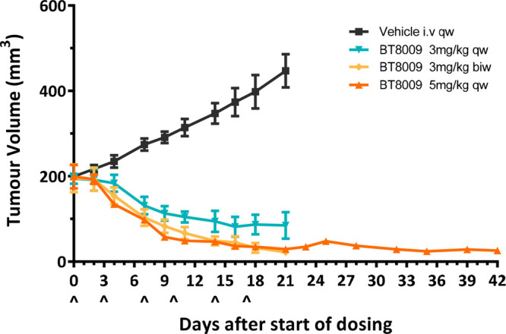
Mudd et al. (2022)
BT8009: From Bench
to Bedside
Bicycle peptide (~4 kDa) + TATA scaffold + MMAE cytotoxin
KD 2.8 nM — antibody-like affinity at 1/30th the size
Near-complete tumor regression by Day 18
Phase I/II clinical trial — most advanced in survey
First-in-class bicycle toxin conjugate for Nectin-4
BT8009 structure: bicycle peptide + linker + MMAE (Mudd 2022)
Near-complete tumor regression in xenograft (Mudd 2022)
Mudd et al. (2022) | Cancer-Targeting Peptides Literature Survey
Notes:
BT8009 is the star of this survey. At 4 kilodaltons it achieves antibody-like affinity. Near-complete tumor regression. And it's in Phase I/II clinical trials.

Slide 15
PARADIGM SHIFT
First Oral Anticancer Peptide
Singh et al. (2025) — SFTI-G5 targets EGFR/HER2 and can be taken as a pill
73 nM
>500x
ORAL
IC50 on
Calu-3 NSCLC
Selectivity over
normal cells
Bioavailability
confirmed in vivo
Singh et al. (2025) | Cancer-Targeting Peptides Literature Survey
Notes:
Singh et al. achieved the biggest paradigm shift — SFTI-G5, an oral anticancer peptide. IC50 73 nM, >500-fold selectivity, and confirmed oral bioavailability.

Slide 16
04
Nanoparticles &
Delivery Platforms
Peptide-functionalized nanocarriers for enhanced lung tumor delivery
Cancer-Targeting Peptides for Lung Cancer | Literature Survey 2014–2025
Notes:
How peptides are being integrated into nanocarrier systems for enhanced delivery to lung tumors.

Slide 17
Kim & Park et al. (2024)
Functionalized Peptides
in Nanomedicine
Three strategies: targeting ligands, self-assembly, stimuli-responsive
Lung highlight: CPP33 + ZIF-90 MOF + survivin siRNA + Oridonin
Dual-payload: gene therapy + chemotherapy in one nanoparticle
Preferential A549 uptake and tumor reduction in vivo
Platforms: MOFs, gold NPs, mesoporous silica, liposomes, polymeric NPs
3-in-1
CPP33 + siRNA +
Oridonin in a single
nanoparticle system
Kim & Park et al. (2024) | Cancer-Targeting Peptides Literature Survey
Notes:
Kim and Park reviewed three peptide-NP strategies. The lung highlight was CPP33 on a ZIF-90 framework carrying both siRNA and Oridonin.

Slide 18
Lee et al. (2025)
Engineered Nanocarriers
for Lung Cancer
Comprehensive: liposomes, PLGA, dendrimers, exosomes, inorganic NPs
T-DXd: ~55% response in HER2-mutant NSCLC (approved)
Emerging: inhalable NP systems for direct pulmonary deposition
Stimuli-responsive: pH, enzyme, hypoxia-triggered release
Inhalable delivery bypasses systemic circulation entirely
~55%
T-DXd response rate
in HER2-mutant
NSCLC (approved)
Lee et al. (2025) | Cancer-Targeting Peptides Literature Survey
Notes:
Lee et al. provided the most comprehensive nanocarrier review. The emerging trend: inhalable nanoparticle systems that bypass systemic circulation for lung-specific targeting.

Slide 19
05
Computational &
AI-Driven Design
How AI and machine learning are reshaping peptide discovery
Cancer-Targeting Peptides for Lung Cancer | Literature Survey 2014–2025
Notes:
The computational revolution — how AI and machine learning are reshaping peptide design and discovery.

Slide 20
Wu et al. (2025)
AI-Driven Anticancer
Peptide Discovery
68
7+
0
AI prediction
models reviewed
Model types: SVM,
RF, CNN, LSTM,
Transformer, LLM
AI-discovered ACPs
in clinical trials
The AI hype is real, but the validation gap is equally real. Most models lack wet-lab confirmation.
Wu et al. (2025) | Cancer-Targeting Peptides Literature Survey
Notes:
Wu et al. reviewed 68 AI models. The critical gap: most lack experimental validation. No AI-discovered ACP has reached clinical trials. The hype is real but so is the validation gap.

Slide 21
Chowdhury et al. (2025)
Molecular Chimera:
Grafted Stable Peptides
Plant scaffolds (cyclotides, SFTI-1) grafted with cancer epitopes
Cyclotides: 28-37 aa, cyclic cystine knot, 3 disulfide bonds
SFTI-1: 14 aa bicyclic — the scaffold behind Singh's SFTI-G5
Targets: EGFR, HER2, PD-L1, VEGF, integrins, p53-HDM2
Same group (Jois lab, LSU) as Singh 2025 — theory meets practice
ORAL
Scaffold stability
enables oral delivery
— validated by SFTI-G5
Chowdhury et al. (2025) | Cancer-Targeting Peptides Literature Survey
Notes:
Chowdhury et al. provide the theoretical framework behind Singh's SFTI-G5. Molecular chimeras: plant scaffolds grafted with cancer-targeting epitopes. This is the blueprint for next-gen orally available peptide therapeutics.

Slide 22
06
Reviews &
Landscape Papers
Five reviews providing the broader context for the field
Cancer-Targeting Peptides for Lung Cancer | Literature Survey 2014–2025
Notes:
Section 6 covers five review papers that provide the broader context for everything we've discussed.

Slide 23
Karankar et al. (2025)
Peptide-Driven Strategies
Against Lung Cancer
Maps peptides against 6 driver mutations: EGFR, TP53, BRAF, MET, ROS1, ALK
Key peptides: GE11 (EGFR), p28 (p53), NKTP-3 (KRAS G12D)
Peptides as bridge between small-molecule TKIs and antibodies
Potential for TKI-resistant tumors — growing clinical need
Gap: zero peptides targeting ALK, ROS1, or MET fusions
0
Experimental peptides
targeting ALK, ROS1,
or MET fusions
Karankar et al. (2025) | Cancer-Targeting Peptides Literature Survey
Notes:
Karankar et al. mapped peptides against six NSCLC driver mutations. Key insight: peptides bridge TKIs and antibodies. But zero peptides target ALK, ROS1, or MET fusions.

Slide 24
Karati et al. (2025)
Nhan et al. (2023)
Peptide Drugs &
Chemoresistance
Peptide-Based Agents
for Cancer Treatment
ACPs bypass P-glycoprotein efflux via membrane disruption
Fundamentally different mechanism from conventional drugs
Targets DNA repair, EMT, apoptosis evasion simultaneously
Challenge: short half-life remains primary limitation
Broadest scope: 56 pre-clinical + 10 clinical-stage peptides
Clinical: LUNA18 (KRAS), p28 (p53), ALRN-6924
Lung: NKTP-3, KRpep-2d, 99mTc-3PRGD2 imaging
FDA history: Leuprorelin (1985) → Carfilzomib (2012)
Cancer-Targeting Peptides for Lung Cancer | Literature Survey 2014–2025
Notes:
Karati: ACPs bypass P-glycoprotein efflux through membrane disruption. Nhan: broadest scope — 56 pre-clinical and 10 clinical-stage peptides.

Slide 25
Alamdari-palangi et al. (2023)
Bauso et al. (2024)
Peptide-Agent
Conjugates
Natural & Synthetic
Anticancer Peptides
PDC landscape: design principles & linker chemistry
28 clinical trials cataloged
60+ approved peptide therapeutics; 12 FDA/EMA cancer drugs
BT8009 featured as key next-gen design
ACPs across 10 cancer types; 7 lung peptides cataloged
MANS, FCHO1, TMEM39AS41, MP06, AC-P19M, DTX-P7
>1,000 clinical trials using ACPs globally
AC-P19M: 5x more toxic to cancer vs normal cells
Cancer-Targeting Peptides for Lung Cancer | Literature Survey 2014–2025
Notes:
Alamdari-palangi: 28 clinical trials of PDCs. Bauso: 7 lung cancer peptides cataloged, >1000 ACP clinical trials globally.

Slide 26
07
Cross-Cutting
Analysis
Patterns, gaps, and opportunities across all 19 papers
Cancer-Targeting Peptides for Lung Cancer | Literature Survey 2014–2025
Notes:
Now let's step back and look at the patterns across all 19 papers.

Slide 27
Method Evolution
2014 → 2025
Phage Display
Cell-based biopanning, iterative selection
McGuire, Chi, Bakhshinejad
2014–2018
NGS + Computation
Phage display + sequencing; virtual screening
Furman, Zhou
2022
De Novo AI Design
AI-predicted sequences; rational amphiphilic design
Shin, Yang
2022
Scaffold Engineering
Plant scaffolds grafted with targeting epitopes
Singh, Chowdhury
2025
AI/ML at Scale
68 models; language models; end-to-end frameworks
Wu
2025
Empirical screening → Rational, computationally guided design
Cancer-Targeting Peptides for Lung Cancer | Literature Survey 2014–2025
Notes:
The field evolved from classic phage display to NGS-enhanced screening, de novo AI design, scaffold engineering, and large-scale AI models. Clear trajectory toward rational, computationally guided design.

Slide 28
Target Landscape
Target | Papers | Most Advanced | Stage
EGFR / HER2 | 8 | SFTI-G5 (oral, 73 nM) | Pre-clinical
Nectin-4 | 2 | BT8009-MMAE | Phase I/II
KRAS G12D | 4 | NKTP-3, LUNA18 | Phase I/II
p53 / HDM2 | 2 | p28 (azurin) | Phase I
PD-1 / PD-L1 | 3 | Cyclotide grafts | Early research
KRAS G12C | 0 | — | GAP
ALK / ROS1 / MET | 0 | — | GAP
KRAS G12C (most common in smokers) and ALK/ROS1/MET fusions = significant unmet needs with zero peptides
Cancer-Targeting Peptides for Lung Cancer | Literature Survey 2014–2025
Notes:
EGFR/HER2 appears in 8 papers. BT8009 targets Nectin-4 in Phase I/II. Critical gaps: zero peptides for KRAS G12C and ALK/ROS1/MET fusions.

Slide 29
Top Performers
Quantitative Efficacy Across the Survey
7 pM
9.4 nM
73 nM
Best Binding
McGuire tetramers
Best IC50
MGS4_V8-saporin
Best Free Peptide
SFTI-G5
-81.6%
+47 d
>500x
Tumor Reduction
K4F6K4 (Day 28)
Survival Extension
HSP4-PLD
Selectivity
SFTI-G5
Cancer-Targeting Peptides for Lung Cancer | Literature Survey 2014–2025
Notes:
Headline numbers: 7 picomolar binding, 9.4 nM cytotoxicity, 81.6% tumor reduction, 47-day survival extension, >500-fold selectivity. Numbers that rival antibody-drug conjugates.

Slide 30
Clinical Translation Pipeline
Discovery / In Vitro
3 papers
LCP1, AC-P19M, P6/P9
In Vivo Xenograft
6 papers
HSP4, K4F6K4, NKTP-3, MGS4_V8, SFTI-G5
Clinical Trials
1 paper
BT8009 (Phase I/II)
AI / Computational
1 paper
68 models → 0 clinical validation
Pipeline is heavily front-loaded — discovery is outpacing clinical translation
Cancer-Targeting Peptides for Lung Cancer | Literature Survey 2014–2025
Notes:
Most papers remain at discovery. Six have in vivo data. Only BT8009 reached clinical trials. AI has 68 models but zero clinical validation. Discovery outpaces translation.

Slide 31
Key Gaps
in the Field
KRAS G12C
Most common KRAS mutation in NSCLC smokers — zero peptides
SCLC
Only Chi 2017 addresses it; aggressive, no targeted therapies
ALK / ROS1 / MET
Mentioned in reviews but zero experimental peptides
Orthotopic Models
Only 1 of 19 papers uses lung-specific tumor model
Head-to-Head
No comparison with standard-of-care antibodies or TKIs
AI Validation
68 models, most without wet-lab confirmation
Immunotherapy
No studies combining peptides with checkpoint inhibitors
Cancer-Targeting Peptides for Lung Cancer | Literature Survey 2014–2025
Notes:
Critical gaps: KRAS G12C, SCLC, ALK/ROS1/MET, orthotopic models, head-to-head comparisons, AI validation, immunotherapy combinations.

Slide 32
Five Emerging Opportunities
1
Oral Peptide Therapeutics
SFTI-G5 proves it's possible — generalizing scaffold grafting transforms compliance
2
AI-to-Clinic
First AI-discovered ACP in clinical trials validates the computational field
3
Peptide-Immunotherapy
PD-L1 cyclotide grafts could synergize with checkpoint inhibitors
4
Inhalable Delivery
Direct pulmonary deposition bypasses systemic distribution
5
Dual-Target Peptides
NKTP-3 proved surface + intracellular targeting is feasible
Cancer-Targeting Peptides for Lung Cancer | Literature Survey 2014–2025
Notes:
Five opportunities: oral peptides, AI-to-clinic, peptide-immunotherapy, inhalable delivery, dual-target peptides.

Slide 33
Thank You
19 Papers Surveyed (2014–2025)
1. McGuire et al. (2014) Sci Rep
2. Chi et al. (2017) Theranostics
3. Bakhshinejad et al. (2018) IJPR
4. Furman et al. (2022) Pharmaceutics
5. Zhou et al. (2022) JACS
6. Shin et al. (2022) IJMS
7. Yang et al. (2022) Pharmaceutics
8. Mudd et al. (2022) J Med Chem
9. Nhan et al. (2023) IJMS
10. Alamdari et al. (2023) JCRC
11. Allred et al. (2023) Commun Biol
12. Bauso et al. (2024) IJMS
13. Kim & Park (2024) Biomedicines
14. Singh et al. (2025) ACS PTS
15. Lee et al. (2025) Explor TAT
16. Wu et al. (2025) iMetaOmics
17. Chowdhury et al. (2025) IJPRT
18. Karankar et al. (2025) Life Sci
19. Karati et al. (2025) IJPRT
Notes:
All 19 papers listed. Thank you — happy to take questions.

