Slide 1
Rust Compiler Case Study
Souradeep Nanda 14BCE1037
Ronak Parmaar 14BCE1040
Praveen Kumar 14BCE1117
Barnik Bannerjee 14BCE1233

Slide 2
What is Rust?
Rust is a systems programming language sponsored by Mozilla Research. It is designed to be a "safe, concurrent, practical language", supporting functional and imperative-procedural paradigms. Rust is syntactically similar to C++, but is designed for better memory safety while maintaining performance.
Rust is open source software. The design of the language has been refined through the experiences of writing the Servo web browser layout engine and the Rust compiler. A large portion of current commits to the project are from community members.
Rust won first place for "most loved programming language" in the Stack Overflow Developer Survey in 2016 and 2017.

Slide 3
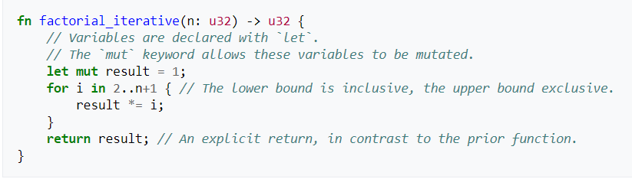
Sample Code

Slide 4
Goal
The goal of Rust is to be a language suited to creating highly concurrent and highly safe systems, and "programming in the large", that is, creating and maintaining boundaries that preserve large-system integrity. This has led to a feature set with an emphasis on safety, control of memory layout, and concurrency. Performance of idiomatic Rust is comparable to the performance of idiomatic C++.
The system is designed to be memory safe, and it does not permit null pointers, dangling pointers, or data races in safe code. Data values can only be initialized through a fixed set of forms, all of which require their inputs to be already initialized. To replicate the functionality in other languages of pointers being either valid or NULL, such as in linked list or binary tree data structures, the Rust core library provides an option type, which can be used to test if a pointer has Some value or None. Rust also introduces additional syntax to manage lifetimes, and the compiler reasons about these through its borrow checker.

Slide 5
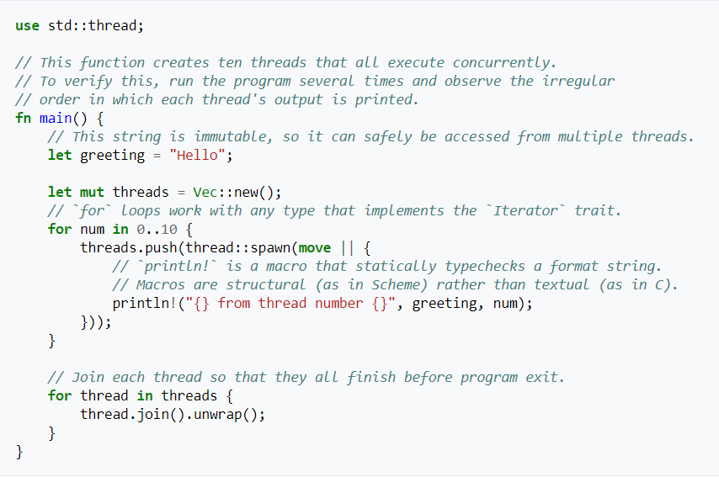
Multithreading

Slide 6
Cargo
Cargo is Rust’s build system and package manager. Cargo takes care of building code, downloading the libraries, and building those libraries.
In order to start a cargo project run the commands
$ cargo new hello_cargo --bin
$ cd hello_cargo
Filename: Cargo.toml
[package]
name = "hello_cargo"
version = "0.1.0"
authors = ["Your Name <you@example.com>"]
[dependencies]

Slide 7
Immutable Variables
In Rust, variables are immutable by default. The following example shows how to use mut before the variable name to make a variable mutable:
let foo = 5; // immutable
let mut bar = 5; // mutable

Slide 8
Where is Rust being used?
Dropbox is using Rust in multiple high-impact projects to manage exabytes of data on the back end, where correctness and efficiency is critical.
Mozilla has started Servo, an alternative to Firefox.
npm started using Rust in production to serve JavaScript packages.

Slide 9
Bibliography
https://github.com/rust-lang/rust/
https://en.wikipedia.org/wiki/Rust_(programming_language)
https://blog.rust-lang.org/2016/09/08/incremental.html
https://doc.rust-lang.org/book/second-edition/
https://blog.rust-lang.org/2016/04/19/MIR.html

