Slide 1
Rust Compiler Case Study
Souradeep Nanda 14BCE1037
Ronak Parmaar 14BCE1040
Praveen Kumar 14BCE1117
Barnik Bannerjee 14BCE1233

Slide 2
What is Rust?
Rust is a systems programming language sponsored by Mozilla Research. It is designed to be a "safe, concurrent, practical language", supporting functional and imperative-procedural paradigms. Rust is syntactically similar to C++, but is designed for better memory safety while maintaining performance.
Rust is open source software. The design of the language has been refined through the experiences of writing the Servo web browser layout engine and the Rust compiler. A large portion of current commits to the project are from community members.
Rust won first place for "most loved programming language" in the Stack Overflow Developer Survey in 2016 and 2017.

Slide 3
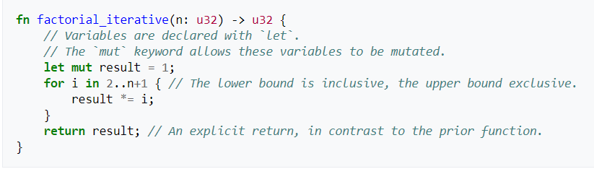
Sample Code

Slide 4
Goal
The goal of Rust is to be a language suited to creating highly concurrent and highly safe systems, and "programming in the large", that is, creating and maintaining boundaries that preserve large-system integrity. This has led to a feature set with an emphasis on safety, control of memory layout, and concurrency. Performance of idiomatic Rust is comparable to the performance of idiomatic C++.
The system is designed to be memory safe, and it does not permit null pointers, dangling pointers, or data races in safe code. Data values can only be initialized through a fixed set of forms, all of which require their inputs to be already initialized. To replicate the functionality in other languages of pointers being either valid or NULL, such as in linked list or binary tree data structures, the Rust core library provides an option type, which can be used to test if a pointer has Some value or None. Rust also introduces additional syntax to manage lifetimes, and the compiler reasons about these through its borrow checker.

Slide 5
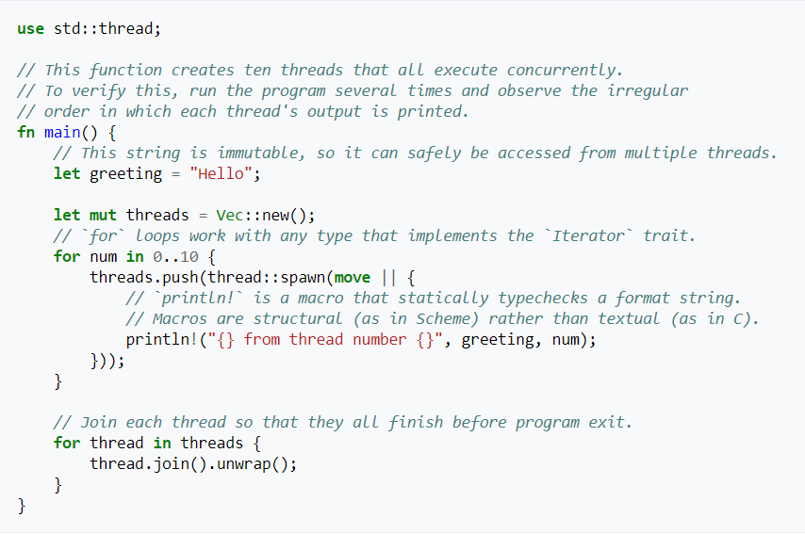
Multithreading

Slide 6
Cargo
Cargo is Rust’s build system and package manager. Cargo takes care of building code, downloading the libraries, and building those libraries.
In order to start a cargo project run the commands
$ cargo new hello_cargo --bin
$ cd hello_cargo
Filename: Cargo.toml
[package]
name = "hello_cargo"
version = "0.1.0"
authors = ["Your Name <you@example.com>"]
[dependencies]

Slide 7
Immutable Variables
In Rust, variables are immutable by default. The following example shows how to use mut before the variable name to make a variable mutable:
let foo = 5; // immutable
let mut bar = 5; // mutable

Slide 8
Where is Rust being used?
Dropbox is using Rust in multiple high-impact projects to manage exabytes of data on the back end, where correctness and efficiency is critical.
Mozilla has started Servo, an alternative to Firefox.
npm started using Rust in production to serve JavaScript packages.

Slide 9
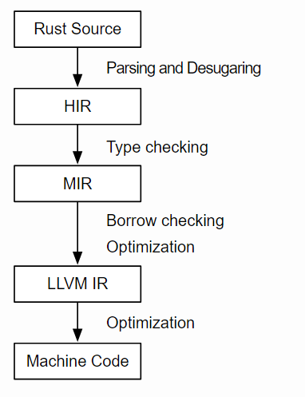
Mid Level Intermediate Representation
MIR stands for mid-level IR, because the MIR comes between the existing HIR (“high-level IR”, roughly an abstract syntax tree) and LLVM (the “low-level” IR). It does its work in two phases, with a vastly simplified version of Rust MIR standing in the middle.

Slide 10
Advantages of MIR
Faster compilation time - MIR also provides a foundation for more efficient data structures and removal of redundant work in the compiler, both of which should speed up compilation across the board.
Faster execution time – Optimizations at each level
More precise type checking - MIR enables much more flexible borrowing, which will in turn improve Rust’s ergonomics and learning curve.
Eliminating redundancy – Removes duplicate safety checks

Slide 11
Incremental Compilation
rustc -Zincremental=<path> ./main.rs Starts the rust compiler in incremental mode
One basic strategy we can employ to achieve this is to view one big computation (like compiling a program) as a composite of many smaller, interrelated computations that build up on each other. Each of those smaller computations will yield an intermediate result that can be cached and hopefully re-used in a later iteration, sparing us the need to re-compute that particular intermediate result again.

Slide 12
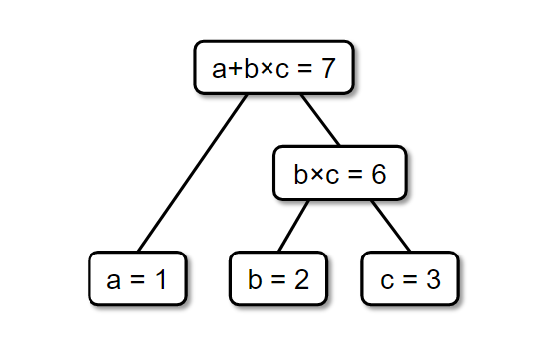
Incremental Compilation
Let’s take a look at a simple example from algebra to make things more concrete. Let’s see what it means to evaluate an expression of the form a+b×c incrementally. This will involve evaluating the expression once with one set of values for a, b, and c, and then evaluating it a second time with a different value for a. For the first time around, a will be 1, b will be 2, and c will be 3:

Slide 13
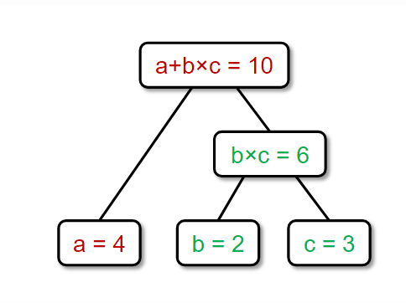
Incremental Compilation
Assume that we “saved” the intermediate results at each step, that is, we remember somewhere that b×c is 6 and a+b×c is 7. Now, in the second round, we want to know what a+b×c is if we change the value of a to 4. When we recompute the value of the expression, however, we see that we already know that b×c = 6, so we don’t have to perform that computation again, and can rather skip directly to (a = 4) + (b×c = 6). We thus have computed the value of our expression in just one step instead of two, sparing us an entire, tedious multiplication.

Slide 14
An Incremental Compiler
The way we chose to implement incrementally in the Rust compiler is straightforward: An incremental compilation session follows exactly the same steps in the same order as a batch compilation session. However, when control flow reaches a point where it is about to compute some non-trivial intermediate result, it will try to load that result from the incremental compilation cache on disk instead. If there is a valid entry in the cache, the compiler can just skip computing that particular piece of data.

Slide 15
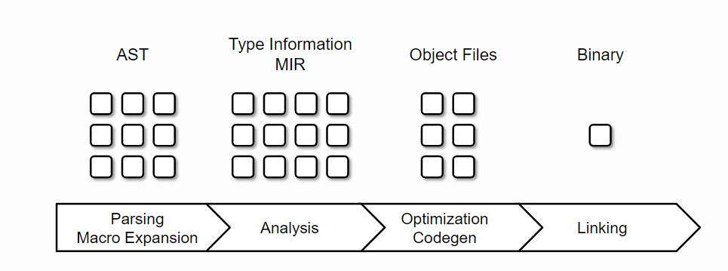
An Incremental Compiler
Let’s take a look at the overview of the different compilation phases and the intermediate results they produce:

Slide 16
An Incremental Compiler
First the compiler will parse the source code into an abstract syntax tree (AST). The AST then goes through the analysis phase which produces type information and the MIR for each function. After that, if analysis did not find any errors, the codegen phase will transform the MIR version of the program into its machine code version, producing one object file per source-level module. In the last step all the object files get linked together into the final output binary which may be a library or an executable.

Slide 17
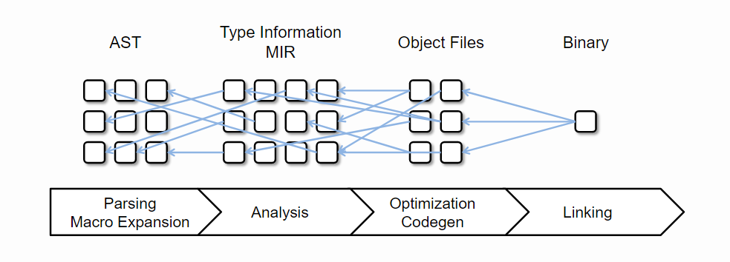
Dependency Tracking in the Compiler
At any point in time the compiler keeps track of which piece of data it is currently working on. This is the currently active node of the dependency graph. Conversely, the data that needs to be read to compute the value of the active node is also tracked: it usually already resides in some kind container (e.g. a hash table) that requires invoking a lookup method to access a specific entry. Whenever an entry is accessed, we know that it is being read and we know what it is being read for (the currently active node). This gives us both ends of the dependency edge and we can simply add it to the graph. At the end of the compilation sessions we have all our data nicely linked up, mostly automatically:

Slide 18
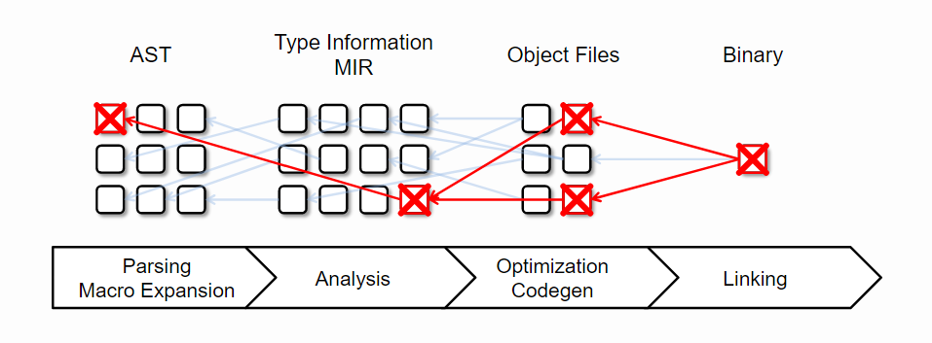
Dependency Tracking in the Compiler
At the beginning of a subsequent compilation session, we detect which inputs (=AST nodes) have changed by comparing them to the previous version. Given the graph and the set of changed inputs, we can easily find all cache entries that are not up-to-date anymore and just remove them from the cache. Anything that has survived this cache validation phase can safely be re-used during the current compilation session.

Slide 19
Bibliography
https://github.com/rust-lang/rust/
https://en.wikipedia.org/wiki/Rust_(programming_language)
https://blog.rust-lang.org/2016/09/08/incremental.html
https://doc.rust-lang.org/book/second-edition/
https://blog.rust-lang.org/2016/04/19/MIR.html

