Slide 1
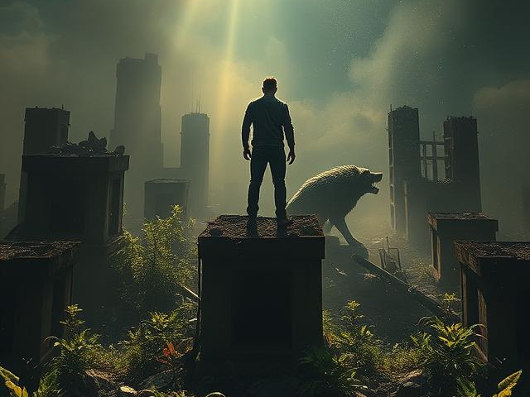
Anastasia
Team:
Daniel Dworski
Aaron Wagner
David Dworski

Slide 2
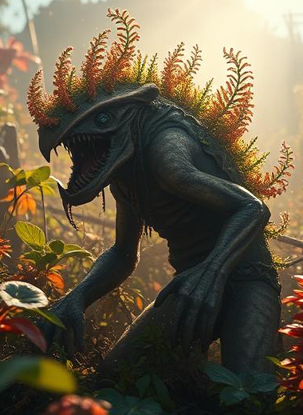
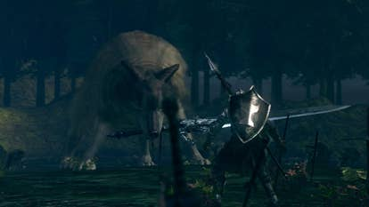

Game Concept
Lore:
post-apocalyptic world
Radiation -> Mutation of animals & plants (enemies)
Gameplay:
Open-world like survival
Upleveling with XP and/or Items
Combat focused with
new mechanics via skills/weapons and enemies
Top-Down-View
Look & Feel:
2D
Smooth graphics (later refocus on pixel art)

Slide 3
Showcase
Start: Outside bunker, where you survived the nuclear Bombing
Player Movement (WASD):
J: Attack (1 hp dmg)
K: Dash
L: Heavy Attack (2 hp dmg)
Ö: Block
Enemy (state machine):
Spotted: Follow
Sprint Attack
Near: Konstant Biting

Slide 4
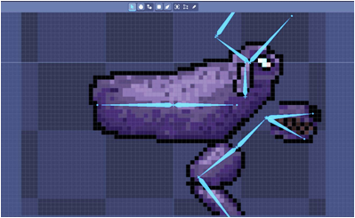
Lessons Learned
Start of a big Project (free time in summer)
Don´t Overthink (~3 days for HP-Bar)
Make plan (separate work)
Biggest Problem:
Create own Sprites - Software (not free) - no talent / experience => (2 days for not finished wolf)
Get to know the Software before using it perfectly (build working demo first, then refactor)

