Slide 1
第7讲 Phaser3游戏示例(1)
2D游戏引擎应用与开发
主讲：刘生建

Slide 2

目录
contents
1
游戏规则
2
游戏设计
3
游戏编码

Slide 3
重点
游戏设计
游戏编码

Slide 4
难点
游戏设计
游戏编码

Slide 5
01
游戏规则

Slide 6
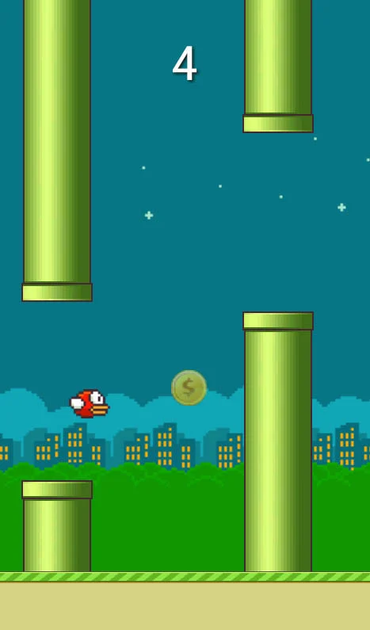
1.1 游戏简介
休闲益智游戏：
FlappyBird

Slide 7
1.2 游戏玩法
有多对中间有空隙的水管组成的障碍物从左往右移动。
玩家使用鼠标左键控制小鸟弹跳。获得冲力时抬头倾斜约45度。随时间流逝小鸟向下倾斜，但最多向下90度

Slide 8
02
游戏设计

Slide 9

2.1 开发工具
Phaser3

Slide 10
2.1 主要模块
英文 | 实现功能 | 依赖
Play | 继承Scene类，实现游戏玩法
main | 程序入口 | Play

Slide 11
03
游戏编码

Slide 12
3.1 常量定义
let gameOptions = {
// bird gravity, will make bird fall if you don't flap
birdGravity: 800,
// horizontal bird speed
birdSpeed: 125,
// flap thrust
birdFlapPower: 300,
// minimum pipe height, in pixels. Affects hole position
minPipeHeight: 50,
// distance range from next pipe, in pixels
pipeDistance: [180, 220],
// hole range between pipes, in pixels
pipeHole: [110, 150],
// local storage object name
localStorageName: 'bestFlappyScore'
}

Slide 13
3.2 加载资源
this.load.spritesheet('bird','assets/bird.png',{frameWidth:34,frameHeight:24});
this.load.spritesheet('pipes','assets/pipes.png',{frameWidth:54,frameHeight:320});
//加载音效
this.load.audio('score','assets/score.wav');
this.load.audio('ground-hit','assets/ground-hit.wav');
this.load.audio('pipe-hit','assets/pipe-hit.wav');

Slide 14
3.3 创建障碍物
this.pipeGroup = this.physics.add.group();
this.pipePool = [];
for (let i = 0; i < 4; i++) {
this.pipePool.push(this.pipeGroup.create(0, 0, 'pipes',0));
this.pipePool.push(this.pipeGroup.create(0, 0, 'pipes',1));
this.placePipes(false);
}
this.pipeGroup.setVelocityX(-gameOptions.birdSpeed);
this.physics.add.collider(this.bird, this.pipeGroup,()=>{
this.sound.play('pipe-hit');
this.die();
}, null, this );

Slide 15
3.4 获取最高分
this.score = 0;
this.topScore = localStorage.getItem(gameOptions.localStorageName) == null ? 0 : localStorage.getItem(gameOptions.localStorageName);
this.scoreText = this.add.text(10, 10, '');
this.updateScore(this.score);

Slide 16
3.5 小鸟上冲
flap() {
this.bird.angle=0;
this.bird.body.velocity.y = -gameOptions.birdFlapPower;
this.tweens.add({
targets: this.bird,
duration:100,
angle:-30,
})
}

Slide 17
3.5 逻辑处理
update() {
if (this.bird.y > this.scale.height || this.bird.y < 0) {
this.sound.play('ground-hit');
this.die();
}
if (this.bird.angle < 90) this.bird.angle += 1;
this.pipeGroup.children.each((pipe) => {
if (pipe.getBounds().right < 0) {
this.pipePool.push(pipe);
if (this.pipePool.length == 2) {
this.placePipes(true);
}
}
}, this)
}

Slide 18
谢谢

