Slide 1
Introduction to networking
TCP/IP Five-Layer Network Model
Joel Enrique Esparza Ramirez
Internet of Things

Slide 2
Lectures
1. Introduction to Networking
2. The Network Layer
3. The transport and application Layer
4. Wireless connections

Slide 3
Introduction to Networking
TCP/IP Five-Layer Network Model

Slide 4
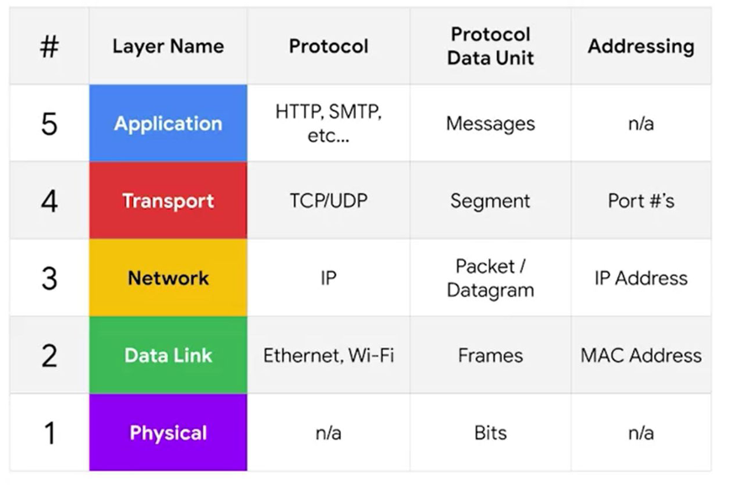
TCP/IP Five-Layer Network Model

Slide 5
Layer 1 physical
Represents the physical devices that interconnect computers

Slide 6
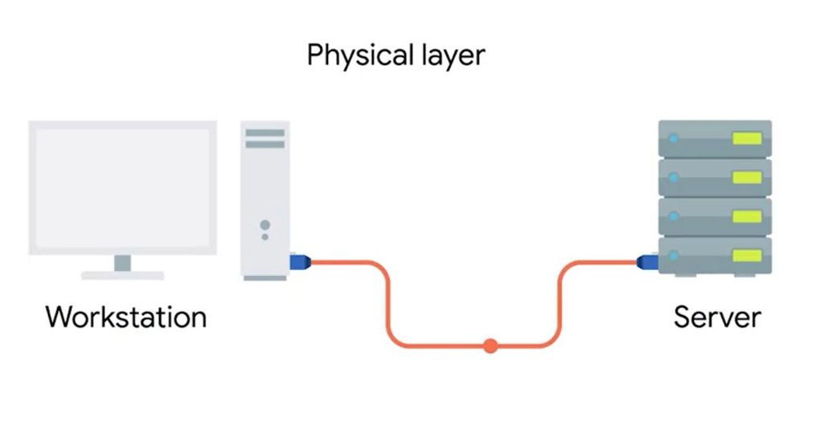

Slide 7
Layer 2 data link
Responsible for defining a common way of interesting these signals so network devices can communicate

Slide 8
ethernet
The Ethernet standards also define a protocol responsible for getting data to nodes on the same network

Slide 9
Layer 3 Network
Allows different networks to communicate with each other through devices known as routers

Slide 10
Network diagram explain internet

Slide 11
internetwork
A collection of networks connected together through routers, the most famous of these being the internet

Slide 12
Internet protocol
IP is the heart of the internet and most smaller networks around the world

Slide 13
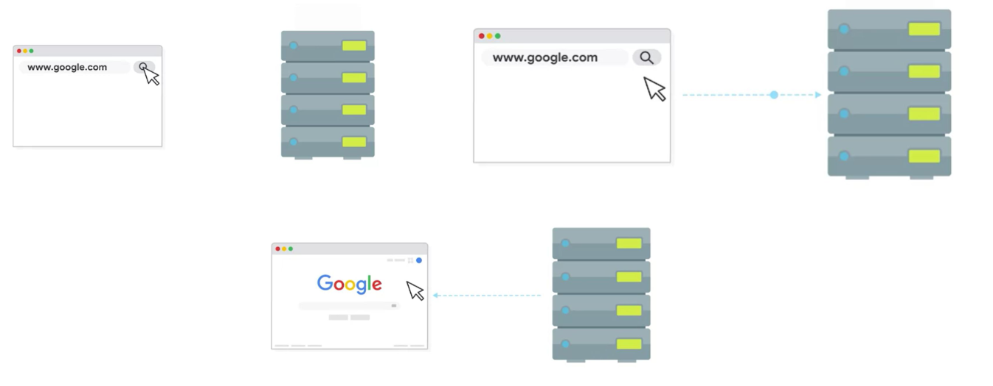
Client Server

Slide 14
Layer 4 transport
Sorts out which client and server programs are supposed to get that data

Slide 15
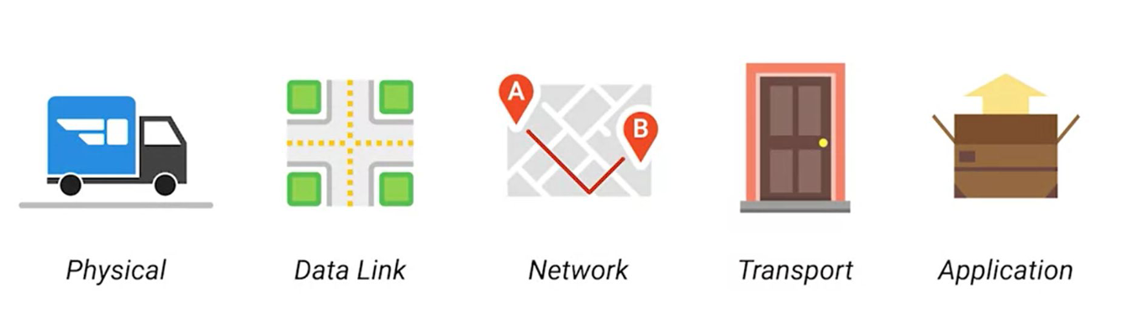

Slide 16
Osi model

Slide 17
Introduction to Networking
The basics of networking devices

Slide 18
cables
Connect different devices to each other, allowing data to be transmitted over them

Slide 19
Cables
Copper (Spanish)
Fiber (Spanish)

Slide 20
Cables
The most common forms of copper twisted-pair cables used in networking are Cat5, Cat5e and Cat6 cables

Slide 21
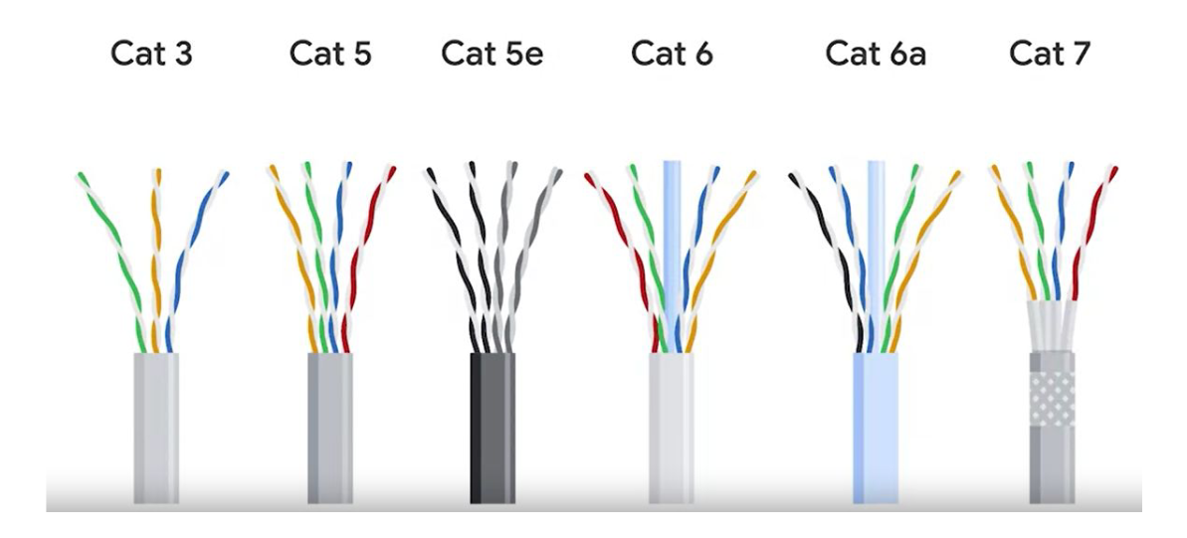

Slide 22
crosstalk
When an electrical pulse on one wire is accidentally detected on another wire

Slide 23
Fiber cables
Contain individual optical fibers, which are tiny tubes made out of glass about the width of a human hair

Slide 24
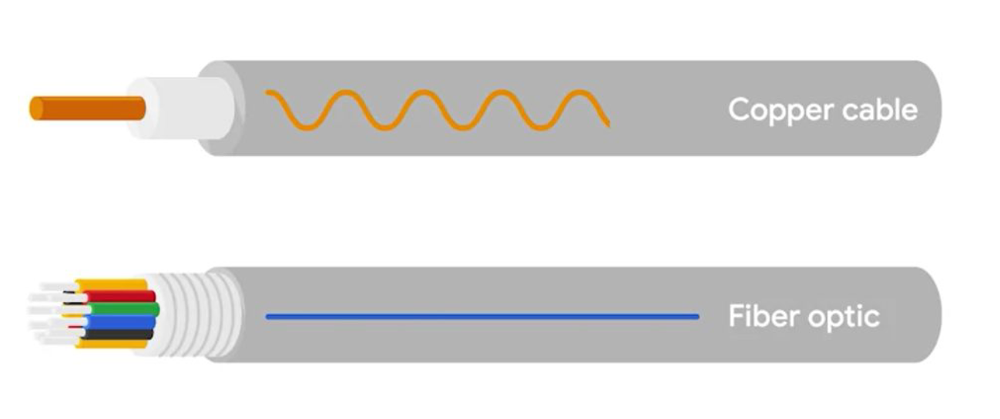

Slide 25
Recap layer 1

Slide 26
HUB
A physical layer device that allows for connections from many computers at once

Slide 27
Update photo

Slide 28
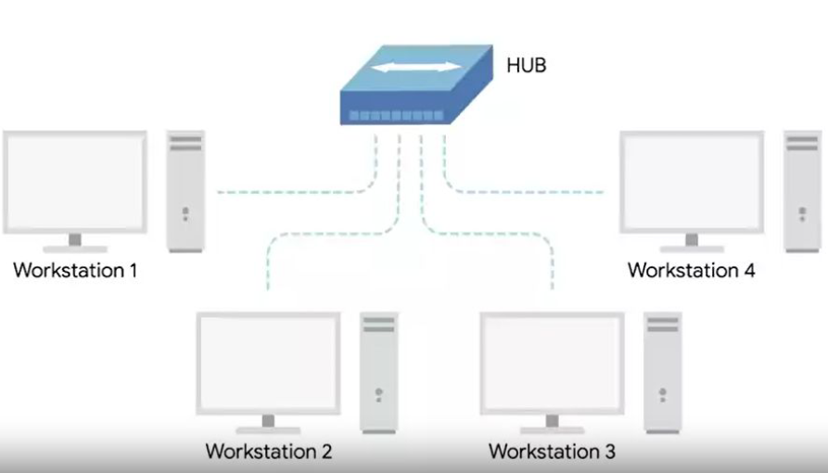

Slide 29
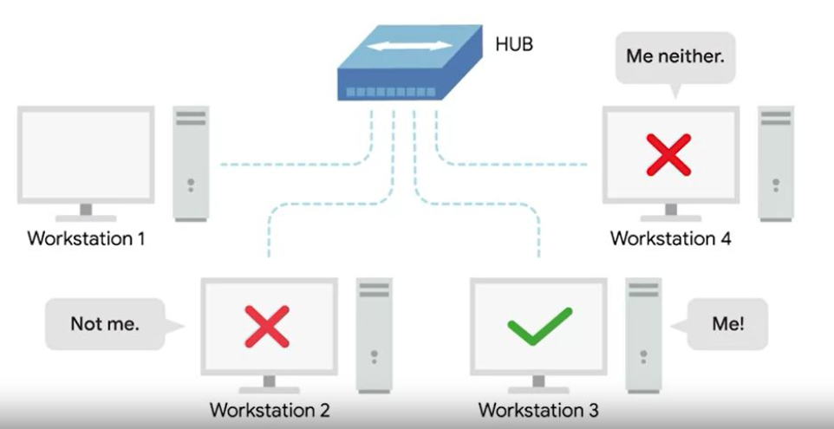

Slide 30
Collision domain
A network segment where only one device can communicate at a time

Slide 31
Collision domain
If multiple systems try sending data at the same time, the electrical pulses sent across the cable can interfere with each other

Slide 32
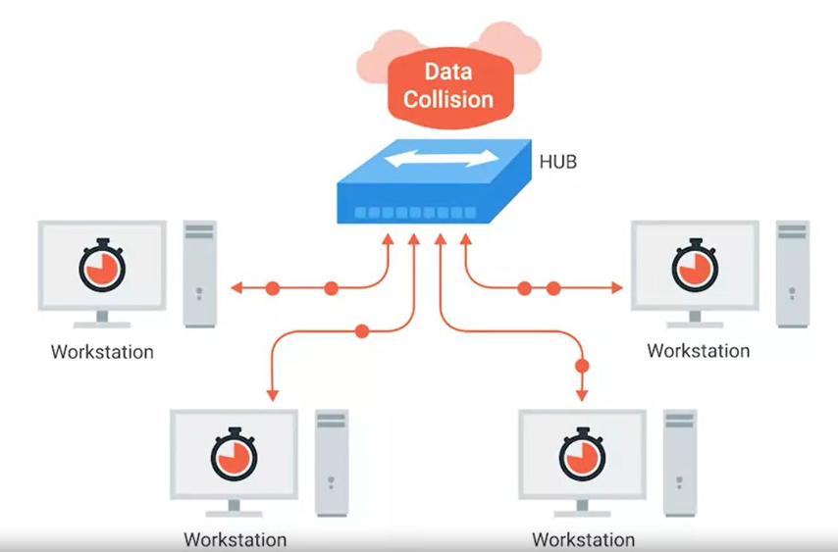

Slide 33
Switch
definition

Slide 34
Switch image

Slide 35
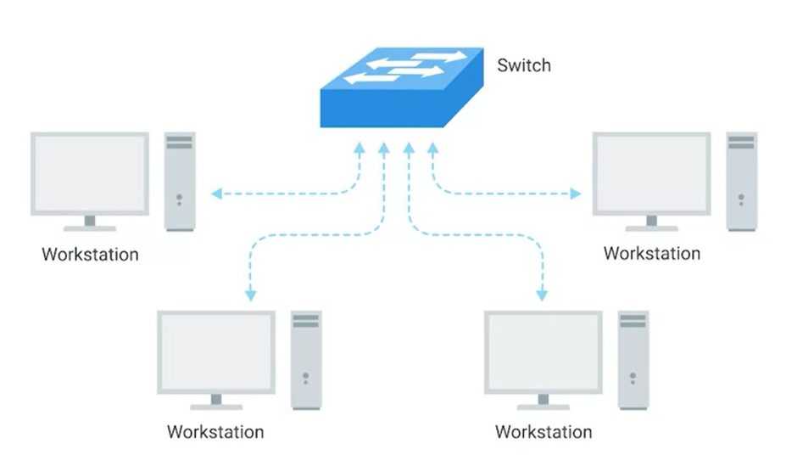

Slide 36
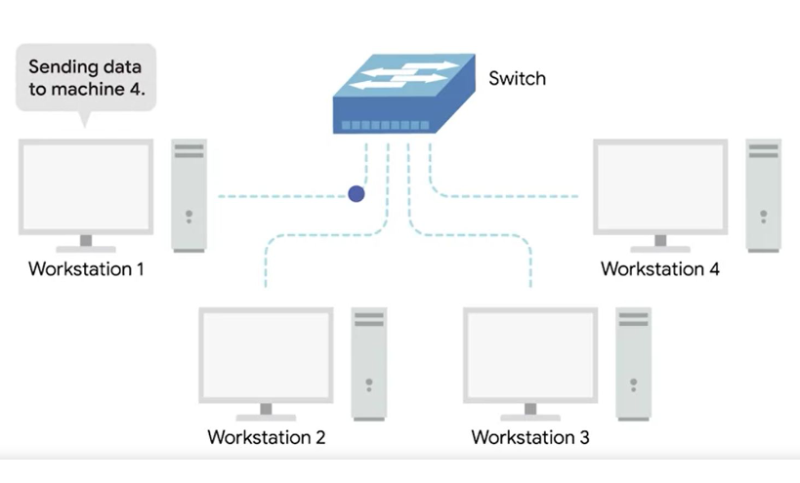

Slide 37
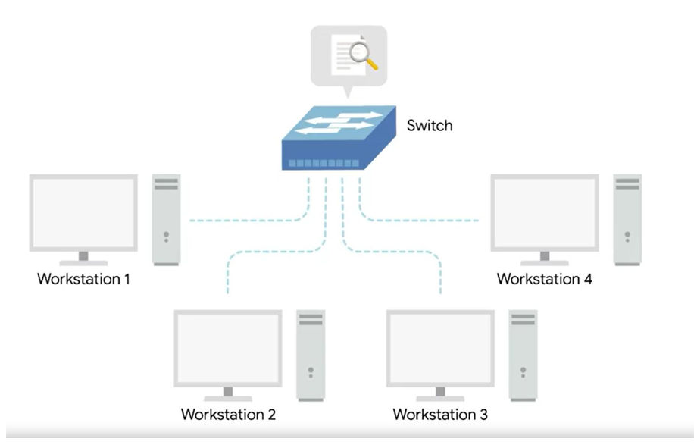

Slide 38
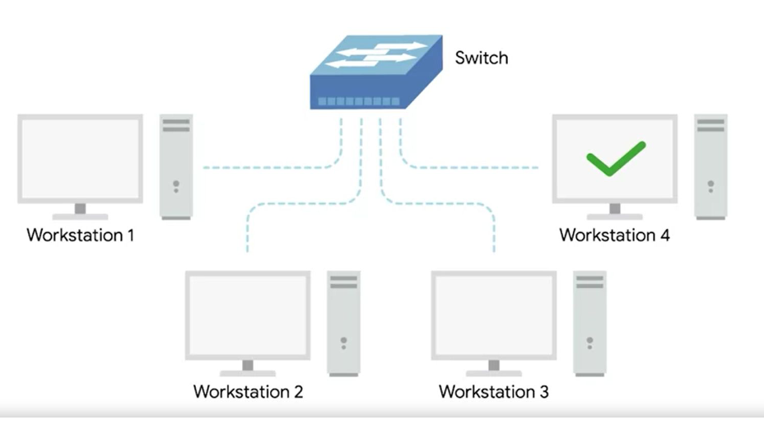

Slide 39
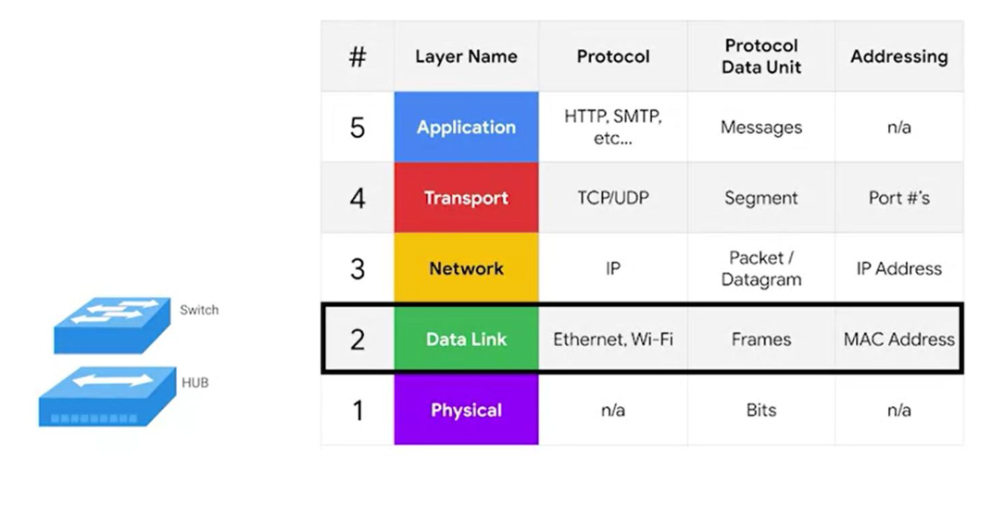

Slide 40
Hub and switches
The primary devices used to connect computers on a single network. Usually referred as a LAN, or local area network

Slide 41
recap

Slide 42
router
A device that knows how to forward data between independent networks

Slide 43
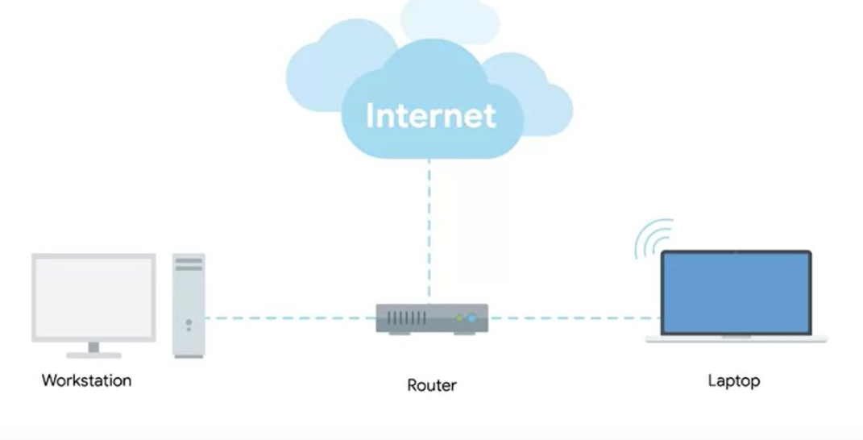

Slide 44
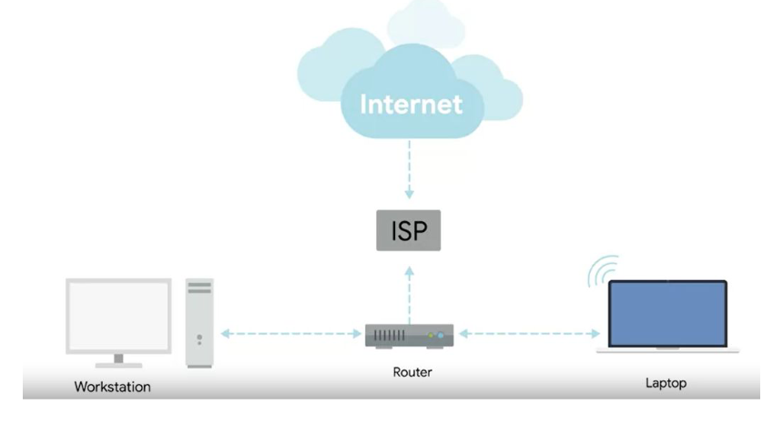
Internet service provider

Slide 45
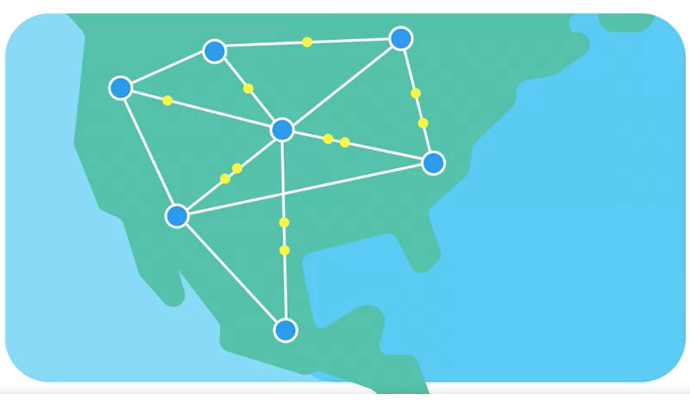

Slide 46
Border gateway protocol (BGP)
Routers share data with each other via this protocol, which lets them learn about the most optimal paths to forward traffic.

Slide 47
NODE
A device connected to the network

Slide 48
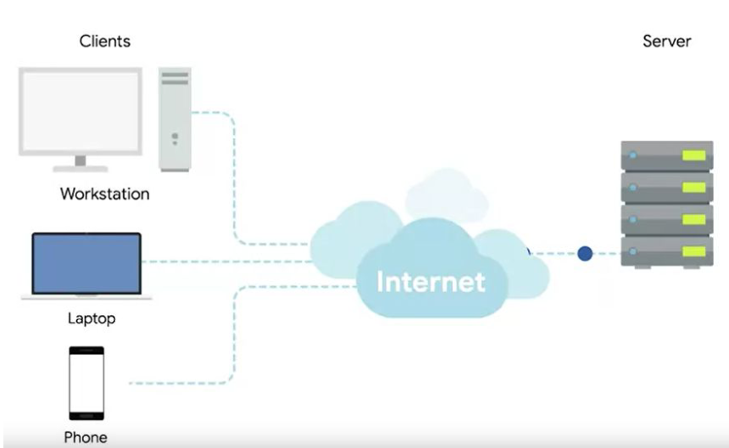

Slide 49
