Slide 1
IOT PROJECT
Joel Enrique Esparza Ramirez
Internet of Things

Slide 2
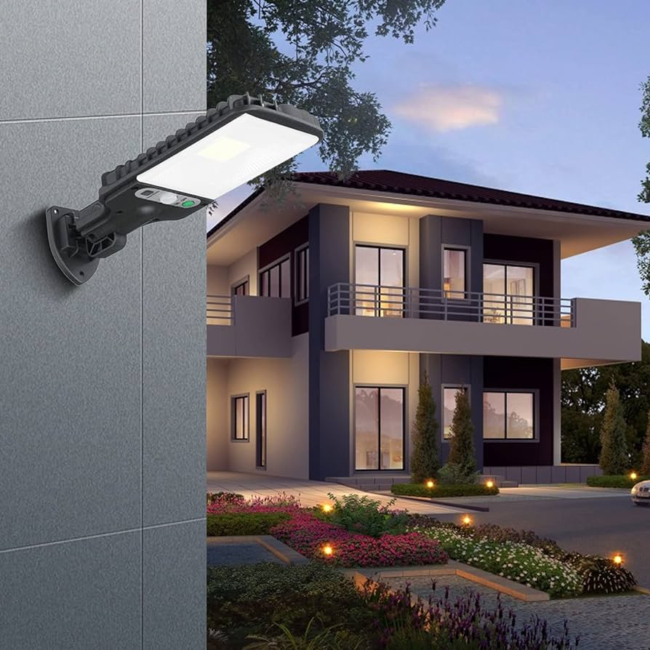
INTELLIGENT LIGHTING

Slide 3
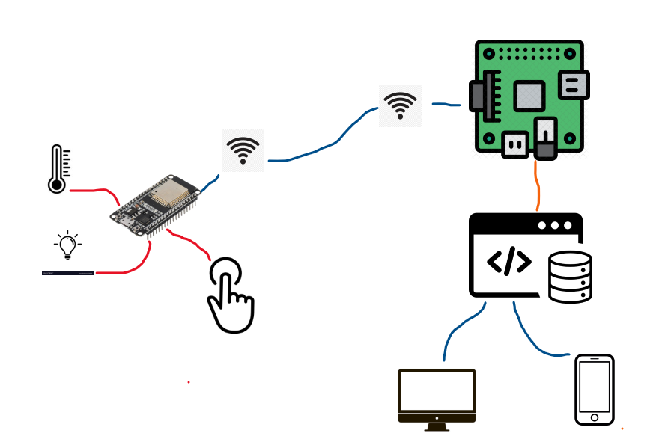
DIAGRAM

Slide 4
Structure
1. ESP32 (CONTROLLER)
2. APP

Slide 5
ESP32
setup

Slide 6
Drivers
Drivers: https://www.silabs.com/developers/usb-to-uart-bridge-vcp-drivers?tab=downloads
### Manual install ###
1. Using Windows File Explorer, locate the driver folder(that you previously unzipped)
2. Right click on the silabser.inf file and select Install
3. Follow the instructions

Slide 7
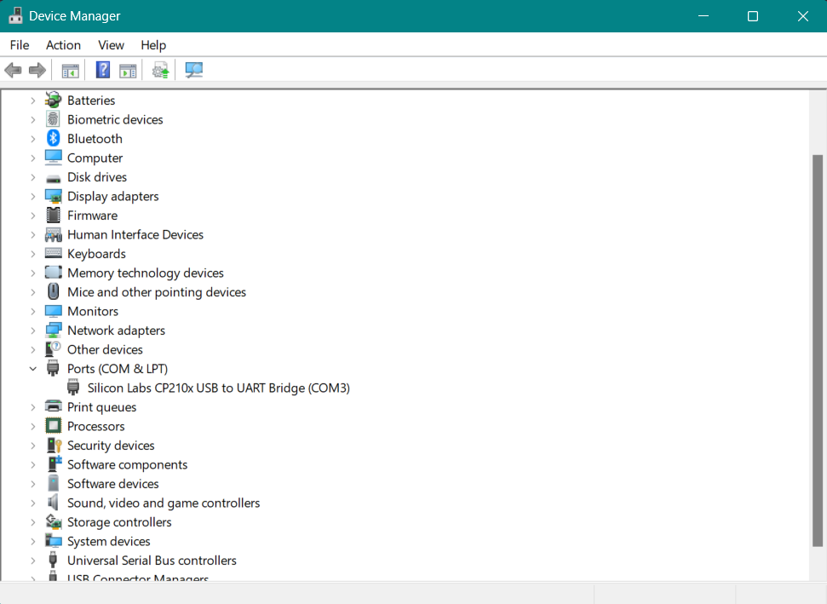

Slide 8
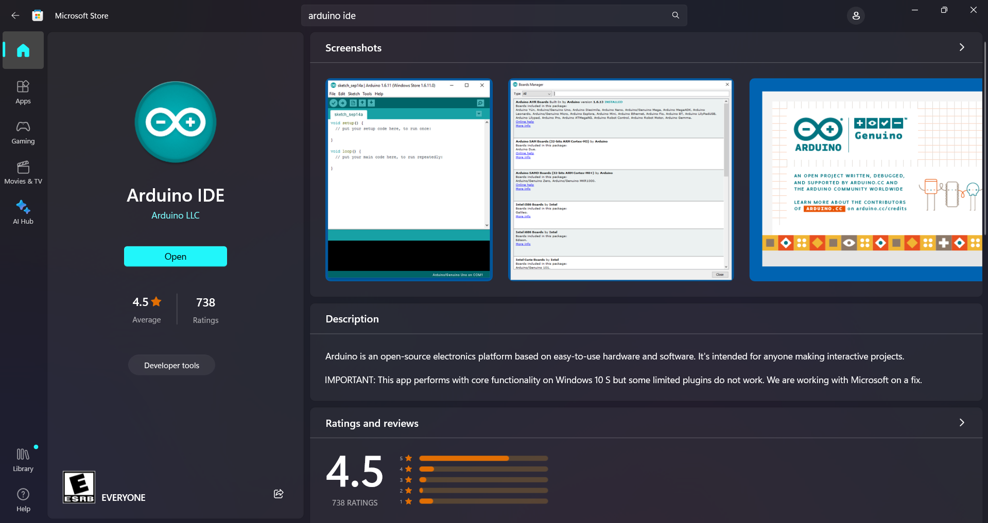

Slide 9
Add board to ide
https://raw.githubusercontent.com/espressif/arduino-esp32/gh-pages/package_esp32_index.json

Slide 10
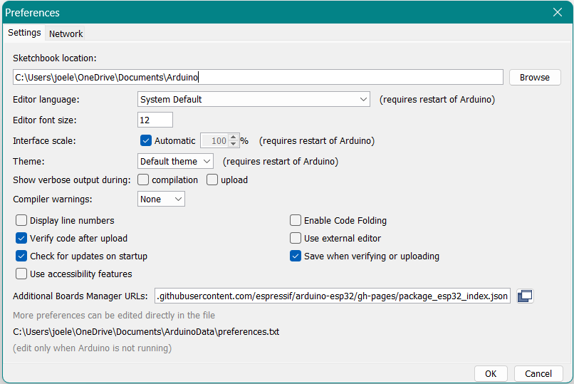

Slide 11
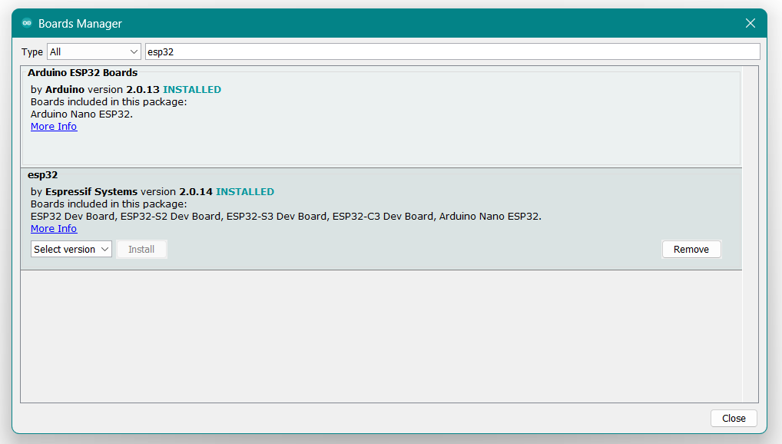

Slide 12
Examples
LED
INTERNET CONNECTION

Slide 13
EXAMPLES (TO DO)
PSH BTN AND TEMP SENSOR
MQTT

Slide 14
MQTT
MQTT, which stands for Message Queuing Telemetry Transport, is a lightweight, publish-subscribe network protocol that transports messages between devices. It is designed for connections with remote locations where a small code footprint is required, or the network bandwidth is limited.

Slide 15
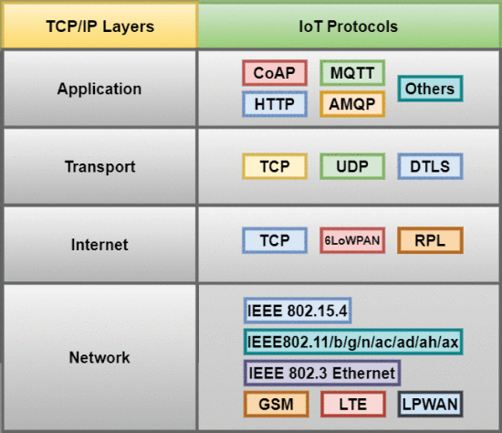

Slide 16
