Slide 1
DATABASES
Something Nice here
Joel Enrique Esparza Ramirez
Internet of Things

Slide 2
Introduction

Slide 3
database
A database is an organized collection of data, generally stored and accessed electronically from a computer system. Databases make it easier to store, manage, and retrieve information efficiently and securely.

Slide 4
Types of Data Storage
Structured: Data that adheres to a predefined model (e.g., relational databases) where it's organized into tables.
Unstructured: Data that doesn't fit neatly into a traditional table structure (e.g., multimedia files, documents).
Semi-structured: Data that does not reside in a relational database but that does have some organizational properties that make it easier to analyze (e.g., XML, JSON).

Slide 5
Relational Databases (RDBMS)
Structure: Data is structured in tables and rows, with relationships between tables defined by keys.
Query Language: SQL (Structured Query Language) is used for managing and querying data.
Examples: MySQL, PostgreSQL, Oracle Database, Microsoft SQL Server.
Use Cases: Suitable for applications requiring complex queries and high transaction integrity, such as banking systems and customer relationship management systems.

Slide 6
NoSQL Databases
Structure: Designed to handle unstructured and semi-structured data with flexible schemas.
Types:
Document Stores: Data is stored in document formats (JSON, XML, etc.). Examples: MongoDB, CouchDB.
Key-Value Stores: Data is stored as a collection of key-value pairs. Examples: Redis, DynamoDB.
Wide-Column Stores: Store data in tables, rows, and dynamic columns. Examples: Cassandra, HBase.
Use Cases: Ideal for big data applications, real-time web apps, and when working with large volumes of distributed data.

Slide 7
USES
Databases are used in almost every kind of application and are vital for businesses and organizations as they provide a systematic way of managing data such as:
Customer information
Inventory data
Financial records
Personal records

Slide 8
Basic Terminology
Tables
Rows
Columns
Primary keys

Slide 9
Tables
Definition: A table is a collection of related data entries, and it consists of columns and rows. Tables are similar to a spreadsheet and are a fundamental component of relational databases.
Use: Tables are used to organize information within a database, with each table usually representing a specific type of entity (e.g., customers, orders).

Slide 10
Rows
Definition: A row, also known as a record, represents a single, implicitly structured data item in a table.
Use: Each row in a table holds individual records (or data entities), with each column of the row representing a data attribute of the record.

Slide 11
COLUMNS
Definition: A column in a database table is a vertical entity that contains all information associated with a specific field in a table.
Use: Columns hold the data of a specific type for each record, such as a customer’s name or their phone number.

Slide 12
Primary key
Definition: A primary key is a column (or a set of columns) in a table that uniquely identifies each row in that table.
Use: Primary keys ensure that each record in a table is unique and not duplicated. They are also critical for establishing relationships between tables (foreign keys point to primary keys in related tables).

Slide 13
PART 1
MYSQL

Slide 14
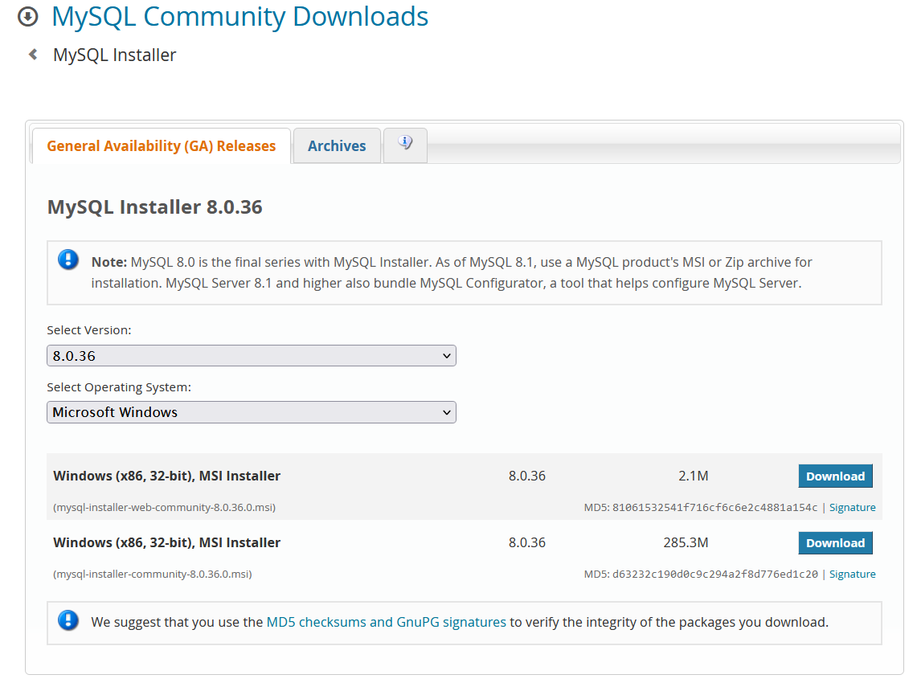
DOWNLOAD
https://dev.mysql.com/downloads/installer/

Slide 15
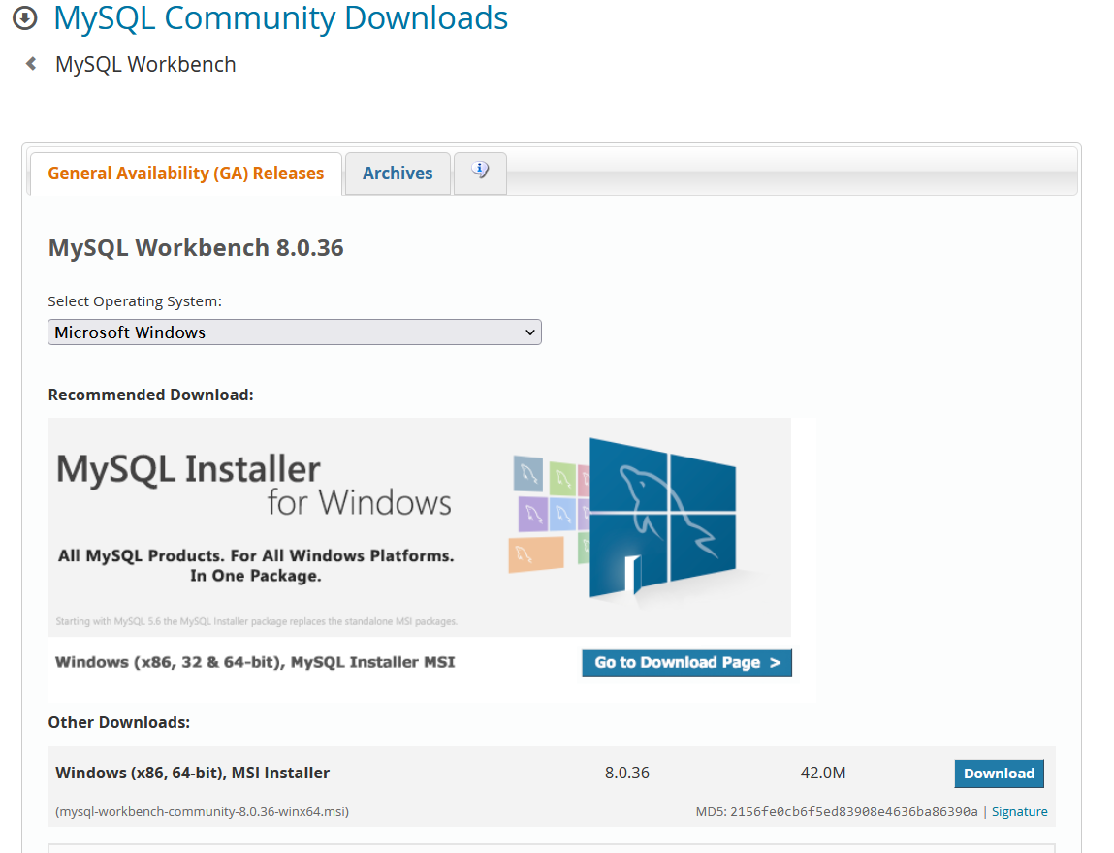
WORKBENCH
https://dev.mysql.com/downloads/workbench/

Slide 16
CREATE VENV
Creating a virtual environment (venv) in Python is a useful way to manage and isolate project dependencies.
python -m venv venv_name
source venv_name/bin/activate

Slide 17
Install connector
pip install mysql
pip install mysql-connector
pip install mysql-connector-python

Slide 18

CREATE DB
Lecture 1

