Slide 1
WEB DEVELOPMENT
HTML CSS JS
Joel Enrique Esparza Ramirez
Internet of Things

Slide 2
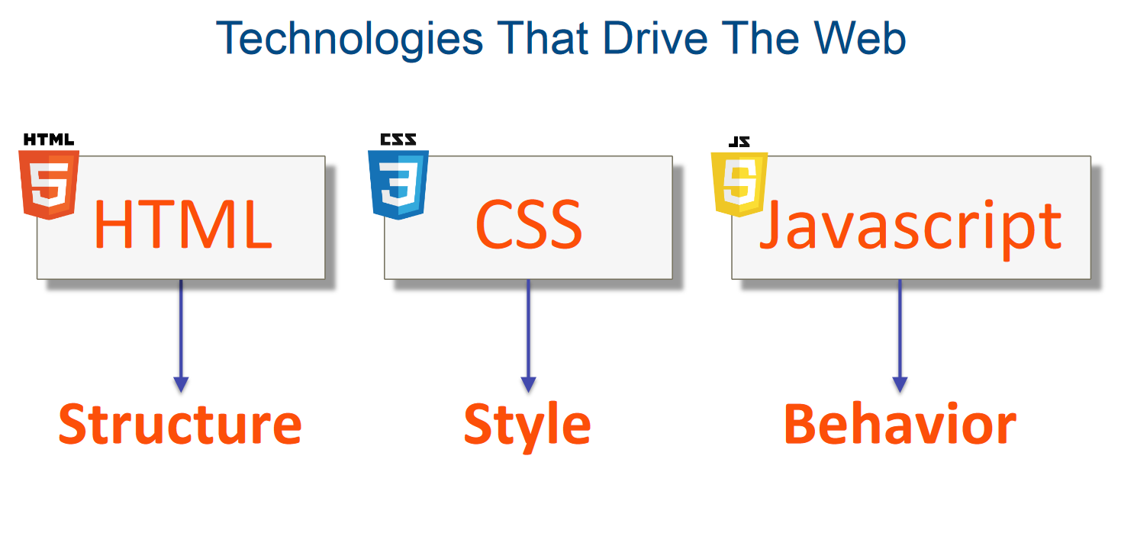

Slide 3
HTML
Hypertext MARKUP language

Slide 4

HTML

Slide 5
Hypertext definition
Hypertext is a method of organizing and presenting information in a digital format where text is linked together through hyperlinks. These hyperlinks allow users to navigate between different pieces of content, often within the same document or across multiple documents or web pages.

Slide 6
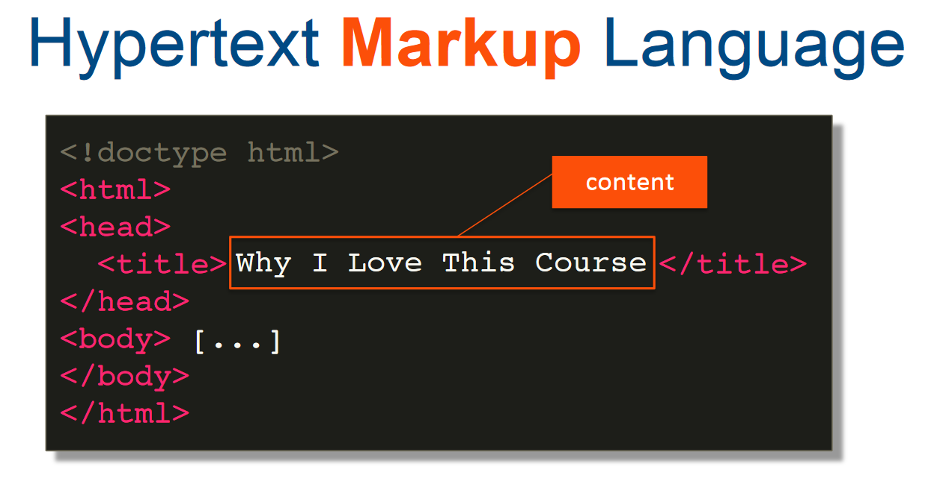

Slide 7
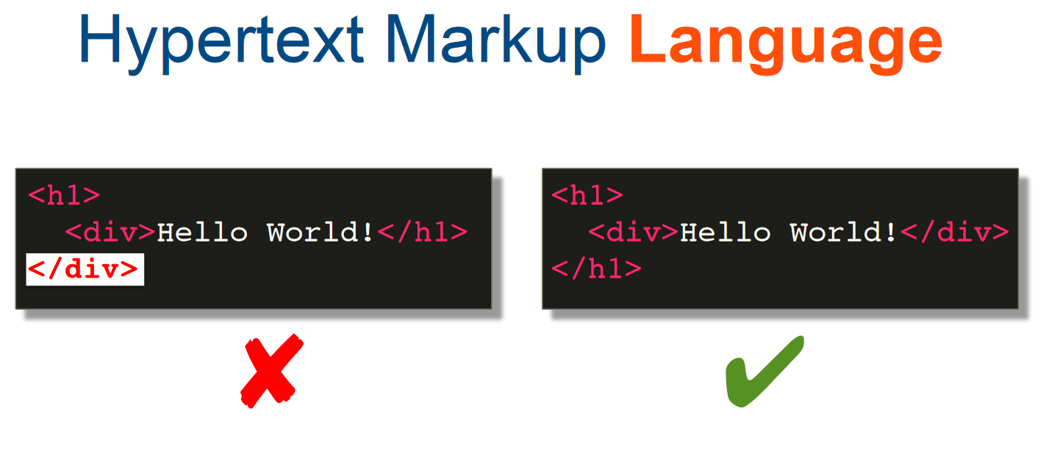

Slide 8
Anatomy of an html tag

Slide 9
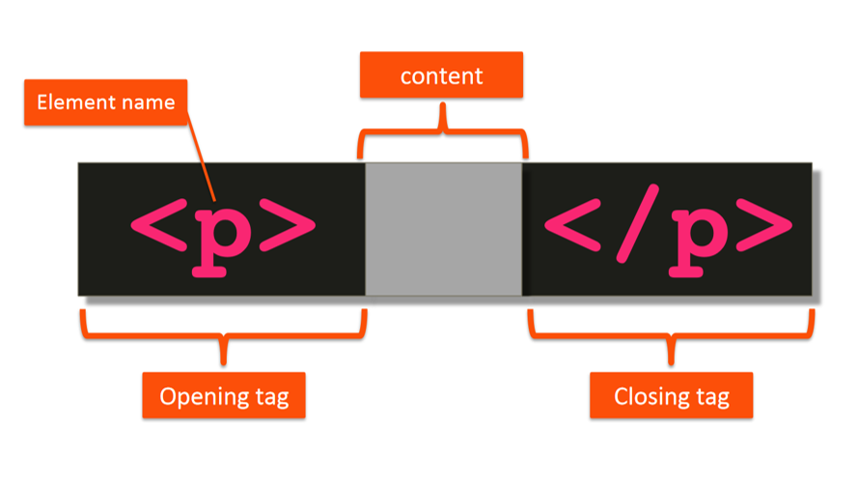

Slide 10
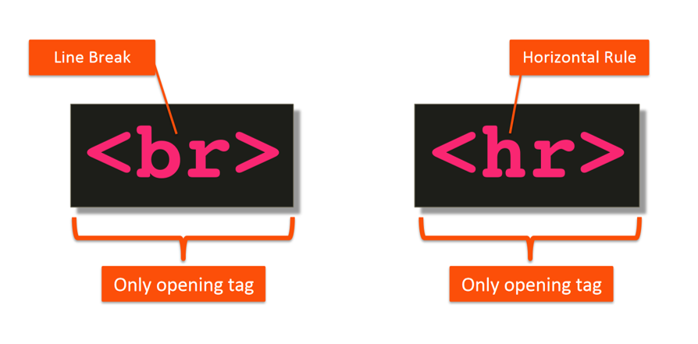
https://developer.mozilla.org/en-US/docs/Web/HTML/Element

Slide 11
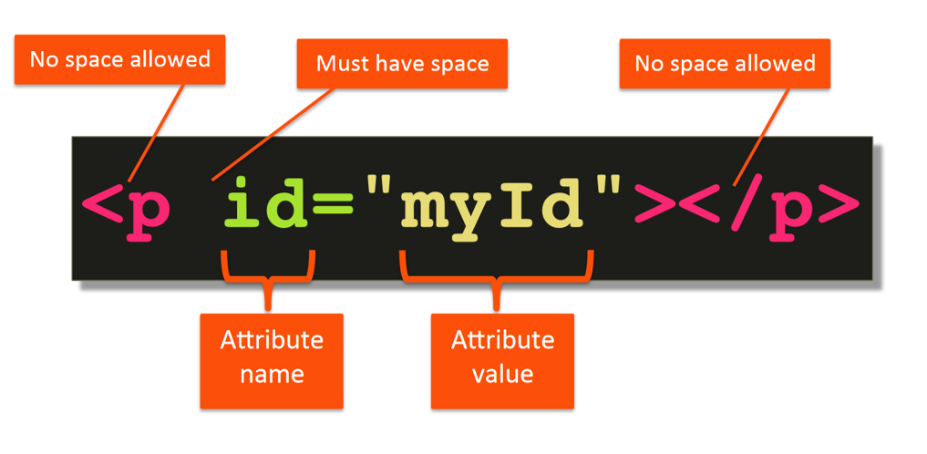

Slide 12
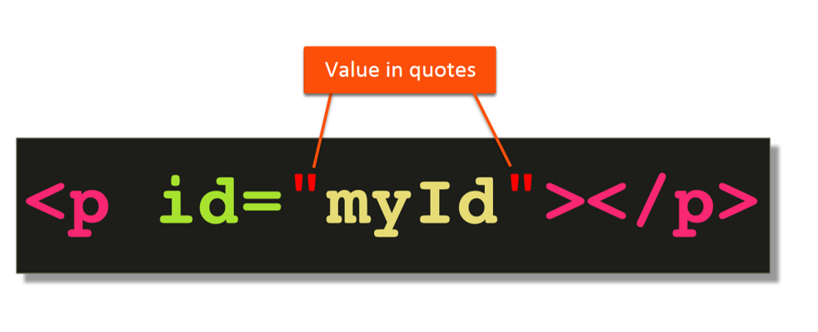

Slide 13
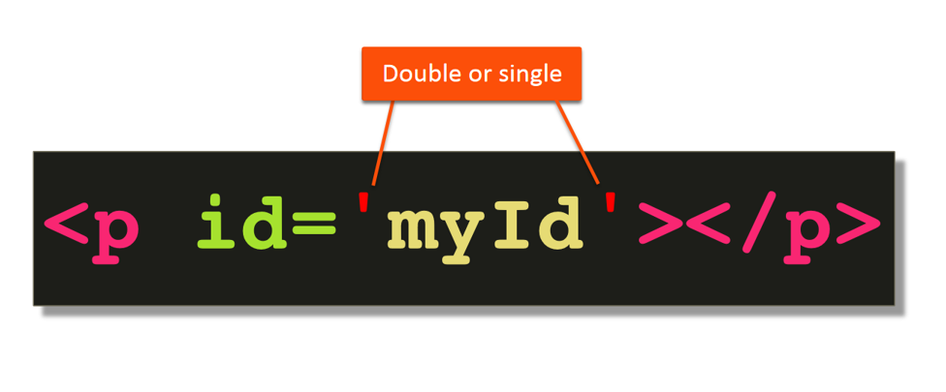

Slide 14
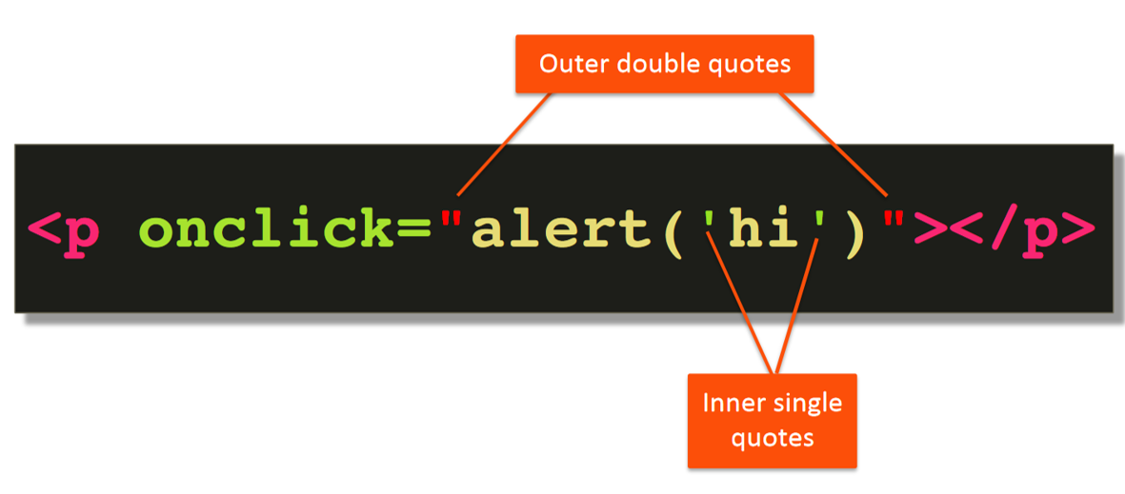

Slide 15
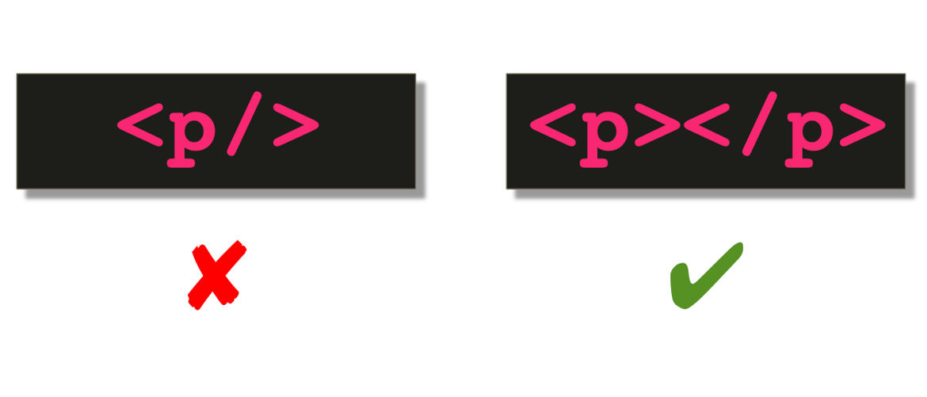

Slide 16
Basic html document structure
Lecture 1

Slide 17
div and span elements
Lecture 2

Slide 18
LISTS
Lecture 3

Slide 19
links
Lecture 4

Slide 20
IMAGES
Lecture 5

Slide 21
Exercise: 1. Basic HTML Structure
Create a simple HTML page with the following structure:
Title: "My First HTML Page"
Heading: "Welcome to My Website"
Paragraph: "This is a basic HTML page. Welcome!"
Image: Display any image of your choice from the web.

Slide 22
2. Creating a List
Create an HTML page that includes the following:
Title: "Favorite Movies"
Heading: "My Top 5 Favorite Movies"
Ordered List (<ol>): List your top 5 favorite movies using list items (<li>)

Slide 23
3. Building a Form
Create an HTML form for a user registration page. Include the following fields:
Title: "User Registration"
Form fields:
First Name (text input)
Last Name (text input)
Email (email input)
Password (password input)
Confirm Password (password input)
Checkbox for agreeing to terms and conditions
Submit button

Slide 24
CSS
Lecture 5

Slide 25
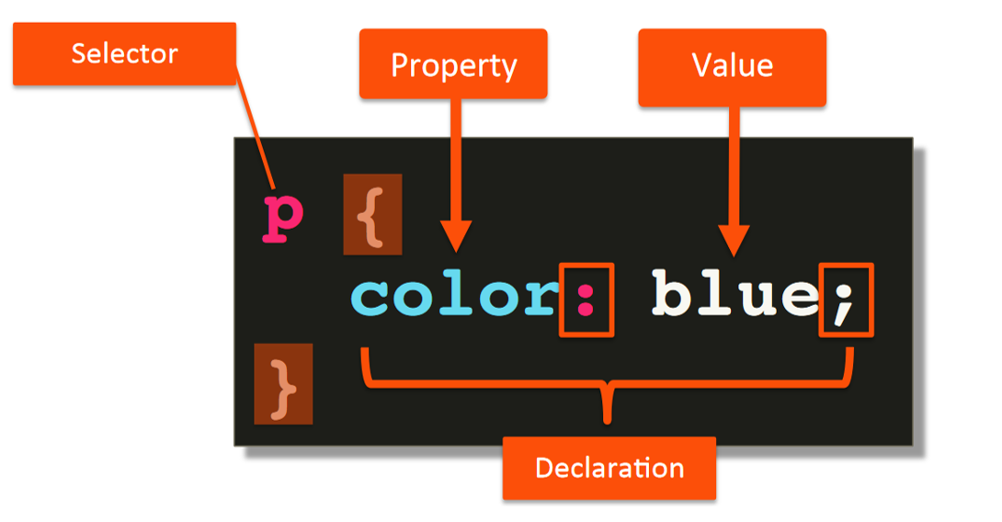

Slide 26
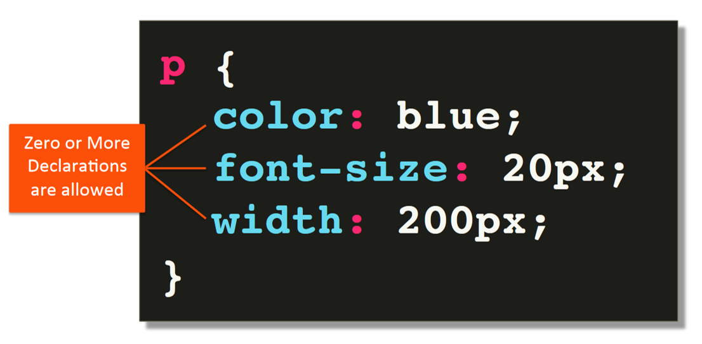

Slide 27
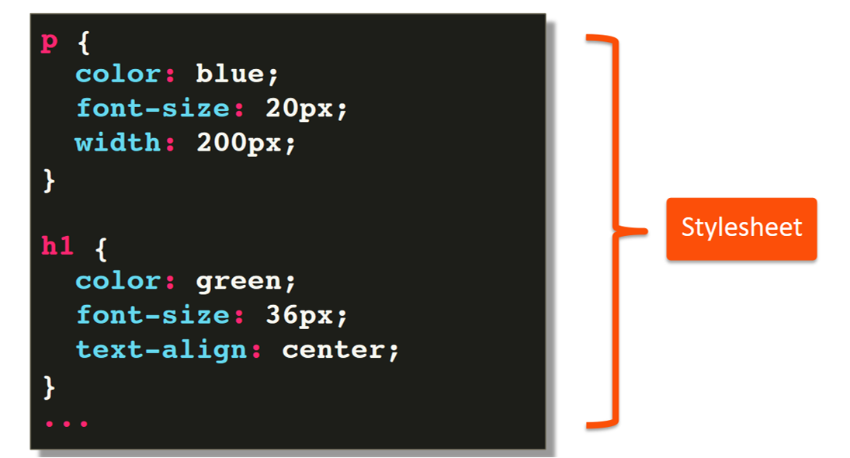

Slide 28
Anatomy of a CSS Rule
Lecture 6

Slide 29
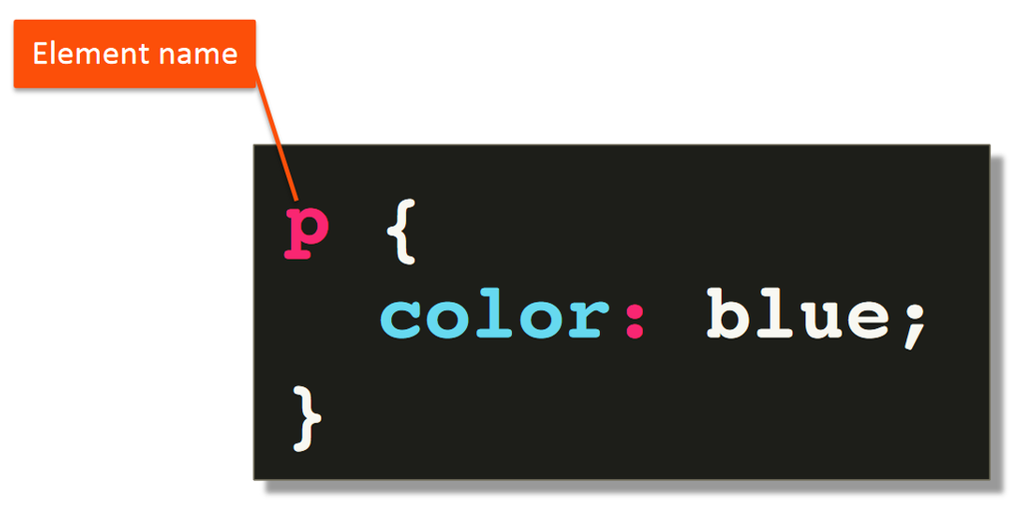

Slide 30
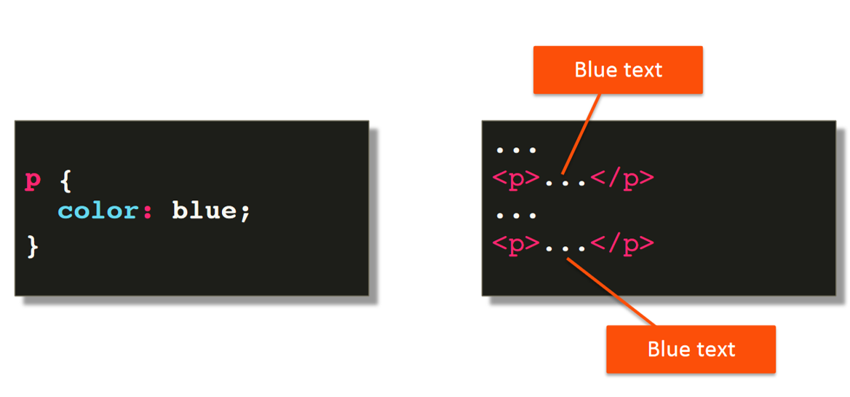

Slide 31
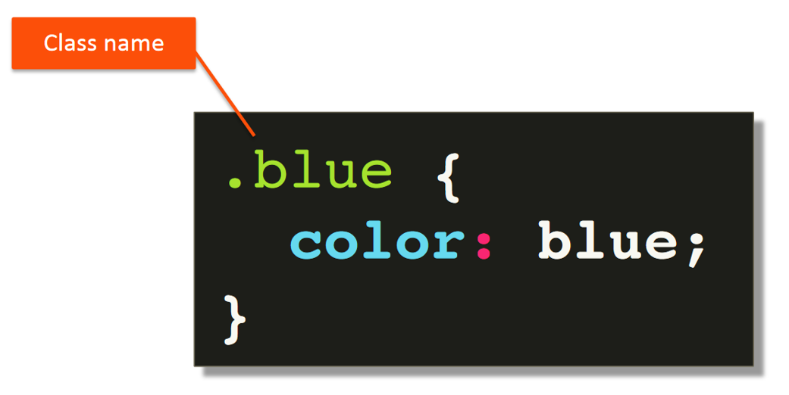

Slide 32
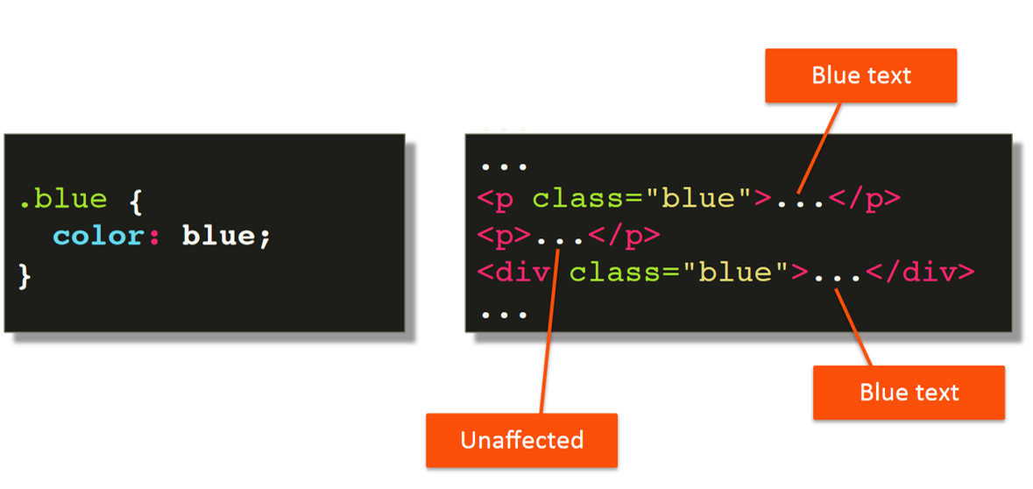

Slide 33
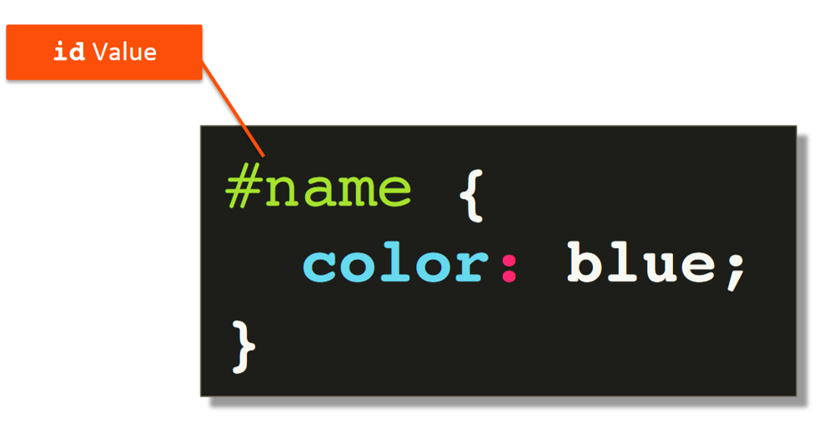

Slide 34
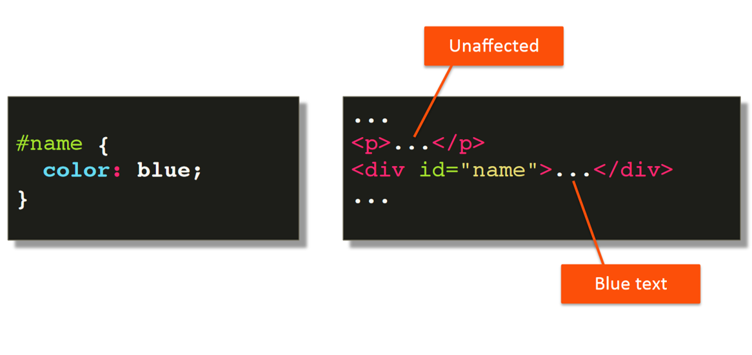

Slide 35
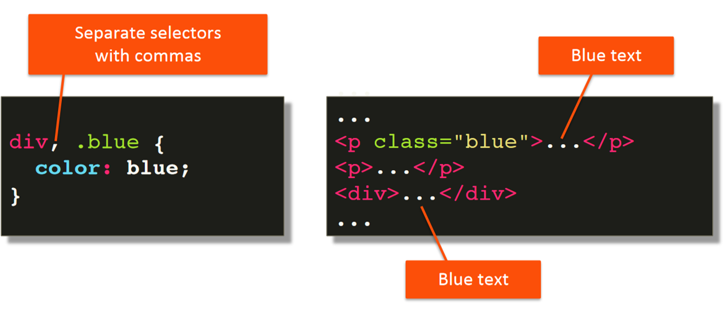

Slide 36
Simple Selectors
Lecture 7

Slide 37
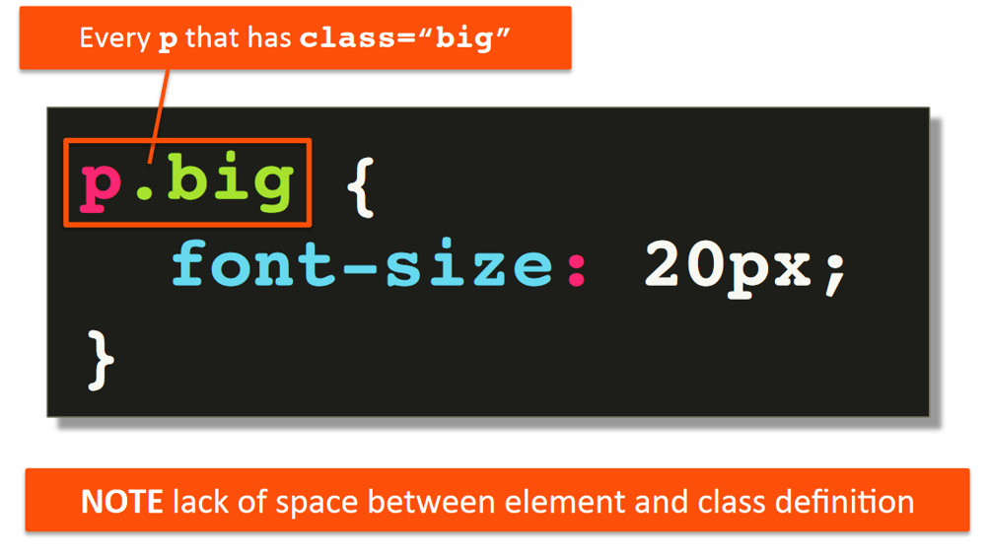

Slide 38
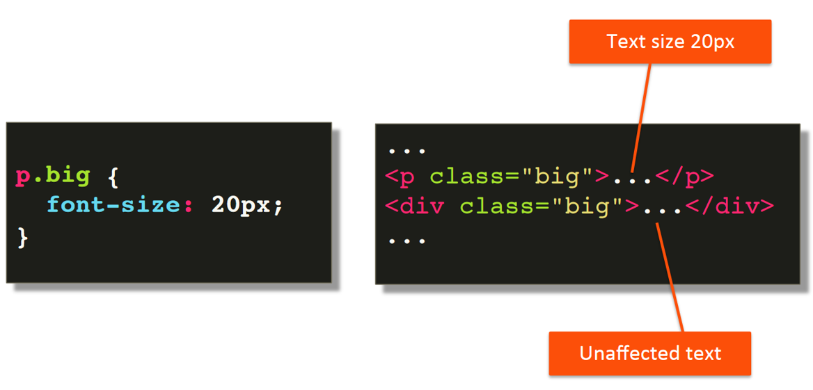

Slide 39
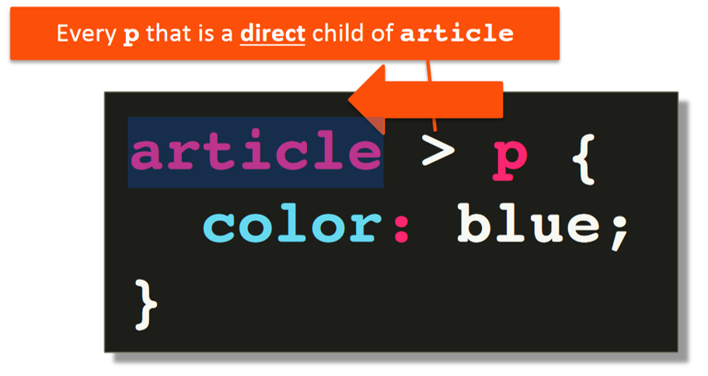

Slide 40
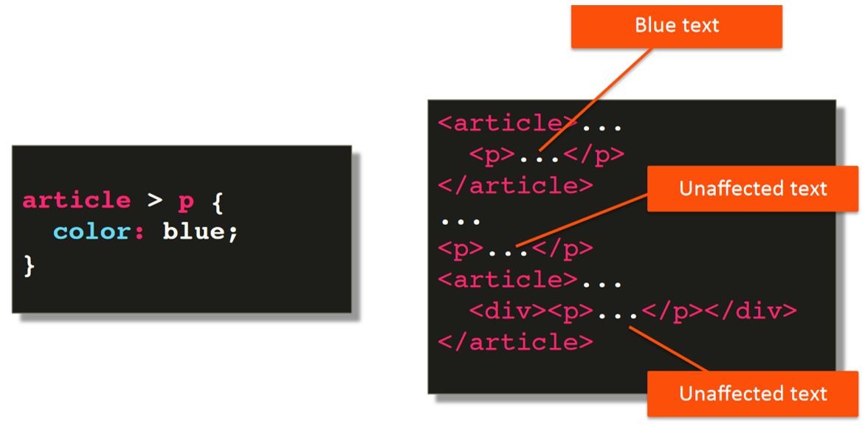

Slide 41
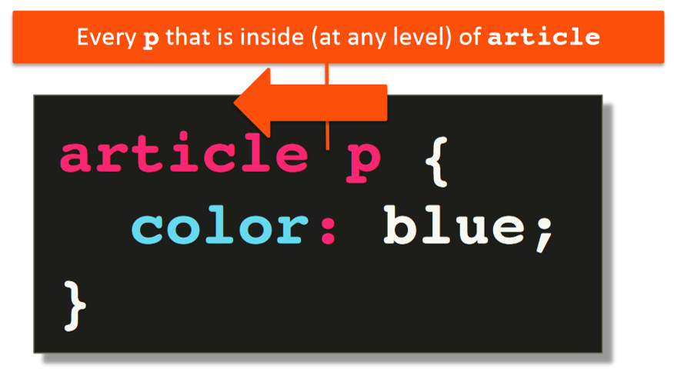

Slide 42
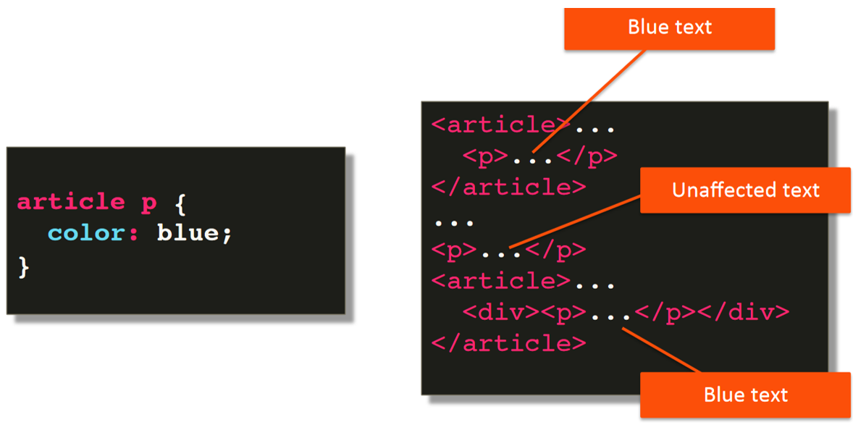

Slide 43
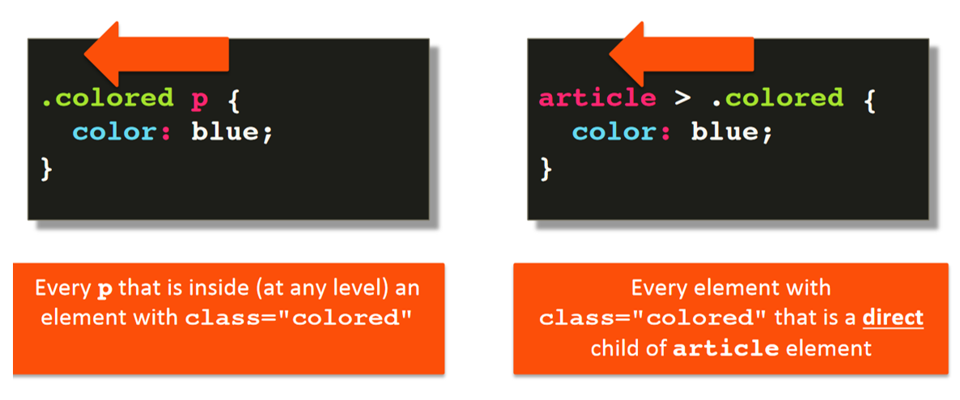

Slide 44
CLASS Selectors
Lecture 8

Slide 45
Style Placement
Lecture 9

Slide 46
Styling Text and font size
Lecture 10

Slide 47
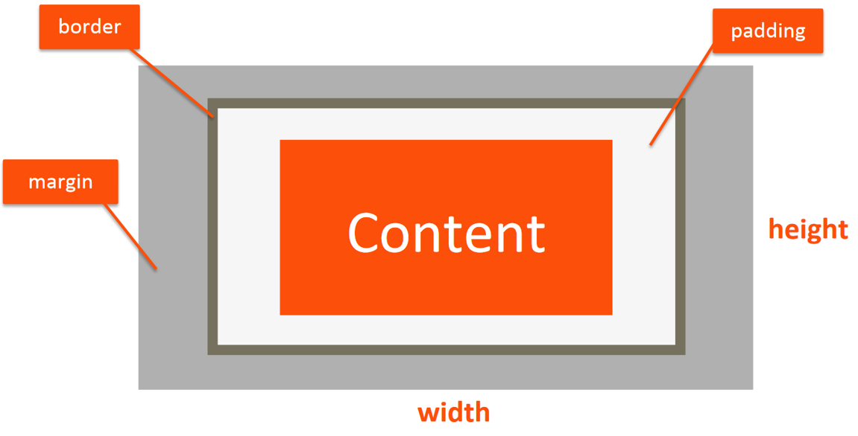

Slide 48
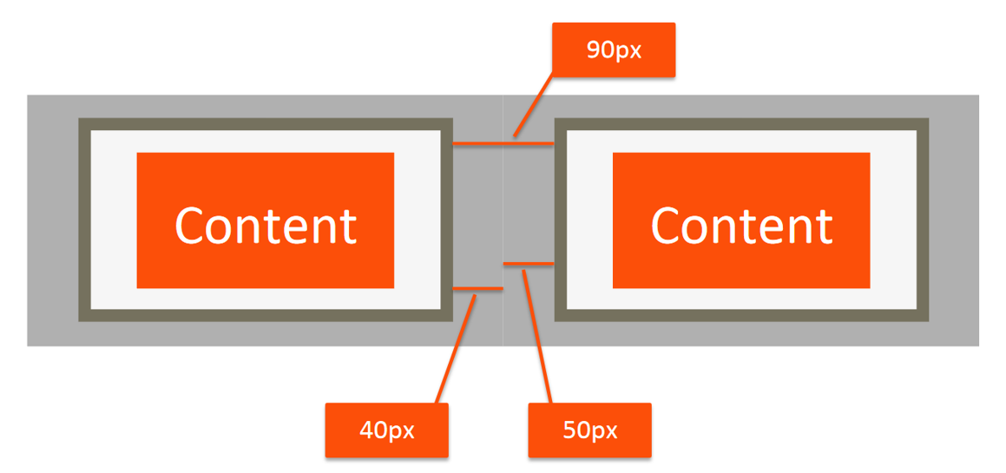

Slide 49
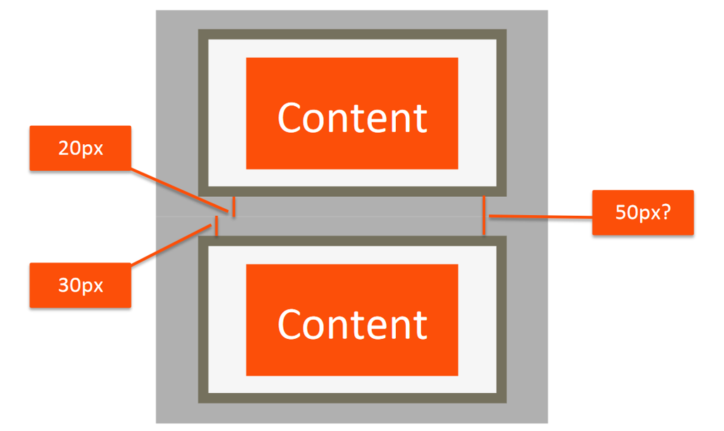

Slide 50
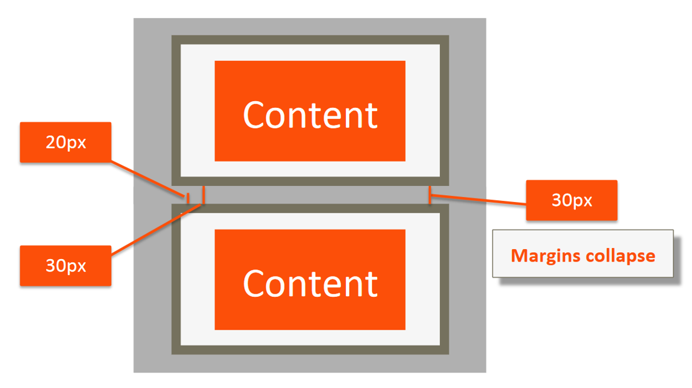

Slide 51
BOARDER BOX DEFINITION

Slide 52
The Box Model
Lecture 11

Slide 53
Background
Lecture 12 --------TODO:ADJUST IMAGE

Slide 54
Floating Elements
Lecture 13

Slide 55
Two Column Design
Lecture 14

Slide 56
Positioning
Lecture 15

Slide 57
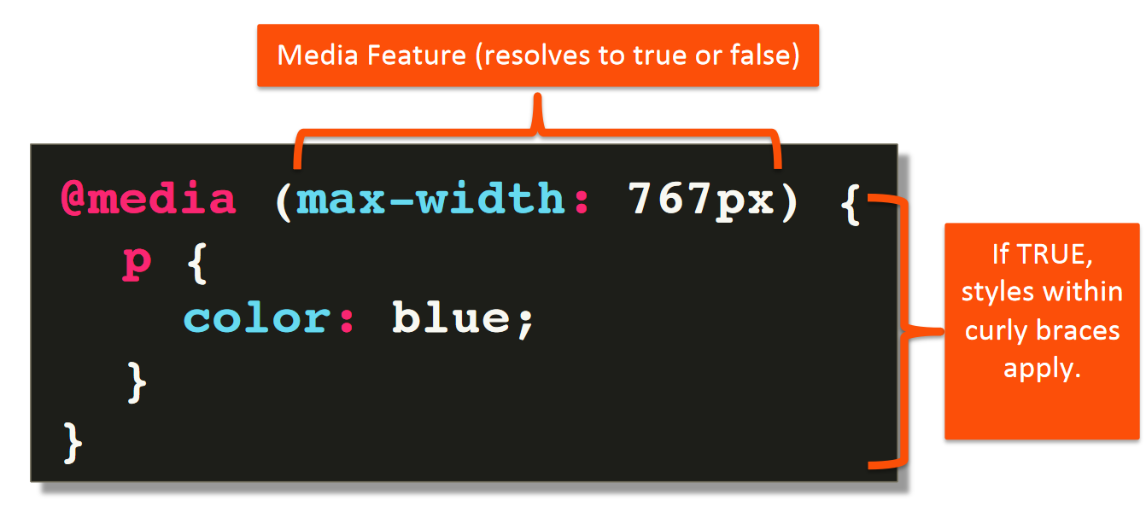

Slide 58
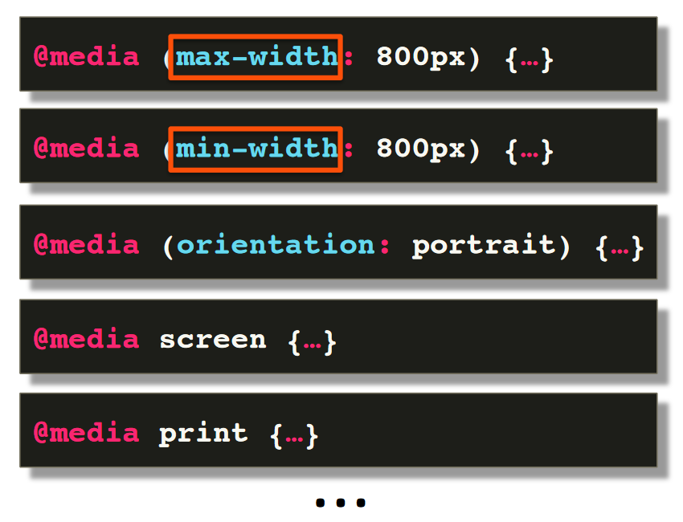

Slide 59
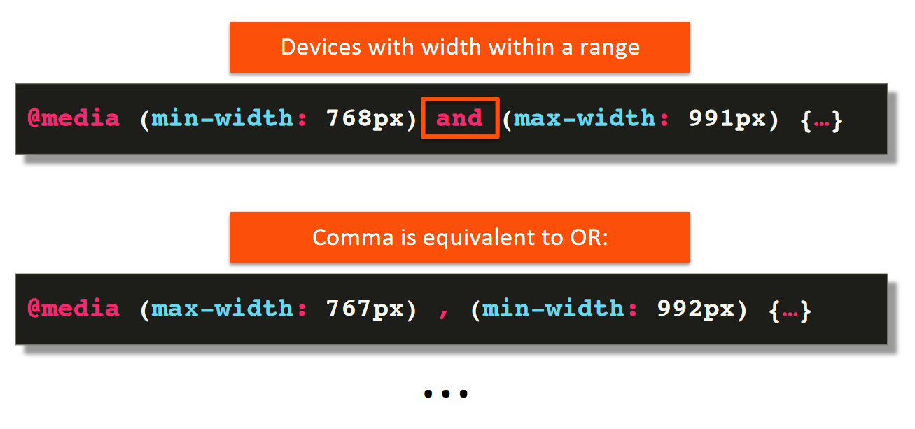

Slide 60
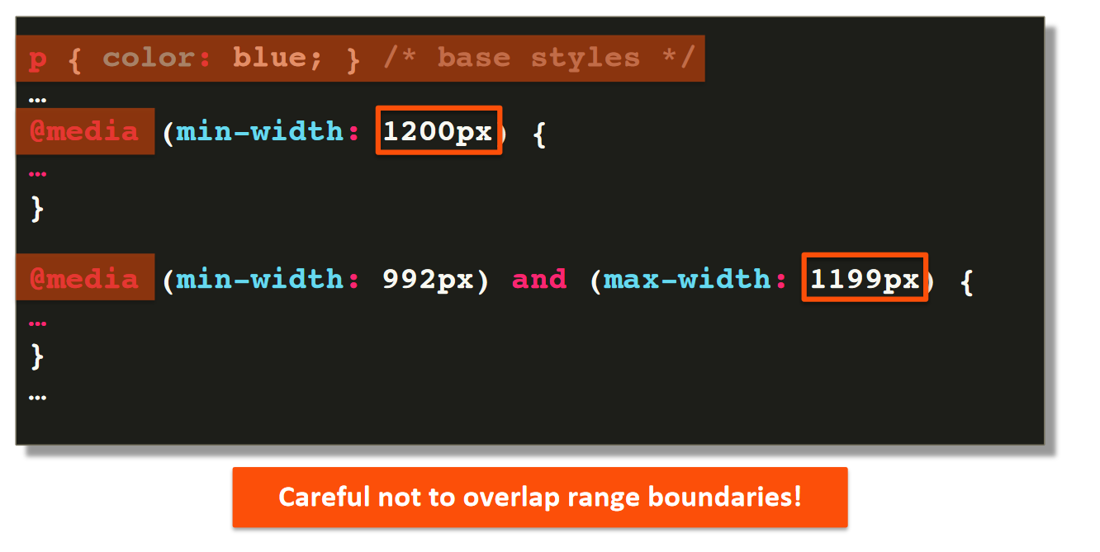

Slide 61
Media Queries
Lecture 16

Slide 62
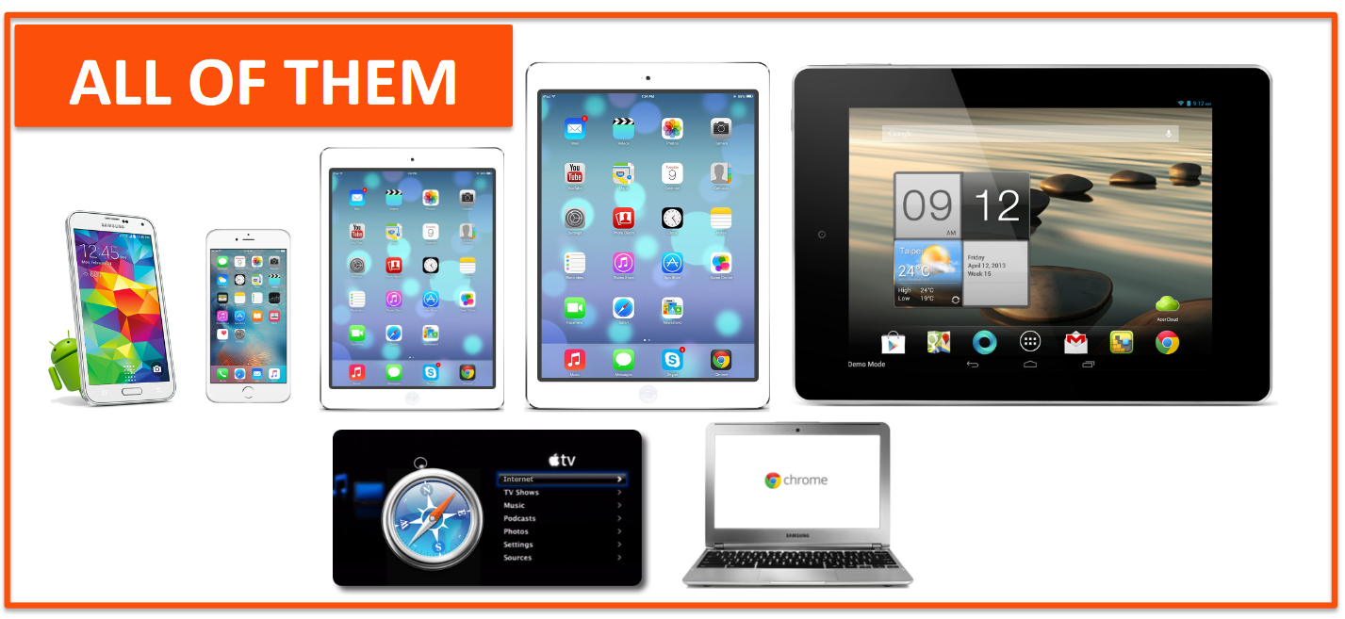
Responsive design

Slide 63
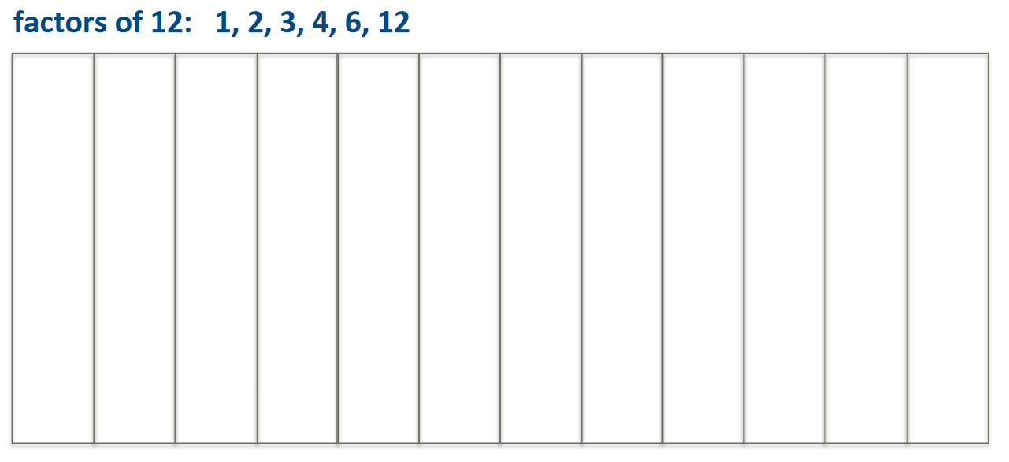

Slide 64
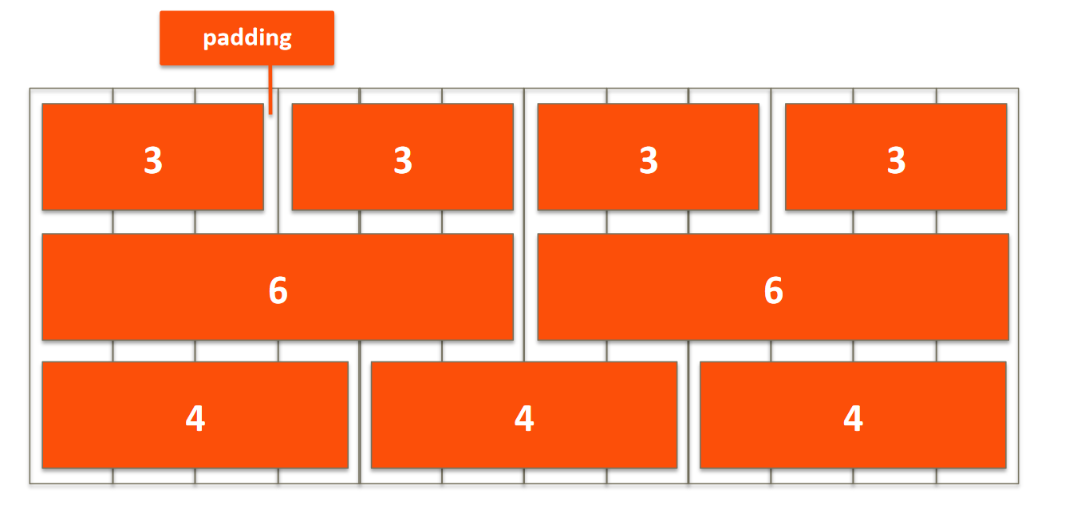

Slide 65
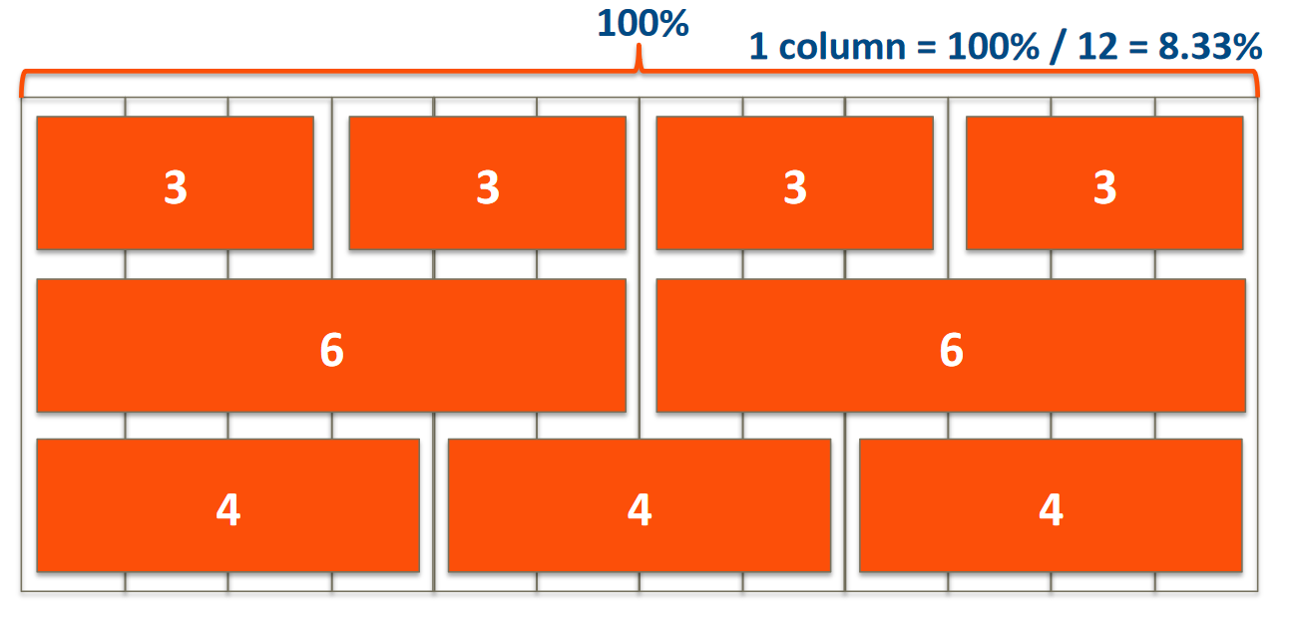

Slide 66
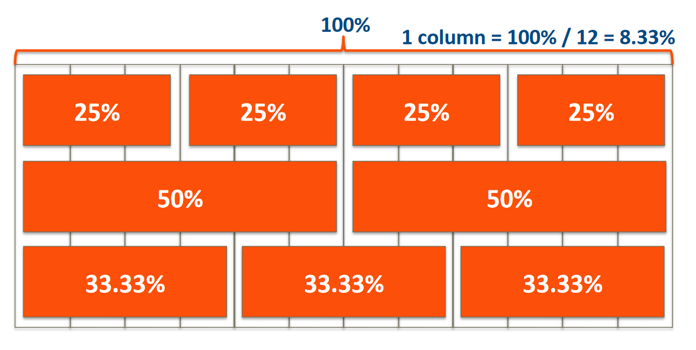

Slide 67
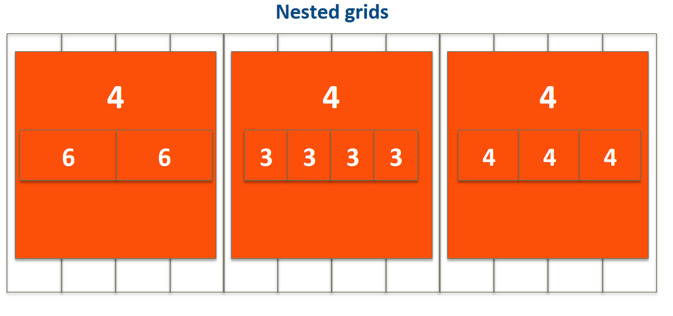

Slide 68
Responsive Layout
Lecture 17

Slide 69

BOOSTRAP INTRODUCTION

Slide 70
BOOSTRAP INSTALLATION

Slide 71
BOOSTRAP ALTERNATIVES

Slide 72
Bootstrap Starter Page
Lecture 18

