Slide 1
Project Title: Smart Campus Navigation System
Course Code/Course Title: ICT 2140 / Introduction to Software Engineering
Group Number: 8
ICT UNIVERSITY MESSASSI YAOUNDE

Slide 2
General Introduction
Problem: Navigating ICT University is confusing for new students/visitors.
Traditional maps are static and lack interactivity.
Solution: A web-based navigation system with interactive maps, dropdowns, and pathfinding.
Built with HTML, CSS, JavaScript, SVG, Agile Scrum.

Slide 3
Aim and Objectives
Aim: Simplify indoor navigation at ICT University.
Objectives:
Interactive SVG maps for all floors.
Dropdown/autocomplete for room selection.
BFS algorithm for shortest path.
Multi-floor navigation via stairs/elevators.
Responsive, user-friendly design.
Agile Scrum methodology for teamwork.

Slide 4
Problem Statement
Large campus → difficult to locate rooms.
Visitors waste time asking for directions.
No digital solution currently available.
Need for a smart, scalable, interactive navigation system.

Slide 5
Literature Review
Concepts: Databases, APIs, SVG graphics, pathfinding algorithms.
Methodologies: Waterfall vs Agile vs Scrum.
Chosen Methodology: Scrum → iterative, flexible, team-based.
Related Works: Indoor navigation systems emphasize usability and accessibility.

Slide 6
Methodology & Materials
Scrum Framework: Sprints, backlog, roles (Scrum Master, Product Owner, Developers).
System Requirements:
Functional: floor maps, dropdowns, BFS, multi-floor navigation.
Non-functional: responsive, scalable, fast.
Materials/Technologies: HTML, CSS, JS, SVG, GitHub.

Slide 7
System Design
Architecture:
Frontend: HTML/CSS/JS + SVG maps.
Backend: GitHub repo, optional database.
Algorithms: BFS for shortest path.
UML Diagrams: Use case, class, sequence diagrams.
Workflow: Team organization, conflict resolution, backlog management.

Slide 8
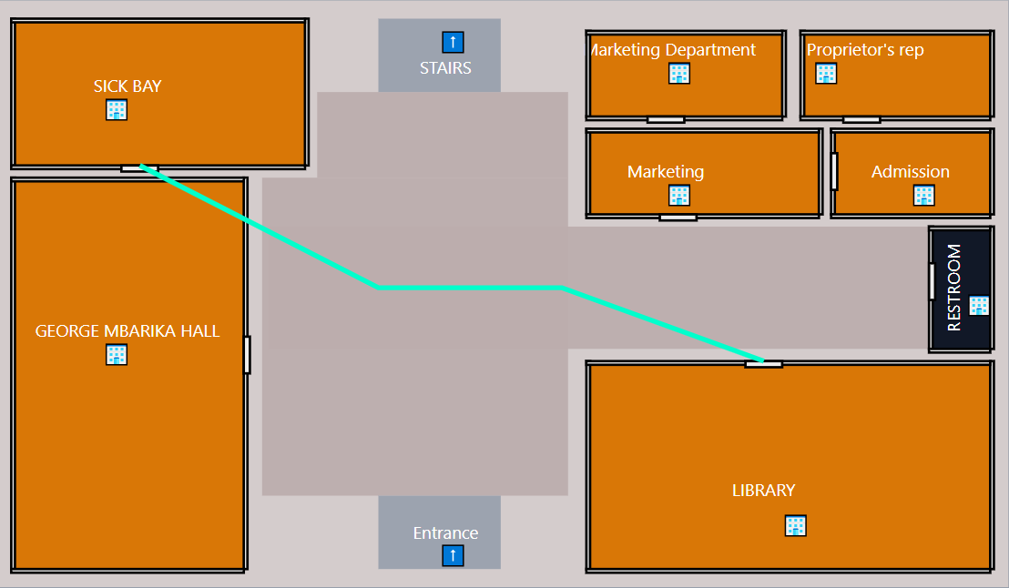
Results & Discussions
Screenshots:
Floor 1 navigation (Library → Sick Bay).
API Examples: Room metadata retrieval.
Discussion: System works, challenges with SVG injection and dropdown mismatches solved.

Slide 9
Recommendations & Conclusion
Achievements: Interactive maps, dropdowns, BFS pathfinding, multi-floor navigation.
Challenges: SVG quirks, dropdown mismatches, multi-floor logic.
Recommendations:
Add real-time positioning (Wi-Fi/Bluetooth).
Accessibility routes (elevator-only).
Mobile app integration.
Enhanced UI with tooltips/icons.

