Slide 1
Quantum-Boosted Channel Allocation
for Dense Small-Cell Networks
ISIT 2026 Quantum Hackathon · Team: The Entanglers
Warm-Start QAOA for Dynamic QUBO Re-optimization One-Hot vs Binary Encoding: a Qubit-vs-Depth Ansatz Design Choice

Slide 2
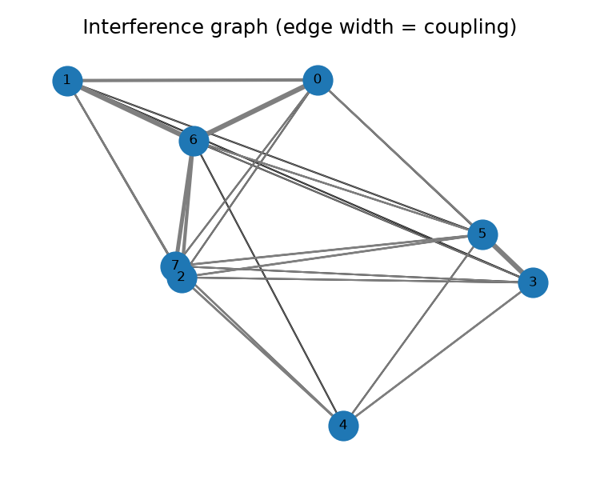
Problem: Channel Allocation in Dense Small Cells
Channel allocation = weighted graph coloring → QUBO
• Nodes = base stations, edges = interfering pairs
• Edge weight = interference coupling (path-loss decay)
• Assign K channels to N cells → minimize co-channel interference
• NP-hard: brute force = K^N assignments
CRITICAL: It's RECURRING — users move, graph shifts,
the same QUBO family must be re-solved snapshot after snapshot.
Key insight: Adjacent snapshots differ by a small perturbation → the previous optimum is near the new one. We can exploit this structure to cut re-optimization cost.

Slide 3
Solution: Warm-Start QAOA for Dynamic QUBOs
❄ Cold-Start QAOA (Standard)
Each snapshot: start from uniform superposition
Optimize all γ, β from scratch via COBYLA
Every iteration = expensive circuit runs + sampling
Budget-constrained → far from optimum
🔥 Warm-Start QAOA (Ours)
1. Relax prior snapshot's bitstring → continuous amplitudes
2. Initialize ansatz state + mixer from this relaxation
3. Search starts inside the basin of the prior solution
→ Better approximation per optimizer iteration ✔
Based on: Egger, Mareček & Woerner — Warm-starting quantum optimization
Our contribution: Apply warm-start QAOA to the dynamic/recurring QUBO regime + encoding study. We don't claim inventing warm-start QAOA.

Slide 4
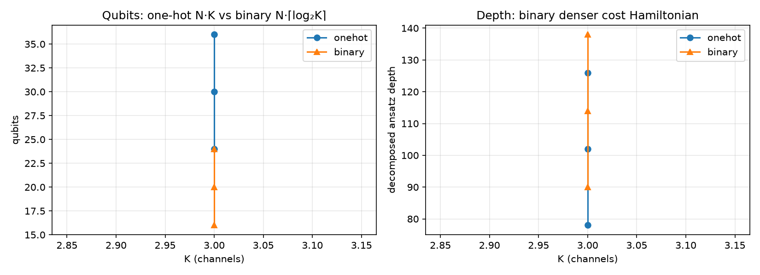
Ansatz Design: One-Hot vs Binary Encoding
One-Hot Encoding
x[v,c] = 1 if cell v uses channel c, else 0
Qubits: N × K
Constraint: Σ_c x[v,c] = 1 (shallow penalty)
✓ Simple constraints, shallow circuit
✗ Qubit count grows linearly with K
Binary Encoding
Channel index encoded in ⌈log₂K⌉ bits per cell
Qubits: N × ⌈log₂K⌉
Constraint: valid indices ≤ K-1 (denser penalty)
✓ Halves qubit count at K≥4
✗ Denser cost Hamiltonian, deeper circuit

Slide 5
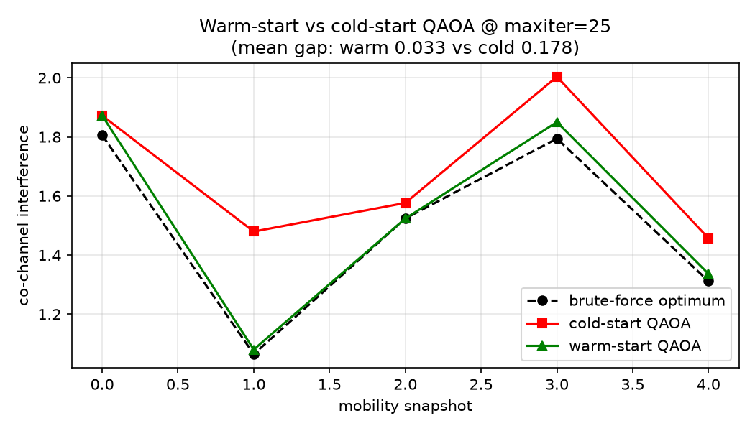
Headline: Warm-Start Outperforms Cold-Start at Fixed Budget
N=8 cells, K=3 channels, 5 mobility snapshots
Optimizer budget: maxiter=25 (tight)
Mean gap to optimum:
Cold-start: 0.178 ✗
Warm-start: 0.033 ✓ (5.5× better)
Warm-start nearer optimum on 4/5 snapshots

Slide 6
Verification: 5 Checks Passed
✓
#1 QUBO Correctness
Both encodings: QUBO argmin = brute-force optimum (exact match).
✓
#2 Warm-Start Advantage
At fixed maxiter=25, warm-start gap 5.5× smaller than cold-start (0.033 vs 0.178) across N=8 mobility sequence.
✓
#3 Encoding Trade-off
Binary halves qubits vs one-hot (e.g. 12 vs 18 for N=6 K=3). Depth comparison is non-monotonic — depends on (N,K).
✓
#4 Cold QAOA Quality
Best of 3 runs: obj=1.8061 (gap 0.0004 vs brute-force 1.8057). QAOA consistently matches/beats greedy.
✓
#5 Scalability
N=10, K=3: QAOA (binary, 20 qubits) beats greedy by −0.41. Brute force (3^10 ≈ 59k) intractable for larger graphs.

Slide 7
Honest Boundaries & Next Steps
Current Limitations
Next Steps
• Simulator-only: no real quantum hardware yet
• No noise model: QAOA depth bounded by simulator cost (reps=1)
• ~26 qubit hard cap: Aer SamplerV2 becomes unreliable beyond
• λ penalty tuned empirically per graph size
• Warm-start QAOA is Egger et al.'s work — we apply it, don't invent it
→ Scale to 20+ cell graphs on GPU-accelerated Aer
→ Add noise model (FakeBrooklyn / FakeSherbrooke)
→ Explore hardware-native encodings (GRSC, parity)
→ Test on real IBM hardware for 2-3 qubit proof-of-concept
→ Extend to multi-objective (throughput + fairness)
We show: warm-start QAOA is a promising approach for dynamic QUBO regimes — the hardware to run it at scale is forthcoming.

Slide 8
Hack Ingredients & Architecture
Quantum Stack
Qiskit 2.4 — circuits, transpiler, ansatz
qiskit-aer 0.17 — statevector simulator
qiskit-algorithms — QAOA, WarmStartQAOAOptimizer
qiskit-optimization — QuadraticProgram, SlsqpOptimizer
Classical Stack
NetworkX — interference graph generation + mobility
NumPy / SciPy — classical baselines, continuous relaxation
COBYLA — outer-loop parameter optimization
Pipeline
Interference graph → coloring QUBO →
cold/warm QAOA → decode → evaluate
Data Flow
src/graphs.py
Interference graph + mobility perturbation
↓
src/qubo.py
One-hot / binary QUBO encoding
↓
src/solve_qaoa.py
Cold-start / warm-start QAOA solver
↓
src/baselines.py ←→ src/dynamics.py ←→ src/encoding_study.py
Brute force, Cold vs warm Qubits vs depth
greedy @ fixed budget vs feasibility

Slide 9
Thank You — Questions?
Team: The Entanglers · ISIT 2026 Quantum Hackathon
Key References
Egger, Mareček & Woerner — Warm-starting quantum optimization (arXiv:2009.10095)
Qiskit WarmStartQAOAOptimizer documentation
Code & Demo
Full pipeline: github.com/.../qhack-isit-2026
5 standalone check scripts + 4 auto-generated figures

