Slide 1

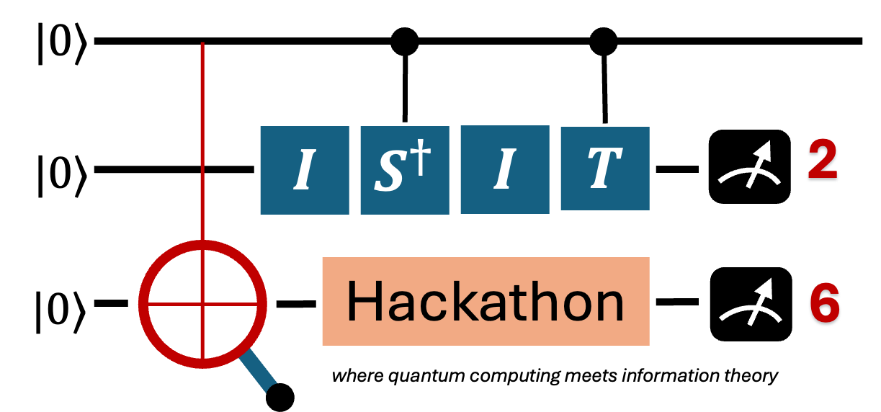
ISIT 2026 Quantum Hackathon : Group - X
🚀 Napkin Pitch: Your Project Name
The Problem:
What real-world problem are you solving?
Your Solution:
What is your technical approach?
Hack Ingredients:
<hardware> <software>
Unique Value Proposition:
Why is your solution better or different? How will your solution create value?
Current Status :
What have you built/tested so far?
<Hackathon Theme: Solving Problems in Communication and Signal Processing using Quantum Computing>

