Slide 1

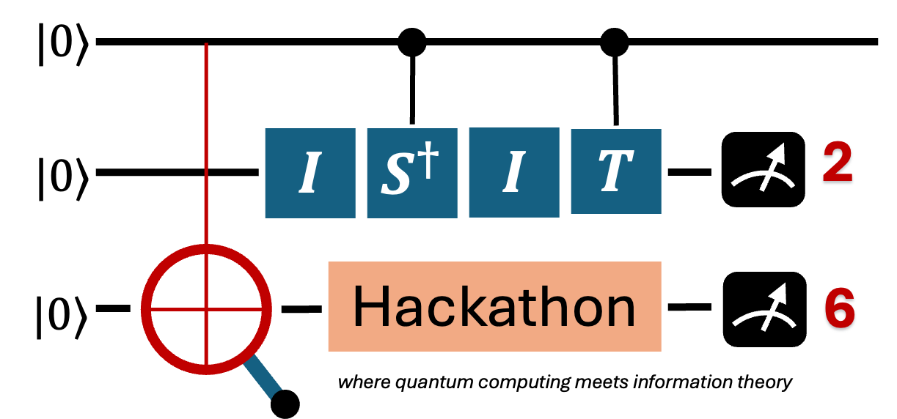
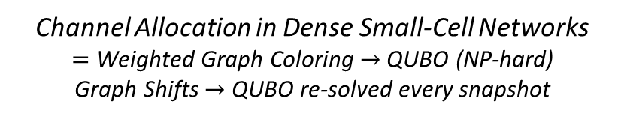
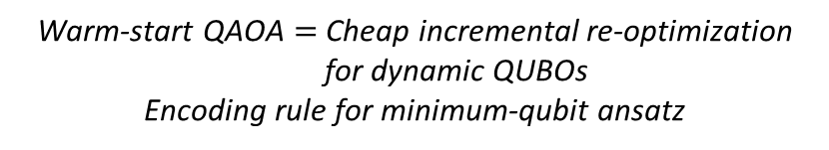
ISIT 2026 Quantum Hackathon : The Entanglers
🚀 Quantum-Boosted Channel Allocation for Dense Small-Cell Networks
Channel Allocation in Dense Small-Cell Networks
$=$ Weighted Graph Coloring $→$ QUBO (NP-hard)
Graph Shifts $→$ QUBO re-solved every snapshot
The Problem:
Your Solution:
Hybrid QAOA on the coloring QUBO
Warm-start from prior snapshot solution
One-hot vs binary encoding
Hack Ingredients:
Qiskit-Optimization (WarmStartQAOAOptimizer)
Qiskit-Aer (Statevector Simulator)
NetworkX (Interference Graphs)
Unique Value Proposition:
Warm-start QAOA $=$ Cheap incremental re-optimization for dynamic QUBOs
Encoding rule for minimum-qubit ansatz
QUBO validated vs brute force
Warm-start nearer optimum
Encoding trade-off benchmarked
Current Status :
<Hackathon Theme: Solving Problems in Communication and Signal Processing using Quantum Computing>

