Slide 1

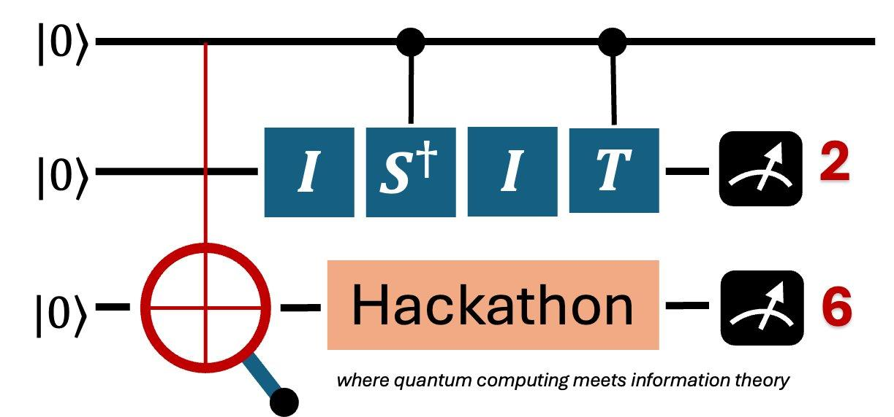
Welcome to the ISIT26 Quantum Hackathon

Slide 2


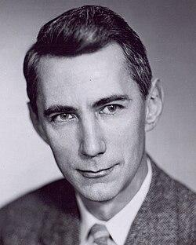
IEEE International Symposium on Information Theory (ISIT)
ISIT is the flagship annual conference of the IEEE Information Theory Society.
It features plenary talks, over 500 peer-reviewed research papers, social programs, and a
quantum hackathon!
🧠 What is Information Theory?
Information theory is the mathematical study of the quantification, storage, and transmission of information. The field was established and formalized by Claude Shannon in the 1940s.
📡 Applications: wireless communication, mathematics, statistics, computer science, neuroscience, physics, and electronics.
Claude Shannon
Notes:
Information theory is the physics of information!

Slide 3
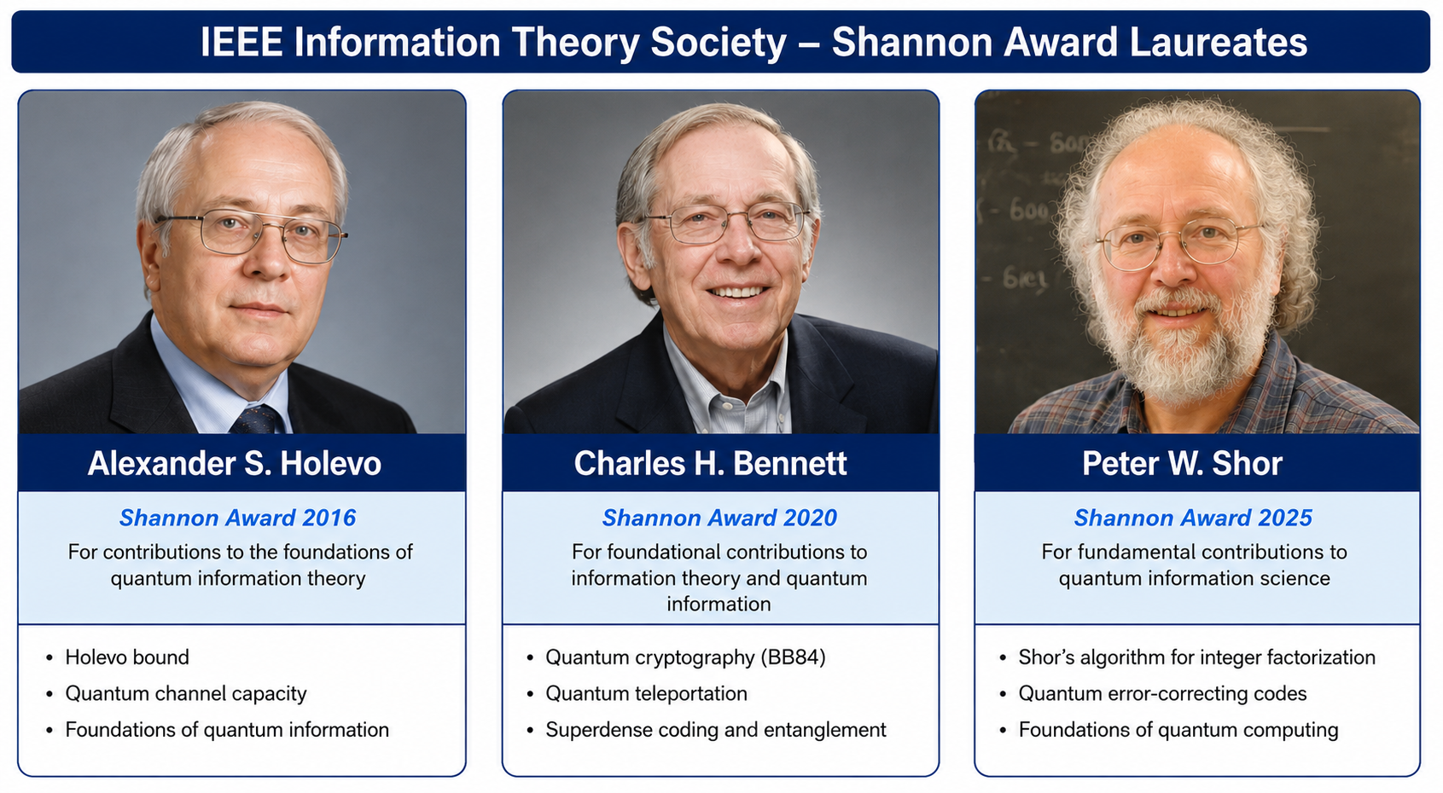
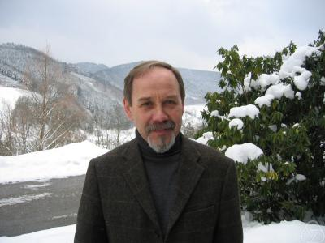
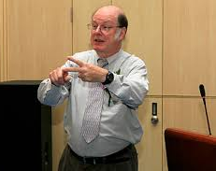
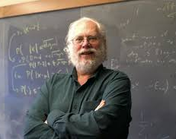
QUANTUM and ISIT
Notes:
Information theory is the physics of information!

Slide 4
Hackathon Organizing Committee
IEEE Information Theory Society
Student & Outreach Subcommittee
Mohammad Aamir Sohail
University of Michigan, Ann Arbor, US
mdaamir@umich.edu
Khac-Hoang Ngo
Linköping University, Sweden
khac-hoang.ngo@liu.se
Xiongfeng Ma
Tsinghua University, China
xma@tsinghua.edu.cn
Fei Shi
Sun Yat-Sen University, China
shif26@mail.sysu.edu.cn
Ye Wang
University of Science and Technology of China
yewang2022@ustc.edu.cn

Slide 5

Prize Sponsor
Established in 2009, originated from the University of Science and Technology of China
Held by China Telecom Quantum Group, a wholly-owned subsidiary of China Telecom
Listed on the Science and Technology Innovation Board in 2020 as the first stock of quantum technology
One of the very few companies in the world with large-scale industrialization capabilities in all three major directions of quantum information: quantum communication, quantum computing, and quantum measurement.

Slide 6
Theme: Quantum Algorithms for Signal Processing, Communication, and Learning
🔹 Use quantum computing to solve classical challenges in communication, signal processing, and machine learning.
🎯 Why this matters:
Quantum methods can enhance error resilience in communication systems.
Quantum machine learning offers compact models for signal denoising and pattern recognition.
Hybrid quantum-classical algorithms help solve optimization problems in networks and coding faster.
🧪 Examples:
Design a quantum-inspired LDPC decoder for classical channels with burst noise.
Use variational quantum classifiers for anomaly detection in bio-signals or radio signals.
Apply QAOA to optimize routing in a dynamically changing communication network.

Slide 7

Navigating Hackathon Schedule
📅 Pre-Hackathon Tutorials: June 22–23 (Virtual) — Quantum 101, Quantum Computing Platforms, Quantum Algorithms, Quantum Machine Learning, Quantum Error Correction
✅ Highly recommended to attend! — Sessions will be recorded and shared.
📅 June 24: Lightning talks & interactive networking sessions.
🎤 June 28 (Sunday): Keynote expert talks.
📅 June 28: Napkin Pitch Session — present your team’s idea briefly!
📅 June 29–30: Develop your hack!
📅 July 01 (Wednesday): Final Presentations — showcase your quantum hack!
See the ISIT 2026 Quantum Hackathon Schedule for further details!

Slide 8
🏆 Prizes & Recognition
🌟 Top Awards
🥇 Quantum Gold Award – $350
🥈 Quantum Silver Award – $250
🥉 Quantum Bronze Award – $200 🗳️ 2 x Observer’s Choice Award – 2 x $100
Voted by participants and attendees – the crowd favorites!
🏅 All Winners Receive Digital Certificates of Achievement
🎓 Certificate of Participation - Awarded to everyone who completes the hackathon*
(*present at the final event).

Slide 9
Final Presentation Format & Deadlines
Each team will deliver a 10-minute presentation followed by 2 minutes of Q&A.
🗣️ At least one team member must present live during the session.
✅ Final Presentation Slides Due: By 08:00 AM UTC+8, July 01, 2026
🎥 Presentation Videos (Optional): Upload by the same deadline only if a live presentation isn't possible.

Slide 10

Recommended Slide Structure
1. Team Name + Members & Roles
2. Problem Statement
3. Quantum Approach (Algorithm or Protocol)
4. Implementation & Tools (e.g., Qiskit, Cirq, PennyLane)
5. Challenges & Mitigations
6. Impact & Future Work
7. (Optional) Demo Video (1–2 mins)
Link to Final Presentation Template

Slide 11
💡 Need Help? We're Here for You!
Reach out via Slack Channel if you need any help!
Hackathon Committee Representatives:
Mohammad Aamir Sohail — mdaamir@umich.edu
Khac-Hoang Ngo — stefano.rini@nycu.edu.tw
Fei Shi — shif26@mail.sysu.edu.cn

Slide 12
🧩 Breakout Session: Connect, Share & Spark Ideas!
👋 Introduce yourself: name, school/company, area of interest
🧊icebreaker:
If quantum were a flavor, what would it taste like?
🌍 If you could solve one global social problem using quantum, what would it be?
👤 What's one misconception people have about quantum computing?
📸 Share a fun fact about your city!

