Slide 1

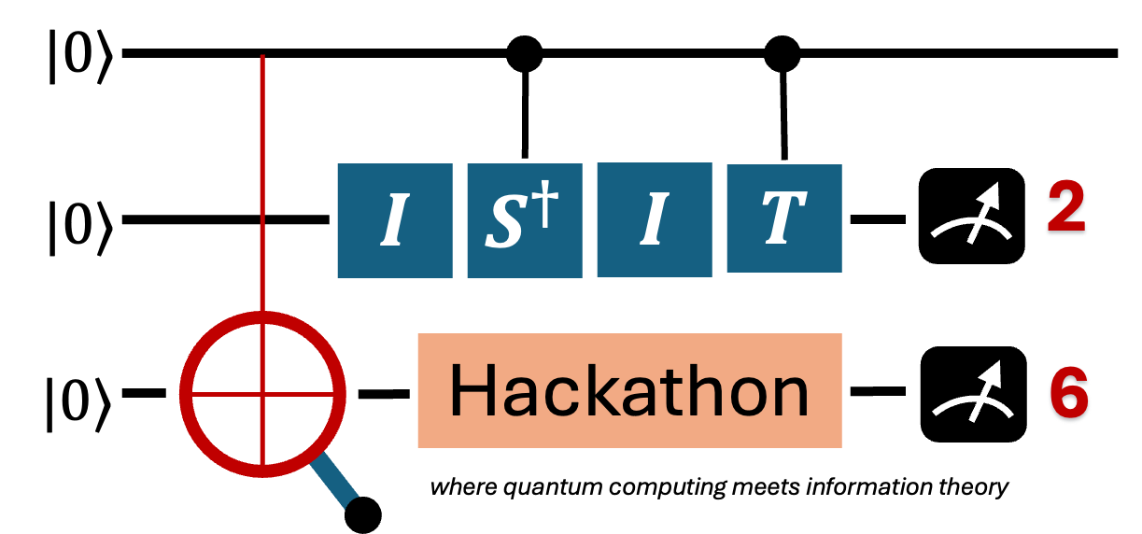
The Entanglers
The Entanglers
Quantum-Boosted Channel Allocation

Slide 2
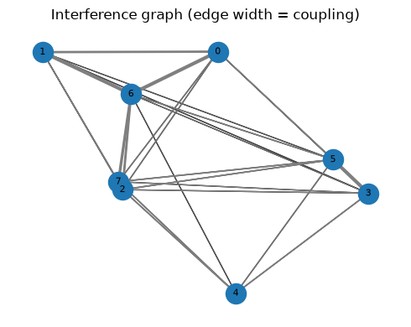
1. Problem: Dynamic Channel Allocation
Dense networks repeatedly solve a weighted graph-coloring problem
Real-world setting
Optimization objective
Nodes are small-cell base stations; colors are channels.
An edge means two cells interfere if they reuse one channel.
Edge weights measure coupling strength, so closer cells are penalized more.
Goal: assign one channel per cell and minimize total weighted co-channel interference.
Mobility changes positions/traffic, so the graph becomes a sequence of snapshots.
Interference Graph
min Σ w_uv · 1[channel(u)=channel(v)]

Slide 3
2. Mapping to QUBO
The communication task becomes a quantum-optimization-ready objective
QUBO construction
Quantum-ready form
Binary variables represent channel choices.
Cost terms activate when interfering cells share a channel.
Penalty terms enforce valid assignments.
The final form is a quadratic binary objective.
QUBO is easy to convert to an Ising Hamiltonian.
QAOA directly optimizes the corresponding cost operator.
Small graphs can be validated against brute force.
H
U
M
xᵀQx + penalties
H
U
M
H
U
M
H
U
M

Slide 4
3. QC Advantage + Challenges
The useful claim is fixed-budget approximation, not guaranteed speedup
Why QAOA applies
Challenges & mitigations
QAOA works natively on QUBO/Ising objectives.
Warm-start changes the initial state and mixer, so it is an algorithm-level modification.
Dynamic snapshots are related, which gives warm-start useful structure.
Cold-start repeats variational search for every snapshot.
Each optimizer step needs circuit executions and expectation estimation.
NISQ resources are limited, so encoding and depth matter.
We claim better approximation at the same budget, not asymptotic quantum speedup.

Slide 5
4. Quantum Approach and Tools
Implementation pipeline used in the hack
Network graph
QUBO encoding
Ising cost
QAOA solve
Decode result
Implementation & Tools
Qiskit + qiskit-optimization
WarmStartQAOAOptimizer + SlsqpOptimizer
qiskit-aer statevector simulator
NetworkX for graph generation
Brute force + greedy baselines for validation
The stack is fully reproducible with uv and runs without real-hardware queue time.

Slide 6
5. Warm-Start Mechanism VS Cold-Start Mechanism
Reuse structure across related QUBO snapshots
Warm-Start Mechanism
Snapshot t gives QUBO_t
Continuous relaxation provides a biased starting point
Initial state and mixer are warm-started
QAOA searches near a promising basin
Cold-start: random initialization without snapshot information

Slide 7
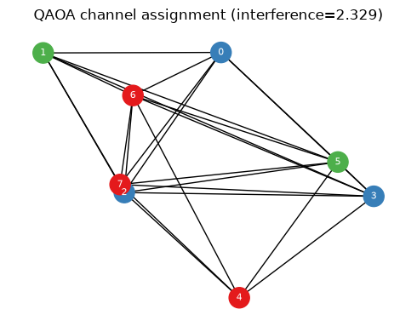
6. Demo: End-to-End Run
Figures are extracted from demo.ipynb
Input graph
QAOA assignment

Slide 8
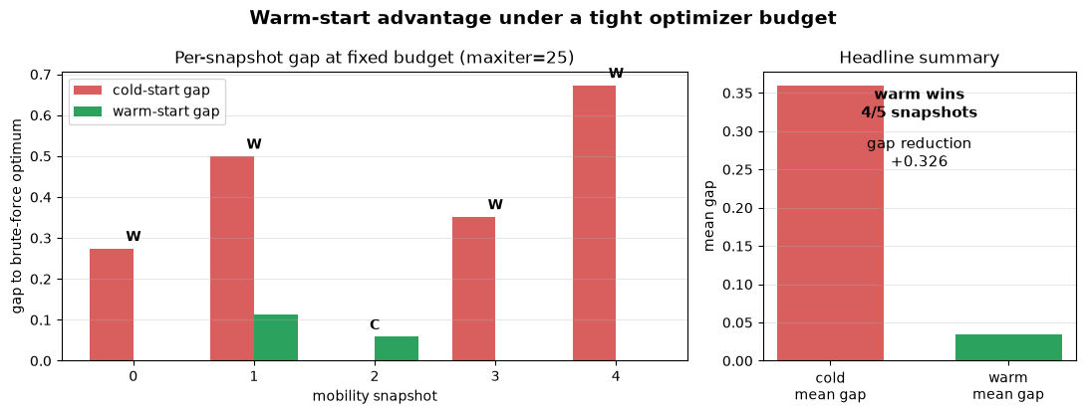
7. Result: Warm-Start Improves Fixed-Budget Quality
Notebook result, directly embedded
Cold vs warm-start QAOA
The Entanglers
ISIT 2026 Quantum Hackathon

Slide 9

8. Resource–Structure Effect of Encoding
Minimum qubits are not the whole story
encoding benchmark
Design rule
Binary encoding reduces qubit requirements from$O\left(NK\right)$to $O\left(N\log{K}\right)$, significantly lowering hardware cost.
However, this does not imply a monotonic trade-off with circuit depth or gate count.
Depth and gate complexity depend on the induced Hamiltonian structure and problem instance.
Empirically, binary encoding may yield:
1. lower qubit usage (consistent)
2. comparable or sometimes lower depth
3. non-uniform gate complexity
graph | one-hot qubits | binary qubits | one-hot depth | binary depth
N8_K3 | 24 | 16 | 78 | 90
N8_K4 | 32 | 16 | 99 | 90
N8_K5 | 40 | 24 | 120 | 138
N10_K4 | 40 | 20 | 129 | 114

Slide 10
9. Impact: Problem Importance
Why this matters beyond a toy graph-coloring example
Problem impact & importance
Why it is not just a demo
Better channel reuse means lower co-channel interference in dense deployments.
Recurring QUBO optimization is a natural model for mobility and traffic shifts.
The same pipeline can be extended to routing and scheduling.
Dense networks are interference-limited, not only bandwidth-limited.
A solver that can re-optimize quickly is useful when topology and demand keep changing.
The QUBO abstraction gives a common language across spectrum, routing, and scheduling.
Communication networks repeatedly make resource-allocation decisions under uncertainty.

Slide 11
10. Business Sustainability & Scalability
Can this be shipped beyond the hackathon?
Viable product path
Sustainable model
Scalability ladder
Near-term product form: a simulator-backed decision-support tool for network planning.
Input: base-station locations, channel count, and interference weights.
Output: channel assignments, interference score, and encoding/resource report.
Hybrid by design: classical graph generation + quantum-inspired/QAOA solver modules.
Can run with classical baselines today and swap in quantum backends as hardware matures.
Encoding study gives a practical resource estimator before submitting circuits.
Small graphs: brute-force validation.
Mid-size graphs: binary encoding + simulator.
Future: GPU/noise-aware simulation and hardware trials.

Slide 12
11. Next Steps
A realistic path from hackathon demo to stronger evidence
Model
Algorithm
System
Add noise models and hardware-inspired connectivity constraints.
Test richer mobility and traffic patterns.
Tune penalties automatically instead of hand-setting λ.
Compare warm-start QAOA with stronger classical warm-start baselines.
Try deeper QAOA and alternative mixers.
Extend from channel allocation to routing and scheduling QUBOs.
Build a small UI/API around the pipeline.
Export resource reports before quantum execution.
Run GPU/noise-aware simulation and later hardware trials.

Slide 13
The Entanglers
Thank You!

