Slide 1
HACK TRIX
SIMULATION
Network Vulnerability and Attack Queue System

Slide 2
DATA STRUCTURES AND ALGORITHMS
COURSE:
INSTRUCTOR:
Dr Zubair Ahmed
TEAM MEMBERS:
Abdullah, Warda and Asjid
2024321
2024663
2024119

Slide 3
INTRODUCTION

Slide 4
INTRODUCTION
Simulates a basic network attack/defense environment.
Systems are represented as nodes with varying vulnerability levels.
Users can queue attacks on specific IP addresses.
Simulation determines attack success/failure using vulnerability and patching factors.
Demonstrates data structure concepts: Array, Lists, Stack, Queues, Graphs
Introduces basic cybersecurity logic such as vulnerability scoring and patch impact.

Slide 5
Problem Statement
Goal:
Make a simple cyber-security simulation game using DSA
What should it do?
Manage multiple systems and their security status
Process attack requests from the player
Log every important action
Allow undoing changes
Show connections between systems
Spread infections across the network
Demonstrate real use of DSA techniques

Slide 6
Project Overview

Slide 7
Project Overview
Add attack requests to a queue
Process attacks and compromise systems
System states can be patched, restored, or infected
Logs maintain a complete history
Scanner cycles through systems
BFS finds shortest paths in the network
Graph shows all connections visually (as matrix)

Slide 8
DATA STRUCTURES USED
To make the simulation realistic, the project combines multiple DSA concepts:
Doubly Linked List → stores all systems in the network
Singly Linked List → maintains logs of every action
Linked List Stack → undo system for restoring previous states
Circular Array Queue → queue of pending attack requests
Circular Linked List → continuous rotation of scanner
Adjacency Matrix → network graph for connections
Queue-Based BFS → pathfinding & infection spreading
Each structure was carefully chosen based on how cyber systems behave

Slide 9
System Storage: Doubly Linked List
The complete list of systems is stored in a Doubly Linked List.
This structure allows smooth movement in both directions and flexible insertion.
Why DLL is used:
Easy traversal for scanning and displaying all systems
Forward/backward movement for debugging and testing
Good structure when systems can be added or tested frequently
Stores rich details like name, IP, vulnerability, hacked/patch status

Slide 10
Attack Queue: Circular Array
Attack requests from the player are stored in a circular array queue.
This represents attacks being processed in fixed order.
Why queue is perfect here:
Attacks must be handled First-In First-Out
Circular array avoids shifting elements
Constant-time enqueue and dequeue operations
Easy to show the list of pending attacks

Slide 11
Logs Singly Linked List
All actions taken by the player and the system are saved in a Singly Linked List.
Why SLL:
Logs are only appended, not edited
SLL is fast and memory-efficient for growing messages
Linear traversal is enough to show full history
Unlimited log entries can be added during gameplay

Slide 12
Scanner Circular Linked List
The scanner cycles through systems one-by-one using a circular linked list.
Once it reaches the last system, it automatically loops back.
Why Circular List:
Scanner never stops
Natural rotation of nodes
No need for special “reset to start” logic
Easy to jump to next system anytime

Slide 13
Graph Adjacency Matrix
The network connections between systems are represented using an
Adjacency Matrix.
Why Matrix:
Simple and predictable layout
Perfect for small networks
Easy to add/remove connections with O(1) updates
Very convenient to print for presentation
Integrates directly with BFS

Slide 14
BFS for Path Finding & Infection
BFS (Breadth-First Search) is used twice:
1. Finding the shortest path between two systems
2. Spreading malware from one infected system to others
Why BFS:
Guarantees the shortest path in unweighted graphs
Naturally works with adjacency matrix
Uses queue internally, which we already have
Easy to implement and understand

Slide 15
Game Flow Diagram
Limitations
Single-threaded, deterministic simulation (no randomness).
Fixed-size queue using arrays.
Future Improvements
Introduce randomized attack success probability.
Use linked list for a dynamic queue.
Add vulnerability updates after multiple attacks.
Include network visualization and attack logging.

Slide 16
CONCLUSION
Demonstrated how data structures (queues, structs) can simulate a real-world cyberattack defense scenario.
Showcased queue operations, decision logic, and structured data handling.
Strengthened understanding of how patching and vulnerabilities affect system security.
Built a foundation for advanced simulations in future project phases.

Slide 17
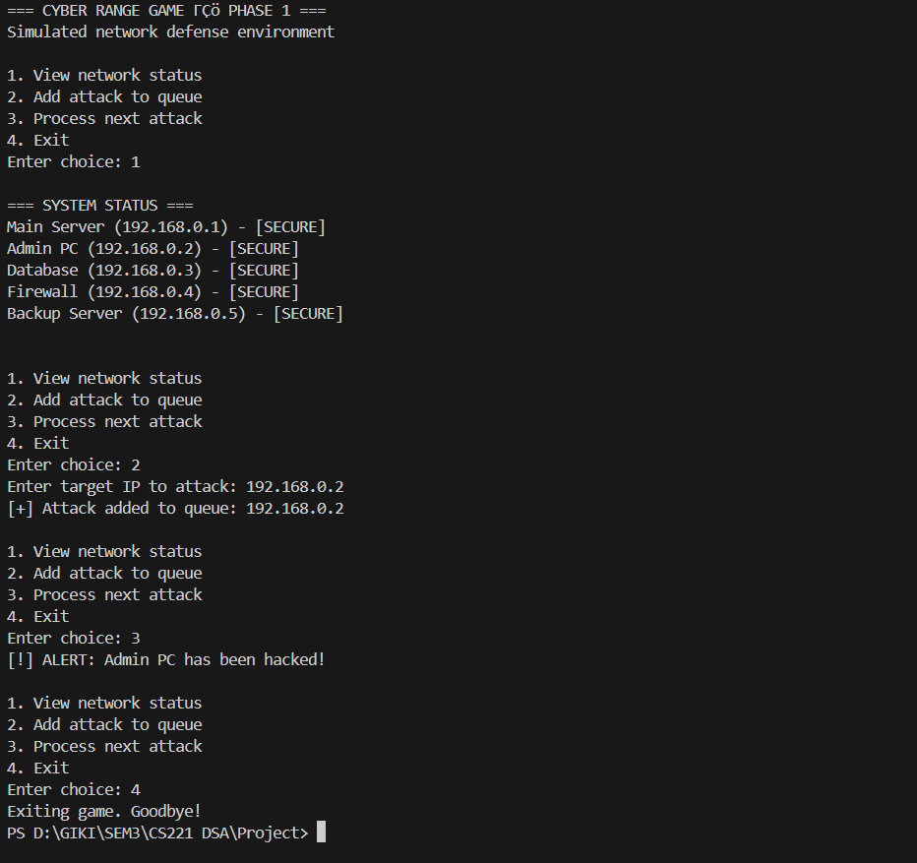
SAMPLE OUTPUT

Slide 18
THANKS

