Slide 1
Cryptography

Slide 2
Modern Cryptography and Perfectly Secret Encryption
Chapter 1

Slide 3
Modern Cryptography Definitions
Principle 1: preciously definition.
Use formulation format and unambiguous definition.
Principle 2: preciously assumption rely.
If the security of encryption relies on assumption, the assumption should be clarify.
Principle 3: preciously security proof.
Follows the mathematics prove principles.

Slide 4
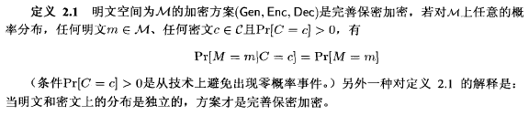
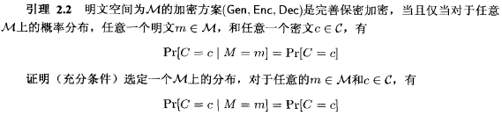
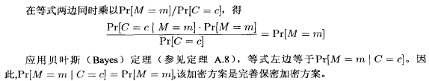
Perfectly Secret
Perfectly secret encryption definition:
The cipher can not give any information about the plain text.

Slide 5

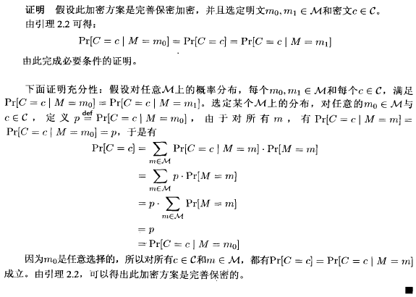
Perfect Indistinguishability
The probabilistic distribution of cipher is independent from the plain text.

Slide 6
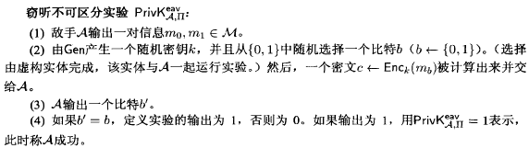
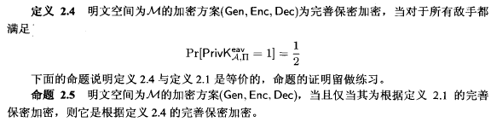
Adversarial Indistinguishability
The adversarial A cannot distinguish the difference.
Perfectly secret and adversarial indistinguishability:

Slide 7
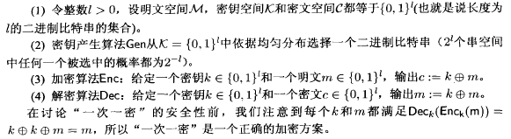
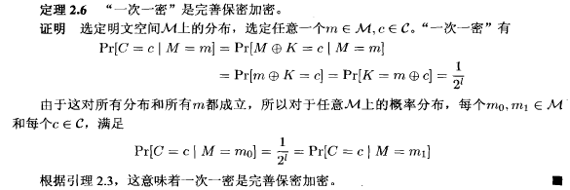
One-time Pad
Definition of One-time Pad:
One-time Pad is perfectly secret:

Slide 8
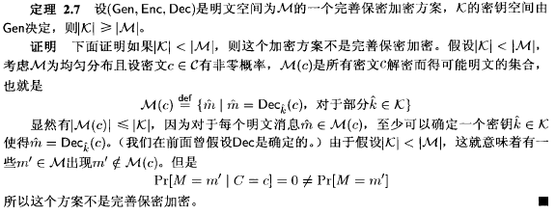
Limitations of Perfectly Secret
The key space is as least large as plain text space:

Slide 9
Private-Key Encryption
Chapter 2

Slide 10
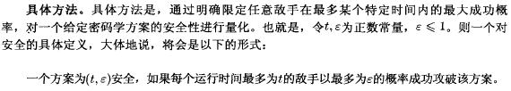
Cryptography Principles
A cryptography algorithm should be open source.
The security of cryptography depends on the security of key.
PPT: Probabilistic Polynomial Time.
The adversarial A is under PPT.
Quantum Cryptography: non PPT secure cryptography.

Slide 11

Definition of Security
Effective computation: under PPT.
Generation randomize.
Negligible success rate:

Slide 12
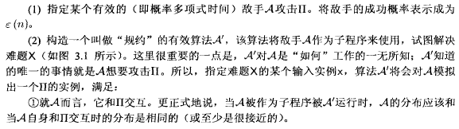
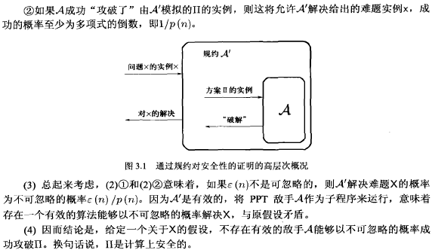
Convectional Proof
To prove a cryptography is secure:

Slide 13
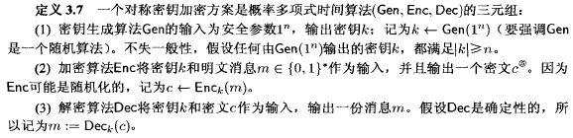
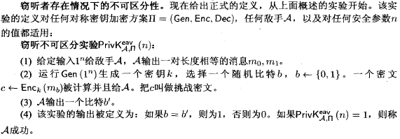
Computational Security
Symbols in Cryptography:
Indistinguishability:

Slide 14
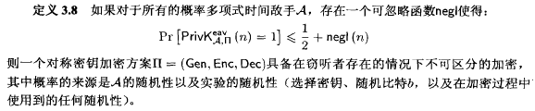

Computational Security
Adversarial indistinguishability:
The probability of adversarial success is not larger than random guess.
Formulation:

Slide 15
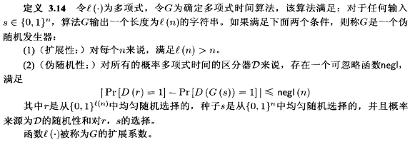
Pseudo-Randomize
Pseudo-random generator (PRG):

Slide 16
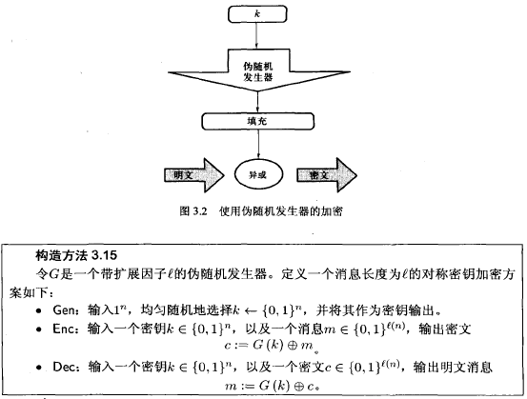
Encryption with PRG
The following encryption with RPG is computational indistinguishable:

Slide 17
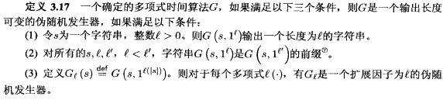
RPG with Flexible Length
Any fixed length PRG can be converted to a flexible PRG:

Slide 18
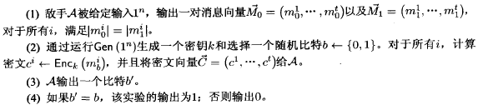
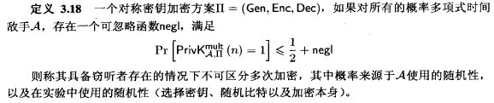
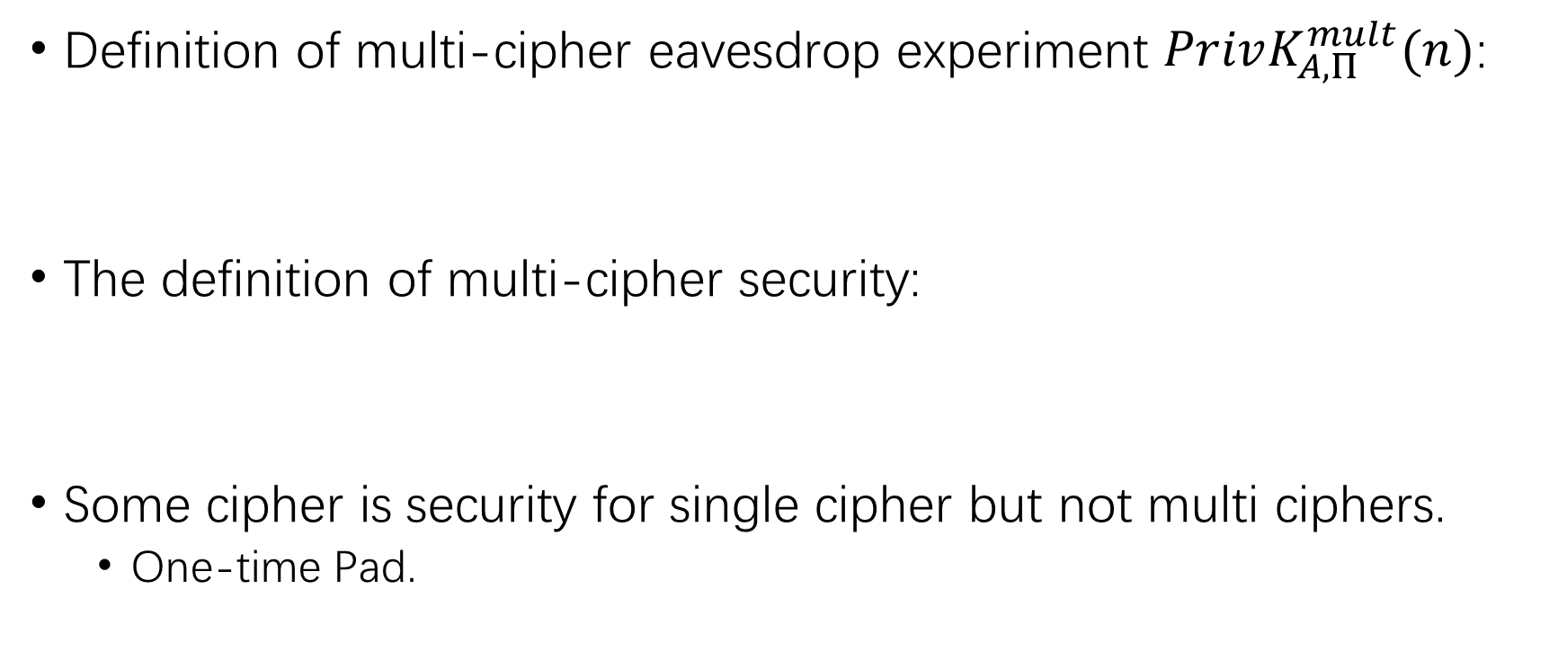
Security with Multiple Ciphers
Definition of multi-cipher eavesdrop experiment $PrivK_{A,Π}^{mult}(n)$:
The definition of multi-cipher security:
Some cipher is security for single cipher but not multi ciphers.
One-time Pad.

Slide 19
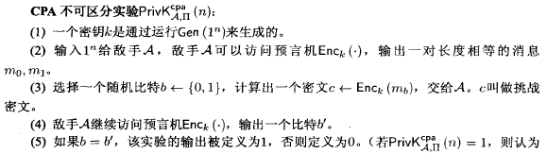
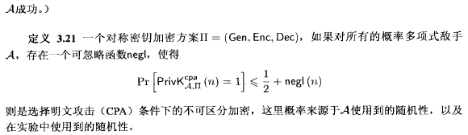
CPA Security
The adversarial can access the encrypt oracle:
For the multi ciphers encryption:

Slide 20
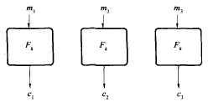
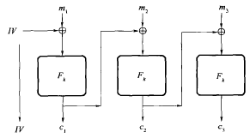
Encryption Models
ECB Mode: not CPA secure
Electronic cipher book
CBC Mode: Cipher Block Chaining

Slide 21
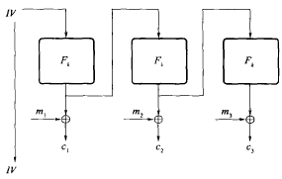
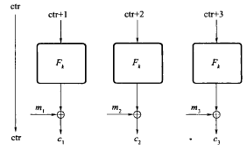
Encryption Models
OFB Mode: Output Feedback
CTR Mode: Counter

Slide 22
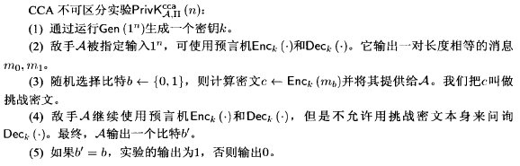
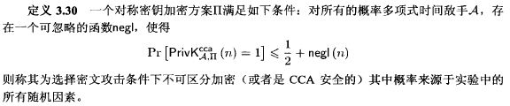
CCA Security
CCA adversarial can access the decryption oracle.
Definition of CCA security:

Slide 23
Message Authentication Codes & Hash Functions
Chapter 3

Slide 24
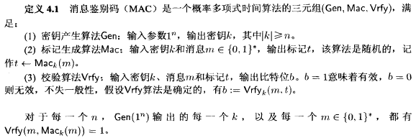
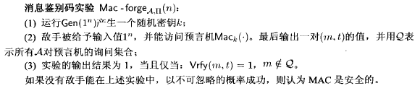
Message Authentication Codes
MAC provides integrity for encryption.
MAC definition:
MAC experiment:

Slide 25
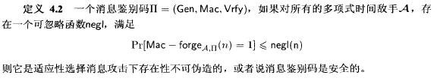
MAC Security
Definition of MAC security:
Replay attack:
MAC cannot prevent replay attack.
As well, MAC cannot prevent re-entrant attack.

Slide 26
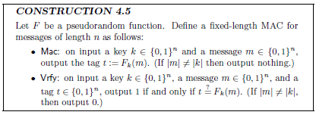
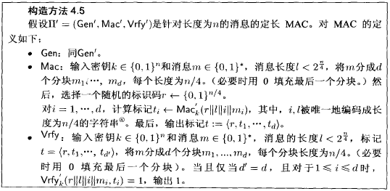
Construct a MAC
A fixed length MAC:
A flexible length MAC:

Slide 27
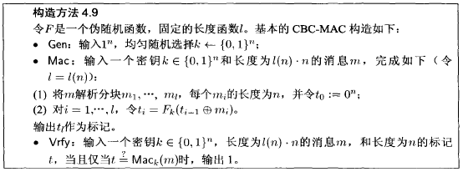
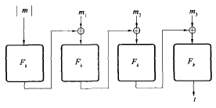

CBC-MAC
Construct a CBC-MAC:
Let $l$ to be a polynomial, and $F$ is a PRF. An unforgeable MAC:

Slide 28

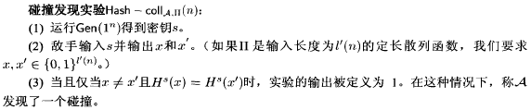

Hash Functions
Definition of hash functions:
Anti-collision Hash Function:
The collide probability is negligible.

Slide 29
Hash Function Security
Anti-collision.
Can’t find a collision in PPT.
Anti second phrase:
Can’t find 2 different inputs with the same hash string in PPT.
Anti origin phrase:
Can’t find the origin phrase from hash string in PPT.

Slide 30
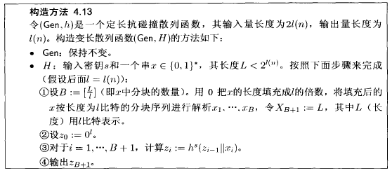

Merkle-Damgard Transformation
Convert a fixed input hash function into flexible input function:
A Merkle-Damgard Transformation:

Slide 31
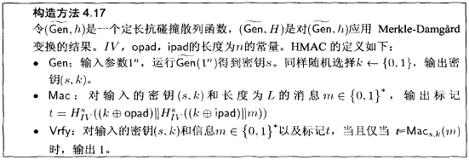
HMAC
Use hash functions to compress MAC:
HMAC security:

Slide 32
Public-Key Cryptography
Chapter 4

Slide 33
Number Theory
The public-key (asymmetric) cryptography is under computational difficulty.
Use private key to find plain text is in PPT.
Without private key to find plain text is difficult.
RSA: large prime resolution.
ECC: elliptic curve.

Slide 34
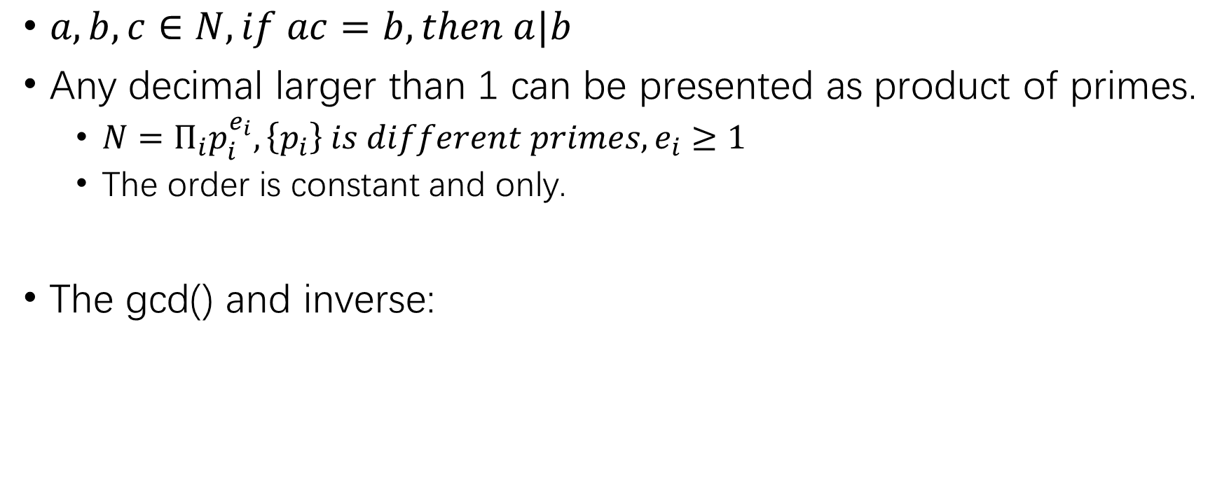
Prime and Divisibility
$a,b,c∈N,if ac=b,then a|b$
Any decimal larger than 1 can be presented as product of primes.
$N=Π_{i}p_{i}^{e_{i}},\left\{p_{i}\right\} is different primes, e_{i}≥1$
The order is constant and only.
The gcd() and inverse:

Slide 35
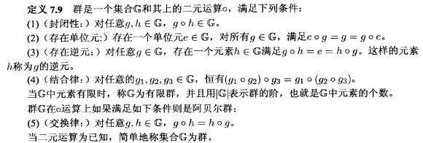

Group
Group definition:
Cancellation law of group:

Slide 36
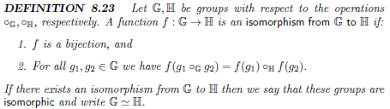
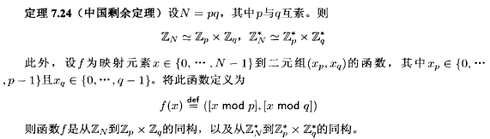
Chinese Reminder Theorem
Isomorphism:
Chinese Reminder Theorem:

Slide 37
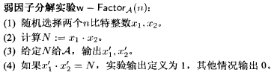
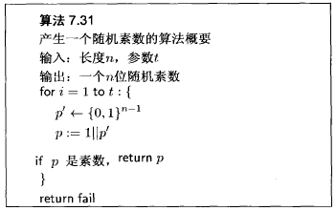
Primes and RSA
Factoring large primes:
Generate random prime:

Slide 38
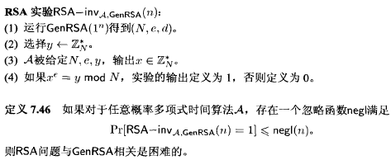
RSA
RSA experiment:

Slide 39
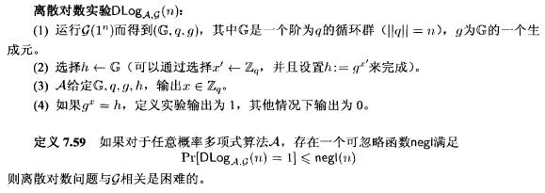
Logistic Logarithm
Logistic logarithm problem is difficult:

Slide 40
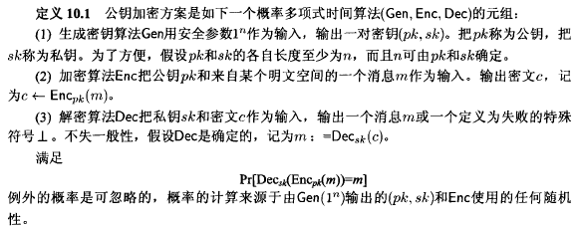
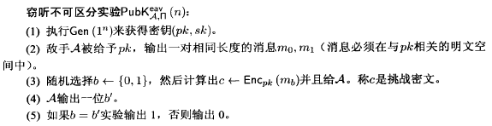
RSA
Definition of public-key encryption:
Indistinguishability:

Slide 41
Attack RSA and ECC
Chapter 5

Slide 42

RSA

Slide 43

RSA

Slide 44


Attack RSA
Factoring N:
Use online factoring database to factor N.
Small N value.
Prime p & q dangerous:
|p-q| is small:
$\frac{p+q}{2}$ is close to $√n$
Find x close to $√n$ till find $x^{2}−n$ is square number, which is $y^{2}$.
Then $x^{2}−n=y^{2}$, use square root formula to find N.

Slide 45

Attack RSA
Prime p & q dangerous:
$p−1$ is smooth:
Smooth number: decimals that can be factor to small prime product.
Use Pollard's p-1 algorithm to factor N.
$M=Π_{q≤B}q^{\left\lfloor \log_{q}{B}\right\rfloor }$ makes $\left(p−1\right)|M$, causes $gcd⁡(a^{M}−1,N)$
$p+1$ is smooth:
Use Lucas's theorem to factor the N.
Complex, search for more information.
$p \& q$ isn’t relatively prime:
Find $gcd⁡(p,q)$ and get p and q.

Slide 46

Attack RSA
Common module attack:
Use the same N, but different private key to encrypt the same message.
$c_{1}=m^{e1} mod N,c_{2}=m^{e2} mod N$
Extend Euclid Algorithm:
$c_{1}^{r}c_{2}^{s}≡m^{re_{1}}m^{se_{2}} mod n≡m^{\left(re_{1}+se_{2}\right)} mod n≡m mod n$
Small public exponent:
e is small, 2 or 3.
Use brute force k to find decimal $m=\sqrt[e]{c+k×n}$.

Slide 47

Attack RSA
Wiener's Attack:
For d is small, $d<\frac{1}{3}N^{\frac{1}{4}}$.
Complex, search for more information.
Basic Broadcast Attack:
Use the same e and sent to e users with different N.
$c_{1}=m^{3} mod n_{1},c_{2}=m^{3} mod n_{2},c_{3}=m^{3} mod n_{3}$.
Chinese Reminder Theorem: $m^{3}≡C mod n_{1}n_{2}n_{3}$.
As $m^{3}<n_{1}n_{2}n_{3}$ and $C<m^{3}<n_{1}n_{2}n_{3}$, then $m^{3}=C$.

Slide 48

ECC

Slide 49

Attack ECC
Invalid curve attack:
$(x,y)$ doesn’t on the curve $y^{2}=x^{3}+ax+b mod n$.
Pick point not on the curve such $(x,0)$.
Dubois, R. (2017). Trapping ECC with Invalid Curve Bug Attacks. IACR Cryptol. ePrint Arch., 2017, 554.
Smart’s Attack:
The order of the curve is equal to q.
Weak Curves In Elliptic Curve Cryptography - Peter Novotney

Slide 50

Attack ECC
Pohlig-Hellman:
Factoring E gives many small primes.
Reduces discrete logarithm calculations to prime subgroups of the order of P and uses Chinese Remainder Theorem to solve system of congruences for discrete logarithm of the whole order.
Sommerseth, M. (2015). Pohlig-Hellman Applied in Elliptic Curve Cryptography.
Lattice attack:
Reveals the signature and the nonce used.
$s=\left(k^{−1}\left(H\left(m\right)+xr\right)\right), x=r^{−1}(ks−H\left(m\right))$
https://blog.trailofbits.com/2020/06/11/ecdsa-handle-with-care/

Slide 51
Reference
Cryptography Theory and Practice
Introduction to Modern Cryptography: Principles and Protocols
新版暗号技術入門: 秘密の国のアリス
https://eprint.iacr.org/2017/554.pdf
https://www.wstein.org/edu/2010/414/projects/novotney.pdf
http://koclab.cs.ucsb.edu/teaching/ecc/project/2015Projects/Sommerseth+Hoeiland.pdf
https://blog.trailofbits.com/2020/06/11/ecdsa-handle-with-care/

