Slide 1
Statistical Analysis of Bitcoin Price , and Preprocessing Data for Price Prediction.

Slide 2
Agenda:-
Introduction.
Intro To Data.
Data Cleansing and EDA
Univariant, Bivariant and Multivariant Analysis.
Conclusion.
Preprocessing data, And Dealing With Outliers.

Slide 3
Introduction:-
Data cleansing and Exploratory Data analysis In order to prepare Data for further investigations
Recognizing patterns and relations between Data features.
Deeper Analysis & extracting all data available.
Understanding patterns and Features affecting Bitcoin Price.
Notes:
gjkgkk

Slide 4
First:- Introduction to Data.
Bitcoin Price data collected and record daily for the period between 2016 and 2020.
Used Date to Obtain Financial and Economical Indicators from Federal Reserve Bank of St. Louis. in the US
Gross Domestic Product (GDP):The total monetary value of all finished goods and services produced within a country's borders in a specific time period.
Unemployment Rate: The percentage of the total labor force that is unemployed but actively seeking employment.
Consumer Price Index (CPI): A measure that examines the weighted average of prices of a basket of consumer goods and services.
Producer Price Index (PPI): Measures the average change over time in the selling prices received by domestic producers for their output.
Consumer Confidence Index (CCI):Measures the optimism or pessimism of consumers regarding their financial situation and the economy.

Slide 5
Second:- Data Cleansing and EDA.
Started Exploring Data Found that Trade Date is In the Wrong Data Type corrected That and Made It Date Time format That allowed me To extract Date/Time Features.
Checked for Null values and Duplicates, found And dropped Duplicates, and Replaced NULL Values Using KNN Imputer Using The Nearest 5 Values, after Sorting Values By Date.
Then Dropped Insignificant Columns That isn’t Relevant to the target [BTC_price_change_1_day, crypto_type, minable, site_url, github_url].
Used Date To Get economical indicators [ GDP, CCI, CPI, PPI, Unemployment Rate ]

Slide 6
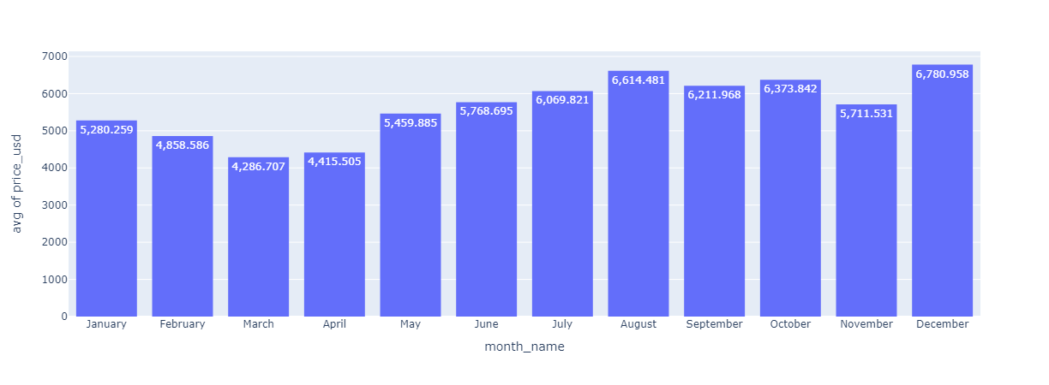
Third:- Univariant, Bivariant Analysis. 1- Target
Average Price Per month.
Found that The Highest Average Price was in December and August and The lowest Was In March.

Slide 7
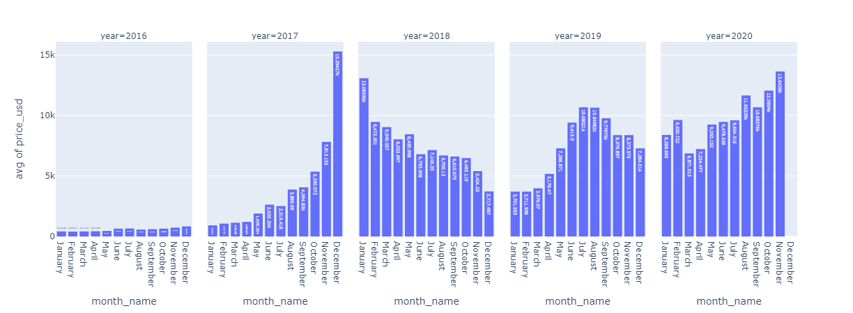
Third:- Univariant, Bivariant Analysis. 1- Target
Average Price Per month For Each Year.
And Upon Checking The Same Average But For Each Year you can notice the Positive Price Trend Except for the Year 2018 as we notice A correction in the price Following the Peak in late 2017 as the market Became Saturated with New Investors and old investors pushed for a major selling trend to liquify their Profit causing the Price to decline.

Slide 8
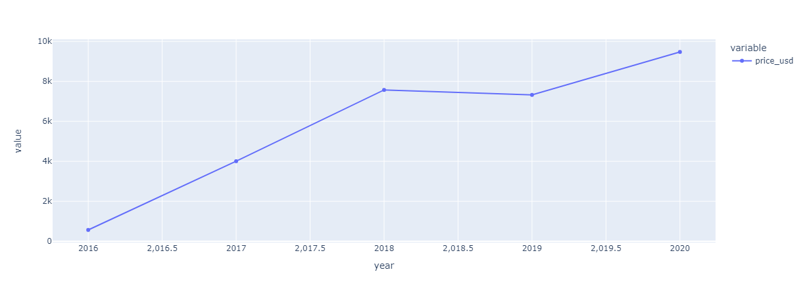
Third:- Univariant, Bivariant Analysis. 1- Target
Average Price Per month For Each Year.
And Upon Checking The Same Average But For Each Year you can notice the Positive Price Trend Except for the Year 2018 as we notice A correction in the price Following the Peak in late 2017 as the market Became Saturated with New Investors and old investors pushed for a major selling trend to liquify their Profit causing the Price to decline.

Slide 9
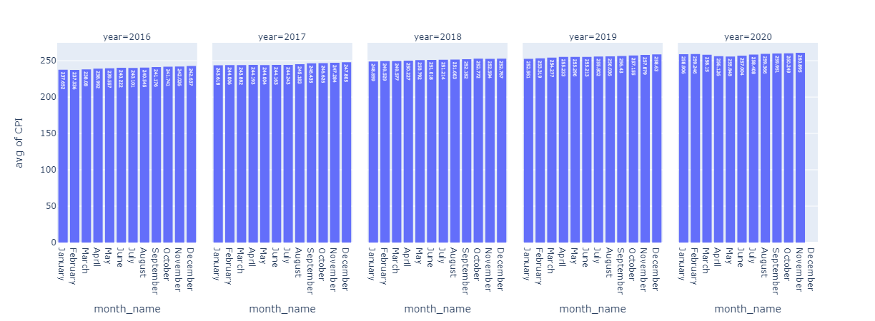
Third:- Univariant, Bivariant Analysis. 2- Features Affecting Target.
Average CPI Per Month For Each Year.
CPI measures the average change over time in the prices paid by consumers for a basket of goods and services.
As it’s the key indicator of inflation, Higher CPI values indicate rising inflation, Causing the Central bank to increase the interest rates to fight the inflation and tightening of monetary policy, Causing Investors to seek Decentralized Assets Like Bitcoin.

Slide 10
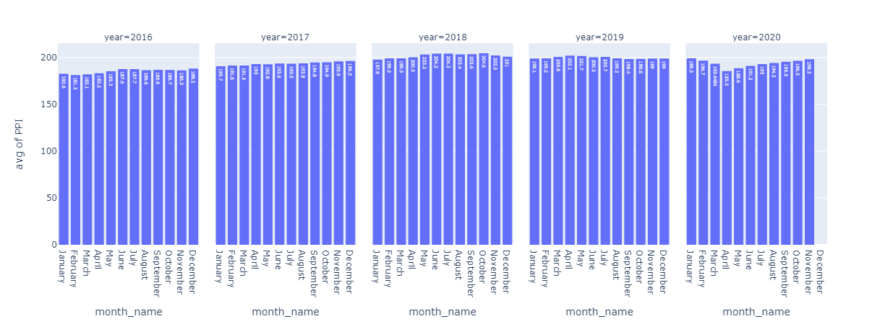
Third:- Univariant, Bivariant Analysis. 2- Features Affecting Target.
Average PPI Per Month For Each Year.
PPI (Producer Price Index) measures the average change in selling prices received by domestic producers for their output.
Rising PPI signals increased production costs, potentially leading to higher future consumer prices (CPI). Investors might seek Bitcoin as an inflation hedge, boosting its demand and price.

Slide 11
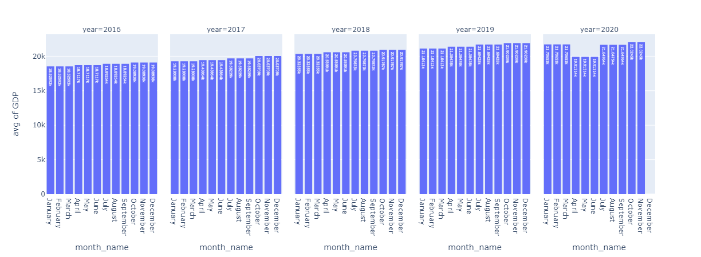
Third:- Univariant, Bivariant Analysis. 2- Features Affecting Target.
Average GDP Per Month For Each Year.
GDP(Gross Domestic Product)measures the total value of goods and services produced within a country's borders over a specific period.
Positive GDP increases Bitcoin investment; negative GDP decreases it.
Robust GDP may raise interest rates, making Bitcoin less attractive; slow GDP growth may devalue fiat currencies, making Bitcoin more attractive as an inflation hedge.

Slide 12
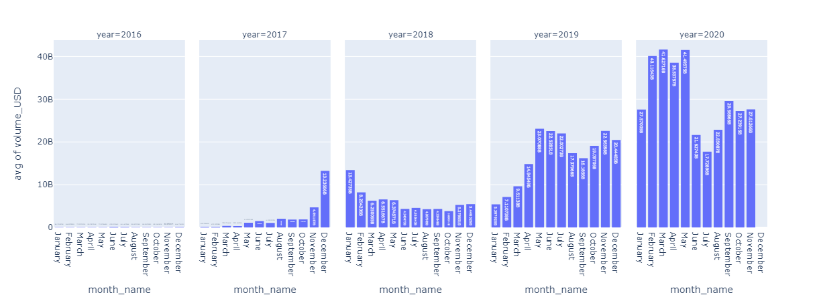
Third:- Univariant, Bivariant Analysis. 2- Features Affecting Target.
Average Volume in USD Per Month For Each Year.
Market trade volume in USD : Higher volume signals more liquidity and demand, likely driving Bitcoin's price up.
High volume suggests increased investor interest and positive sentiment, often leading to price rises.
It helps establish accurate price levels, but extreme volumes can indicate market manipulation or speculative bubbles, affecting prices.

Slide 13
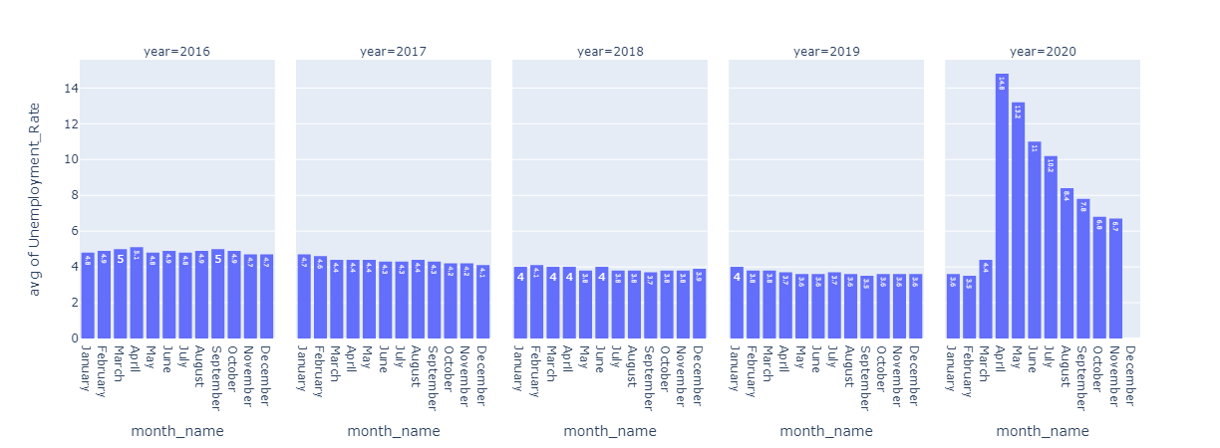
Third:- Univariant, Bivariant Analysis. 2- Features Affecting Target.
Average Unemployment Rate Per Month For Each Year.
Unemployment Rate: is a measure of the percentage of the labor force that is unemployed and actively seeking employment
High unemployment reduces investor confidence and disposable income, leading to lower Bitcoin and USD trade volume. It also increases risk aversion but may prompt monetary easing and stimulus, potentially boosting liquidity and Bitcoin trade volume.

Slide 14
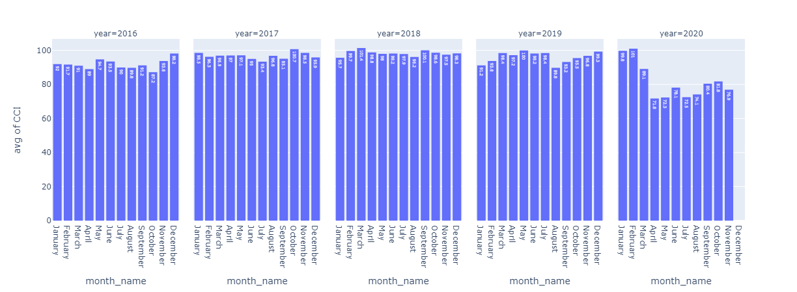
Third:- Univariant, Bivariant Analysis. 2- Features Affecting Target.
Average CCI Per Month For Each Year.
Consumer Confidence Index (CCI) : is a measure of consumer sentiment toward the economy, reflecting how optimistic or pessimistic consumers are about their financial situation and the overall economic prospects.
A high CCI indicates economic confidence, boosting investor confidence and leading to higher trade volumes in USD.

Slide 15
Fourth:- Conclusion.
Bitcoin’s price is largely influenced by supply and demand dynamics. With a capped supply of 21 million coins, demand plays a crucial role in its valuation. As demand increases, with supply remaining limited, the price is likely to rise significantly.
Price Exhibits a Increasing Trend With Time due to a phenomena called halving Which refers to the event where the reward for mining new blocks is cut in half.
The CPI tracks inflation, and when it rises, central banks may hike interest rates to slow inflation. This can lead investors to consider decentralized assets like Bitcoin as inflation hedges.
PPI (Producer Price Index) Rising PPI signals increased production costs, potentially leading to higher future consumer prices (CPI). Investors might seek Bitcoin as an inflation hedge, boosting its demand and price.
GDP(Gross Domestic Product) Positive GDP increases Bitcoin investment; negative GDP decreases it, Robust GDP may raise interest rates, making Bitcoin less attractive; slow GDP growth may devalue fiat currencies, making Bitcoin more attractive as an inflation hedge.
High USD trade volume indicates more market liquidity and demand, which can raise Bitcoin’s price. It reflects investor interest and market sentiment, but very high volumes may suggest manipulation or bubbles, Like Late 2017.
Unemployment rate and Consumer confidence Index Indirectly Impacts the Price Of bitcoin by affecting Trade Volume.
All OF the Above Factors Aren’t Deterministic as there are Other Non Numerical Factors That affects The Price Like Political events, monetary policies, and natural disasters also play a role, adding to the complexity and unpredictability of cryptocurrency markets.

