Slide 1


SSH
Powerpoint 09. 05. 12

Slide 2
Using SSH keys
I recommend looking at this page:
http://blakesmith.me/2010/02/08/understanding-public-key-private-key-concepts.html
Also, this video explain it
https://www.youtube.com/watch?v=svRWcx7dT8g
There is a longer story on SSH on Lynda.com
https://www.lynda.com/Developer-Network-Administration-tutorials/Welcome/189066/365610-4.html

Slide 3
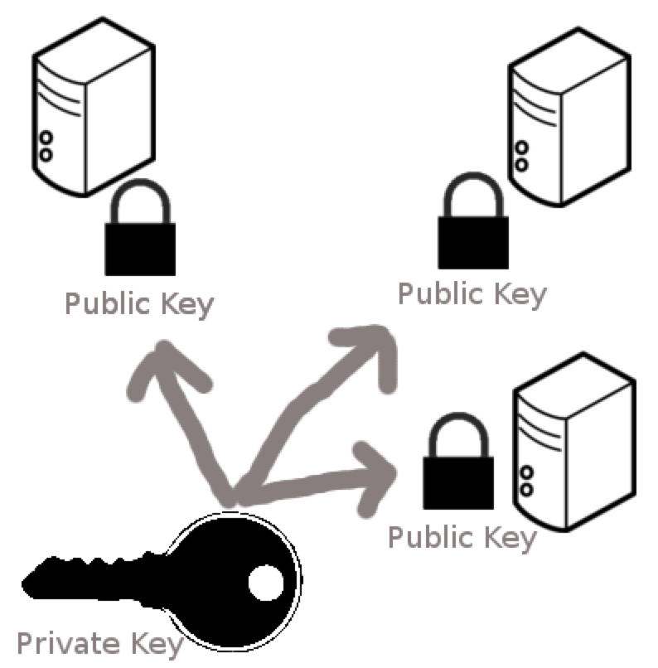

Public and private key
You store the private key on your computer
The public key is placed on the remote computer
You can place the public key on many computers

Slide 4
Public and private key
You store the private key on your computer
The typical place is in your root directory in the folder named “.ssh”.
The private key is normally called id_rsa, and the public one called id_rsa.pub
The public key is placed on the remote computer
The public key is placed in the .ssh/authorized_keys
You can place the public key on many computers

Slide 5
How to make a key pair
In git-bash and on mac:
ssh-keygen
It will ask you for where to place it.
Place it in the .ssh directory
You can pick your own name for it if you want?
Some have one key for every thing (git and servers)
Some have a key for each server they use

Slide 6
Logging in using ssh keys
From git-bash
ssh username@ip-address
If you saved your key in a file other than id_rsa, then you must tell the file name with the key:
ssh –i filename username@ip-address

Slide 7
The ssh config file
If you are logging in and out of the server very often you get tired of remembering the ip-address number and other parameters
You can have a file named config in the .ssh folder
Having an ssh file allows us to log in as:
ssh ralfpriv
Host ralfpriv HostName 95.85.40.235 User ralf IdentityFile ~/.ssh/digitalocean

Slide 8
Encryption principle of SSH
Outside of normal usage of SSH – just for background
A message encrypted using private can be decrypted by public key
A message encrypted using public can be decrypted using private key
Assume two parties A and B each has their private key, and the public key of the other.
How can A send a message to B which only B can read?
How can B be sure the message is from A?
(hard) – if B does not have A’s public key, how can B be sure a message is from A

Slide 9
ssh
Ressources:
https://www.digitalocean.com/community/tutorials/understanding-the-ssh-encryption-and-connection-process
https://en.wikipedia.org/wiki/Public-key_cryptography

Slide 10
Special directory “names”
If you are logged in as user ralf,
~ is short for /home/ralf
~joe is short for /home/joe
.. is short for the folder above current directory
. is the current directory
If a filename (or directory name) starts with . it is not shown by ls.
To see files starting with . use the –a switch

Slide 11
Redirecting output
Many commands produce output to the terminal
This output can be redirected
Eg. ls –al > myfile.txt
some files read from the terminal
this input can be redirected
Eg. wc < myfile
output from one command can be given as input to an other – this is called “piping”
Eg. ls—al | wc -w

Slide 12
Exercises for Wednesday
We will start Wednesday by taking a look at exercise 9

