Slide 1
Ludicrous engine
Not Fast, Just Furious!

Slide 2

Who are we?
Naveen Prasad
Colin Pugh
Christian Lee

Slide 3
What is ‘Ludicrous engine’?
Ludicrous Engine is a powerful tool used to design and create awesome 2D games
Uses C++ as the main coding language and SFML as its graphics library

Slide 4
What does our engine have?
System Requirements Test
Audio Component
Base Component
Rigidbody Component
Render Component
SceneGraph Component
Transform Component
Manage GameObjects
Particle System
Physics System
Input Handling
Scene Management
OpenGL Shader

Slide 5
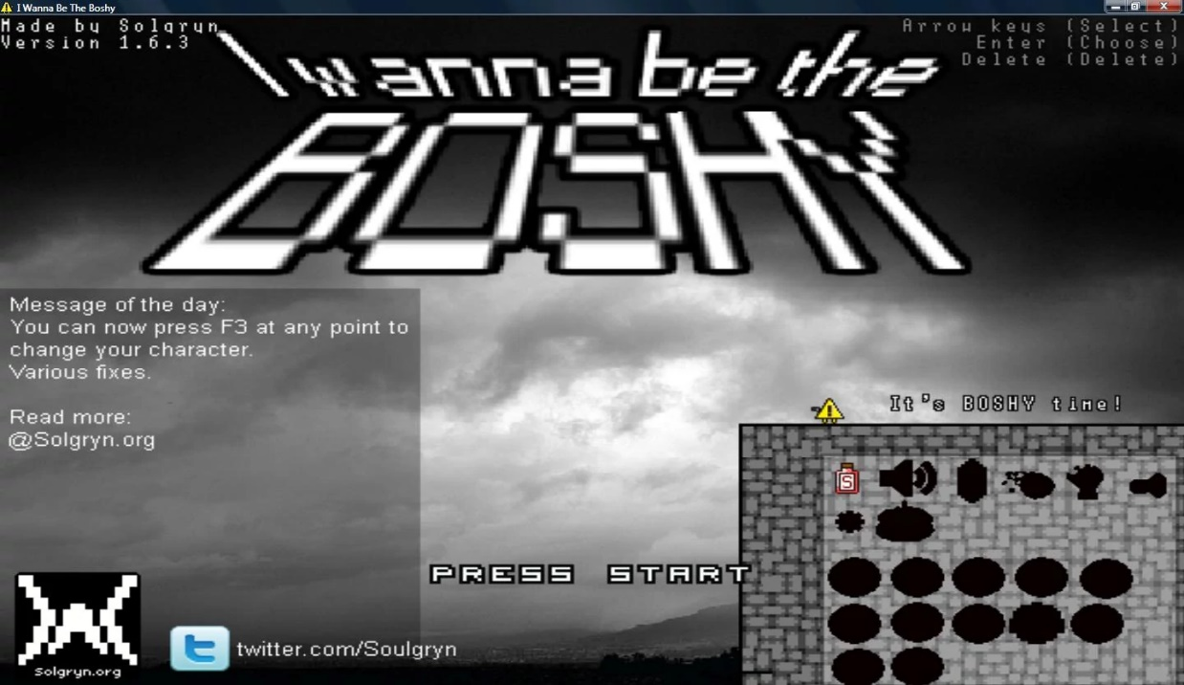


Engine inspiration

Slide 6
what game did we decide to make?
From our inspiration, we have decided to make a endless survival game
If you get hit by 1 of the balls, you must restart and try to survive longer this time
Heavy focus on simple mechanics and heavy replayability.
Use as much of the engine as possible
We decided to call it ‘Balls of Fury’ because, well, there's a lot of balls and a lot of rage

Slide 7
Enough talking!
LETS DEMO WHAT WE GOT

Slide 8
Do you have any questions for us?

Slide 9
Thank you!
Hope you all have a great summer!

