Slide 1
IEM / KOLKATA
SOFTWARE ENGINEERING / GROUP 10
SOFTWARE ENGINEERING SEMESTER PROJECT
IEM
TEAM / ASSIGNED ROLES
Debarghya Mitra (248)
Admission Portal
Project Manager
Arka Ghosh Dastider (220)
UI/UX Designer
Institute of Engineering & Management, Kolkata
Jitesh Jana (243)
QA Engineer
Jatin Kumar (232)
TEAM 404 BRAIN NOT FOUND
Software Architect
Group 10
Diptomoy Das (227)
Full-Stack Engineer
Requirements to design, observed implementation and verification
IEM Admission Portal · Semester project
01 / 10

Slide 2
IEM / 404 BRAIN NOT FOUND
SOFTWARE ENGINEERING · GROUP 10
A centralized portal targets fragmented admissions
Project motivation, grounded in the SRS—not a claim of measured impact.
Traditional process
One intended admission workflow
Scattered forms
01
Applicant entry
Registration and application submission
Separate documents
02
Document handling
Keep required files with the application
Repeated status inquiries
03
Status tracking
Make application progress visible to applicants
Manual staff handoffs
04
Staff review
Support authorized review and status updates
GOAL
Reduce fragmentation and improve visibility.
Benefits remain unmeasured.
Basis: Assignment 2 (SRS), PDF pp. 3, 5–6 · Intended scope
02 / 10

Slide 3
IEM ADMISSION PORTAL
GROUP 10 / SOFTWARE ENGINEERING
Requirements define the core workflow and quality targets
SRS baseline • intended behavior and acceptance targets
OBJECTIVE & SCOPE
Centralize the web admission workflow for applicants and authorized staff.
FUNCTIONAL
NON-FUNCTIONAL
FR-1
Register an applicant account
Authorized access
FR-2
Complete and submit an application
Records restricted to authorized users
Clear, usable interface
FR-3
Handle documents and application fee status
Easy to use with minimal assistance
FR-4
Track application status
Within 3 seconds
FR-5
Authorize staff review, verification and updates
Normal requests under expected workload;
external service delays excluded.
Requirements ≠ verified operation or measured performance.
Source: Assignment 2 · SRS · PDF p. 5 (printed p. 4)
03 / 10

Slide 4
IEM ADMISSION PORTAL
SOFTWARE ENGINEERING / GROUP 10
A phased project plan links requirements to verification
Charter basis: an eight-week sequence of planned milestones—not a completion record.
WEEK 1
WEEK 2
WEEKS 3–4
WEEK 5
WEEKS 6–7
WEEK 8
1
2
3
4
5
6
Requirements
/ SRS
Architecture &
database design
Development
Integration
Testing / UAT
Deployment &
documentation
WHY THIS FITS A SEMESTER PROJECT
A bounded schedule links the SRS to design, build work
and verification artifacts, making the plan traceable.
Read every phase as planned; testing and UAT are gates, not demonstrated outcomes.
Source: Assignment 1, p. 1 — project charter and milestone plan
04 / 10

Slide 5
IEM ADMISSION PORTAL
GROUP 10 / ARCHITECTURE
The deployed client is visible; backend integration is unverified
Observed deployment path—not a claim of a working end-to-end system
OBSERVED CLIENT & REQUEST PATH
Browser
HTTPS
Angular SPA
HTTP
api
Visitor’s machine
iem-admission-404bn.web.app
VERIFIED FRONTEND EVIDENCE
SITE-DESCRIBED • INTEGRATION UNVERIFIED
Firebase SDK is present in the bundle.
Bootstrap is loaded by the page.
Express / Firebase Auth
Firestore / Cloud Storage
No database schema or payment
integration was verified.
No confirmed data flows are drawn to these services.
HLD proposal
React / Node / PostgreSQL differs from the live description; not the deployed stack.
A hosted client’s localhost API points to the visitor’s machine—not a remote backend.
Basis: live browser inspection, 11 Nov 2026; Assignment 3, HLD p. 8
05 / 10

Slide 6
IEM ADMISSION PORTAL
GROUP 10 / SOFTWARE ENGINEERING
Design models express the intended admission workflow
SRS / PROPOSED — requirements and design models, not live system proof
01 USE CASE
02 DATA FLOW
IEM Admission Portal
Submission
Applicant
Application
processing
Register
Applicant
Submit application
Track status
Store / retrieve
Authorized
staff
Review / status
Authorized
staff
Review application
D1 Proposed
application records
Update status
System boundary
Conceptual store — not a verified database schema
03 ACTIVITY — INTENDED
Authenticate
Complete application
Submit
Staff review
Status update
Start
End
The models define expected behavior; processing and authorization still require verification.
Sources: Assignment 2, SRS pp. 5–6; Assignment 3, design worksheet pp. 4, 7, 9–10
06 / 10

Slide 7
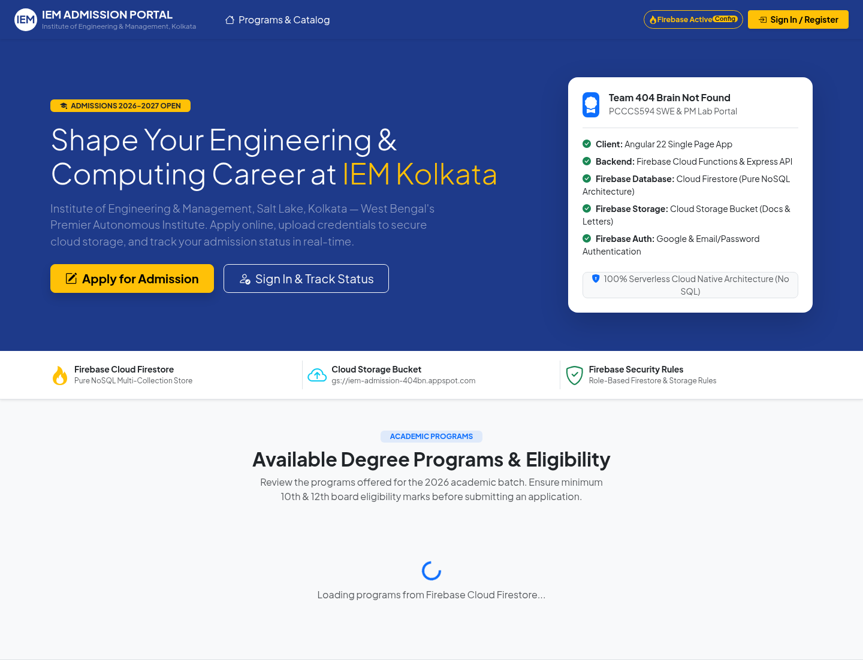
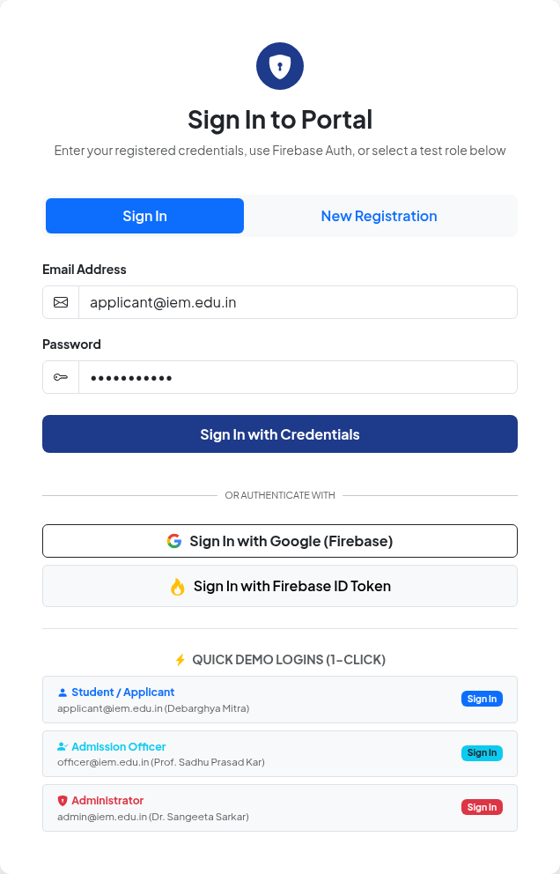
IEM ADMISSION PORTAL
SOFTWARE ENGINEERING / GROUP 10
What the live interface actually shows
Visible controls are evidence of UI delivery—not proof of an end-to-end admission flow.
01 / HOME
02 / SIGN-IN
VISIBLE CONTROLS
Home & program area
Branding, navigation and calls to apply / sign in. Catalog stayed loading.
Sign-in & registration
Email/password, Google and Firebase-token controls; three demo roles. Registration form visible.
OBSERVED ACCESS LIMIT
Admin, officer and apply routes redirected to sign-in
Source: live website captures • inspected 11 Nov 2026 • environment-specific observations
07 / 10

Slide 8
IEM ADMISSION PORTAL
GROUP 10 / SOFTWARE ENGINEERING
Verification reveals a backend connectivity blocker
Plan: functional, integration, system and usability tests; execution records pending.
Scenario | Expected | Actual | Status
Signed-out /admin access | Sign-in redirect | Redirected to sign-in | ● Observed
Demo role login | Session opens | Session opens | ● Observed
Program catalog | Programs load | Programs load | ● Observed
Submit application end-to-end | Submission succeeds | Submission succeeds | ● Observed
Inspection environment only. No test credentials, uploads or real payments were submitted.
Source: Assignment 4, pp. 1–7; website inspection · 11 Nov 2026
08 / 10

Slide 9
IEM ADMISSION PORTAL
404 BRAIN NOT FOUND / GROUP 10
Connectivity and verification remain the critical gaps
Planning risks, live observations and proposed actions are separate evidence categories.
01 CHALLENGES
Requirements & dependencies
Live connectivity failure
Documented risk +
observed blocker
Ambiguous policies and external
integrations were flagged in planning.
Browser API calls targeted localhost;
connections were refused.
02 LIMITATIONS
Visible inspection limits
Evidence still unavailable
Observed behavior +
unverified outcomes
Programs did not load; demo login failed.
Protected workflows and database
operations could not be verified.
No documented test execution results
or acceptance evidence were supplied.
03 ENHANCEMENTS
Restore access
Prove readiness
Extend after approval
Proposed, not delivered
Deploy/configure an
accessible API; verify
role-based authorization
and data access.
Execute end-to-end
and performance tests;
record results against
acceptance criteria.
Reliable notifications,
scalable storage and
payment integration—
after scope approval.
Priority: restore API access, then validate the protected admission workflow.
Basis: Assignments 1, 2 & 4; live browser inspection, 11 Nov 2026
09 / 10

Slide 10
404 BRAIN NOT FOUND / IEM KOLKATA
GROUP 10 · SEMESTER PROJECT
A defined workflow—with validation still needed
A centralized admissions foundation—not yet an end-to-end verified service.
CONCLUSION
ASSIGNED ROLE RESPONSIBILITIES
Requirements, design models, a test plan and a visible web UI establish the foundation for a centralized admission portal.
Debarghya Mitra (248)
Coordination
Arka Ghosh Dastider (220)
UI/UX
End-to-end operations remain unverified.
Jitesh Jana (243)
QA
KEY LEARNING
Jatin Kumar (232)
Connect requirements → models →
implementation → test evidence.
Architecture
Diptomoy Das (227)
Full-stack engineering
Identify integration and security boundaries.
Thank You | Questions & Answers
https://iem-admission-404bn.web.app/
Basis: Assignments 1–4; live-site observation, 11 Nov 2026.
10 / 10

