Slide 1
LOCAL-FIRST AI SYSTEMS
A Local Agent,
Knowledge, and Voice Architecture
An anonymized briefing on how a workstation, local agent host, durable knowledge, training workflows, and voice interface work together.
Workstation
Local agent host
Private durability
Canvas • coding • messaging • voice
Hermes • models • tools • training
GBrain • authored sources • Git
ARCHITECTURE AUDIT • JULY 2026
Hermes = runtime • GBrain = durable knowledge • TARS = voice/persona
INSTRUCTIONAL BRIEFING • SANITIZED
01

Slide 2
START HERE
The four-layer mental model
1. Interaction
2. Agent
3. Knowledge
4. Durability
Where a person asks, observes, and approves.
Canvas
Messaging
Coding sessions
Voice
Where requests are authenticated, scoped, reasoned about, and executed.
Gateway
Hermes sessions
Local models
Approved tools
Where current evidence is reconciled with durable context.
Live run state
Scoped GBrain
Training receipts
Provenance
Where authored knowledge can be backed up and restored.
Markdown sources
Local index
Private Git
Recovery
The workstation controls. The local host executes. GBrain remembers.
ANONYMIZED LOCAL AI/ML ARCHITECTURE
02

Slide 3
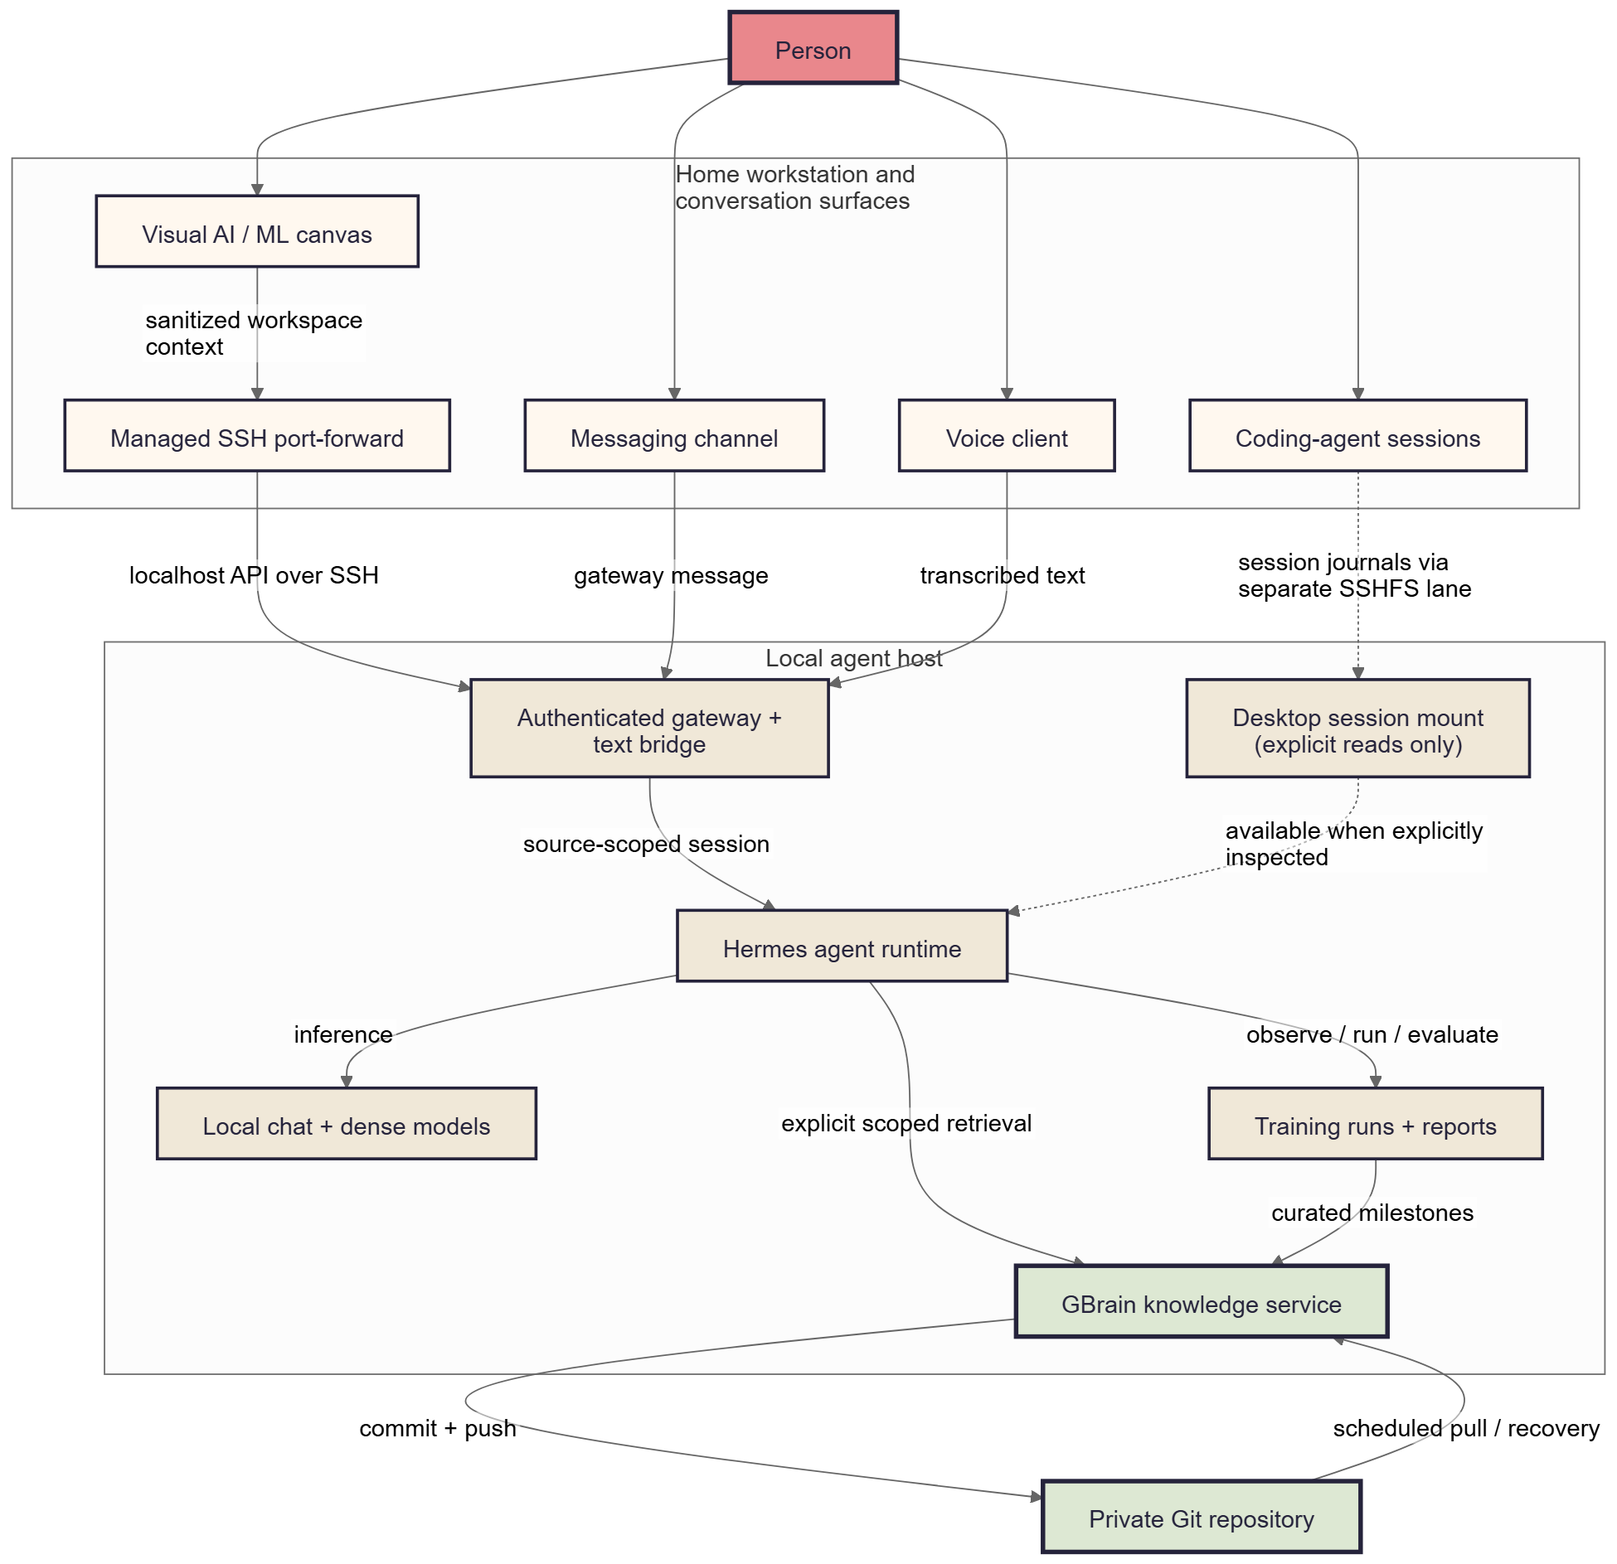
ARCHITECTURE
One system, several deliberately separate lanes
WHAT CROSSES THE BOUNDARY
Canvas: sanitized workspace context over a managed SSH port-forward
Messaging: a source-scoped gateway message
Voice: transcribed text over a trusted local network
Coding sessions: explicit reads through a separate filesystem lane
Durability: authored GBrain sources commit and push outside the request path
ANONYMIZED LOCAL AI/ML ARCHITECTURE
03

Slide 4
REQUEST FLOW
What happens during one canvas request
1
Workspace prompt
2
Sanitized canvas context
3
Localhost API over SSH
4
Authenticated, scoped session
5
Local model + approved tools
6
Explicit GBrain retrieval if needed
7
Response, evidence, and optional receipt
Live jobs and evaluator output remain the operational source of truth.
ANONYMIZED LOCAL AI/ML ARCHITECTURE
04

Slide 5
CONTEXT MODEL
Context is scoped—not magically shared
Automatic
Explicit
Not implied
• Sanitized canvas context with each prompt
• Stable source-specific session identity
• Gateway authentication and transport
• Configured local model and approved tools
• Scoped GBrain retrieval
• Coding-session journal inspection
• Training, evaluation, and promotion workflows
• Cross-surface provenance reconciliation
• One giant transcript across surfaces
• Automatic indexing of mounted directories
• Copying all raw logs into GBrain
• Old skill text overriding live state
Availability is not ingestion. History is not current state.
ANONYMIZED LOCAL AI/ML ARCHITECTURE
05

Slide 6
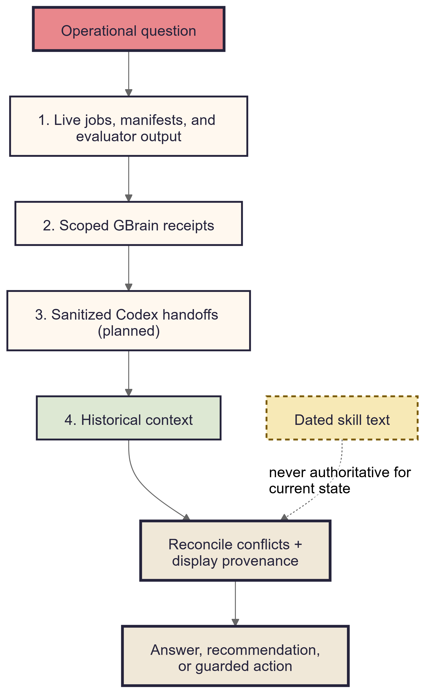
FRESHNESS ORDER
Fresh evidence first. Durable context second.
1
Live operations
Jobs, manifests, evaluator output, and artifacts answer what is happening now.
2
Scoped GBrain receipts
Goals, prior decisions, and verified outcomes explain why the system is here.
3
Sanitized handoffs
Recent coding context becomes useful after it is explicitly published and bounded.
4
Historical context
Older sessions support an answer; they do not become authority.
Dated skills never override current evidence.
ANONYMIZED LOCAL AI/ML ARCHITECTURE
06

Slide 7
KNOWLEDGE DURABILITY
GBrain stores durable receipts—not the whole machine
Authored sources
Belongs in GBrain
Stays outside
Markdown decisions, procedures, outcomes, and evidence pointers
Goals and evaluation gates
Raw training logs
Dataset and model identifiers
Checkpoints and large datasets
Final metric snapshots
Credentials and private transcripts
Derived index
Decisions, failures, and lessons
Unrestricted home-directory content
Search indexes and embeddings rebuilt from the authored source
Stable report and artifact references
Ephemeral process state
PRIVATE GIT = RECOVERY FOR AUTHORED SOURCE
Audit note: verify durability per source. The primary source was aligned; isolated sources can differ.
ANONYMIZED LOCAL AI/ML ARCHITECTURE
07

Slide 8
TRAINING AND EVALUATION
The agent operates a task-general training loop
1
Preflight
2
Launch
3
Observe
4
Evaluate
5
Decide
6
Report
7
Curate
Embedding fine-tuning is one profile—not the identity of the platform.
The same operator pattern can support SFT, preference optimization, RL workflows, distillation, adapters, and future full-model training.
ANONYMIZED LOCAL AI/ML ARCHITECTURE
08

Slide 9
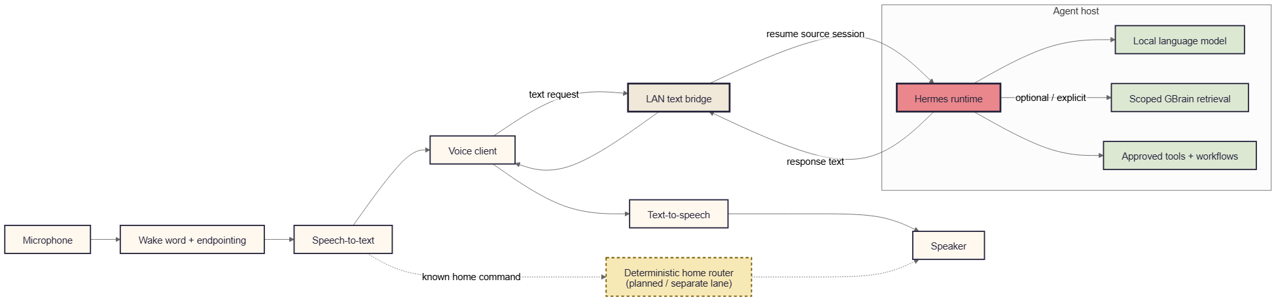
VOICE PATH
TARS is the voice/persona layer around the same agent
VOICE ≠ A SECOND BRAIN
Local audio
Same agent runtime
Deterministic lane
Wake word • endpointing • speech-to-text • text-to-speech
Source-scoped Hermes session with optional tools and GBrain
Planned path for known home commands that should stay fast and predictable
ANONYMIZED LOCAL AI/ML ARCHITECTURE
09

Slide 10
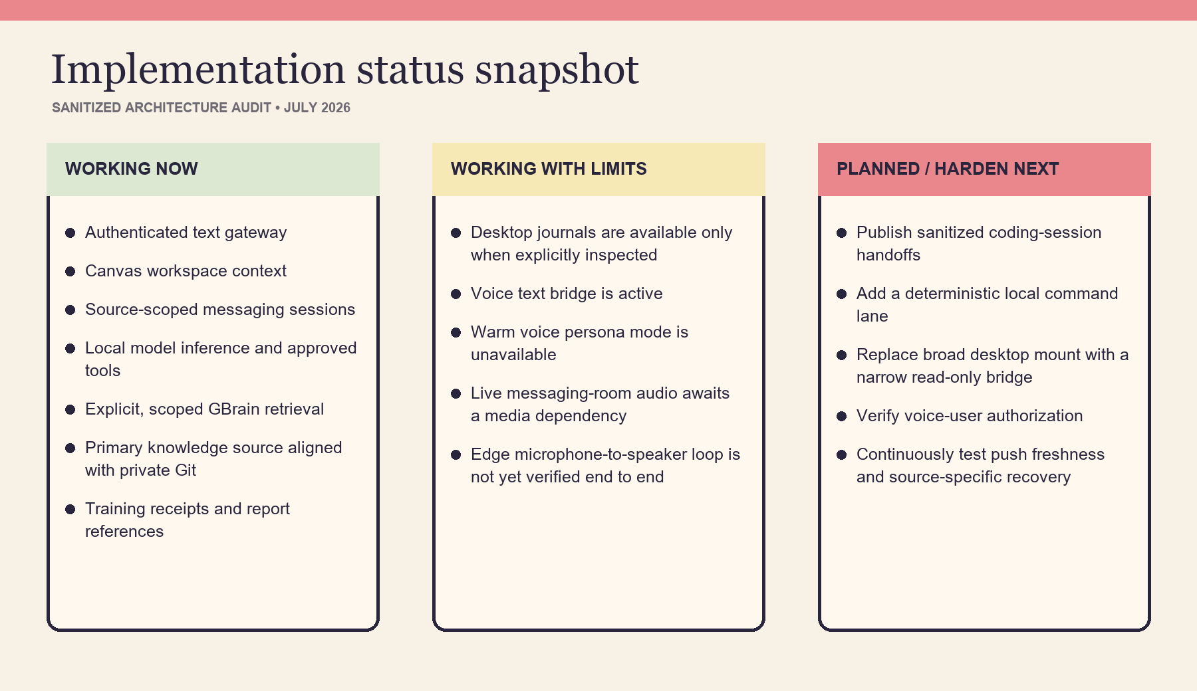
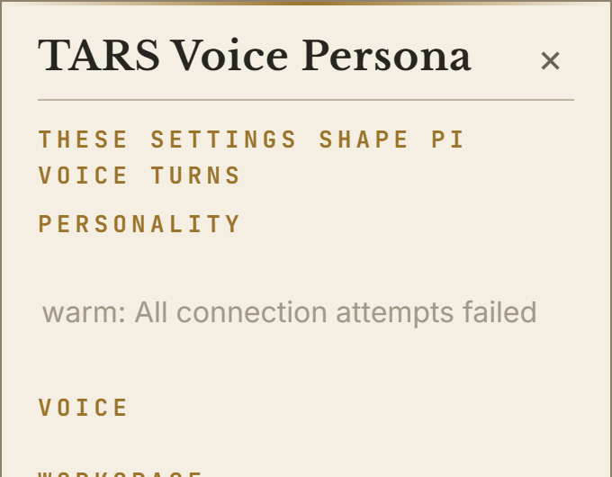
IMPLEMENTATION SNAPSHOT
Working now, limited now, and planned next
VOICE HARDENING CHECKLIST
Restore and test warm persona service
Install live-room media dependency
Run microphone-to-speaker trace
Verify voice-user authorization
ANONYMIZED LOCAL AI/ML ARCHITECTURE
10

Slide 11
SECURITY AND RECOVERY
Trust boundaries are part of the product
Canvas → agent host
Voice → text bridge
Current: authenticated API through a managed SSH port-forward.
Harden: rotate credentials and preserve redaction tests.
Current: trusted-LAN text request.
Harden: explicit caller authorization or an authenticated tunnel.
Workstation journals
GBrain → private Git
Current: separate filesystem bridge with explicit reads.
Harden: narrow, read-only handoff folder instead of a broad writable mount.
Current: authored-source backup and scheduled recovery.
Harden: monitor push failures and verify policy for every isolated source.
A LAN listener is not automatically safe. A mounted folder is not automatically knowledge.
ANONYMIZED LOCAL AI/ML ARCHITECTURE
11

Slide 12
SPEAKER GUIDE
How to describe the system
30-second version
Technical walkthrough
“The interface lives on a normal workstation, while the agent, models, training tools, and durable knowledge run on a dedicated local host. Canvas, messaging, and voice connect through authenticated, source-scoped sessions. The agent uses current job evidence first and queries GBrain only when durable history is useful. GBrain stores curated outcomes backed by private Git. Voice is another input and output layer around the same agent—not a separate brain.”
Name the interaction surface and session scope
Explain the authenticated transport
Separate automatic context from explicit retrieval
Identify the current source of truth
Show where reports, receipts, and recovery live
Do not claim shared transcripts, automatic ingestion, universal Git backup, or production-ready voice without evidence.
ANONYMIZED LOCAL AI/ML ARCHITECTURE
12

