Slide 1
Robust Training of Graph Neural Networks
via Noise Governance
Siyi Qian¹, Haochao Ying¹, Renjun Hu², Jingbo Zhou³, Jintai Chen¹, Danny. Z. Chen⁴, Jian Wu¹
Zhejiang University, Hangzhou, China
Alibaba Group, Hangzhou, China
Baidu Research, Beijing, China
University of Notre Dame, Notre Dame, IN 46556, USA
2022-12
Notes:
Hello. Everyone. Firstly, I want to give you a brief introduction of myself. My name is Siyi Qian, and I am currently pursuing a master’s degree at Zhejiang University. Our research is Robust Training of Graph Neural Networks via Noise Governance.

Slide 2
Background
Most of the existing works about Graph Neural Networks(GNNs) assume that labels are sufficient and clean.
In reality, the labels could be naturally scarce and noisy.
Knowledge graph annotation
User Ratings in social media
……
Challenges:
Scarcity of labels causes difficulties for nodes to receive sufficient supervision from labeled neighbors.
Nodes in graphs are directly influenced by potential noises through message passing.
Notes:
In the past decade, Graph Neural Networks (GNNs) have shown promising capacity in modeling graph data. And most of the existing approaches assume that labels are sufficient and clean. However, the labels on graphs could be naturally scarce and noisy. For example, in social networks, only a small fraction of users would like to fill out the rating form carefully. Another example is the annotation of the knowledge graph. The annotation process is labor-intensive and expensive. It will also lead to some errors due to subjective judgment. One unique aspect of this problem is that: the scarcity of labels causes difficulties for nodes to receive supervision from labeled neighbors. Meanwhile, nodes in graphs are directly influenced by potential noises through message passing. Failing to balance the two would either lead to massive erroneous supervision from noisy labels or end up with insufficient learning.

Slide 3
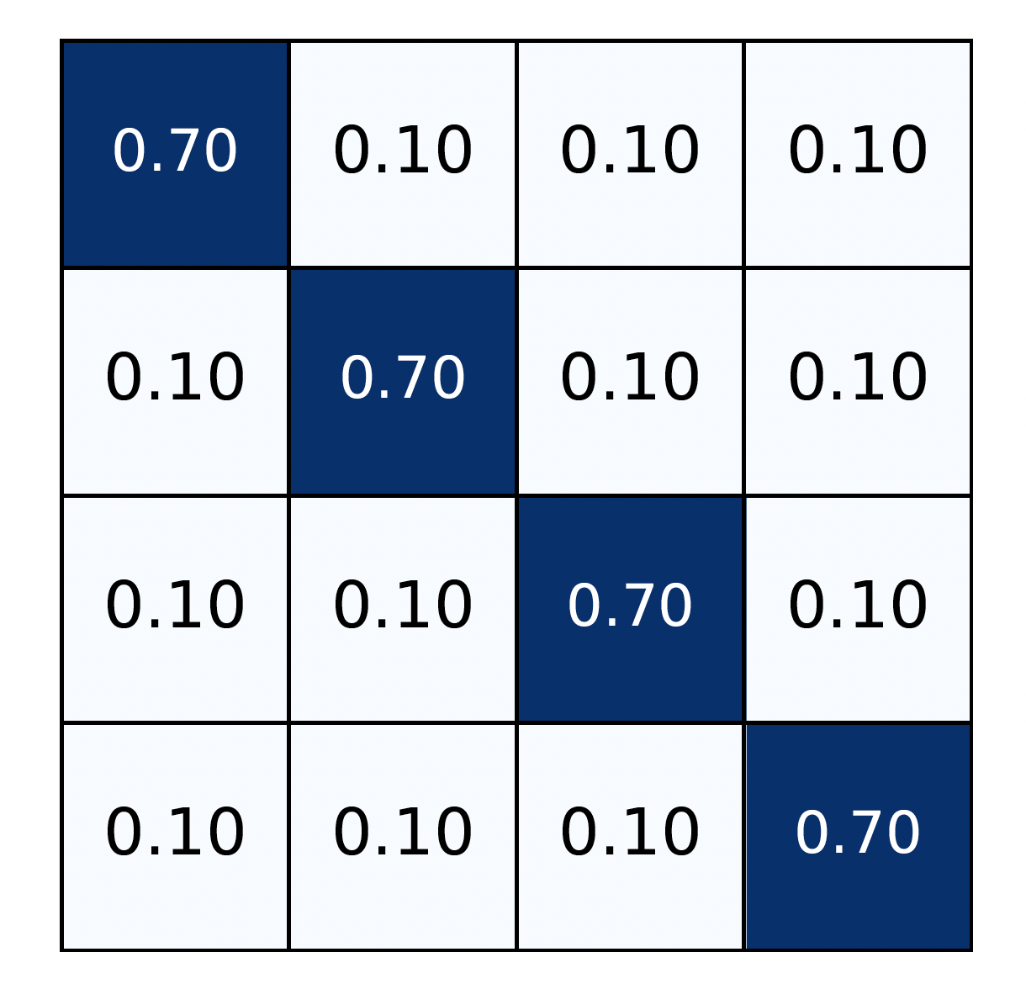
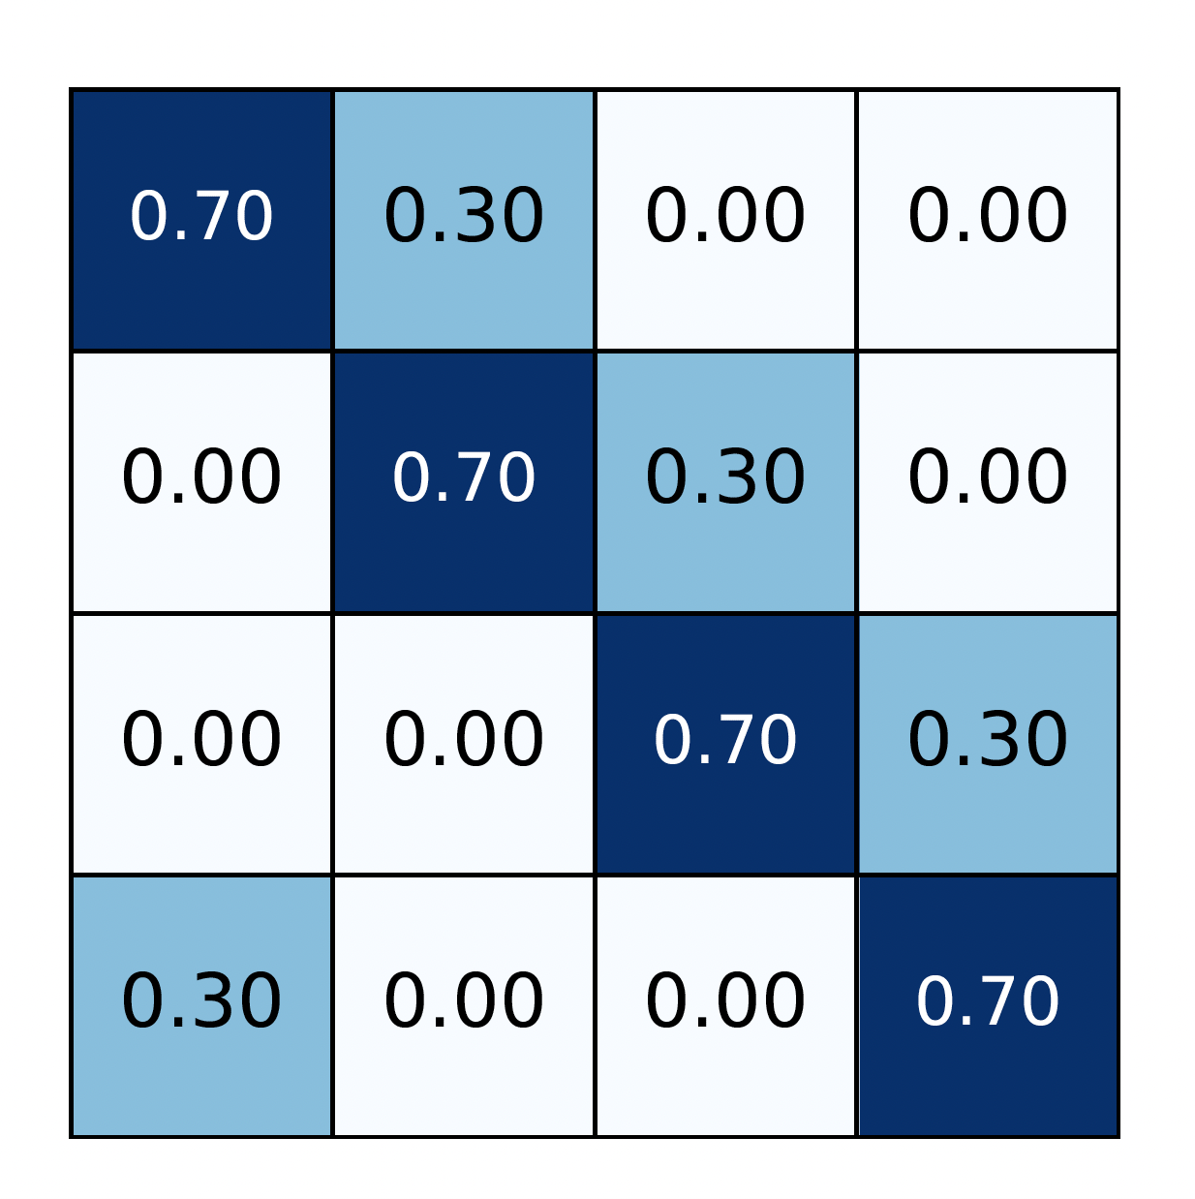
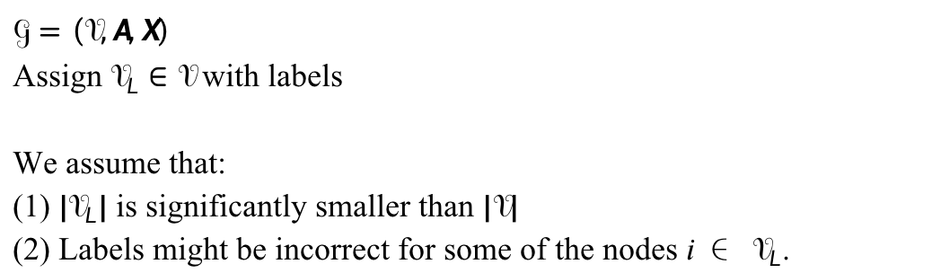
Preliminaries
Problem Formulation
Two typical types of noises[1,2]
$$𝒢=\left(𝒱,A,X\right)$$
Assign $𝒱_{L}∈𝒱$ with labels
We assume that:
(1) ${|𝒱}_{L}|$ is significantly smaller than $|𝒱|$
(2) Labels might be incorrect for some of the nodes 𝑖 ∈ $𝒱_{L}$.
（a）Uniform Noise
（b）Pair Noise
Noise rate=30%
Assumption
Noise rate<0.5
[1] Malach E, Shalev-Shwartz S. Decoupling" when to update" from" how to update"[J]. Advances in neural information processing systems,
2017, 30.
[2] Dai E, Aggarwal C, Wang S. Nrgnn: Learning a label noise resistant graph neural network on sparsely and noisily labeled graphs[C]
//Proceedings of the 27th ACM SIGKDD Conference on Knowledge Discovery & Data Mining. 2021: 227-236.
Notes:
Here we give a formulation of our problem which means that we investigate training Graph Neural Networks with low label rates and the labels might be incorrect. In this research, we simulate two typical noises following previous works. The first one is the uniform noise and the second one is the pair noise. Here we give an example of these two noises with the noise rate being thirty percent. Also, we assume that the majority of nodes are correctly classified, which means the noise rate is less than fifty percent. This assumption is practicable in reality.

Slide 4
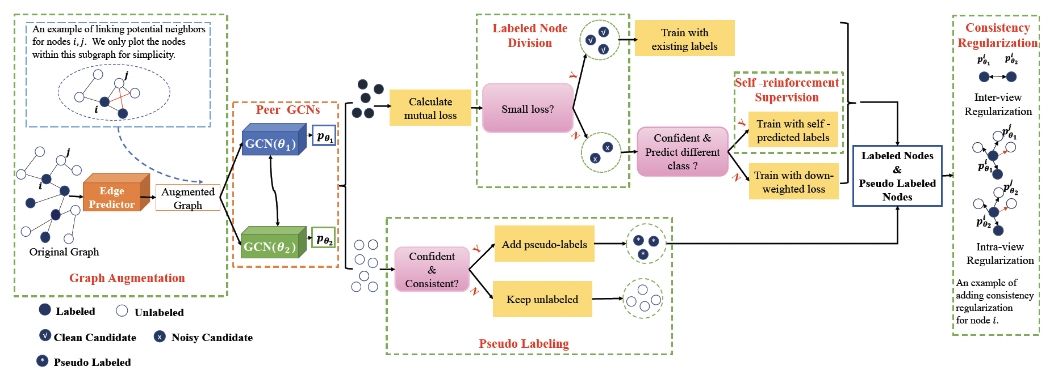
Our approach -Overall Framework
Core idea:
Explicitly govern label noise to facilitate sufficient supervision from clean labels while mitigating
noise propagation among graphs.
Figure 1. Overall architecture
Notes:
A natural idea to handle scarce and noisy labels is to explicitly govern label noise to boost sufficient supervision from clean labels while mitigating noise propagation among graphs. Based on the idea, we design a model called RTGNN consisting of two main parts: The graph augmentation module and the noise governance module. We leverage a pair of Siamese [saɪəˈmiz] GCNs as the backbone and it can be extended to other types of Graph Neural Networks.

Slide 5
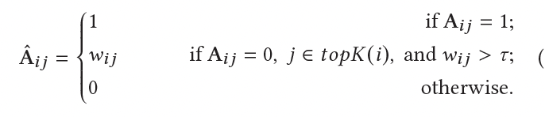



Our approach-Graph Augmentation
Step 1. Perform offline K-Nearest Neighbor search:
Step 3. Generate augmented graph:
Retrieve the top-𝐾 nearest labeled/unlabeled nodes
for each unlabeled/labeled based on the node feature.
Reasons: 1) Labeled nodes provide direct supervision
to similar unlabeled ones. 2) Unlabeled nodes with
pseudo-labels could facilitate model supervision on
labeled ones as a supplement.
Step 4. Train with reconstruction loss:
Step 2. Perform link inference:
Adopt encoder-decoder structure like GAE [3].
Distributions of
negative samples (uniform)
Encoder
Negative sampling to improve computational
efficiency and avoid bias toward negative pairs.
Decoder
[3] Kipf T N, Welling M. Variational graph auto-encoders[J]. arXiv preprint arXiv:1611.07308, 2016
Notes:
The first part is graph augmentation. Firstly, we perform an off-line K-nearest neighbor search based on the raw feature to do sparsification on graphs. Here we search between labeled and unlabeled nodes to promote more efficient and robust message passing. Then inspired by graph autoencoder, we adopted an encoder-decoder structure to infer links. We use GCN as the encoder to project nodes into latent representation and use the non-negative cosine function as the decoder. After that, the augmented graph is constructed as follows which means that we add links for those nodes in the nearest neighbor set. We also introduce a threshold [tɔ:] to exclude noisy links. Finally, we use the Mean Squared Error loss as the reconstruction loss. Further, we perform negative sampling to improve computational efficiency and avoid bias toward negative pairs.

Slide 6
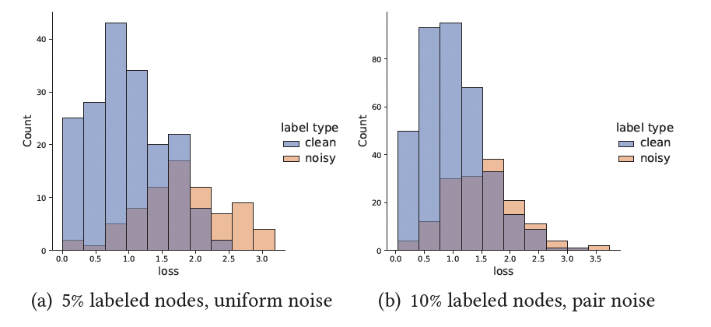
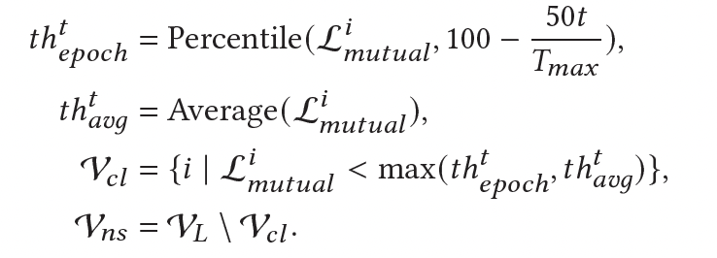
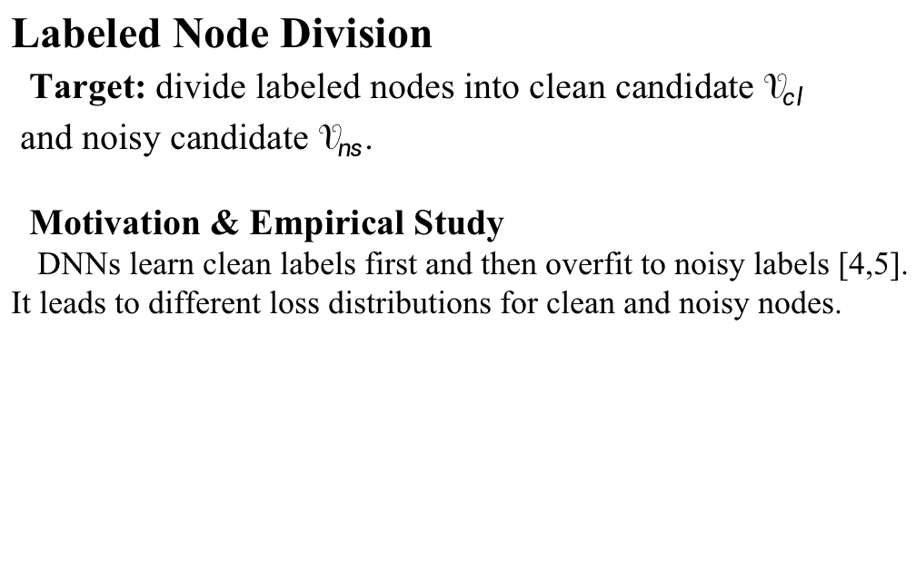
Our approach—Noise Governance
Labeled Node Division
Target: divide labeled nodes into clean candidate $𝒱_{cl}$
and noisy candidate $𝒱_{ns}$.
Motivation & Empirical Study
DNNs learn clean labels first and then overfit to noisy labels [4,5].
It leads to different loss distributions for clean and noisy nodes.
Criterion:
Figure 2. Loss distribution of the 40th epoch on
BlogCatalog with a noise rate 𝜖 = 0.3.
Benefits
No need for elaborate hyper-parameter tuning
Strikes a balance between sufficient training in the early stage and noise-resistant training in the later stage.
The total training epochs
[4] Han B, Yao Q, Yu X, et al. Co-teaching: Robust training of deep neural networks with extremely noisy labels[J]. Advances in neural information processing systems, 2018, 31.
[5] Yu X, Han B, Yao J, et al. How does disagreement help generalization against label corruption?[C]//International Conference on Machine Learning. PMLR, 2019: 7164-7173.
Notes:
The second part is noise governance. Firstly, we divide labeled nodes into the clean candidate and noisy candidate Some previous works show that when training the Deep Neural Networks, they will first learn the clean labels and then gradually overfit to noisy ones. This principle will also lead to the differences in loss distributions of clean and noisy labels. Here we also conduct an empirical study on GCNs and we show the results in Fig. 2. We can observe that the clean nodes always have small losses at the early stage of training. Therefore, we use the small-loss criterion to filter clean nodes. Here we adopt mutual loss (that is the sum of the classification losses of two GCN classifiers) as the loss criterion. Especially, at the t-th epoch, we perform the division following this formula:
Please notice that this formula guarantees that at least fifty percent of nodes are classified as clean since we assume that the noise rate is less than fifty percent. This strategy has two main advantages: firstly, it does not require elaborate parameter tuning under different conditions of different datasets, secondly, at the early stage, the model has not learned reliable patterns so we could choose a conservative threshold. Also, since the model has not overfitted to noises yet, choosing a conservative threshold would not hurt the model’s performance. The strategy strikes a balance between sufficient training in the early stage and noise-resistant training in the later stage.

Slide 7
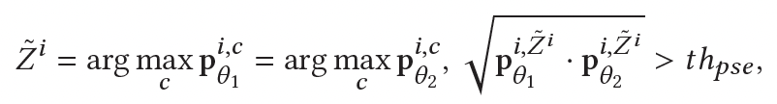
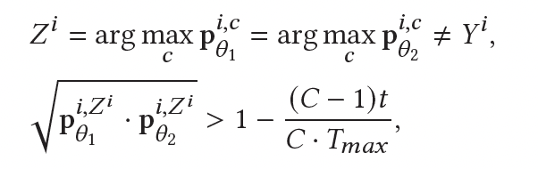

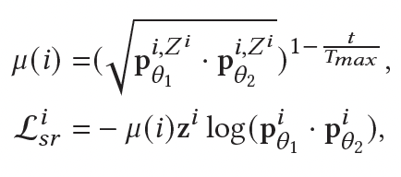
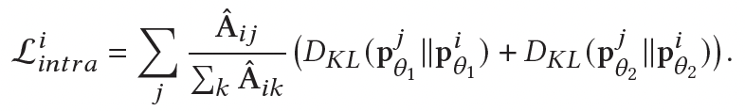
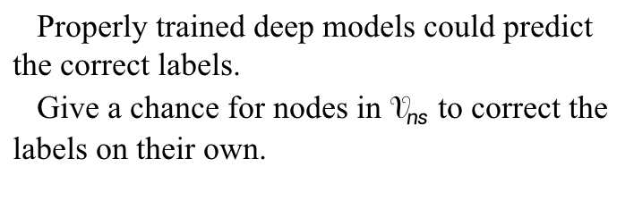
Our approach—Noise Governance
Pseudo Labeling
Self-reinforcement Supervision
Properly trained deep models could predict
the correct labels.
Give a chance for nodes in $𝒱_{ns}$ to correct the
labels on their own.
Find consistent and confident predictions to add pseudo labels.
Consistency Regularization
Two GCNs mimic each other’s prediction:
Train with adaptive weighted loss:
Mimic neighbors’ predictions within the same GCN:
Notes:
After dividing nodes into clean and noisy ones, since the properly trained deep models could predict the correct labels on their own before overfitting, we give the chance for those nodes in the noisy candidate set to reinforce the training on their own prediction. We select a small subset of nodes that make the same prediction between two classifiers and the predictions are confident. We then trained the corrected nodes with node-wise adaptive weight,
Next, learning from pseudo-labels may further alleviate the scarcity and noise problem. We follow a similar criterion to select pseudo labels. Finally, we add some regularization terms. The first one is called inter-regularization, in which the two classifiers teach and guide the peer’s training. Another one is called intra-regularization, it enforces the nodes to mimic their neighbors’ predictions since the linked nodes are expected to have similar classes.

Slide 8
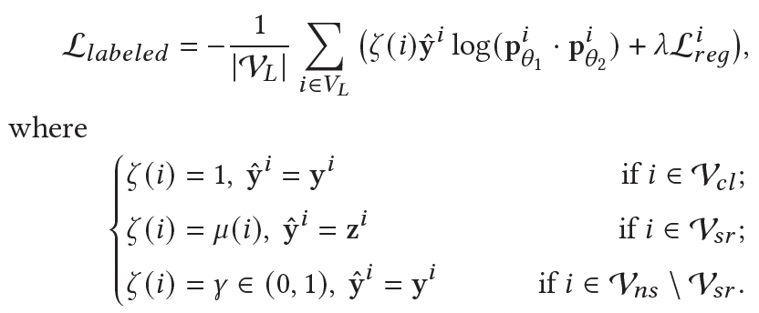
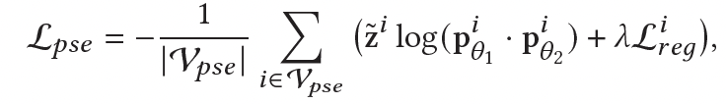

Our approach—Training Loss
Classification loss of the labeled nodes
Classification loss of the pseudo-labeled nodes
Total Loss
Notes:
Finally, the training loss consists of three parts. The first one is the classification loss of labeled nodes. As we divide labeled nodes into various types, we summarize them as follows. The second one is the classification of pseudo-labeled nodes. And the third one is graph reconstruction loss as we introduce in the graph augmentation part.

Slide 9
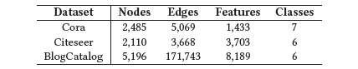
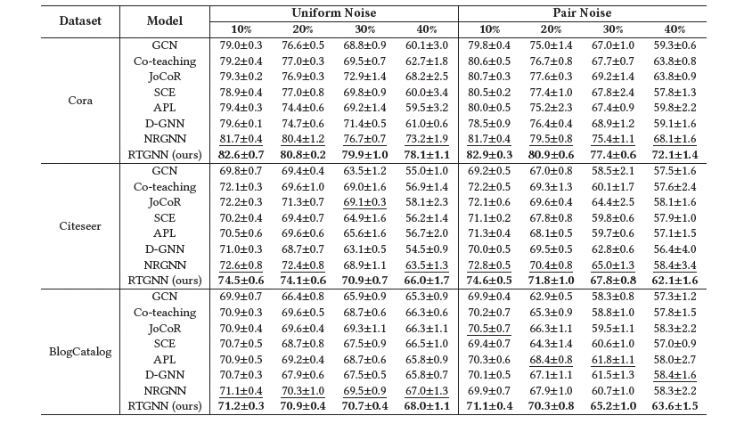
Experiments
Table 1 Dataset statistics
Table 2 Comparison of node classification performance (test accuracy, mean±std,
averaged by 5 runs) by different models.
SOTA for non-graph data tasks
SOTA for GNNs
Notes:
In the experiment part, we compare RTGNN with some competitive baselines. Here we choose 2 types of SOTA models. The first four baselines are originally designed for non-graph data tasks such as image classification. The last two baselines are specially designed for Graph Neural Networks. We report the performance under different noise types and different noise rates. And the results show that our model outperforms all baselines under various conditions.

Slide 10
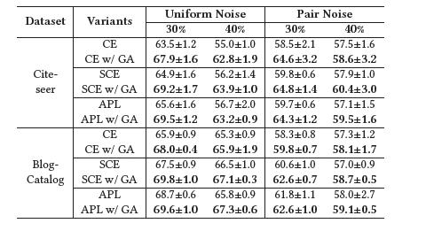
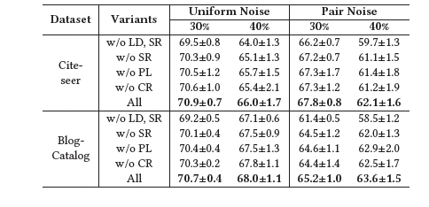
Experiments
Table 3. Ablation Study on Graph Augmentation
Table 4. Ablation Study on Noise Governance
w/ GA:
plug the graph augmentation into the base model
LD: Labeled node division
SR: Self-reinforcement supervision
PL: Pseudo labeling
CR: Consistency regularization
Notes:
Furthermore, we perform ablation studies. Firstly, we plug graph augmentation into GCN using various loss functions. We could observe that: Graph augmentation module boosts the training of GCN with scarce and noisy labels. Then, we validate the effectiveness of each component in the noise governance strategy. Especially, we could learn that the variant without labeled node division performs worst. Thus, the importance of explicit label division is validated. You could refer to our paper for more about this part.

Slide 11
Conclusion
In this paper, we proposed a novel RTGNN framework that performed explicit noise governance with supplemental supervision.
Especially, we designed an effective strategy to classify labeled nodes into clean and noisy ones and adopted reinforcement supervision to correct noisy labels.
Comprehensive experiments showed superior performance of RTGNN under two types of noise and varying noise rates.
Notes:
To conclude,
In this paper, we proposed a novel RTGNN framework that performed explicit noise governance with supplemental supervision.
Especially, we designed an effective strategy to classify labeled nodes into clean and noisy ones and adopted reinforcement supervision to correct noisy labels
Comprehensive experiments showed superior performance of RTGNN under two types of noise and varying noise rates.

Slide 12
Thanks!
Notes:
That’s all about our paper. Thank you for your listening!

