Slide 1
CLOUD COMPUTING · FACULTY DEMO
PG Manager
Owner & Tenants
two roles, one login
A full-stack Paying Guest house management system — designed, built and deployed on Amazon Web Services, entirely on the free tier.
Browser
React 18 SPA over HTTPS
EC2
RDS PostgreSQL
Nginx + HTTPS
AWS Cloud
EC2 · RDS · Nginx · Let's Encrypt
React 18 · Node.js / Express · PostgreSQL · Docker alternative included
Notes:
OPEN (30s): I built PG Manager — a management system for a Paying Guest house — and deployed it on real AWS cloud infrastructure at zero cost using the free tier.
Say: 'Everything you see runs on AWS: an EC2 virtual server, an RDS managed database, HTTPS with free certificates.'
If asked what a PG is: rental housing with paying tenants; the owner manages rooms, rent, complaints.

Slide 2
THE APPLICATION
What the application does
Replaces the register-and-WhatsApp workflow of a PG house with one secure web system.
Owner (admin)
Tenant
Tech stack
Dashboard: occupancy, income vs expense
Rooms by floor with live bed counts
Approve or reject rent UPI proofs
Complaints, notices, expenses
Dues report + CSV export
Full activity audit log
Room, rent and monthly status
Upload payment proof, track approval
View and print receipts
Raise complaints, read replies
Notice board, profile, password
React 18 + Vite single-page app
Node.js + Express REST API
PostgreSQL 16, parameterised SQL
bcrypt passwords, JWT httpOnly cookie
zod validation on every request body
15 automated API tests (pg-mem)
Notes:
35s: Two roles. The owner runs everything from the dashboard — occupancy, income vs expense, approving rent payments. Tenants pay rent by uploading a UPI payment screenshot, download receipts, raise complaints.
Point out the third column: this is a plain React + Node + PostgreSQL stack — nothing cloud-specific in the code. Cloud comes from HOW it is deployed.
Possible question: 'Why not a serverless framework?' — Answer: a single long-running Express process is simplest to run on a free-tier VM and easy to containerize.

Slide 3
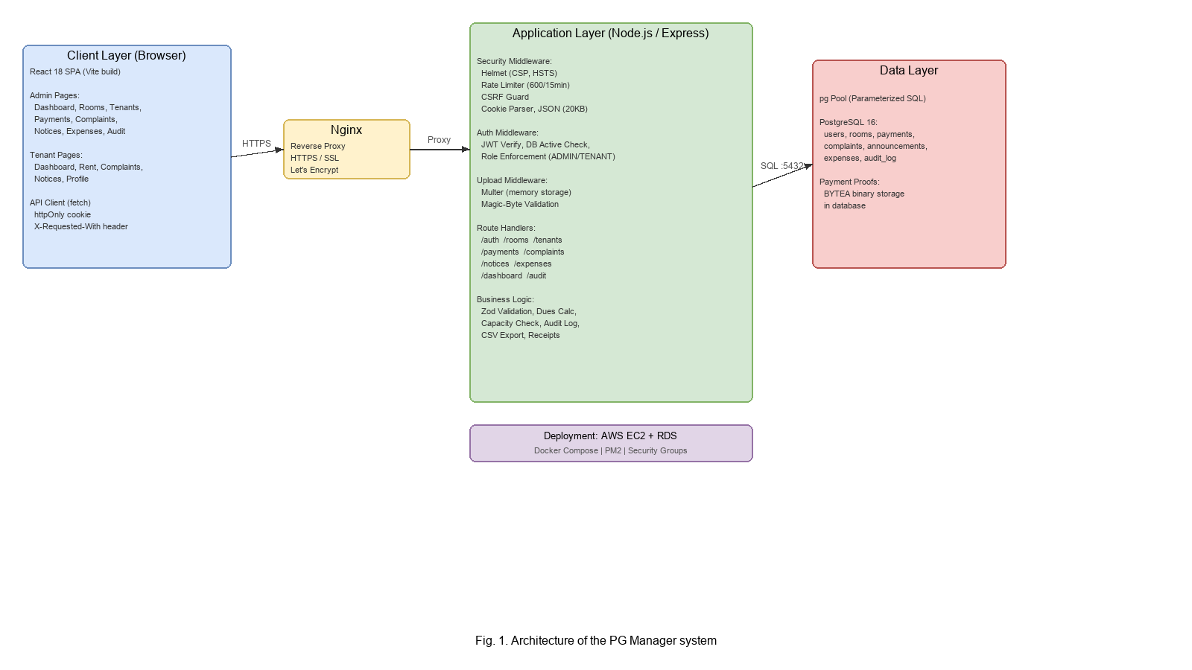
CLOUD ARCHITECTURE
One request, four stops
Browser → Nginx → Node/Express → PostgreSQL — nothing is exposed that shouldn't be.
1
Browser
React SPA, fetch with httpOnly cookie over HTTPS only (HSTS)
2
Nginx on the EC2 instance
Reverse proxy, free TLS certificates from Let's Encrypt
3
Node / Express on :5000
One process serves the REST API and the built React app, kept alive by PM2
4
RDS PostgreSQL
Private endpoint with SSL — reachable only from the web server's security group
Three-tier deployment: client, application, data — on AWS EC2 + RDS
Notes:
40s: Walk the diagram left to right. Browser talks HTTPS only. Nginx on the EC2 instance terminates TLS and proxies to Node on localhost:5000. One Node process serves both the REST API and the built React files. PostgreSQL is NOT on the server — it is RDS, with public access turned off, reachable only from the web server through a security group rule.
Key line: 'The database has no public address at all — even if someone finds the endpoint, the firewall refuses them.'

Slide 4
SERVICE MAP
Why these cloud services
Each layer maps to a different cloud service model — and a different amount of work you no longer do yourself.
Amazon EC2
IaaS
Amazon RDS PostgreSQL
Managed DB
t3.micro virtual server: you install and manage the OS, Nginx, Node and the app. Free tier covers 750 hours/month — one always-on server at no cost for the first 12 months.
Database as a service: automated backups, patching and SSL. Launched with Public access = No, so it is only reachable from inside the VPC security group it trusts.
Nginx + Let's Encrypt
TLS
Security groups
Virtual firewall
Reverse proxy on 80/443 with free HTTPS certificates, auto-renewed by certbot. HTTP is upgraded, HSTS enabled; the Node app itself stays on localhost :5000.
pg-web-sg: SSH (22) from my IP only, 80/443 open. pg-db-sg: port 5432 allowed only from pg-web-sg — by group reference, not an IP range.
Notes:
40s: Map to service models — this is the slide for a theory-minded examiner.
EC2 = IaaS: AWS owns the hardware and hypervisor; I own the OS, runtime and app.
RDS = managed database (often called PaaS for data): backups, patching, failover are AWS's job.
Nginx + Let's Encrypt = TLS termination with free auto-renewing certificates.
Security groups = stateful virtual firewall at the instance level; the DB group accepts port 5432 only from the web group — reference by group, not IP.
If asked 'What is shared responsibility here?': AWS — physical, network, hypervisor, RDS engine patching. Me — OS updates, app code, secrets, firewall rules.

Slide 5
SECURITY & RELIABILITY
Defense in depth, measured
A cloud app is attacked from day one — every layer has a concrete control behind it.
12
5 → 15
8 h
15
bcrypt cost factor
wrong tries, 15-min lock
JWT session lifetime
automated API tests
Passwords are hashed and never stored in plain text; policy of 8+ chars enforced.
Per-account brute-force lockout, plus IP rate limits: 30 auth and 600 API calls per 15 min.
httpOnly, SameSite=Strict, Secure cookie; the DB re-checks the account on every request.
Auth, lockout, roles, uploads, approvals, dues and CSV run against an in-memory Postgres.
Also in place: parameterised SQL + zod validation · CSP & HSTS via helmet · CSRF custom-header guard · magic-byte checks on image uploads (2 MB max) · CSV formula-injection neutralised · audit log of every login and admin action with IP · secrets only in .env, never in git
Notes:
35s: Numbers, not adjectives. bcrypt cost 12; 5 wrong passwords locks the account 15 minutes plus IP rate limiting; JWT lives 8 hours in an httpOnly SameSite=Strict cookie so JavaScript can never read it; the DB is re-checked every request so deactivating a user kills their session instantly; 15 automated API tests.
Footer line covers injection (parameterised SQL + zod), XSS (React + CSP), CSRF (SameSite + custom header), uploads (magic-byte signature check, 2MB cap).
Likely question: 'Where are files stored?' — Payment screenshots go into PostgreSQL as BYTEA and are streamed back only to admin/owner with nosniff and locked CSP.

Slide 6
DEPLOYMENT
From laptop to cloud in six steps
The whole path is scripted in DEPLOY.md — reproducible in about 30 minutes on the free tier.
Clone + .env
Build
PM2
Nginx site
HTTPS
Verify
1
2
3
4
5
6
git clone on EC2; DATABASE_URL, JWT_SECRET set in a chmod 600 .env — never in git
npm run build: Vite compiles React to static files served by the same Node process
pm2 start + startup: restarts on crash, survives reboot, restarts at 300 MB memory
deploy/nginx.conf copied in, domain pointed via DuckDNS, proxying to localhost :5000
certbot --nginx issues and auto-renews a free Let's Encrypt certificate, HSTS on
/api/health returns {"ok":true}; tables and admin account auto-created on first start
Updates after any change: git pull → npm run build → pm2 restart pg-manager
Notes:
35s: The deployment is a script anyone can rerun: clone, set .env (chmod 600, never committed), build, PM2 keeps the process alive through crashes and reboots, Nginx site config, certbot for HTTPS, then /api/health proves it.
Mention: tables + admin account auto-create on first start via migrations — no manual DB setup.
Update flow at the bottom: git pull, build, pm2 restart — under a minute.

Slide 7
PORTABILITY & GROWTH
Containers and the scaling path
The same app ships as one command with Docker — and the design already allows measured growth on AWS.
Run anywhere: Docker
Scaling path from one server
docker compose up --build → running system on :5000, one command
Two services: the app image + postgres:16-alpine
Named volume keeps data across restarts; pg_isready healthcheck gates startup order
Same image runs on a laptop, EC2, ECS or any container host
PaaS fallbacks documented: Render / Railway for zero-ops deploys
Vertical first: bigger EC2 instance, bigger RDS class — one config change
Sessions are stateless (JWT in cookie, no server store) → app servers can be added behind a load balancer
Payment proofs live in the DB as BYTEA → move to S3 when storage grows
Static React build is CDN-ready (CloudFront)
RDS Multi-AZ standby for high availability
Notes:
40s: Left: same app in one Docker command — app + postgres:16 containers, volume for persistence, healthcheck for startup order; Render/Railway documented as zero-ops fallbacks.
Right: honest scaling path. Today one t3.micro is enough for ~50 rooms. Because sessions are stateless JWT, adding a second server behind a load balancer needs no code change. Storage-heavy proofs would move to S3; static build to CloudFront; RDS Multi-AZ for HA.
Likely question: 'What breaks first?' — probably the single EC2 instance; that is why PM2 + auto-restart and a stateless design are in place.

Slide 8
PG MANAGER · CLOUD COMPUTING
Thank you — questions?
A production-shaped full-stack app — React + Node + PostgreSQL on EC2 and RDS, HTTPS via Let's Encrypt, guarded by security groups, reproducible with Docker — running on the AWS free tier.
Live demo available
Docs: README · DEPLOY.md
Project report
15 automated API tests · zero secrets in git · one-command Docker fallback
Notes:
CLOSE (10s): 'A real, secure, multi-user web system on production cloud infrastructure without spending anything.' Offer the live demo.
BEFORE YOU START, memorize these three one-liners she is most likely to probe:
1) IaaS vs PaaS vs SaaS — EC2 is IaaS (raw VM), RDS is managed/PaaS-style, the app itself becomes SaaS for tenants.
2) Why PostgreSQL on RDS instead of MySQL/Mongo — relational data (tenants-rooms-payments with constraints), free tier support, managed backups.
3) Cost — t3.micro EC2 + db.t3.micro RDS are both in the 12-month AWS free tier; only the DuckDNS domain and my laptop cost anything.

