Slide 1
TQ
ThermIQ
Industrial Knowledge Intelligence for Thermal Power Plants
A unified asset & operations brain that makes a plant’s scattered documents queryable — and quantifies undocumented knowledge as financial risk.
ET AI Hackathon 2026 · Problem 8
AI for Industrial Knowledge Intelligence — Unified Asset & Operations Brain
Yaminichandra K J
IIM Amritsar (IPM) · therm-iq.vercel.app

Slide 2
PROBLEM CONTEXT
The Industrial Knowledge Gap
Asset-intensive plants run on knowledge scattered across P&IDs, maintenance logs, operating procedures, inspection reports and regulatory filings — typically 7–12 disconnected systems per plant. Much of the critical operating judgement is never written down at all; it lives in the heads of senior engineers.
The cost is threefold: hours lost re-finding or recreating information, unplanned downtime from decisions made without full equipment history, and a looming knowledge cliff as experienced staff retire and take undocumented expertise with them.
35%
7–12
of working hours spent searching for or recreating documents that already exist
disconnected document systems in the average large plant
McKinsey, 2024
NASSCOM–EY
18–22%
~25%
This is not a document-management problem. It is a safety, quality and operational-efficiency problem — and it compounds every year it is left unsolved, across India’s 200+ GW coal fleet.
of unplanned downtime events linked to knowledge fragmentation
of experienced engineers retiring within the next decade
BIS Research
Sector estimate
02 ThermIQ · Problem 8

Slide 3
SOLUTION OVERVIEW
A Unified Asset & Operations Brain
ThermIQ ingests a plant’s heterogeneous documents — text and scanned PDFs (via OCR), spreadsheets, and Google Drive folders — into one searchable knowledge base, then layers four capabilities on top. Its defining move: it does not only retrieve what is documented, it detects and prices what is missing.
1
Query Copilot
2
Knowledge-Gap Detection
Ask questions in plain English; get direct, cited answers drawn from the plant’s own documents and the benchmark standards.
Scores each plant’s corpus against a benchmark of what should be documented, flagging what is absent or only partial.
3
Risk Quantification Dashboard
4
Knowledge Graph
Converts every gap into rupee-crore operational risk, ranked, with a suggested closure order and a one-click Excel export.
Links failure modes to real historical outage cost and the regulations that mandate the missing procedure.
One ingestion pipeline, one live backend, one risk model. The four modules are views on the same data — not four separate demos.
03 ThermIQ · Problem 8

Slide 4
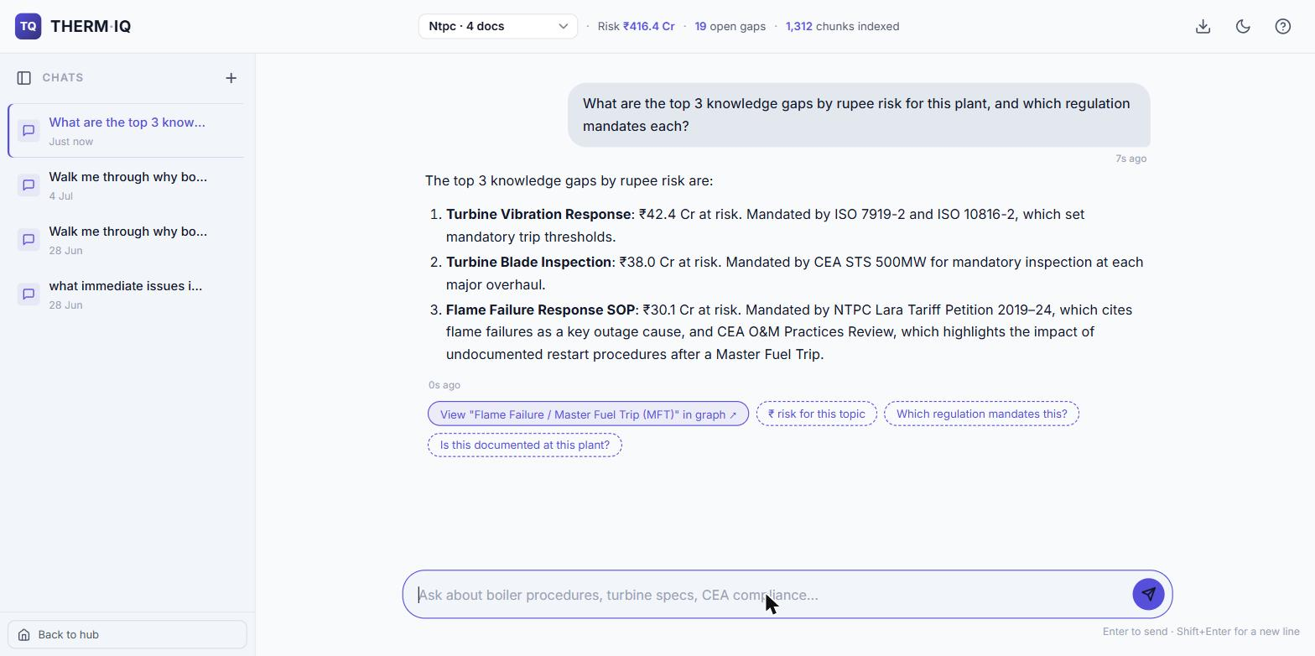
FEATURE DEEP-DIVE · 1
Conversational Knowledge Retrieval
Ask in plain English. Any procedure, spec or failure mode — a direct, cited answer in seconds, no keyword hunting.
Understands meaning, not words. Semantic search matches intent even when the wording differs (Jina AI + Qdrant).
Answers you can trust. Every response separates benchmark standards from the plant’s own documents, with source citations and a confidence signal.
Decides what to look up. Agentic tool-use picks between document search, the live risk register, real outage records, or the web.
UNDER THE HOOD Jina AI embeddings · Qdrant vector search · Gemini 2.5 Flash · agentic tool-calling
Always available. A four-model fallback chain (Gemini → NVIDIA NIM → OpenRouter) keeps it answering under free-tier limits.
Example — an NTPC plant profile: the assistant returns the top gaps with ₹ exposure and the regulation mandating each.
Guides the next step. Multi-turn memory, one-click follow-up suggestions, and a jump straight into the knowledge graph.
04 ThermIQ · Problem 8

Slide 5
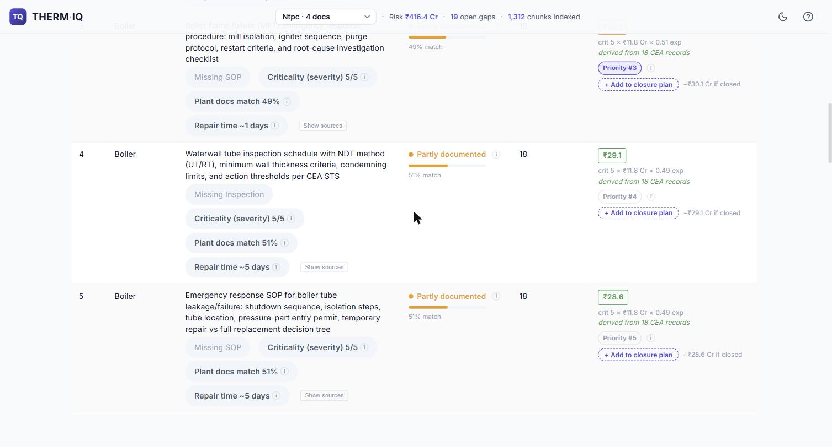
FEATURE DEEP-DIVE · 2
Quantifying Knowledge Gaps as Financial Risk
Risk = Criticality (how severe, 1–5) × Consequence (₹ Cr lost per outage) × Exposure (how undocumented, 0–1)
Criticality
Graded from CEA forced-outage frequency and CERC regulations — evidence, not opinion. (e.g. boiler failures lead forced outages; Vasudha 2022, 735 units.)
Consequence
The real revenue lost when this fails, computed from CEA daily outage records at ₹5/kWh (LBNL/Ember, 2024).
Exposure
How poorly the plant documents this topic — the gap between the question and the plant’s own documents (Jina AI similarity).
19-item expert checklist. What a well-run plant should document — scored automatically against each plant’s corpus.
Worked example (NTPC profile). The engine surfaces 19 gaps totalling ₹416.4 Cr of exposure — every figure traceable to its CEA / CERC source. The same engine runs unchanged on any plant’s documents.
Ranked by rupee impact. Every gap ordered by ₹ exposure, with coverage status and a recommended closure sequence.
Board-ready output. One-click themed Excel export of the full risk register, per plant.
05 ThermIQ · Problem 8

Slide 6
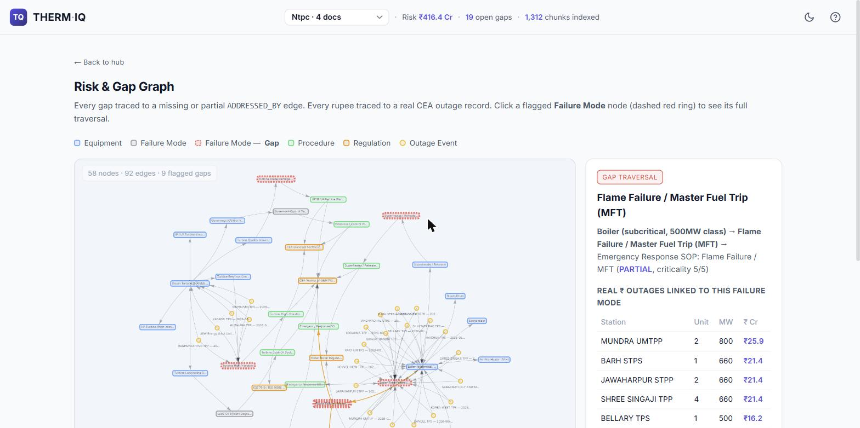
FEATURE DEEP-DIVE · 3
Failure-Mode-to-Regulation Traceability
A map, not a list. A knowledge graph (Neo4j) connects equipment, failure modes, real outage events and the regulations that govern them.
Click to trace. Select any flagged failure mode to see how severe it is, how much it has already cost across the fleet, and which rule mandates documenting it.
Turns a number into evidence. A single ₹ figure becomes an auditable chain a plant or auditor can defend.
EXAMPLE TRACE · NTPC
UNDER THE HOOD Neo4j knowledge graph · equipment → failure mode → outage event → regulation
Waterwall tube thinning flagged PARTIAL · criticality 5/5
18 real CEA outage records = ₹211.85 Cr already lost across the fleet
Mandated by CEA STS 500 MW + Indian Boiler Regulations
06 ThermIQ · Problem 8

Slide 7
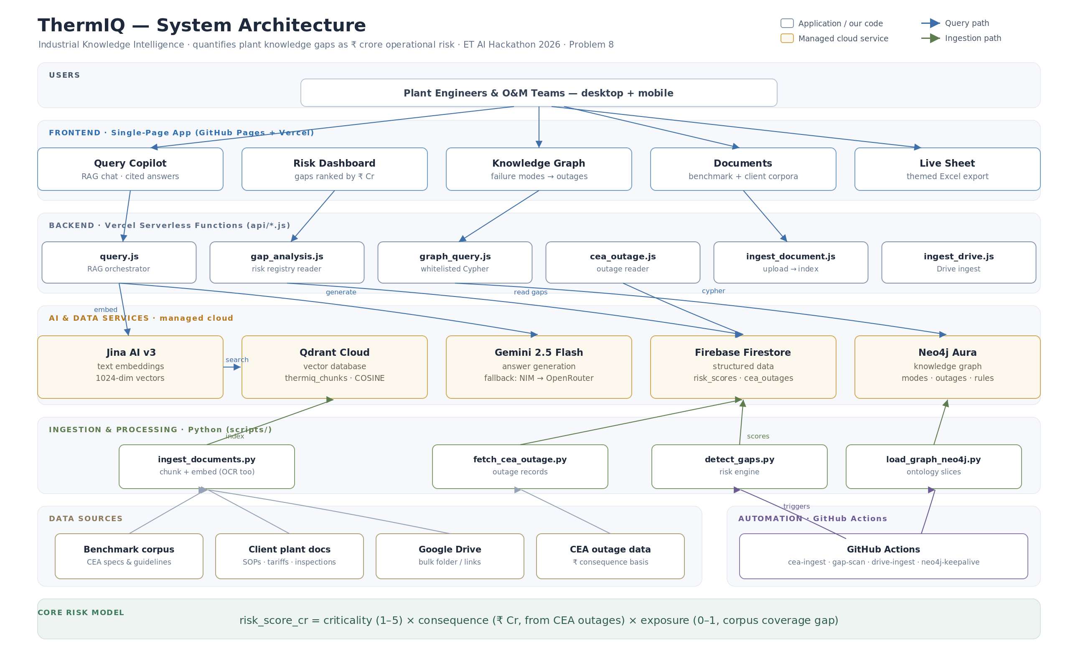
SYSTEM ARCHITECTURE
Technology & Data Flow
Frontend
Single-page web app (GitHub Pages + Vercel); works on desktop and field mobile.
Backend
Lightweight serverless functions on Vercel.
Understanding docs
Jina AI turns text into vectors; Qdrant searches them by meaning.
Answers
Google Gemini 2.5 Flash, with NVIDIA NIM + OpenRouter as automatic backups.
Records & structure
Firebase Firestore (risk register, outage data) · Neo4j (knowledge graph).
Ingestion
Python pipelines chunk & embed PDFs, run OCR on scans, and score gaps.
Automation
GitHub Actions refresh CEA outage data and re-scan gaps on a schedule.
Public CEA standards & outage reports form the fixed benchmark; each plant’s own uploaded documents form the client corpus measured against it.
07 ThermIQ · Problem 8

Slide 8
DIFFERENTIATION
What Sets ThermIQ Apart
Prices the absence of knowledge
Grounded in real data, end to end
Most tools retrieve what is written down. ThermIQ scores what is missing and puts a rupee value on it — reframing documentation from a compliance chore into a capital-allocation decision.
Every rupee figure traces to actual CEA outage records and CERC regulation — no invented benchmarks or fabricated accuracy claims.
Benchmark-vs-client architecture
Multi-plant by design
Public CEA standards are the fixed yardstick; each plant’s own SOPs are measured against it — so onboarding a new plant needs zero re-engineering.
Each plant is an isolated profile with its own corpus and scores (namespacing) — demonstrated across separate NTPC and Saraighat profiles.
Resilient by construction
Auditable by default
A four-model answer-generation fallback chain keeps the copilot live under free-tier limits; the graph auto-recovers via a scheduled keep-alive.
Every score and answer carries its source, so a plant manager can defend it — for instance, in a CERC tariff petition.
08 ThermIQ · Problem 8

Slide 9
DELIVERY STATUS
Live Today · Limitations · Roadmap
● Live today
▲ Known limitations
→ Roadmap
Single-page app with five working views
RAG copilot with source citations
19-item gap-scoring engine (v3)
Rupee risk register, ranked & exportable
Neo4j graph with click-through traversal
Per-plant profiles (NTPC, Saraighat)
Automated CEA-ingest & gap-scan pipelines
One source spec (BMD-01) unreachable from the build network
No computer-vision P&ID parsing yet — text + OCR only
Free-tier hosting caps backend functions
A finer v4 scoring engine is built but held back pending human review of two outliers
Accuracy not yet scored against a formal expert benchmark
Computer-vision parsing of P&IDs and engineering drawings
More plants onboarded at full document depth
Mobile-first field-technician view
Validated v4 evidence-graded scoring engine
Expert-benchmarked answer & extraction accuracy
Shipped and honest: v3 is the validated scoring engine running live today. The finer v4 engine and computer-vision drawing parsing are the immediate next milestones — deliberately not overstated as done.
09 ThermIQ · Problem 8

Slide 10
CONCLUSION
An intelligence layer for industrial knowledge — buildable today
ThermIQ answers Problem 8 directly: it ingests heterogeneous industrial documents, makes their collective knowledge queryable with citations, and — uniquely — quantifies what remains undocumented as financial risk, every figure traceable to real regulatory and outage data.
The result: a plant can see, in rupees, what its knowledge gaps are worth, and close the highest-value ones first.
Retrieve
Quantify
Trace
Cited answers across the full document corpus, for engineers and O&M teams.
Every knowledge gap priced as ₹-crore operational risk, ranked and sourced.
Failure mode → real outage cost → governing regulation, end to end.
Live application therm-iq.vercel.app Source github.com/GhostUnamused/thermIQ
Yaminichandra K J · IIM Amritsar (IPM) · a research-preview prototype built with AI as a development partner

