Slide 1
TQ
ThermIQ
Industrial Knowledge Intelligence for Thermal Power Plants
Turn a plant’s scattered documents into a queryable operational brain — and price what it doesn’t know, in ₹ crore.
Problem 8 · ET AI Hackathon 2026
AI for Industrial Knowledge Intelligence — Unified Asset & Operations Brain
YC · IIM Amritsar (IPM)
therm-iq.vercel.app
Notes:
One-line pitch: ThermIQ turns a thermal plant's scattered documents into a queryable RAG copilot AND quantifies every knowledge gap as rupee-crore operational risk. Built solo for ET AI Hackathon 2026, Problem 8. Live at therm-iq.vercel.app. Differentiator to land verbally: most teams built a search tool; we price the ABSENCE of documentation.

Slide 2
THE PROBLEM
Knowledge is fragmented — and it’s walking out the door
35%
7–12
18–22%
~25%
of working hours spent searching for or recreating documents that already exist
disconnected document systems in the average large Indian plant
of unplanned downtime events driven by this fragmentation
of experienced engineers retire within a decade — undocumented knowledge leaves with them
McKinsey, 2024
NASSCOM–EY
BIS Research
Sector estimate
Not a file-management problem. A safety, quality, and operational-efficiency problem that compounds every year it goes unsolved.
02 · ThermIQ
Notes:
The brief's own framing, India-specific. The knowledge cliff is the emotional hook: once a 30-year operator retires undocumented, that judgment is gone. This is why the problem needs a platform, not a folder rename.

Slide 3
OUR INSIGHT
Don’t just answer questions. Price what the plant doesn’t know — in rupees.
A RAG copilot answers what’s written down. Everyone will build that.
ThermIQ scores what ISN’T written down — every gap becomes a priced operational risk.
A knowledge gap stops being an audit footnote and becomes a capital-allocation decision.
03 · ThermIQ
Notes:
The whole pitch in one slide. The reframe from search problem to capital-risk problem maps onto the two heaviest criteria (Innovation 25% + Business Impact 25%). A plant manager can't act on 'you have documentation gaps'; they can act on 'flame-failure SOP gap = Rs 30 Cr exposure, mandated by CEA.'

Slide 4
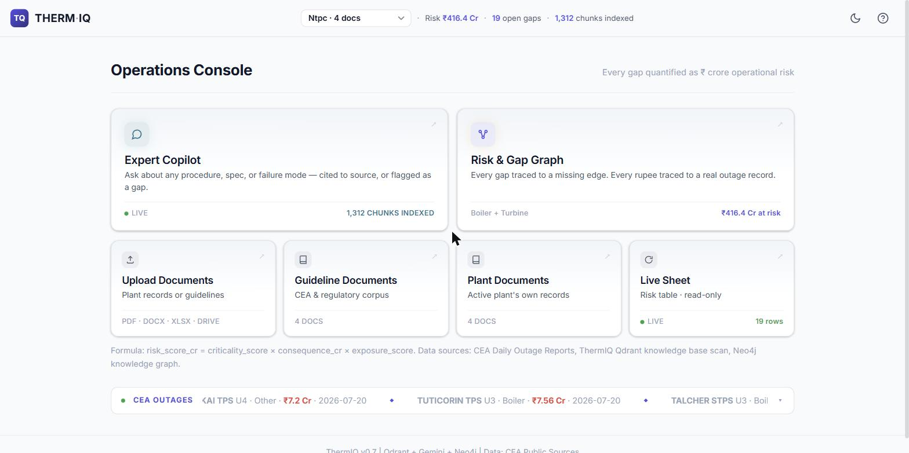
SOLUTION
One operational brain, four working layers
1
Query Copilot
RAG chat over plant + CEA docs. Cited answers, built for O&M engineers.
2
Knowledge-Gap Detection
A 19-item expert checklist scored against each plant’s own corpus.
3
Risk Quantification Dashboard
Every gap priced in ₹ crore, ranked, and explained — with its source.
4
Knowledge Graph
Live console — therm-iq.vercel.app
Failure modes linked to real outage cost and the regulation that governs them.
All four layers share one live backend and one risk model — nothing here is a standalone demo.
04 · ThermIQ
Notes:
Walk the four layers, then stress: single backend, single risk model. The screenshot is the real Operations Console on NTPC (Rs 416.4 Cr, 19 gaps, 1,312 chunks).

Slide 5
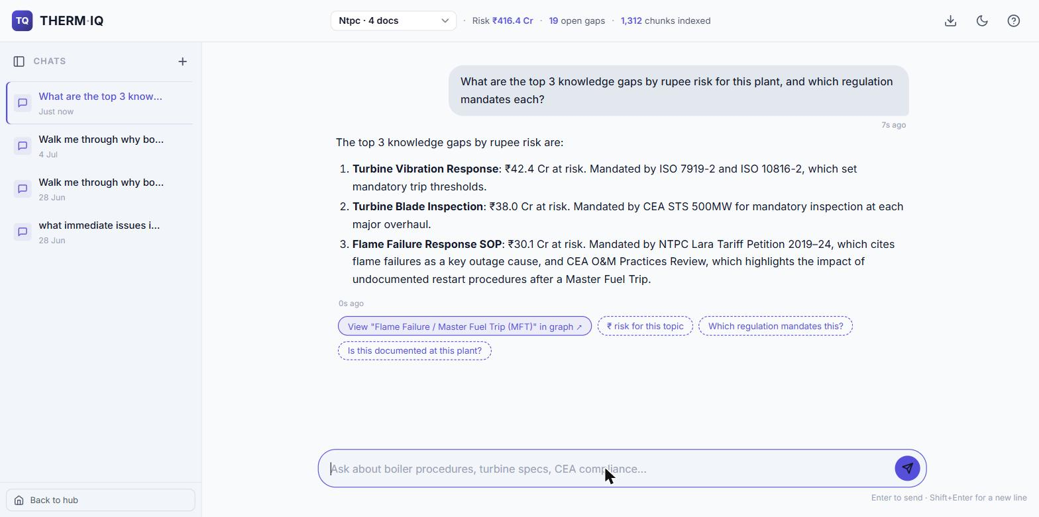
SEE IT LIVE · 1
Query Copilot — cited answers in seconds
Real ₹ figures
Top gaps returned with rupee-crore exposure, not vague advice.
Every claim cited
Answers tied to CEA specs and the plant’s own documents.
Regulation-aware
Names the CEA / ISO / tariff clause that mandates each item.
Graph hand-off
One click jumps to the failure mode in the knowledge graph.
05 · ThermIQ
Notes:
Live NTPC screenshot. 'Top 3 gaps by rupee risk + mandating regulation' returns Turbine Vibration Rs 42.4 Cr (ISO 7919/10816), Turbine Blade Inspection Rs 38.0 Cr (CEA STS 500MW), Flame Failure SOP Rs 30.1 Cr (NTPC Lara tariff + CEA O&M). Note the 'View in graph' chip.

Slide 6
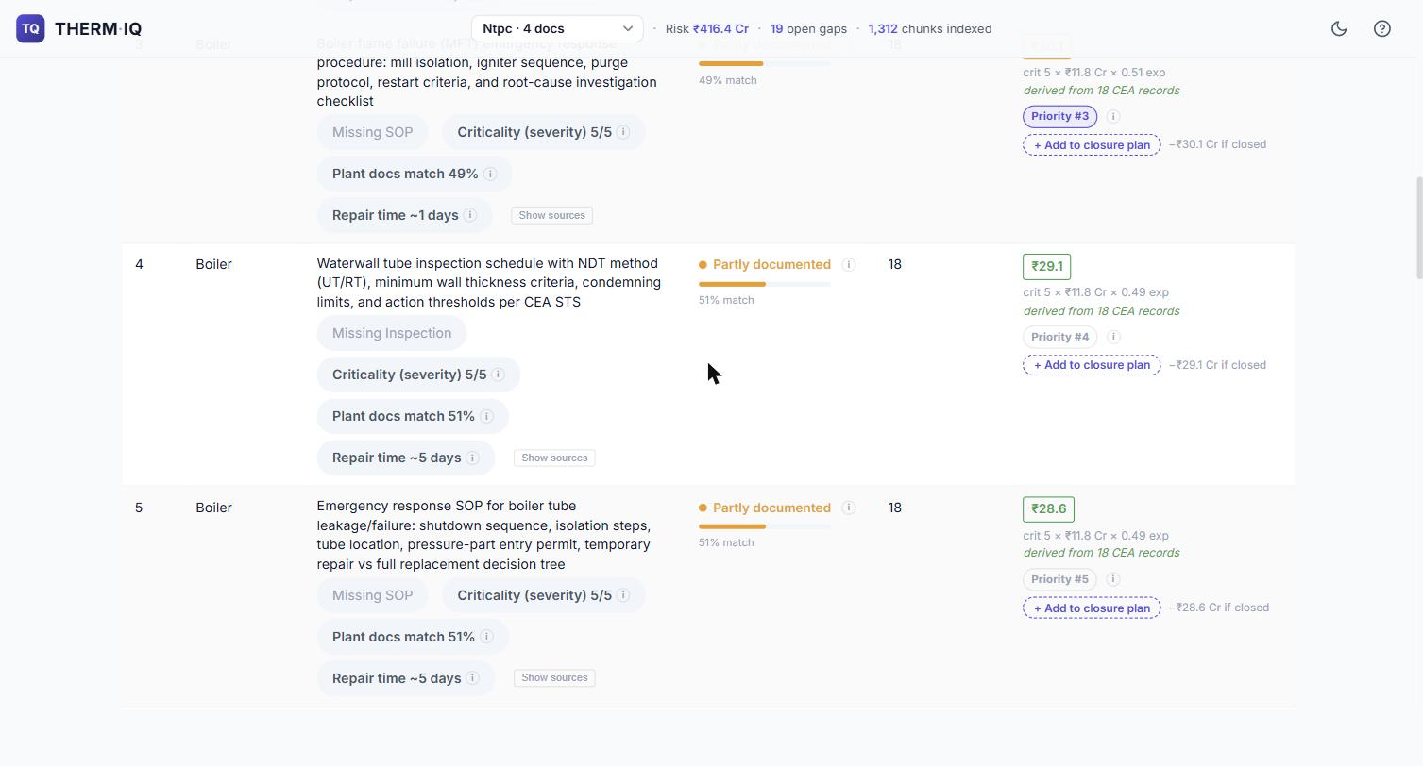
SEE IT LIVE · 2
The risk model — every number is sourced
risk = criticality (1–5) × consequence (₹ Cr) × exposure (0–1)
Criticality
CEA outage frequency + CERC rules. Boiler failures lead forced outages (Vasudha 2022, 735 units).
Consequence
Avg revenue lost per real CEA forced-outage event, at ₹5/kWh (LBNL/Ember 2024).
Exposure
1 − best semantic match of the topic vs the plant’s own documents (Jina v3).
Live risk register — per-row math shown
₹416.4 Cr total quantified risk
NTPC today — 19 scored gaps, every figure traceable to its CEA / CERC source.
06 · ThermIQ
Notes:
Credibility slide. Each factor is grounded in a cited source. Dashboard shows the per-row audit trail 'crit 5 x Rs 11.8 Cr x 0.49 exp, derived from 18 CEA records.' If asked: ticker Rs 416.4 Cr is all 19 gaps; dashboard card Rs 367 Cr counts only CEA-outage-backed rows. Both real.

Slide 7
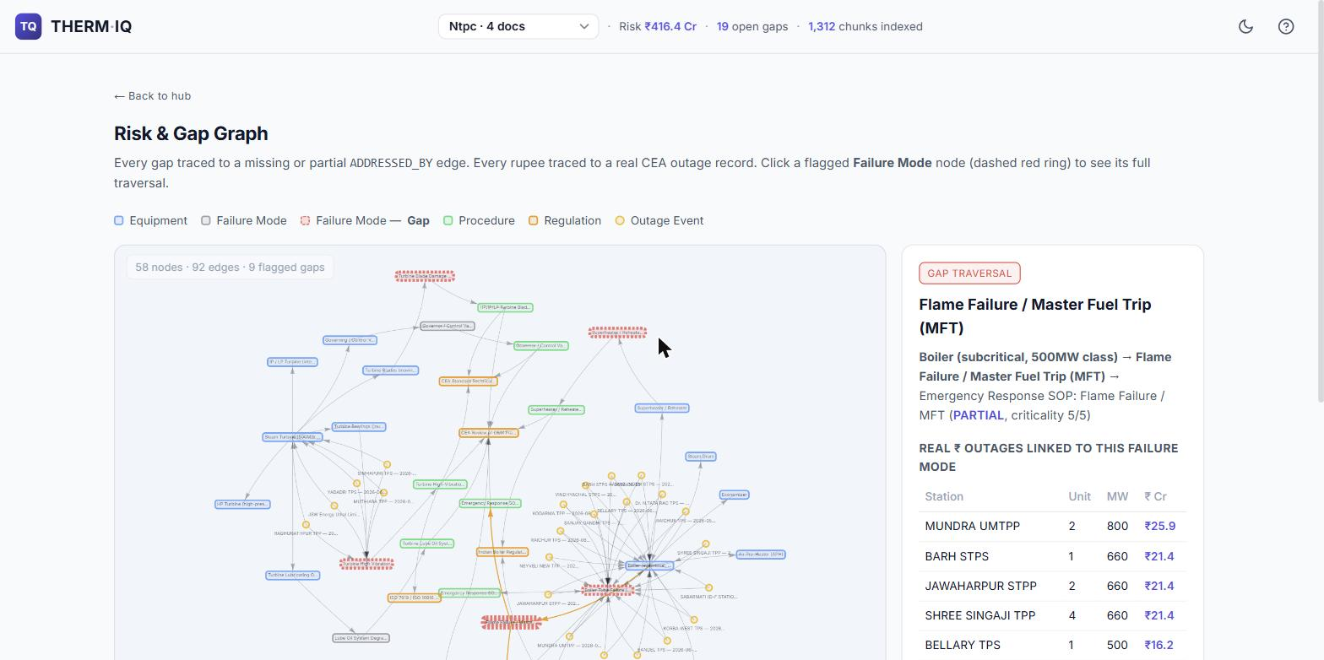
SEE IT LIVE · 3
Knowledge graph — failure mode to regulation
An auditable chain, not a dashboard number:
Waterwall tube thinning
flagged PARTIAL · criticality 5/5
18 real CEA outage records
= ₹211.85 Cr already lost
mandated by CEA STS 500MW + IBR
07 · ThermIQ
Notes:
Neo4j-backed. The Rs number isn't asserted, it's traceable: click a flagged failure node and the panel shows the equipment path, the real CEA outages that sum to the figure, and the regulation requiring the missing procedure. Answers the brief's 'knowledge graph linkage' criterion. Live, not a mockup.

Slide 8
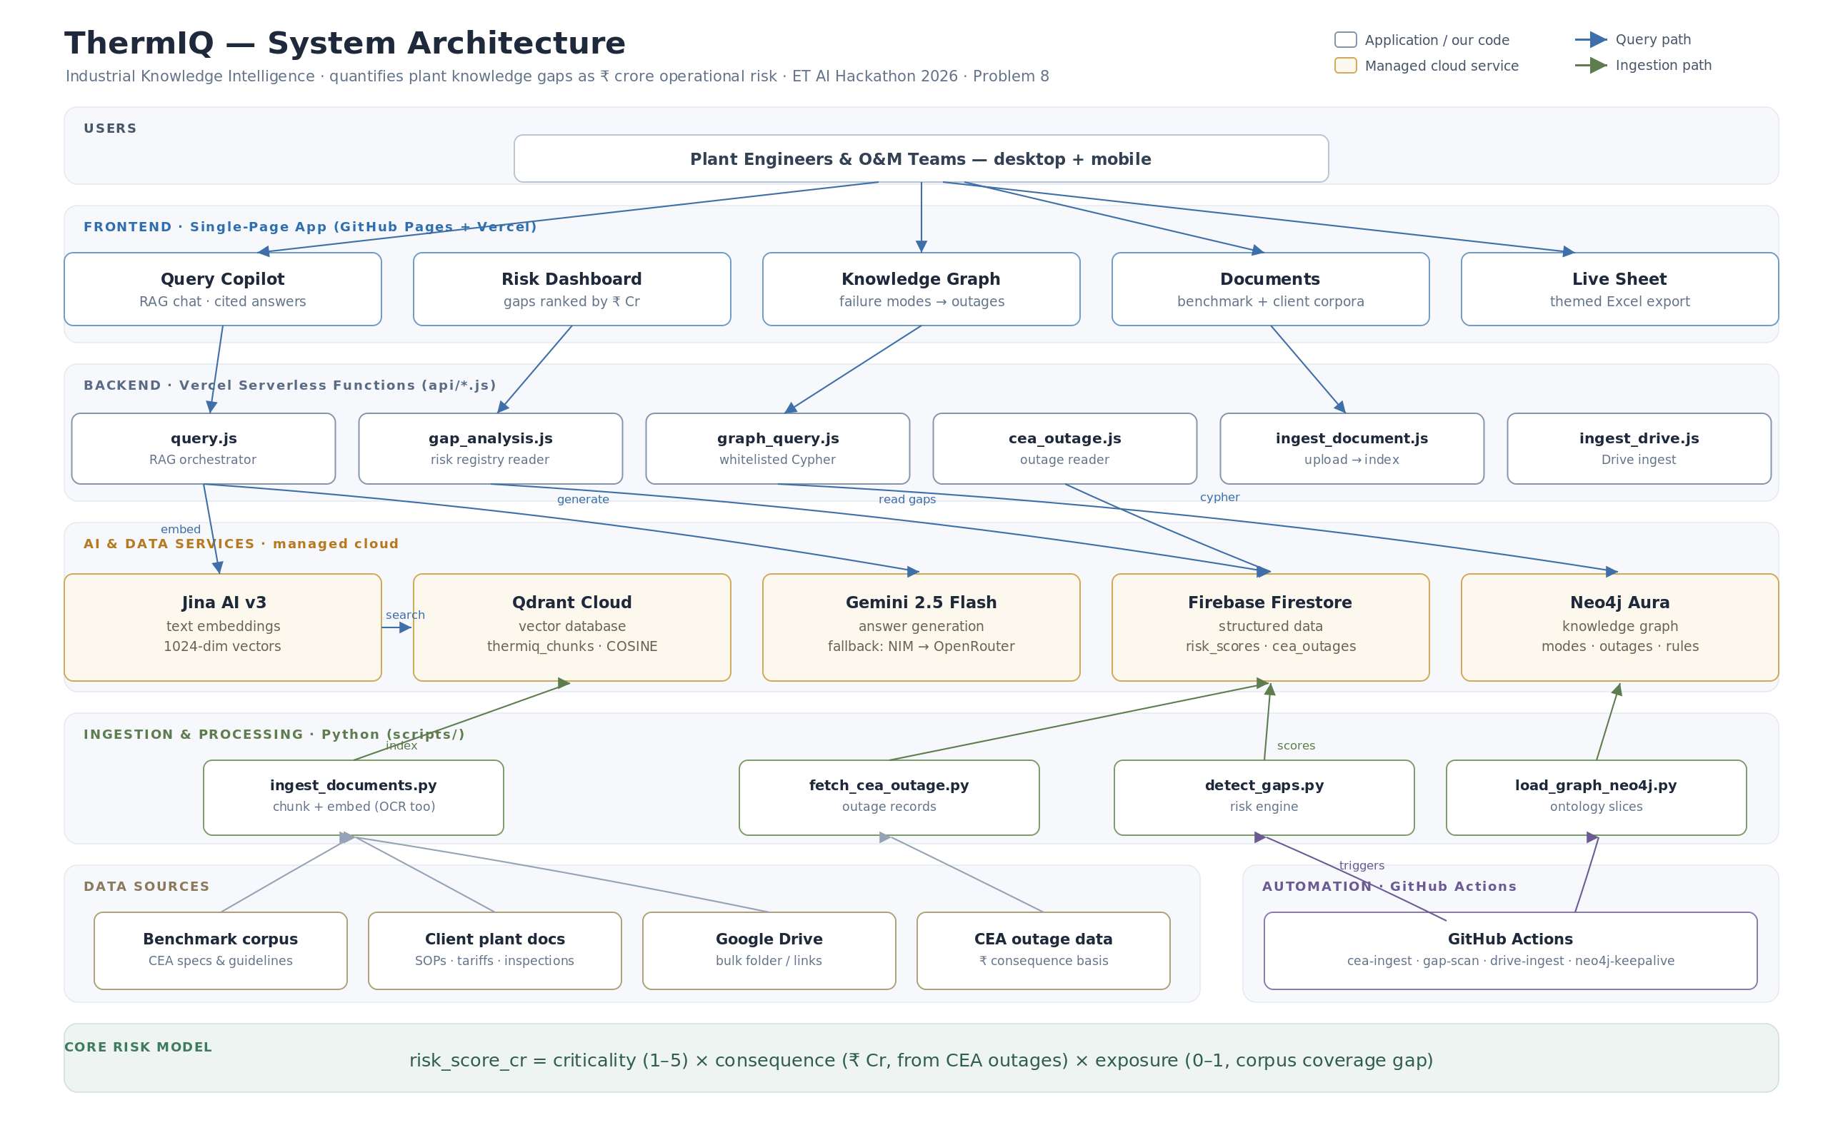
ARCHITECTURE
How it fits together
Frontend
SPA · GitHub Pages + Vercel
Backend
Vercel serverless (api/*.js)
Retrieval
Jina v3 → Qdrant vectors
Generation
Gemini 2.5 Flash + fallbacks
Structured
Firestore · Neo4j graph
Automation
GitHub Actions pipelines
08 · ThermIQ
Notes:
All on free tiers: Jina embeddings, Qdrant vector DB, Gemini 2.5 Flash with NIM->OpenRouter fallback cascade so the copilot keeps answering under quota, Firestore for the registry, Neo4j for the graph, GitHub Actions for daily CEA ingest and gap scans. Diagram is the real ThermIQ_Architecture.svg.

Slide 9
WHY IT STANDS OUT
Mapped to how it’s judged
25%
Innovation
Prices the ABSENCE of documentation in ₹ — a capital-risk framing, not another RAG chatbot.
25%
Business Impact
A sourced number a manager can act on, or defend in a CERC tariff petition.
20%
Technical Excellence
4-stage LLM fallback cascade + agentic tool-calling over vectors, registry, and outage data.
15%
Scalability
Per-plant namespacing; CEA benchmark vs client corpus scales to any plant, zero re-engineering.
15%
User Experience
Cited answers, click-through graph, one-click themed Excel export.
09 · ThermIQ
Notes:
Judges score against this rubric, so show them the rubric being answered. Lead with the two 25% criteria where the rupee-quantification framing is strongest.

Slide 10
HONEST STATUS
What’s real today, and what isn’t
● Live today
▲ Known limitations
SPA with 5 working views
RAG copilot with citations
19-item gap engine → ₹416.4 Cr on NTPC
Neo4j graph with click-through traversal
Per-plant document namespacing
Themed one-click Excel export
Automated CEA-ingest + gap-scan pipelines
BMD-01 spec not ingested
vendor host unreachable from the build network
No P&ID computer-vision yet
ingestion is text + OCR only
Vercel free tier caps 12 functions
at the cap; new endpoints need a swap
v4 scoring engine held back
2 outliers need a human check before it ships
No formal expert benchmark yet
live-verified, not independently scored
10 · ThermIQ
Notes:
Leading with limitations builds credibility. Strongest point: v4 scoring engine (dry-run Rs 2,223 Cr) exists but we deliberately shipped the conservative validated v3 rather than a flashier unreviewed number. Research-preview prototype, built solo in under a month.

Slide 11
Let’s talk
A research-preview prototype — built solo, non-engineering background, in under a month, with AI as a development partner. Proof the intelligence layer this brief asks for can be built fast when the framing is right.
Live app
therm-iq.vercel.app
GitHub
github.com/GhostUnamused/thermIQ
Built by
YC · IIM Amritsar (IPM)
The ask: judges’ feedback, and an introduction to any plant team willing to pilot with their own documents.
Notes:
Close on the framing win: a non-engineer built a working, rupee-quantified industrial knowledge platform in under a month. Ask for feedback and a pilot intro.

