Slide 1

Smart Classroom
Presented By:
Anshul
22DCS003
Presented To:
Dr. Robin Singh Bhadoria
Department of Computer Science and Engineering
National Institute of Technology, Hamirpur

Slide 2
Table of Contents
01
Problem Statement
06
Alert System
02
Proposed Solution
07
Limitations
03
Methodology & Data Flow
08
Future Scope
04
Hardware & Sensors
09
Conclusion
05
Simulation & Results

Slide 3
1. Problem Statement
Manual Attendance
No Occupancy Data
Poor Air Quality
Wastes 5–10 minutes per lecture. Proxy attendance widespread with no physical verification.
Administrators have zero real-time visibility into room usage.
Overcrowded rooms → CO₂ > 2500 ppm → drowsiness & reduced concentration.
Fire Safety Risk
No Analytics
Safety norms require exact occupancy count. Impossible with paper registers.
No historical data on attendance trends, peak hours, or room utilization.

Slide 4
2. Proposed Solution
RFID Attendance
Occupancy Tracking
Air Quality Monitor
Students tap college ID on RC522 reader → instant log
Real-time entry/exit counting via RFID + PIR motion sensor
MQ-135 sensor measures CO₂/VOC levels continuously
Environmental Sensing
Cloud Dashboard
Smart Alerts
DHT22 tracks temperature & humidity in real-time
ThingSpeak displays live graphs accessible from any device
Auto buzzer + LCD warnings on overcrowding or bad air

Slide 5
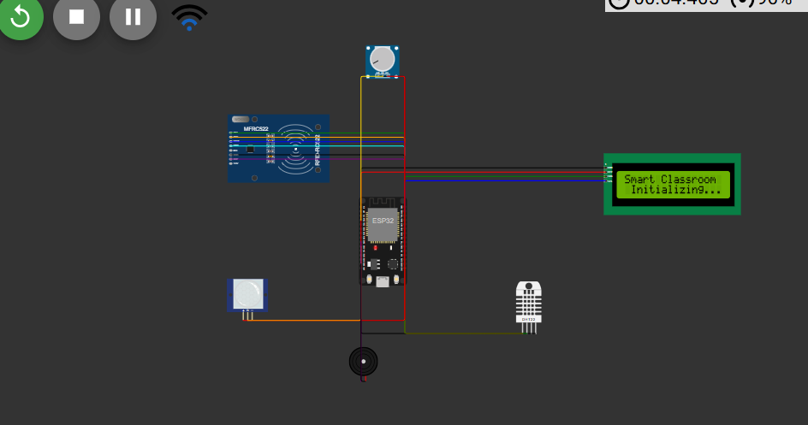
3. Methodology & Data Flow
System Architecture
Data Flow
Wokwi Simulation Circuit
1
SENSE
Sensors read every 2s
2
PROCESS
ESP32 checks thresholds
[ Insert Wokwi Circuit Screenshot Here ]
3
ACT
LCD + buzzer respond
4
TRANSMIT
HTTPS to ThingSpeak (16s)
5
VISUALIZE
Live graphs on cloud
6
ALERT
Node-RED triggers alerts

Slide 6
Communication Protocols
Protocol | Connection | Purpose
SPI | ESP32 ↔ RC522 RFID | High-speed card reading (10 MHz)
I²C | ESP32 ↔ LCD 16×2 | Display status messages (2 wires)
OneWire | ESP32 ↔ DHT22 | Temperature & humidity data
ADC | ESP32 ↔ MQ-135 | Analog air quality reading (0–4095)
HTTPS | ESP32 → ThingSpeak | Encrypted cloud data transmission
GPIO | ESP32 ↔ PIR, Buzzer | Digital input/output signals

Slide 7
4. Hardware & Sensors
Component Specifications
# | Component | Model | Role | Interface
1 | Microcontroller | ESP32 DevKit V1 | Central processing + WiFi | —
2 | RFID Reader | MFRC522 (RC522) | Student ID card scanning | SPI
3 | RFID Tags | 13.56 MHz Mifare | Student ID cards | —
4 | Motion Sensor | HC-SR501 PIR | Presence detection | GPIO
5 | Air Quality | MQ-135 | CO₂ / VOC detection | ADC
6 | Temp & Humidity | DHT22 / AM2302 | Environmental monitoring | OneWire
7 | Display | LCD 16×2 I2C | Local status messages | I²C
8 | Buzzer | Passive Buzzer | Audio alerts | GPIO

Slide 8
ESP32 Pin Mapping
Component | ESP32 Pin | Protocol
RFID SDA | GPIO 5 | SPI
RFID SCK | GPIO 18 | SPI
RFID MOSI | GPIO 23 | SPI
RFID MISO | GPIO 19 | SPI
RFID RST | GPIO 4 | GPIO
LCD SDA | GPIO 21 | I²C
LCD SCL | GPIO 22 | I²C
DHT22 Data | GPIO 15 | OneWire
PIR Output | GPIO 27 | Digital
MQ-135 (Analog) | GPIO 34 | ADC
Buzzer | GPIO 26 | Digital
Why ESP32?
▸ Dual-core
240 MHz Xtensa processor
▸ WiFi Built-in
802.11 b/g/n + BLE
▸ 34 GPIO Pins
Enough for all sensors
▸ ADC Support
Reads analog MQ-135 directly
▸ Low Power
Deep sleep modes available
▸ Affordable
₹350–500 per unit

Slide 9
5. Simulation & Results
Wokwi ESP32 Simulator + ThingSpeak Cloud Dashboard
Test Scenario | Action in Simulator | Expected Result
Student Entry | Tap RFID tag on reader | LCD: 'Welcome, XYZ!' + 1 beep + occupancy +1
Student Exit | Tap same tag again | LCD: 'Goodbye, XYZ!' + 2 beeps + occupancy −1
Unknown Card | Tap unregistered tag | LCD: 'Access Denied' + 3 beeps
Temperature Change | Click DHT22, adjust slider | Updated values on LCD + ThingSpeak graph
Air Quality Spike | Turn potentiometer high | LCD warning + 5 beeps if ADC > 2500
Motion Detection | Click PIR sensor | Motion field updates on ThingSpeak cloud

Slide 10
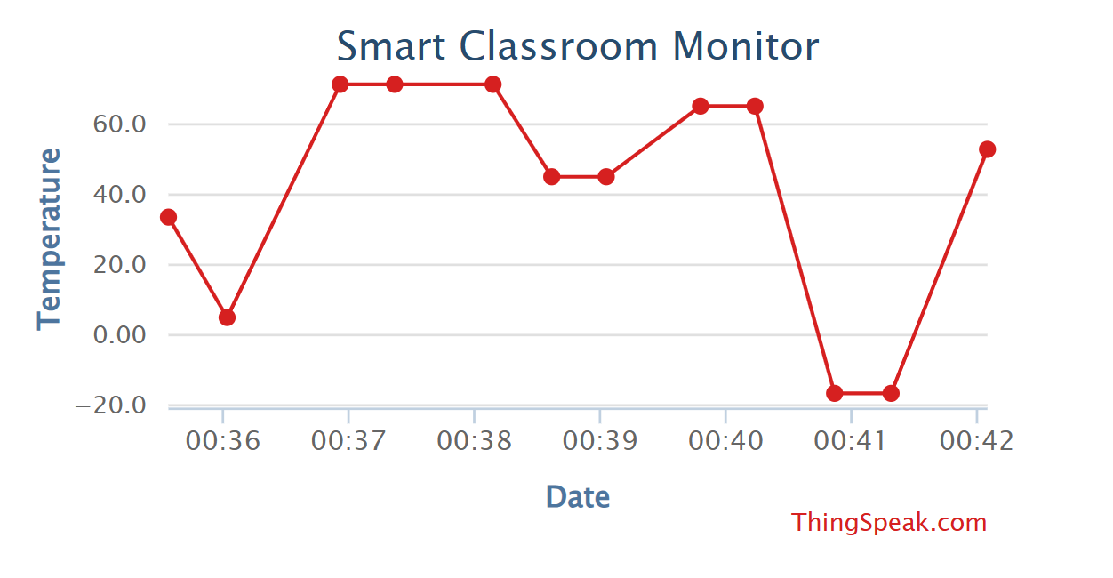
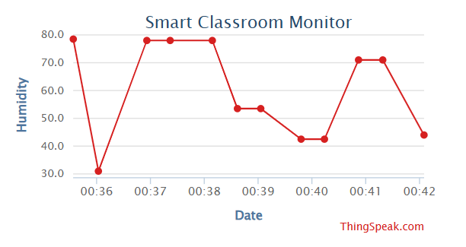
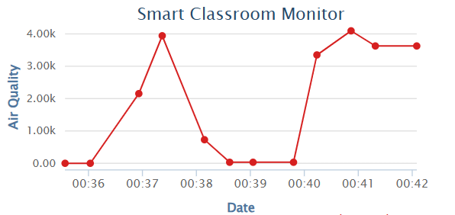
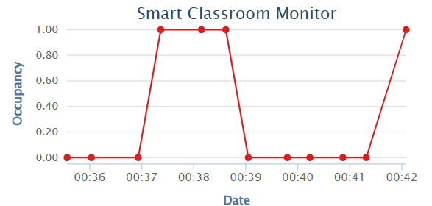
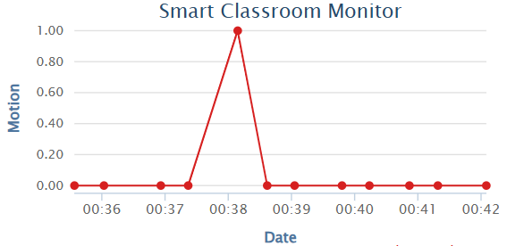
ThingSpeak Cloud Dashboard — Live Results
Field 1: Temperature (°C)
Field 2: Humidity (%)
Field 3: Air Quality (ADC)
Field 4: Occupancy (count)
Field 5: Motion (0/1)
Right-click placeholder → Format Shape → Fill → Picture → paste ThingSpeak screenshots

Slide 11
Serial Monitor Output
=== Smart Classroom Occupancy System === [RFID] RC522 ready [WiFi] Connecting..... Connected! [WiFi] IP: 10.10.0.2 [SYSTEM] Ready! [SENSORS] T=45.1C H=75.0% AQ=120 PIR=no Occ=0 [RFID] UID: E9:76:42:A3 [RFID] Anshu ENTERED | Occupancy: 1 [CLOUD] ThingSpeak entry #1 [SENSORS] T=45.1C H=75.0% AQ=3850 PIR=YES Occ=1 [ALERT] OVERCROWDING / BAD AIR! [CLOUD] ThingSpeak entry #2 [RFID] UID: A1:B2:C3:D4 [RFID] Rahul ENTERED | Occupancy: 2 [CLOUD] ThingSpeak entry #3

Slide 12
6. Alert System
Multi-level alerts for safety and attendance
Alert Type | Trigger Condition | System Response
Entry Beep | Valid RFID card tapped (entry) | 1 beep + LCD: 'Welcome, [Name]!'
Exit Beep | Same card tapped again (exit) | 2 beeps + LCD: 'Goodbye, [Name]!'
Unknown Card | Unregistered RFID tag detected | 3 beeps + LCD: 'Access Denied'
Overcrowding | Occupancy count > 30 students | 5 rapid beeps + LCD: '!! WARNING !!'
Bad Air Quality | MQ-135 analog > 2500 (ADC) | 5 rapid beeps + LCD: 'BAD AIR QUALITY'

Slide 13
7. Limitations
ThingSpeak Rate Limit
Single Entry Point
Free tier: updates only every 15 seconds — not truly real-time
Current design assumes one door; multi-door needs more readers
No Persistent Database
MQ-135 Calibration
Attendance log in serial output only — no database storage
Simulated with potentiometer; real sensor needs warm-up period
WiFi Dependency
Hardcoded API Key
Cloud features fail without internet (local LCD/buzzer still work)
Needs secure key management for production deployment
No Battery Backup
Simulation vs Real HW
ESP32 needs constant 5V USB — no operation during power cuts
Wokwi RFID has limited features vs actual RC522 hardware

Slide 14
8. Future Scope
Potential Enhancements & Scalability
→ Face Recognition
→ Mobile App
ESP32-CAM for visual verification — zero proxy
Flutter/React Native for student attendance check
→ Database Backend
→ Multi-Door Support
Firebase/MongoDB for persistent attendance records
Multiple ESP32+RFID units per classroom
→ HVAC Integration
→ ML Prediction
Auto-control fans/AC based on temp + CO₂
Predict peak occupancy from historical data
→ LoRa/Mesh Network
→ Solar + Battery
Campus-wide coverage without WiFi
Uninterrupted operation during power cuts

Slide 15
9. Conclusion
Successfully designed and simulated a Smart Classroom Occupancy System using ESP32
RFID-based attendance eliminates manual registers and prevents proxy attendance
Real-time environmental monitoring (temp, humidity, CO₂) ensures student comfort
Cloud dashboard on ThingSpeak provides live visualization from any device
Alert system warns against overcrowding and poor air quality — locally and on cloud
Entire system built using 100% open-source tools as per assignment requirements

Slide 16
References
[1] Wokwi ESP32 Simulator — https://wokwi.com
[2] ThingSpeak IoT Platform — https://thingspeak.com
[3] Node-RED Flow Editor — https://nodered.org
[4] MFRC522 Library — https://github.com/miguelbalboa/rfid
[5] ESP32 Arduino Core — https://github.com/espressif/arduino-esp32
[6] Tech Monitor: Open-Source IoT Tools
https://techmonitor.ai/technology/software/open-source-tools-for-iot-applications
[7] G2: IoT Platforms — https://g2.com/categories/iot-platforms/free
[8] DHT22 Datasheet — Aosong Electronics
[9] MQ-135 Gas Sensor Datasheet — Winsen Electronics

