Slide 1
MACHINE LEARNING
Optimizer
Cookbook
A Practical Empirical Study of 7 Optimizers on CIFAR-10
SGD
Momentum
Adagrad
RMSprop
Adam
AdamW
RAdam

Slide 2
WHAT IS THE OPTIMIZER COOKBOOK?
In deep learning, the optimizer is responsible for updating model weights during training. The wrong choice can mean slow convergence, poor accuracy, or unstable training — yet most tutorials just say "use Adam" without explaining why.
📖
🎯
🔬
What
Goal
Method
A structured, recipe-style reference comparing 7 major optimizers — each with theory, math, code, and empirical results.
Demonstrate empirically which optimizer is best, how each works, why it behaves the way it does, and when to use each.
Same model, same dataset, same seed — only the optimizer changes. Results are directly comparable across all 7.
7
Optimizers
8
Notebooks
32
Plots Generated
20
Epochs Each

Slide 3
DATASET: WHY CIFAR-10?
What is CIFAR-10?
Why CIFAR-10 for this study?
60,000
total images (32×32 RGB)
✅ Benchmark standard
Used in hundreds of optimizer papers — results are directly comparable to published work.
50,000
training images
✅ Fast to train
10,000
test images
Small images (32×32) mean full epochs in under 60s on a modern GPU — ideal for running 7 optimizer comparisons.
10
classes (airplane, car, bird…)
✅ Non-trivial
Not too easy (like MNIST) — optimizers show real differences in convergence speed and final accuracy.
Balanced
— 6,000 images per class
✅ Dense data
Unlike NLP/sparse tasks, all optimizers are on equal footing — no inherent advantage for Adagrad.

Slide 4
MODEL & EXPERIMENTAL SETUP
SimpleCNN Architecture
Input
Conv+BN
MaxPool
Conv+BN
MaxPool
Conv+BN
MaxPool
FC(256)
FC(10)
3×32×32
32 filters
→16×16
64 filters
→8×8
128 filters
→4×4
Drop 0.3
Softmax
Fixed Config (same across all optimizers)
Why a Controlled Setup?
Parameter | Value
Batch Size | 128
Epochs | 20
Seed | 42 (fully reproducible)
Loss Function | Cross Entropy
Augmentation | RandomCrop + HorizontalFlip
Normalisation | CIFAR-10 mean/std per channel
Same random seed ensures all optimizers start from identical initial weights.
Same augmentation means accuracy differences come only from the optimizer.
Same architecture rules out model capacity as a confounding factor.
All results saved to CSV — every comparison is fully reproducible.

Slide 5
THE OPTIMIZER EVOLUTION
1951
1964
2011
2012
2015
2019
2020
SGD
+ Momentum
Adagrad
RMSprop
Adam
AdamW
RAdam
Pure gradient
descent
Velocity
accumulation
Per-param
adaptive LR
EMA fixes
dying LR
Momentum
+ RMSprop
Decoupled
weight decay
Rectified
variance
Problem: one global LR
→ Adagrad introduces per-param LR
Problem: Adagrad LR dies → RMSprop fixes with EMA → Adam adds momentum

Slide 6
OPTIMIZER DEEP DIVE — UPDATE RULES
SGD + Momentum
Adam
v = β·v + ∇L θ = θ − η·v
m = β₁m+(1−β₁)∇L v = β₂v+(1−β₂)(∇L)² θ = θ − η·m̂/√v̂+ε
USE WHEN: CNNs + LR schedule
USE WHEN: General default
Adagrad
AdamW
G += (∇L)² θ = θ − η/√(G+ε) · ∇L
Same as Adam + θ = θ − η(m̂/√v̂+ε + λθ)
USE WHEN: Sparse NLP, embeddings
USE WHEN: Transformers, fine-tuning
RMSprop
RAdam
E[g²] = ρ·E[g²] + (1−ρ)(∇L)² θ = θ − η/√(E[g²]+ε) · ∇L
Adam + rectification r_t → SGD mode if ρ_t ≤ 4
USE WHEN: RNNs, RL
USE WHEN: No warmup needed

Slide 7
KEY FINDINGS
01
Adam/AdamW converge fastest
Both reach 70%+ accuracy in fewer epochs than all SGD variants. The bias correction gives a measurable advantage in early training.
02
Adagrad's LR truly dies
The dying LR visualisation confirms it — effective LR drops by 80%+ over 20 epochs. On dense image data it stalls earlier than all other adaptive optimizers.
03
AdamW generalises better
The train/val gap is consistently smaller with AdamW vs Adam when weight_decay > 0. Decoupled regularisation is mathematically cleaner.
04
SGD+Momentum is still competitive
With enough epochs and a proper LR schedule, SGD+Momentum matches Adam in final accuracy — and sometimes generalises better on small datasets.
05
RAdam removes the warmup need
The rectification term automatically stabilises early training. LR robustness tests confirm it tolerates a wider range of learning rates than plain Adam.

Slide 8
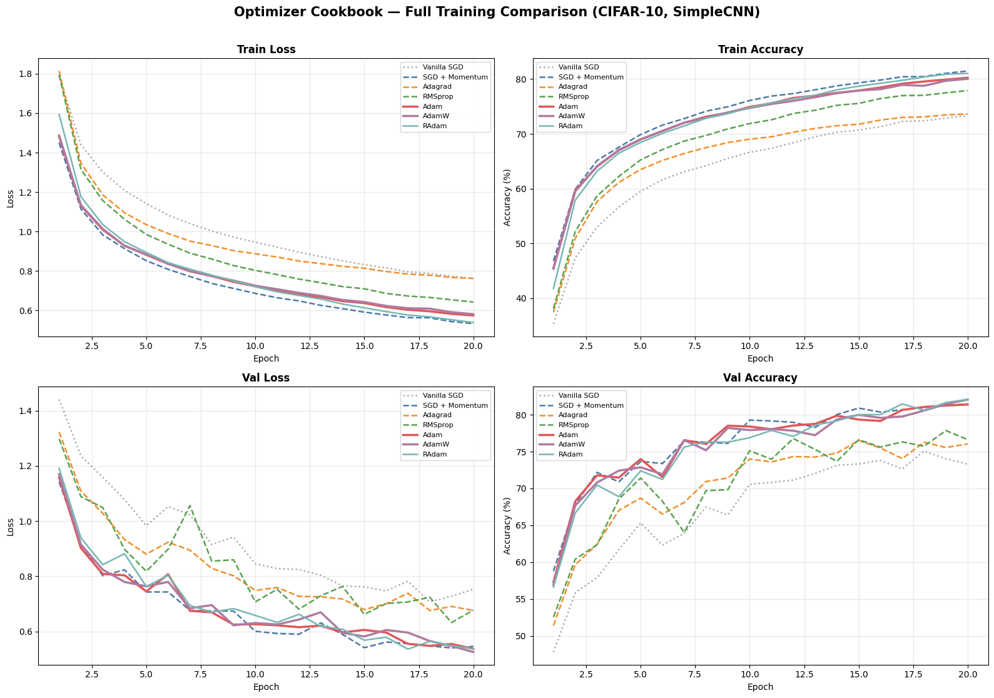

Slide 9
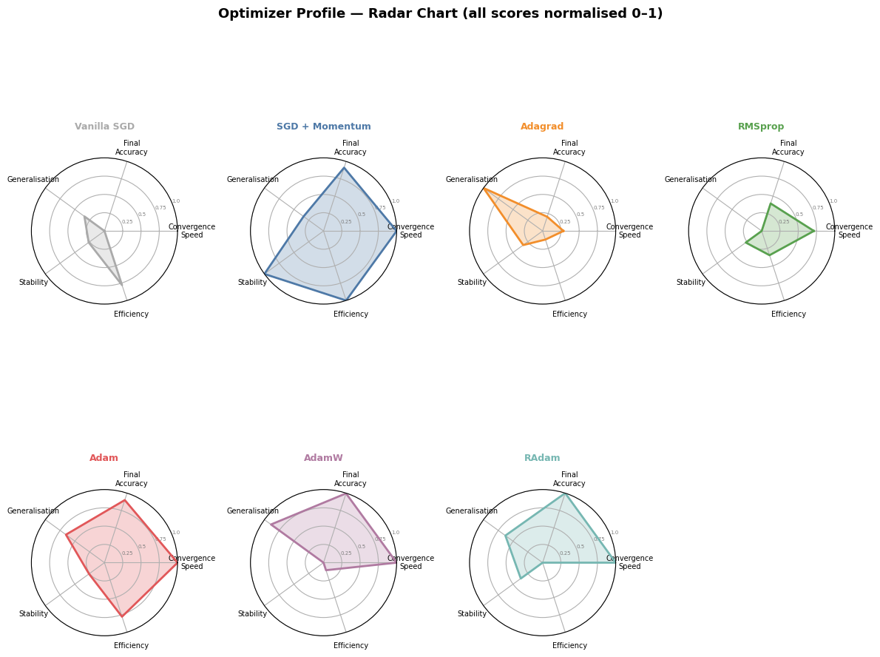
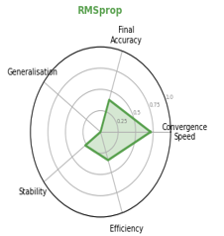
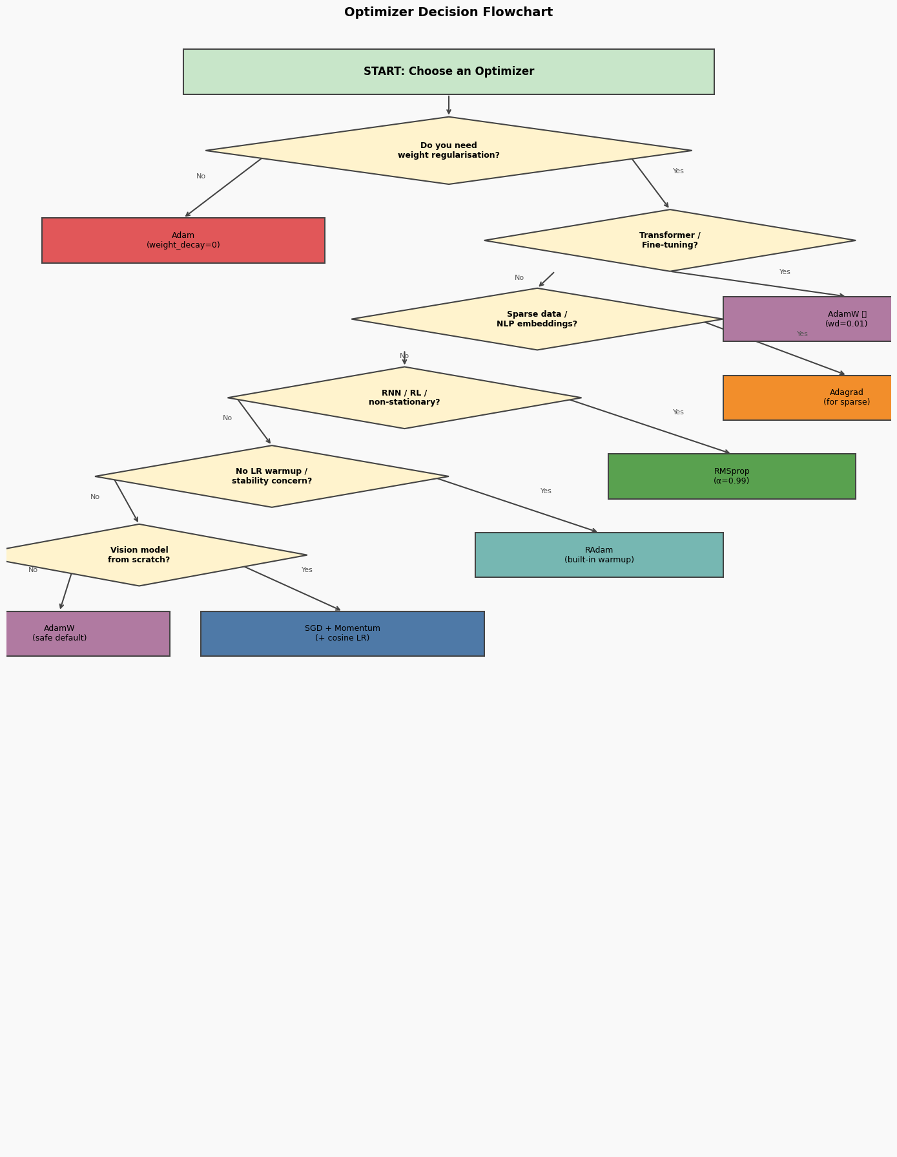

Slide 10
DECISION GUIDE — WHEN TO USE WHICH OPTIMIZER
Optimizer | Best Scenario | Avoid When | Default LR
SGD | Baseline / controlled experiments | Sparse data, no LR tuning time | 0.01
SGD+Momentum | CNNs, ResNets + cosine LR schedule | NLP, sparse features | 0.01
Adagrad | Sparse NLP, word embeddings (GloVe) | Deep nets, long training runs | 0.01
RMSprop | RNNs, LSTMs, Reinforcement Learning | Transformers, large models | 0.001
Adam | General default — any new task, GANs | When weight decay > 0 (use AdamW) | 0.001
AdamW | Transformers, BERT, GPT, fine-tuning | When weight decay = 0 (= Adam) | 0.001
RAdam | No LR schedule, quick experiments | When warmup scheduler already used | 0.001
💡 Rule of thumb: start with AdamW for any new task. Switch to SGD+Momentum if you have time to tune a LR schedule and want maximum final accuracy.

Slide 11
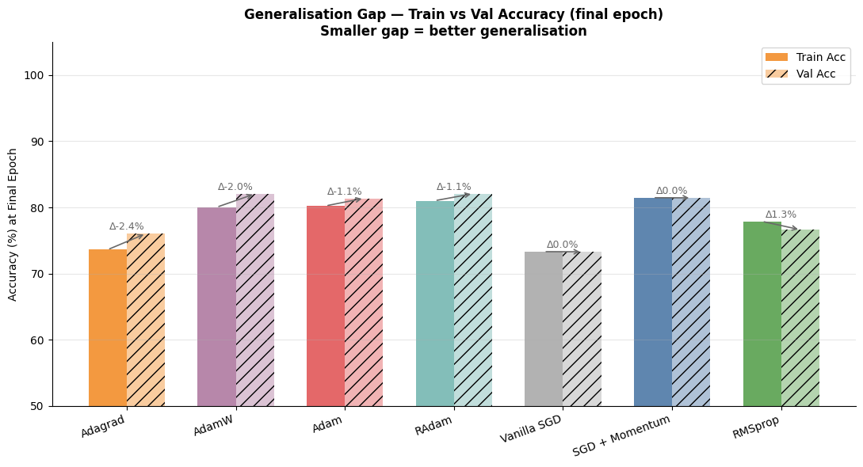

Slide 12
CONCLUSION
There is no single best optimizer.
There is only the best optimizer for your task.
🏆 Adam & AdamW win on CIFAR-10 — fastest convergence, robust to LR.
📐 AdamW is the correct Adam when weight decay matters — the math is cleaner.
🔁 SGD+Momentum remains relevant for vision models with a tuned schedule.
📉 Adagrad's dying LR is a real, measurable problem — not just theory.
🛡️ RAdam is the safest default when you cannot add a warmup scheduler.
Next steps: ResNet-18 validation · LR schedulers · LAMB/LARS · Sophia & Muon

