Slide 1
Autonomous AI Bug Fixer
A Multi-Agent System for Automated Bug Investigation, Code Fixing & Validation
AI + Software Engineering
Investigator → Fix Generator → Sandbox → Validator → Feedback Loop

Slide 2
1. Problem Statement
Manual Debugging
Trial-and-Error Fixes
Need for Automation
Developers spend time reading bug reports, locating the root cause, editing code and repeatedly running tests.
A fix may solve one issue but introduce another. Validation and regression checking require repeated effort.
An AI system should not only generate code—it should investigate, test, validate and improve the fix using feedback.
2

Slide 3
2. Proposed Solution
An autonomous multi-agent workflow for debugging
Accepts a bug report and source code as input.
Investigator Agent identifies the affected area and root cause.
Fix Generator Agent creates a corrected version of the code.
Sandbox Executor runs the generated code against Pytest tests.
Validator Agent interprets the test result and decides whether the fix is acceptable.
If validation fails, feedback is sent back to the Fix Generator for another attempt.
3

Slide 4
3. System Architecture
Core components and their responsibilities
AI Layer
Technology Stack
Investigator, Fix Generator and Validator agents powered by a local LLM.
Python
Streamlit
Ollama + Llama 3.2
Pytest
Temporary sandbox / subprocess execution
Modular agent-based architecture
Execution Layer
Sandbox Executor creates a temporary workspace and runs Pytest on the generated fix.
Interface Layer
Streamlit provides a simple interface to submit the bug, source code and fix-attempt limit.
4

Slide 5
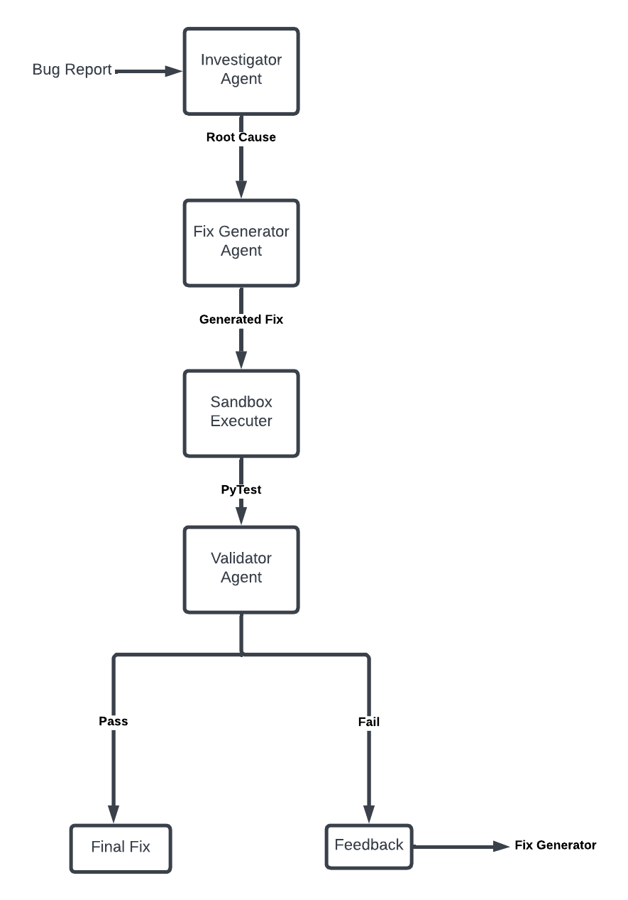
4. Agent Workflow / DFD
The supplied workflow diagram showing the autonomous feedback loop
5

Slide 6
5. How the Agents Work
01 Investigator
02 Fix Generator
03 Validator
04 Sandbox
Reads the bug report and source code.
Finds the likely root cause and identifies what needs to change.
Output: root-cause analysis.
Uses the investigation to generate a complete corrected source file.
Receives validator feedback when an earlier attempt fails.
Output: generated fix.
Reviews Pytest results and determines whether the fix works and whether there is a regression.
Output: pass/fail + feedback.
Creates a temporary workspace, runs tests and captures the result.
Keeps generated execution separate from the main project.
6

Slide 7
6. Working Prototype / Demo
Input
Autonomous Processing
Output
Bug report + source code
Example:
Division by zero should raise ValueError instead of crashing unexpectedly.
Investigation
↓
Code generation
↓
Sandbox execution
↓
Pytest
↓
Validation
If tests pass:
Final Fix
If tests fail:
Validator Feedback → Fix Generator → Retry
Demo objective: show one complete bug → fix → test → validation cycle within 5 minutes.
7

Slide 8
7. Key Technical Features
Multi-agent separation of responsibilities instead of one large debugging prompt.
Autonomous feedback loop allows the Fix Generator to improve a failed attempt.
Automated validation using Pytest rather than relying only on the LLM's explanation.
Temporary sandbox execution isolates the generated code during testing.
Local LLM integration through Ollama reduces dependence on a hosted AI API.
Streamlit interface makes the workflow easy to demonstrate and operate.
8

Slide 9
8. Benefits & Current Prototype Scope
Benefits
Current Prototype
• Reduces repetitive debugging effort
• Gives structured root-cause analysis
• Automatically tests generated fixes
• Provides feedback-driven retries
• Creates a clear audit trail of the debugging stages
• Python-based demonstration
• Llama 3.2 through Ollama
• Pytest-based validation
• Temporary execution sandbox
• Streamlit interface
• Example repository for demonstrating the end-to-end workflow
9

Slide 10
9. Future Scope & Conclusion
Future Scope
Conclusion
• GitHub repository integration
• Automatic pull-request generation
• Support for multiple programming languages
• Static analysis and security checks
• Improved test generation
• Human approval before applying production changes
The project demonstrates how specialized AI agents can work together to automate a software debugging loop.
The key idea is not simply “AI writes code”, but:
Investigate → Generate → Execute → Validate → Improve
10

