Slide 1

From HTML to Design
Learning CSS by improving our own projects

Slide 2
Look at Your Website
Last week we created the structure.
We now have:
Navigation
Headings
Paragraphs
Images
Sections
Footer
But our websites probably look very basic.
Question
How do we make them look like real products?

Slide 3

What Is CSS?
CSS controls how HTML looks.
HTML tells the browser:
"What is this?"
CSS tells the browser:
"How should it look?"
For example:
<h1>AvatarVerse</h1>
CSS can make it:
h1 {
color: cyan;
font-size: 48px;
}

Slide 4
HTML + CSS
Think about building a house.
HTML
The structure:
Walls
Doors
Windows
Rooms
CSS
The design:
Paint
Furniture
Size
Spacing
Arrangement

Slide 5
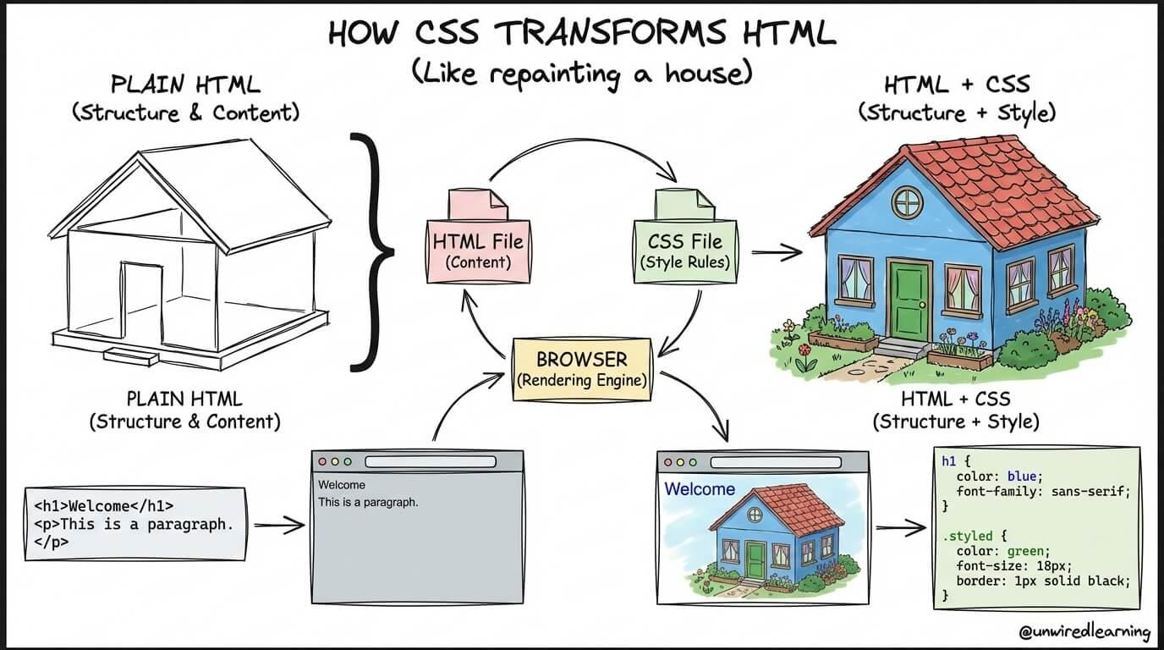

Slide 6
How CSS Works
CSS uses a simple pattern:
selector {
property: value;
}
Example:
h1 {
color: blue;
}
Selector
h1
Property
color
Value
blue

Slide 7
Connecting CSS to HTML
Our HTML:
<head>
<link rel="stylesheet" href="css/style.css">
</head>
Our CSS:
body {
background-color: black;
}
The HTML provides the structure.
The CSS provides the appearance.

Slide 8
CSS Selectors
We can select HTML elements.
Element selector
p {
color: white;
}
Class selector
.card {
padding: 20px;
}
HTML:
<div class="card">
ID selector
#hero {
background-color: black;
}

Slide 9
Colors
CSS gives us many ways to control color.
color: white;
background-color: black;
We can also use:
color: #00ffff;

Slide 10
Build Your Color Identity
Joshua — AvatarVerse
Suggested palette:
Black
Dark purple
Neon cyan
White
Buyi — Footy Stats
Suggested palette:
Black
Dark green
White
Gold
John — The Long Way Home
Suggested palette:
Dark navy
Blue
Orange
White

Slide 11
Typography
Typography controls how text looks.
CSS can control:
font-family
font-size
font-weight
line-height
Example:
h1 {
font-size: 48px;
font-weight: bold;
}

Slide 12
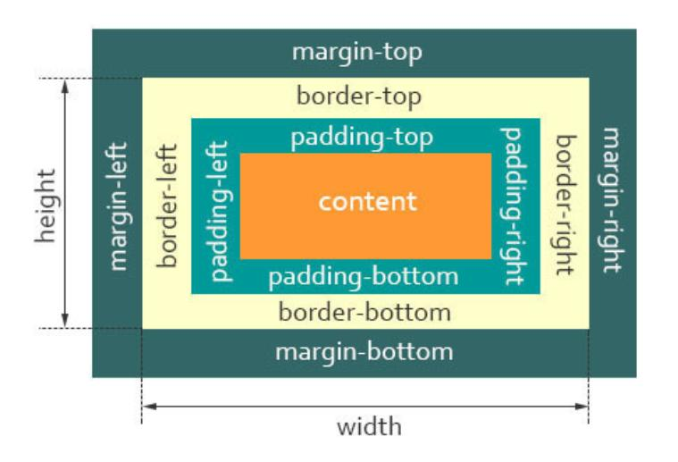
Why Spacing Matters
A website can have good content but still look bad if everything is crowded.
CSS gives us:
margin
padding
gap
Think:
Margin = space outside
Padding = space inside

Slide 13
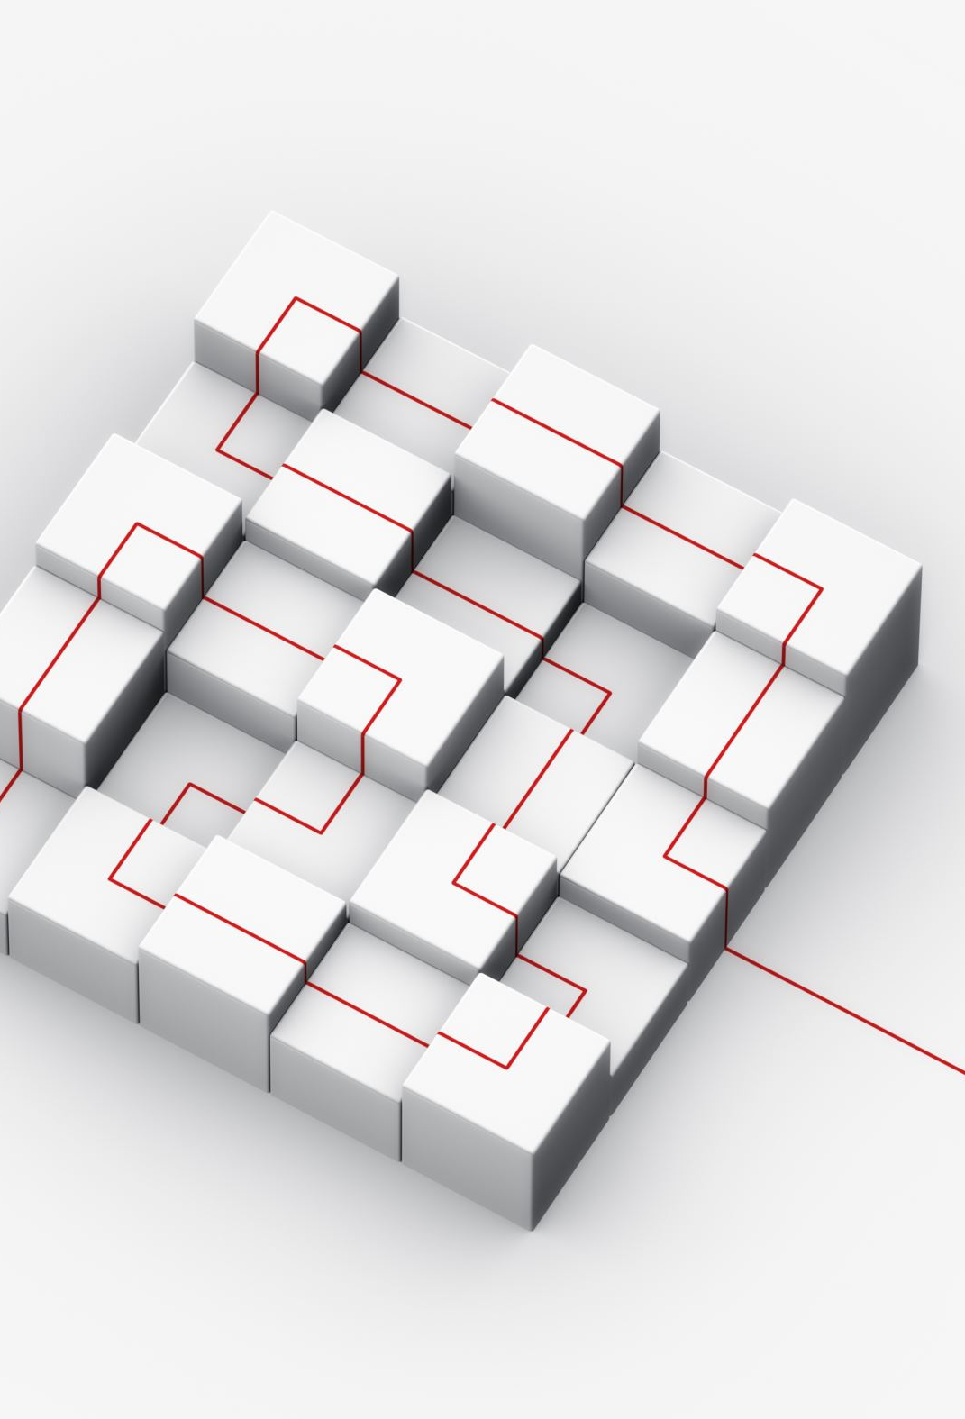
The CSS Box Model
Every HTML element can be thought of as a box.
Margin
└── Border
└── Padding
└── Content
Example:
.card {
padding: 20px;
margin: 20px;
}

Slide 14
Design Challenge
Improve your homepage.
Change:
Background color
Text color
Font size
Spacing
Heading style
Navigation style
Goal
Make your website look completely different from the default HTML page.

Slide 15
Accessibility
A beautiful website should also be usable.
Ask:
Can people read the text?
Is there enough contrast?
Are headings organised?
Do images have alt text?
Can someone use the keyboard?
Good design is design that people can use.

Slide 16
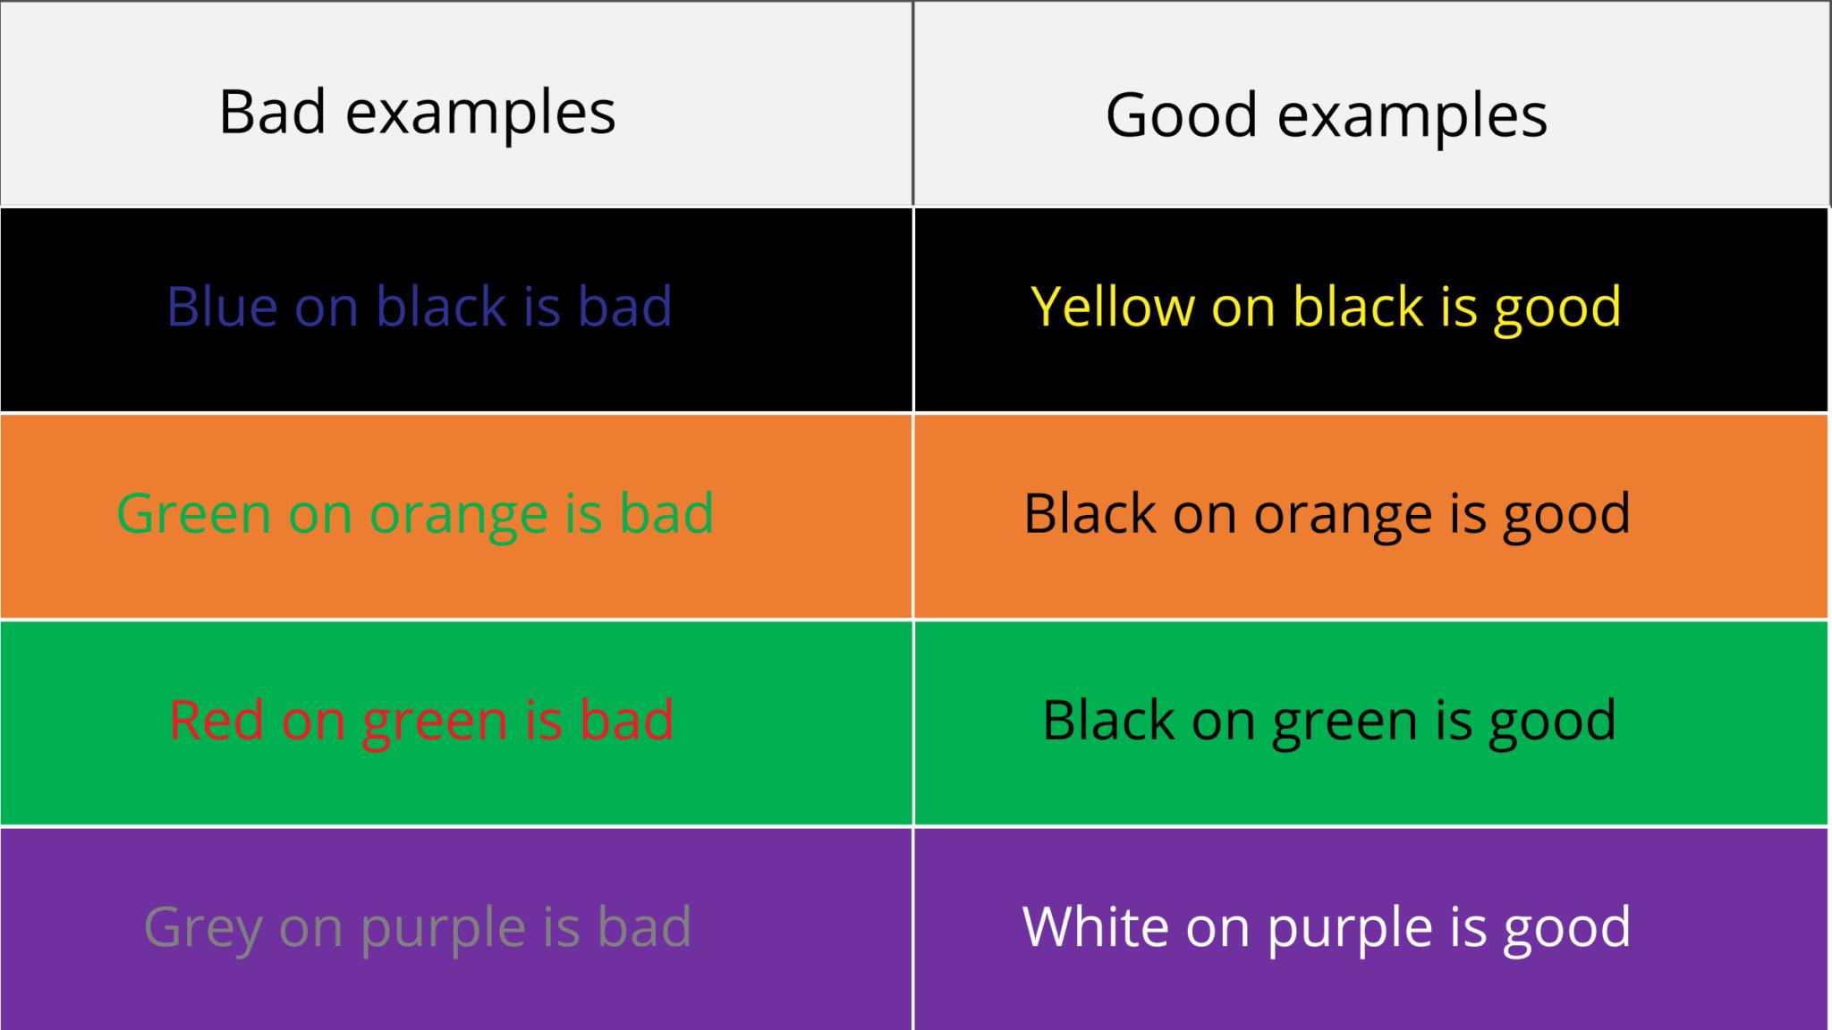
Colour Contrast
Bad:
Light gray text
on
White background
Good:
White text
on
Dark background
Explain that contrast makes content easier to read.

Slide 17

AI Enters Week 2
Last week:
AI explains.
This week:
AI can draft.
But there is a rule:
You must understand what AI gives you.

Slide 18
Our AI Rule
You may ask AI:
"Create CSS to make my navigation look modern."
But you must:
Read the CSS.
Paste it into your project.
Ask questions about unfamiliar code.
Change something yourself.
Explain what you changed.

Slide 19
AI Activity
Try this prompt:
Explain this CSS rule to me like I am a beginner.
[PASTE CSS HERE]
Explain:
1. What each property does.
2. Why it is being used.
3. What would happen if I changed the value.

Slide 20
Monday Challenge
Make Your Website Feel Different
Joshua:
Make AvatarVerse feel futuristic.
Buyi:
Make Footy Stats feel like a football analytics platform.
John:
Make The Long Way Home feel like an adventure game.

Slide 21

Homework
Choose:
A colour palette
A heading font
A body font
Write one sentence explaining:
"I chose these because..."

