Slide 1


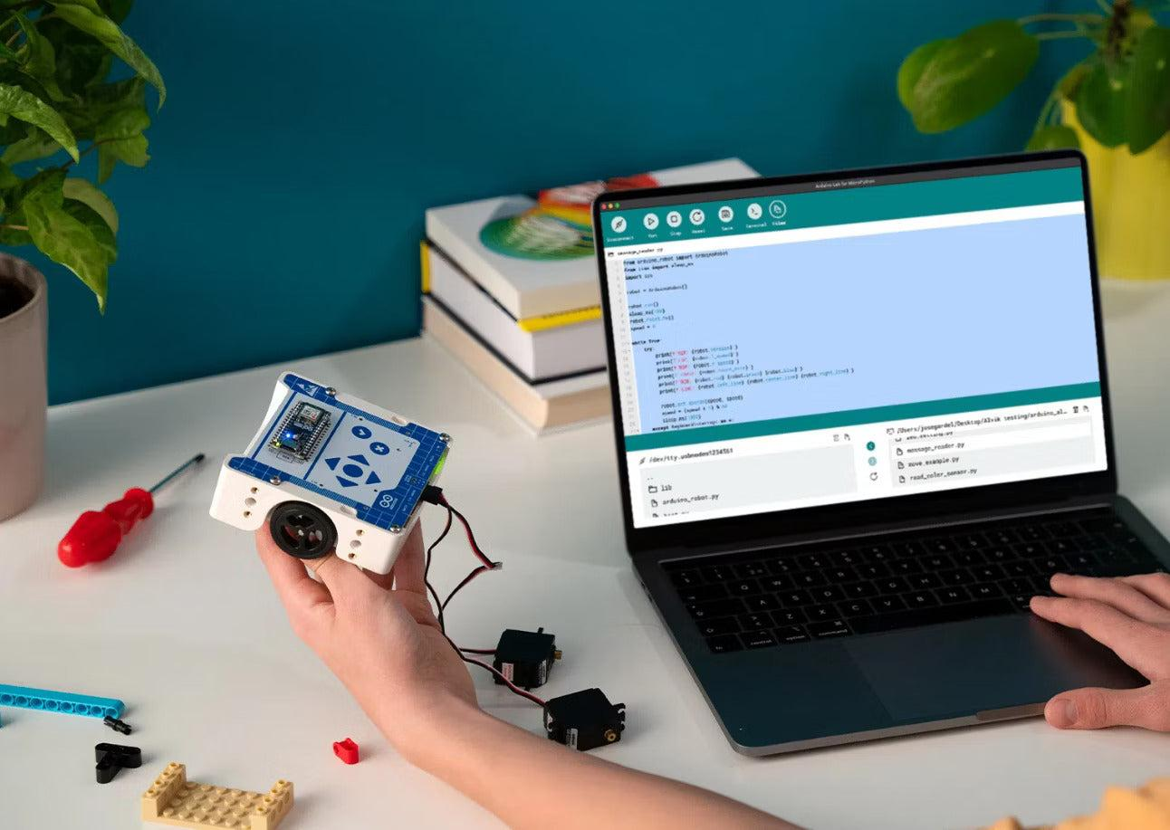


Welcome to Kokoodi AI Makers Camp
Think Like an Engineer |Build • Create • Innovate
Notes:
Welcome everyone!
I'm Kingsley, and over the next four weeks we're going to learn how software engineers build websites, solve problems, and create amazing technology.
This isn't a normal class.
We're going to build real projects together.

Slide 2
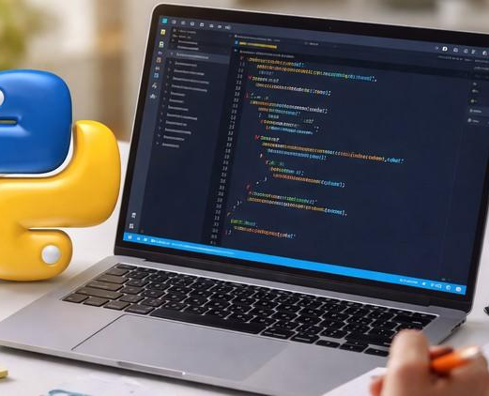
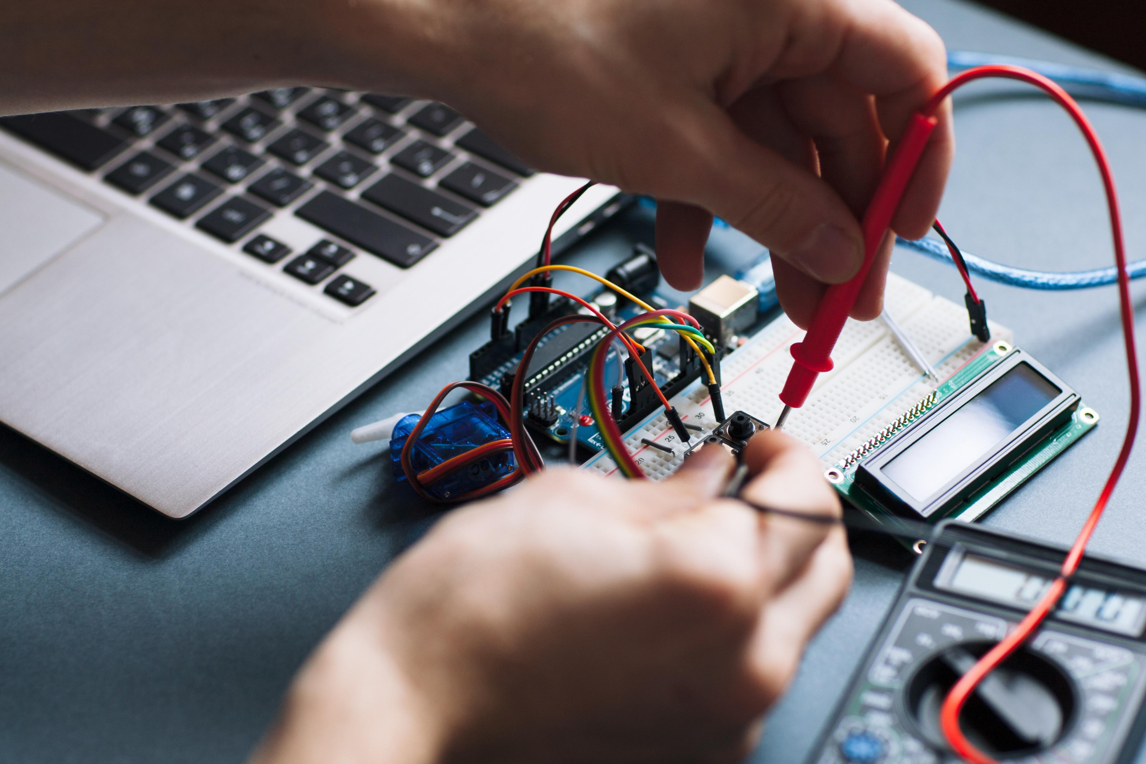
Meet Your Instructor
Kingsley Onyema
Aspiring Software Developer
Robotics Instructor
STEM Educator
Python Programmer
Technology Enthusiast
Notes:
Tell your story.
Don't read your CV.
Explain
Why you love technology
How you started
Why mistakes helped you learn
Students connect with stories.

Slide 3

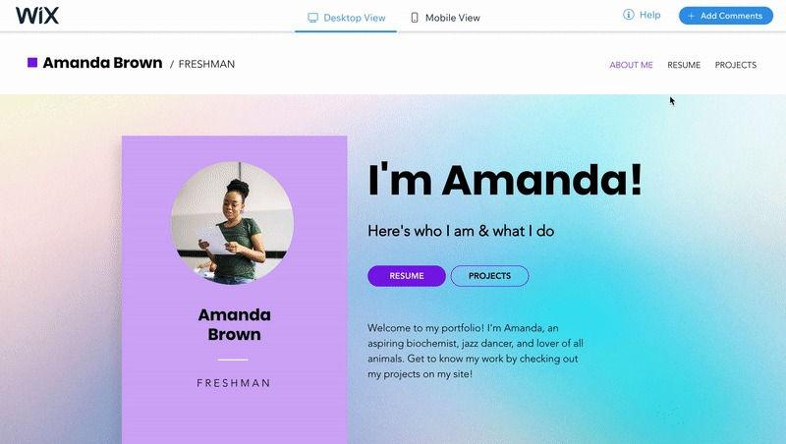
Our Mission
By the end of this programme...
YOU will have your own website.
Portfolio Website
Live on the Internet
Built by YOU
Notes:
Explain
"We're not just learning HTML.
We're building something you can proudly show your family and friends."

Slide 4

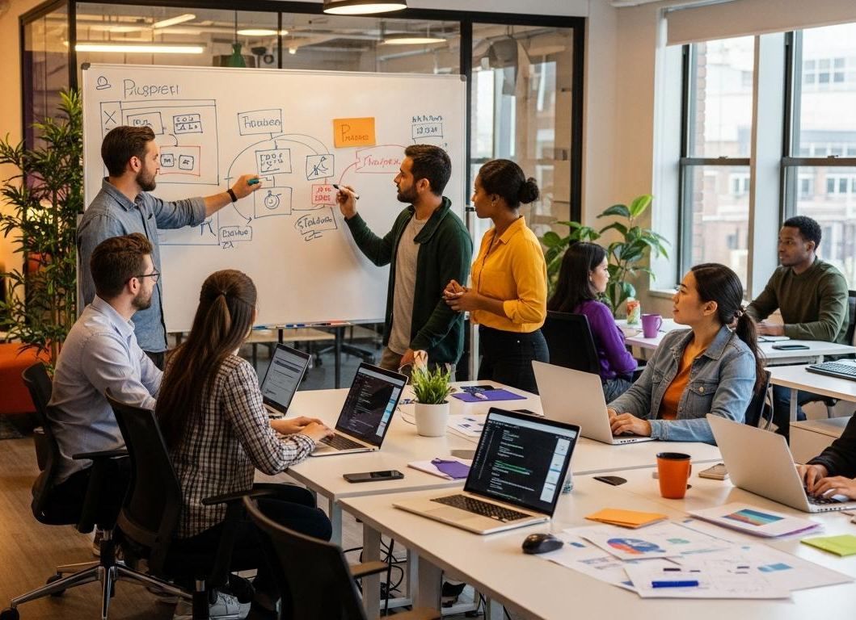
What Does a Software Engineer Do?
Software Engineers
Solve Problems
Build Apps
Build Websites
Create Games
Build AI
Notes:
Ask Students
What apps do you use every day?
Notes
Write their answers.
YouTube
TikTok
Spotify
WhatsApp
Then explain
Someone built these.

Slide 5
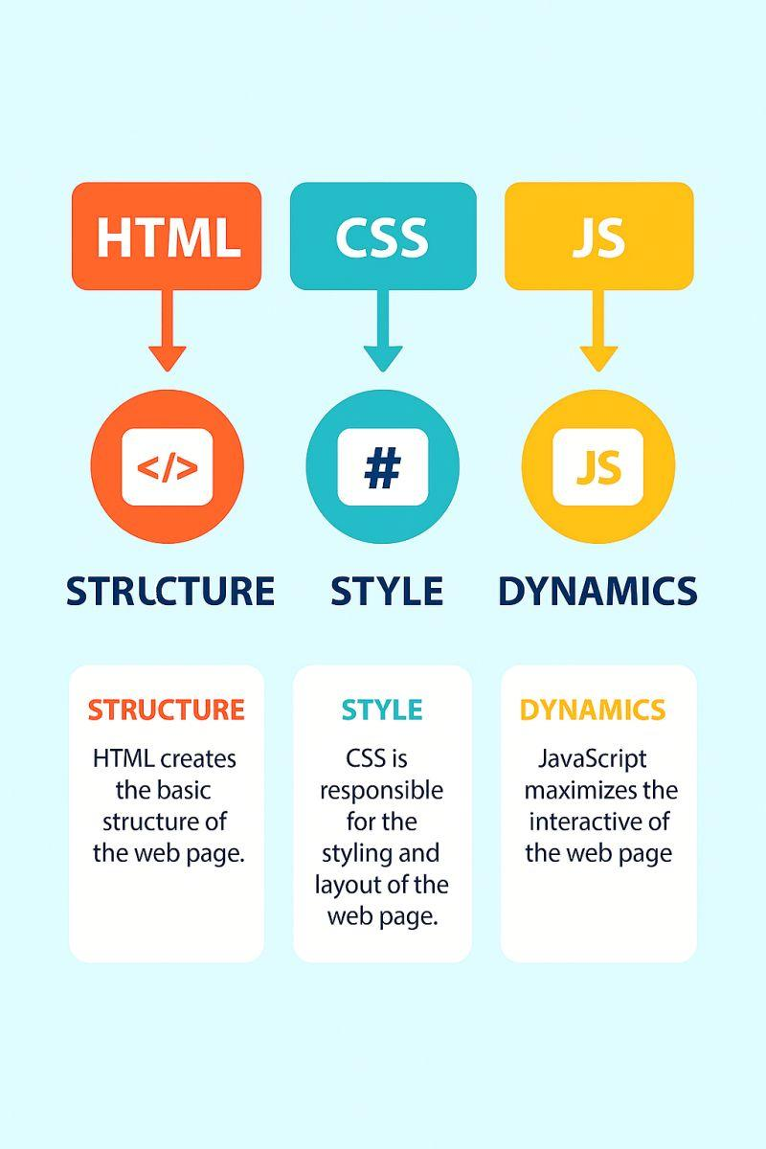
Every Website Uses These
HTML
Structure
CSS
Style
JavaScript
Interaction
Notes:
Use the house analogy.
HTML
Bricks
↓
CSS
Paint
↓
JavaScript
Electricity

Slide 6
Robots Need Code Too!
Robot
Program
Action
Website
Code
Action
Notes:
Show your robot.
Ask
What happens if I change the code?
Connect robotics to websites.

Slide 7
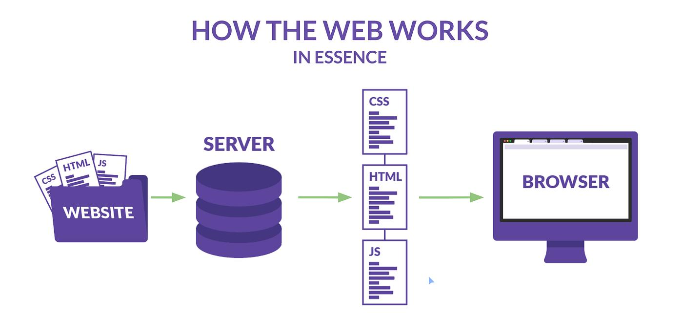
How Does a Website Reach You?
Browser
↓
Internet
↓
Website Files
↓
Your Screen
Notes:
Open Google.
Open YouTube.
Open BBC.
Explain
They're just files.

Slide 8
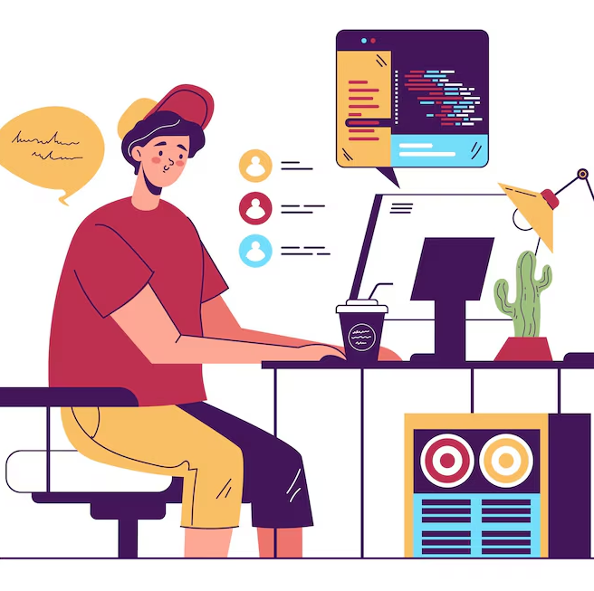
If You Could Build Anything...
Question
What would YOU build?
Ideas
Game
School Website
Football App
Music App
Robot Controller
Notes:
Spend time here.
This is the most important discussion today.

Slide 9

AI Helps You Learn
Week 1 Rule
AI Explains
AI DOES NOT Build Your Project
Examples
Explain HTML
Explain Errors
Explain Tags
Notes:
Teach responsible AI.

Slide 10
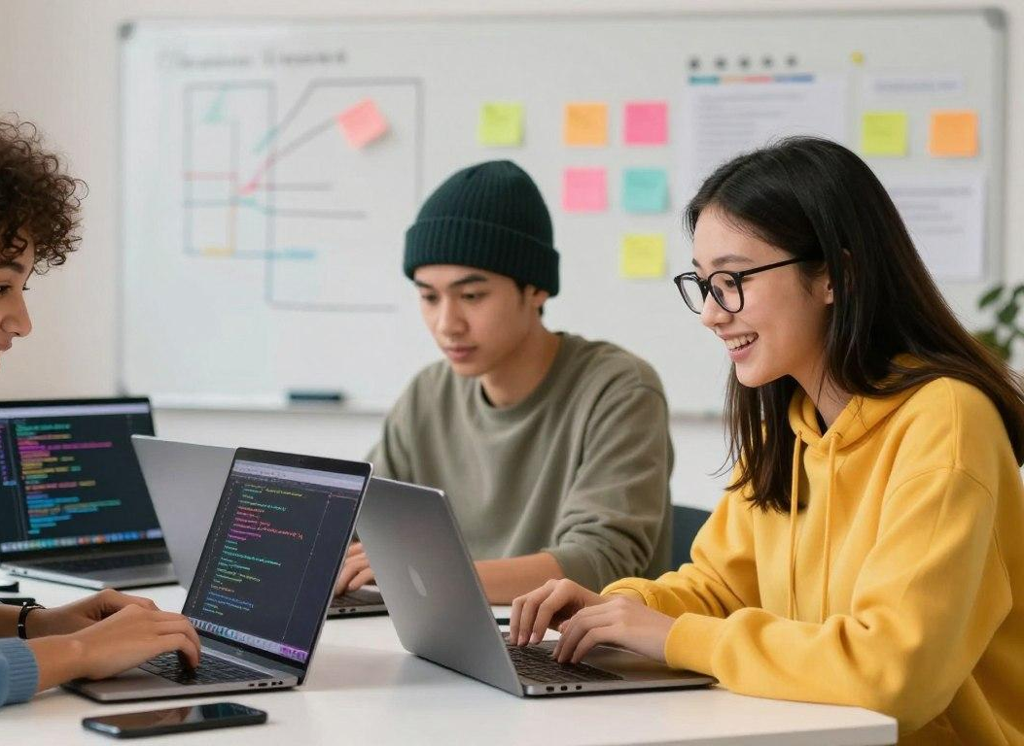
Today's Challenge
Think.
Imagine.
Sketch.
Share.
Draw the website you want to build.
Notes:
Let everyone draw.
No coding.
No pressure.

Slide 11

Homework
Find 3 Websites You Love
Write
Why do you like them?
What would you improve?
Notes:
Simple homework.
5 minutes.

Slide 12

Great Job Builders!
Next Session
We Build
Our First Website!
Questions?
Thank You!

