Slide 1
Keep a safe distance
Reinforcement Learning
Student ID:61075029h

Slide 2
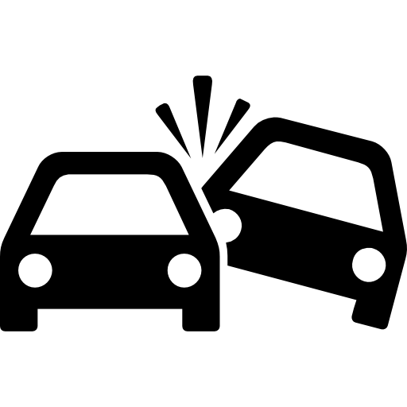
Problem: The speed limit is higher on high-speed roads, so if drivers do not keep a proper safety distance, they may not be able to react to sudden traffic conditions and cause traffic accidents.

Slide 3
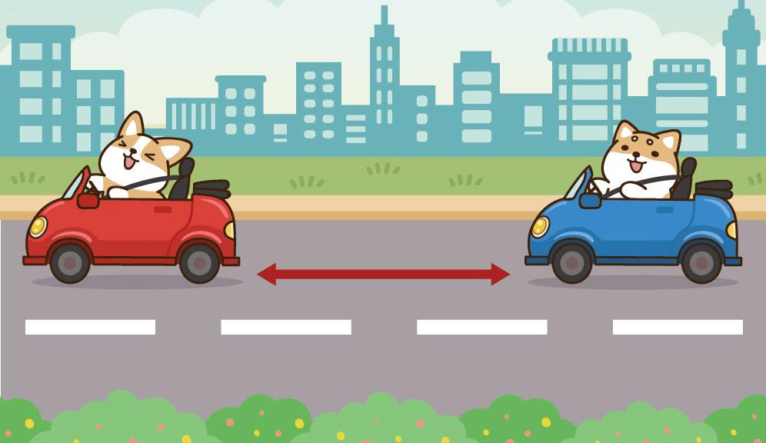
Goal: Build a reinforcement learning model to automatically adjust the distance to a safe distance based on current speed and distance of the vehicle in front of you.

Slide 4
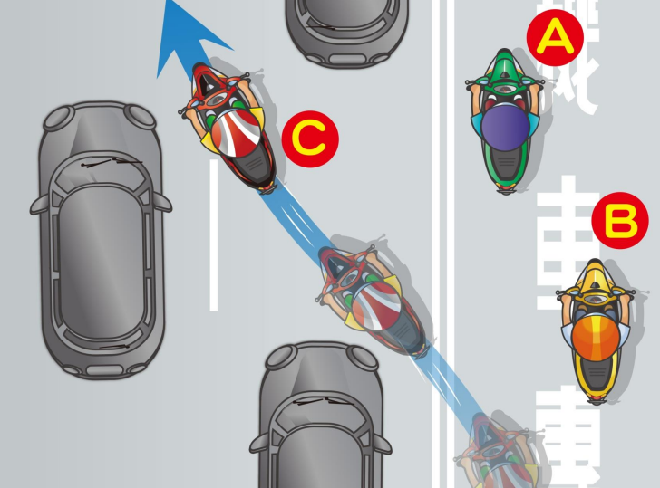
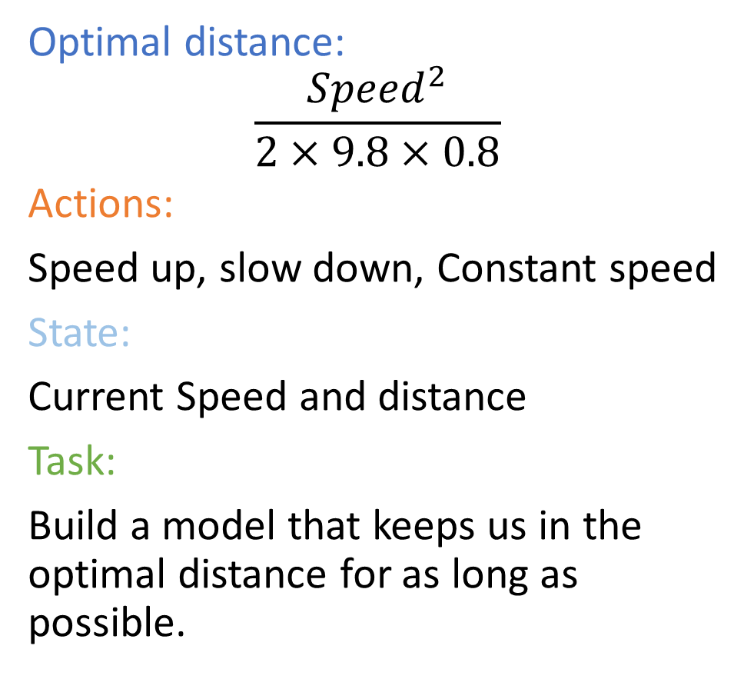
Optimal distance:
$$\frac{{Speed}^{2}}{2×9.8×0.8}$$
Actions:
Speed up, slow down, Constant speed
State:
Current Speed and distance
Task:
Build a model that keeps us in the optimal distance for as long as possible.
Notes:
Optimal distance :
This equation calculates how much distance we need to maintain based on the current speed of the car. (acceleration of gravity, coefficient of friction)
In this problem, we will add some special conditions so that if a car suddenly passes us from the side the safety distance will change.
Distance from the vehicle in front of you. Speed

Slide 5
Thanks you

