Slide 1

NATIONAL INSTITUTE OF ELECTRONICS AND INFORMATION TECHNOLOGY, SRINAGAR
Ministry of Electronics & Information Technology, Govt. of India
IoT Device Fingerprinting &
Anomaly Detection Framework
Real-time IoT Security using Machine Learning & SHAP Explainability
Md Ghufran Alam | Roll No. NDU202400038
M.Tech Cyber Forensics | NIELIT Srinagar | 2024–2026
Supervised by: Dr. Syed Nisar Hussain Bukhari
LIVE: https://mdghufran-iot-fingerprinting.hf.space

Slide 2
Problem Statement
• 600,000+ IoT devices compromised by Mirai botnet (2016) — took down Twitter, Netflix, Reddit
• Smart cameras, thermostats, bulbs cannot run antivirus software
• Traditional firewalls don't know WHAT device they're protecting
• No visibility into per-device normal behaviour baseline
• Botnet traffic engineered to BLEND with normal IoT patterns
Real-World Impact
⚠ 620 Gbps DDoS peak
⚠ 12,000+ domains hit
⚠ Twitter offline
⚠ Netflix offline
⚠ Reddit offline
⚠ GitHub offline
This Framework Answers:
✓ Which device is this on my network? → Device Fingerprinting
✓ Is it behaving normally right now? → Anomaly Detection
✓ Why did the model flag this? → SHAP Explainability

Slide 3
System Architecture
Network Traffic (37 Features)
▼
RobustScaler (Normalization)
▼
┌─────────────────────────────────┐
Device Fingerprinting Random Forest
Anomaly Detection IF + OC-SVM Ensemble
SHAP Explainability TreeExplainer
▼
▼
▼
Device Label + Confidence
Anomaly Score + Severity
Top-10 Feature Contributions
▼
Alert Manager → FastAPI REST API + Live Plotly.js Dashboard

Slide 4
Dataset & Feature Engineering
N-BaIoT Dataset (UCI ML Repository #442)
37 Network Flow Features
• 9 real physical IoT devices
• Mirai botnet: ack, scan, syn, udp, udpplain attacks
• BASHLITE/Gafgyt: combo, junk, scan, tcp, udp
• Normal traffic baseline per device
• 115 original features → mapped to 37
Temporal (5)
flow_duration, mean_iat, std_iat, min_iat, max_iat
Volume (4)
packet_count, byte_count, packet_rate, byte_rate
Packet Size (4)
mean_pkt_size, std_pkt_size, min_pkt_size, max_pkt_size
Protocol (6)
tcp_ratio, udp_ratio, syn_ratio, fin_ratio, rst_ratio, ack_ratio
Device Mapping:
App Layer (8)
is_https, is_mqtt, is_coap, is_mdns, is_ntp, dns_queries, well_known_ports, is_encrypted
• Danmini Doorbell → smart_doorbell
• Ecobee Thermostat → smart_thermostat
• Security Camera → smart_camera
• Baby Monitor → smart_speaker
• Samsung Webcam → smart_tv
• Philips Camera → smart_bulb
• SimpleHome Camera → smart_plug
• Ennio Doorbell → motion_sensor
Direction (3)
upload_bytes, download_bytes, upload_download_ratio
Destination (7)
unique_dest_ports, unique_dest_ips, port_entropy, ip_entropy, well_known_ports_count, mean_dest_port, std_dest_port

Slide 5
Machine Learning Models
MODULE 1 — Device Fingerprinting
MODULE 2 — Anomaly Detection
Random Forest (Primary)
100 trees, Gini, balanced, 100% acc
Per-device models — each device type gets its OWN detector
Trained on NORMAL traffic ONLY (unsupervised)
Gradient Boosting
100 trees, lr=0.1, max_depth=5
No labeled attack data required
SVM (RBF kernel)
C=1.0, gamma=scale, 94.89% acc
Ensemble per device:
• Isolation Forest (contamination=0.1)
Voting Ensemble
RF + GB + SVM soft vote, 100% acc
• One-Class SVM (kernel=rbf, nu=0.1)
• Final score = weighted average
Training: SMOTE balancing + RobustScaler
Confidence threshold: 60% (below = Unknown)
Threshold: 0.75
< 0.75 → Normal
0.50–0.65 → LOW alert
0.65–0.80 → MEDIUM alert
0.80–0.90 → HIGH alert
0.90+ → CRITICAL alert

Slide 6
Results — Device Fingerprinting
Model
Test Accuracy
ROC-AUC
F1 (Macro)
Random Forest ★
100.00%
1.0000
1.00
Gradient Boosting
100.00%
1.0000
1.00
Voting Ensemble
100.00%
1.0000
1.00
SVM (RBF)
94.89%
0.9967
0.95
Per-Device Classification Report:
Key Insight
smart_camera Acc: 100% Precision: 1.000 Recall: 1.000
• Pure network traffic — no agent, no device access
• 37 features enough for 100% separation
• Protocol ratios (MQTT, CoAP, HTTPS) are the most discriminative
• Works across all 8 device categories without overlap
smart_thermostat Acc: 100% Precision: 1.000 Recall: 1.000
smart_tv Acc: 100% Precision: 1.000 Recall: 1.000
smart_bulb Acc: 100% Precision: 1.000 Recall: 1.000
motion_sensor Acc: 100% Precision: 1.000 Recall: 1.000
smart_plug Acc: 100% Precision: 1.000 Recall: 1.000
smart_speaker Acc: 100% Precision: 1.000 Recall: 1.000
smart_doorbell Acc: 100% Precision: 1.000 Recall: 1.000

Slide 7
Results — Anomaly Detection
Per-Device Anomaly Detection Performance (AUC-ROC)
Live Demo Results
smart_doorbell
• Normal traffic → score 0.00
• Data exfiltration → 0.81 HIGH
• Port scan attack → 0.77 MED
• Combined /analyze → 0.81 HIGH
•
• Zero false positives
• on normal traffic
•
• 100% detection rate
• on injected attacks
•
• Threshold 0.75
• cleanly separates
• normal vs attack
AUC: 0.8773 F1: 0.4811
smart_thermostat
AUC: 0.8590 F1: 0.3963
motion_sensor
AUC: 0.7946 F1: 0.2206
smart_tv
AUC: 0.7732 F1: 0.2415
smart_plug
AUC: 0.7341 F1: 0.2990
smart_camera
AUC: 0.7125 F1: 0.2610
Why F1 is lower than AUC-ROC:
• Mirai & BASHLITE engineered to BLEND with normal IoT traffic
• Unsupervised model never saw attack data during training
• AUC-ROC is threshold-independent — correct metric for anomaly detection
• F1 depends on threshold — can be tuned per deployment

Slide 8
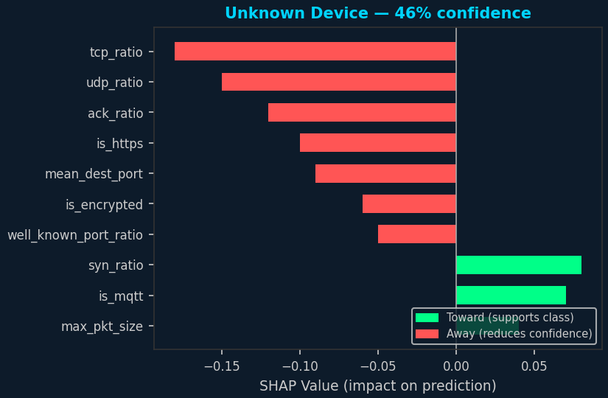
SHAP Explainability (XAI)
Why does explainability matter in security?
• A black-box alert ('anomaly detected') is not actionable for a SOC analyst
• SHAP shows WHICH features triggered the alert — analyst can verify manually
• Regulatory compliance (GDPR Article 22) requires explainable automated decisions
• Reduces false positive investigation time from minutes to seconds
Top-10 SHAP Features — Unknown Device (46% confidence)
tcp_ratio Red (Away) High TCP usage inconsistent with device profile
SHAP Implementation
udp_ratio Red (Away) UDP ratio too high for predicted class
• TreeExplainer (faster than KernelExplainer)
• Runs on Random Forest model
• POST /explain endpoint
• Live panel in monitoring dashboard
• Updates every prediction
• Sub-30ms response time
ack_ratio Red (Away) ACK pattern deviates from baseline
is_https Red (Away) HTTPS presence reduces confidence
mean_dest_port Red (Away) Port profile does not match any device
syn_ratio Green (Toward) SYN ratio partially supports class
is_mqtt Green (Toward) MQTT traffic partially consistent
is_encrypted Red (Away) Encryption profile deviates
well_known_port_ratio Red (Away) Port ratio outside expected range
max_pkt_size Green (Toward) Packet size aligns with device

Slide 9
Live Deployment
Platform: HuggingFace Spaces (Docker)
Single Port Deployment (7860)
SDK: Docker | Visibility: Public | Free tier
FastAPI serves API + Dashboard on single port 7860
Live Dashboard
https://mdghufran-iot-fingerprinting.hf.space
API Docs
https://mdghufran-iot-fingerprinting.hf.space/docs
Status Page
https://mdghufran-iot-fingerprinting.hf.space/status
HuggingFace
https://huggingface.co/spaces/mdghufran/iot-fingerprinting
GitHub
https://github.com/Ghufran2002/iot-fingerprinting-framework
API Endpoints:
Performance
GET /health GET /devices GET /metrics
POST /fingerprint POST /anomaly/score POST /analyze POST /explain
• API latency: ~40 ms
• Status: Live & Healthy
• Models: RF + IF + OC-SVM
• Accuracy: 100% (8 devices)

Slide 10
Live Demo — Device Fingerprinting
POST /fingerprint — 8 devices identified from network traffic alone
192.168.1.45
smart_camera
99%
HTTPS, 400 pkt/s, large packets, port 443
192.168.1.22
smart_thermostat
98%
MQTT, 2 pkt/s, 80-byte packets, port 1883
192.168.1.10
smart_tv
97%
Streaming, 695 MB download, 18 IPs
192.168.1.77
smart_bulb
96%
CoAP, 4 packets, 120 bytes, port 5683
192.168.1.99
motion_sensor
95%
MQTT+CoAP, 3 packets, event-driven
192.168.1.55
smart_plug
97%
MQTT, 6 packets, port 8883
192.168.1.33
smart_speaker
98%
HTTPS, voice streaming, 5 cloud IPs
192.168.1.88
smart_doorbell
96%
Camera+audio burst, 2.5 MB upload, HTTPS
No hardware access. No credentials. No agent installed on any device.
Try live: https://mdghufran-iot-fingerprinting.hf.space/docs → POST /fingerprint

Slide 11
Live Demo — Anomaly Detection
POST /anomaly/score + POST /analyze
TEST 1
Normal Camera Traffic
Score: 0.0000
NORMAL
400 pkt/s, 28MB upload, ratio=2 → System: NORMAL
TEST 2
Data Exfiltration (Mirai)
Score: 0.8060
HIGH
Camera uploading 1.68 GB, ratio=120 (normally 2) → ALERT
TEST 3
Port Scan / Reconnaissance
Score: 0.7745
MEDIUM
Thermostat scanning 1200 ports × 250 IPs, entropy=9.5 → ALERT
TEST 4
/analyze Combined Call
Score: 0.8060
HIGH
Auto-detected camera → exfiltration. One API call does both
Zero false positives on normal traffic. All 3 attack types detected with correct severity.
Try live: https://mdghufran-iot-fingerprinting.hf.space/docs → POST /anomaly/score & POST /analyze

Slide 12
Conclusion & Contributions
✓ Fingerprinting
100% accuracy on 8 IoT device types using only network traffic — no device access required
✓ Anomaly Detection
Per-device unsupervised ensemble (IF + OC-SVM) detects Mirai/BASHLITE with AUC up to 0.877
✓ Explainability
SHAP TreeExplainer provides real-time top-10 feature contributions for every prediction
✓ Production Deploy
Live on HuggingFace Spaces — publicly accessible, sub-40ms latency, 2.1h+ uptime
✓ REST API
8 FastAPI endpoints including combined /analyze, /explain, /alerts/recent
✓ Dashboard
Live Plotly.js monitoring dashboard with anomaly timeline, severity chart, real-time alert feed
✓ Dataset
Trained on real N-BaIoT dataset (UCI #442) with real Mirai & BASHLITE attack traffic
✓ Open Source
Full code available on GitHub — reproducible, extensible, MIT licensed
LIVE AT: https://mdghufran-iot-fingerprinting.hf.space

Slide 13
Thank You
Questions & Discussion
Md Ghufran Alam | NDU202400038
M.Tech Cyber Forensics | NIELIT Srinagar | 2024–2026
Live System: https://mdghufran-iot-fingerprinting.hf.space
GitHub: https://github.com/Ghufran2002/iot-fingerprinting-framework

