Slide 1
Hidden Layer Prediction
William Huibregtse
whuibreg@iu.edu

Slide 2
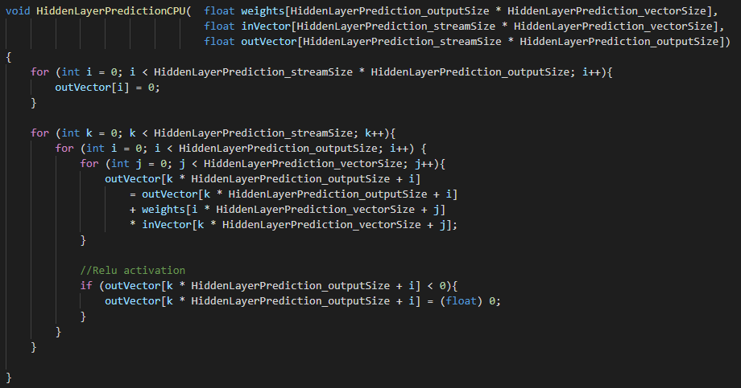
MultiCore/ManyCore Implementation
C implementation
Can be run in multiple cores at once

Slide 3
Essence of DataFlow Execution
Input parsed in as vector
Matrix multiplication with supplied hidden layer weights to find pre-activation value at a node
Activation function (ReLu) calculated at each node
Activations streamed out as a vector

Slide 4
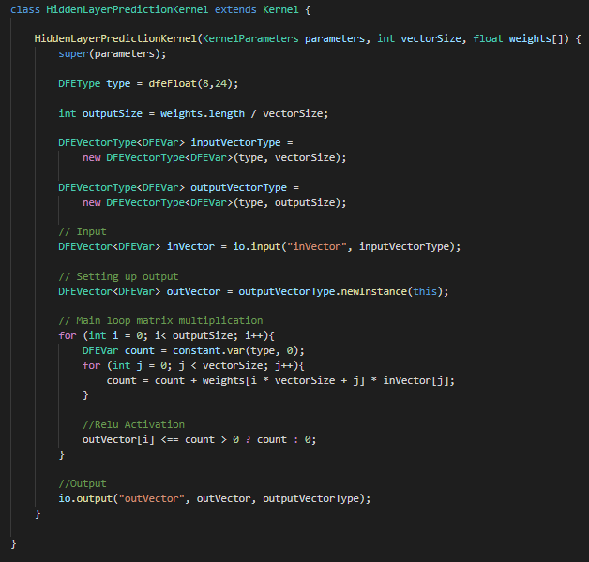
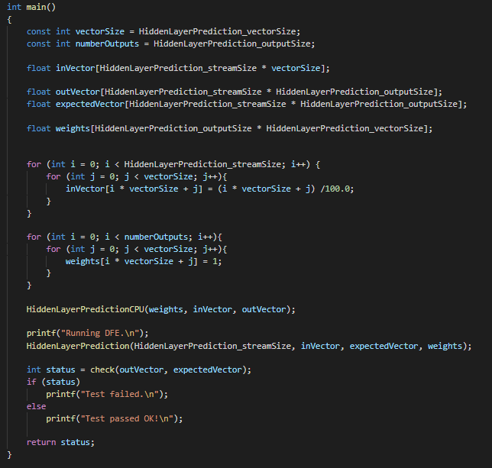
Kernel and Host Code

Slide 5
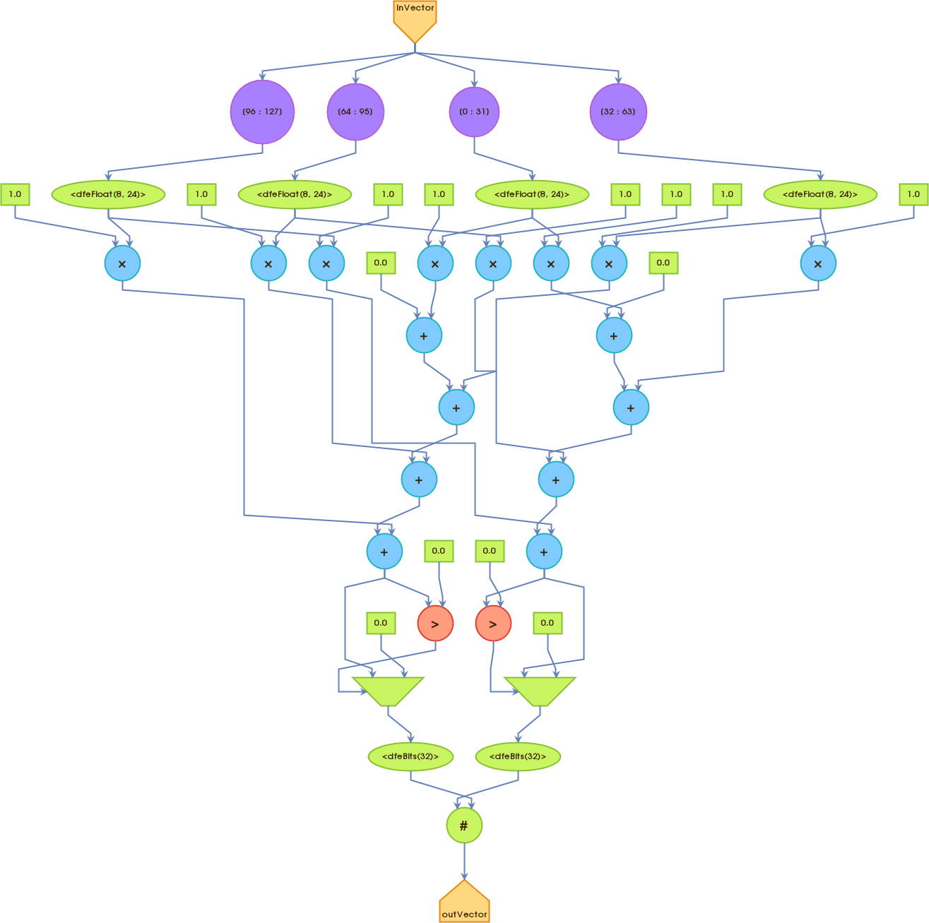
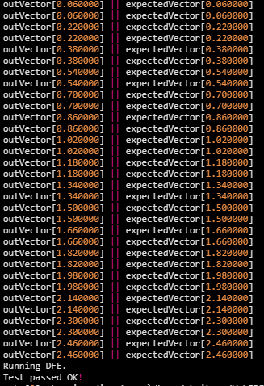
Execution Graphs
Original Execution Graph

Slide 6
Measured Performance and Reflection
Allows hidden layer predictions at logic gate level, so significant speed increase over ControlFlow implementation if input was IP stream
Does not support weight training for hidden layer weights; only capable of predictions
Would require a ‘re-burn’ of FPGA when changing hidden layer weights or activation function

