Slide 1
Homogeneity Edge Detection
William Huibregtse
whuibreg@iu.edu

Slide 2
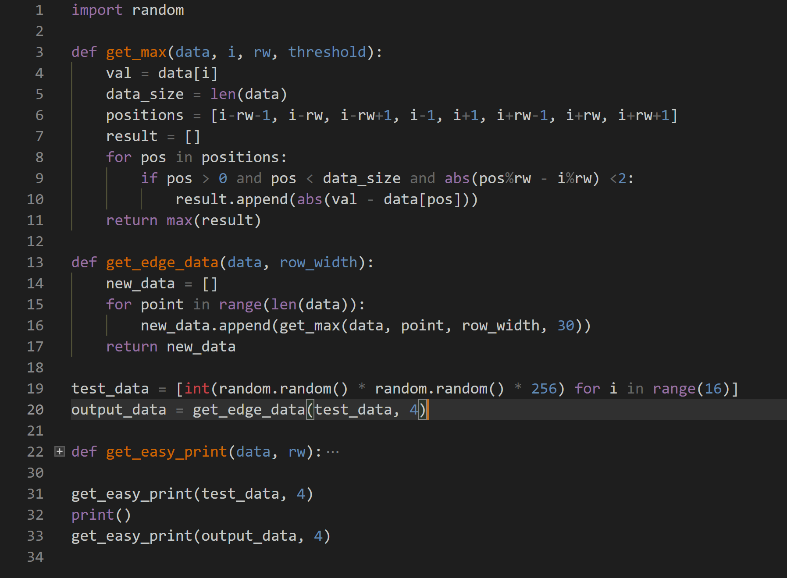
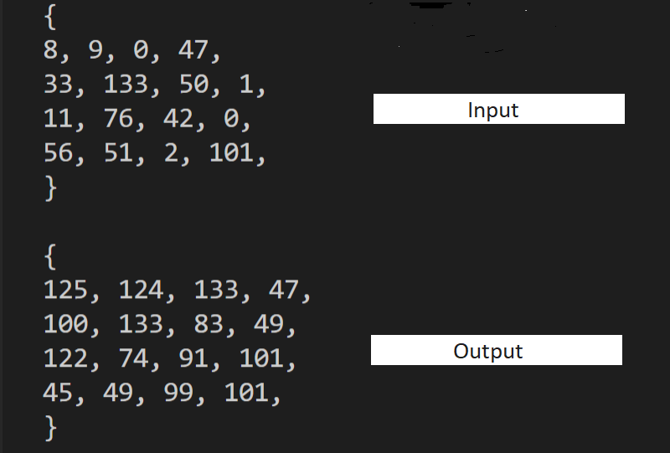
MultiCore/ManyCore Implementation
Python 3.6 implementation
Can be run in multiple cores at once
Cannot be run on input images before they are saved to disk

Slide 3
Essence of DataFlow Execution
Input pixels are streamed in
Absolute values of differences in pixel brightness are calculated for all neighbors of the pixel using stream offsets
Maximum of these values is used as the new pixel brightness value (large difference represents very distinct edge)
This value is streamed out

Slide 4
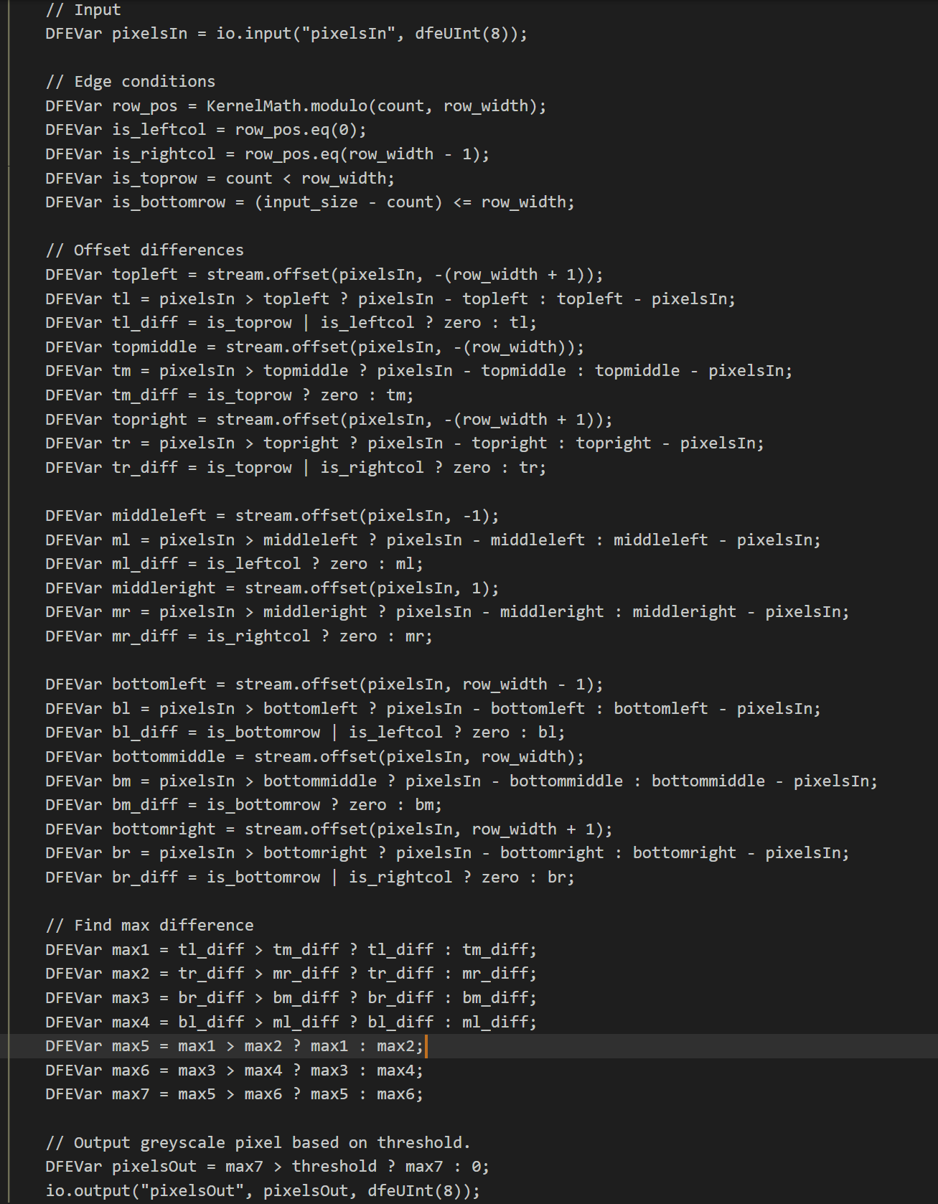
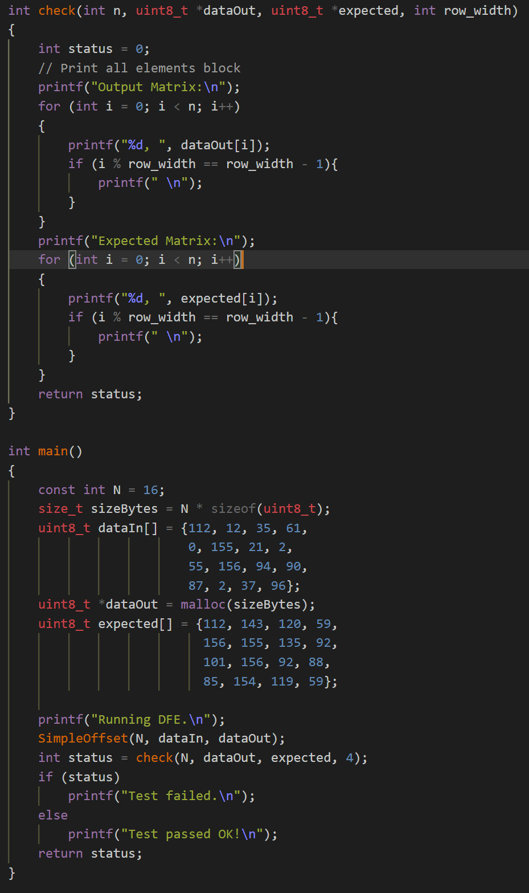
Kernel and Host Code

Slide 5
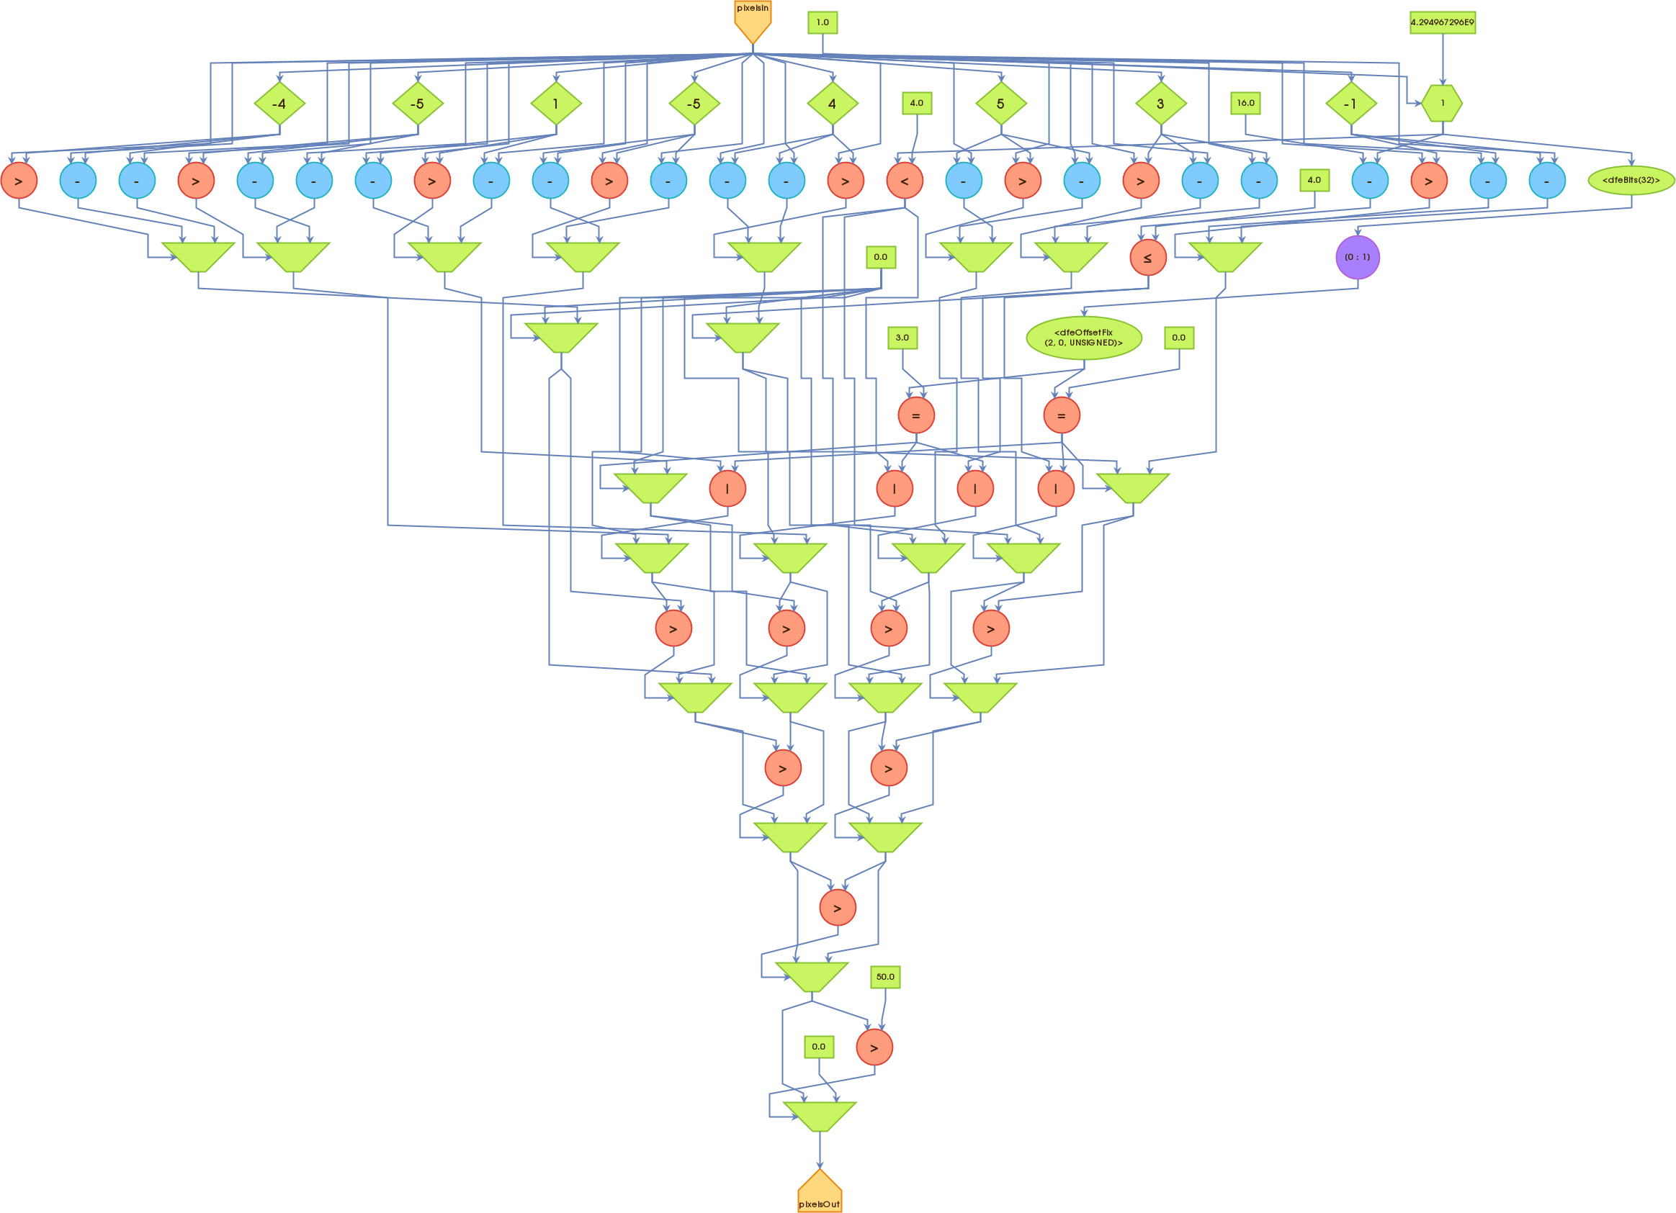
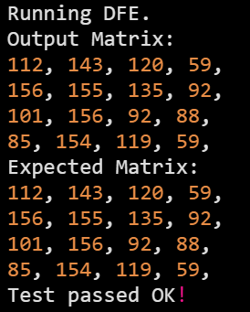
Execution Graphs

Slide 6
Measured Performance and Reflection
Data can be streamed in from camera hardware (pre-compression) or on existing saved RAW image formats
Allows for potential of ‘real-time’ edge detection photo/video
Much faster than doing edge detection calculations on software level after images are saved
Exact performance increase unknown due to development and testing in simulation environment only

