Slide 1






Health Outcome in
South Caucasus
Data Visualization: DS 116
Kima Badalyan
Syuzanna Harutyunyan
Narek Ghukasyan
Husik Sargsyan
Professor: Habet Madoyan

Slide 2

Overview
The healthcare systems in Armenia, Georgia, and Azerbaijan share common regional factors that impact health outcomes. Still, each country faces various challenges that affect life expectancy, disease prevalence, and healthcare quality.
Similar Healthcare Financing Strategies
Armenia, Georgia, and Azerbaijan use similar strategies in financing their healthcare systems.
Study Objective
Investigate if these similar financing strategies result in comparable health outcomes across the countries.

Slide 3
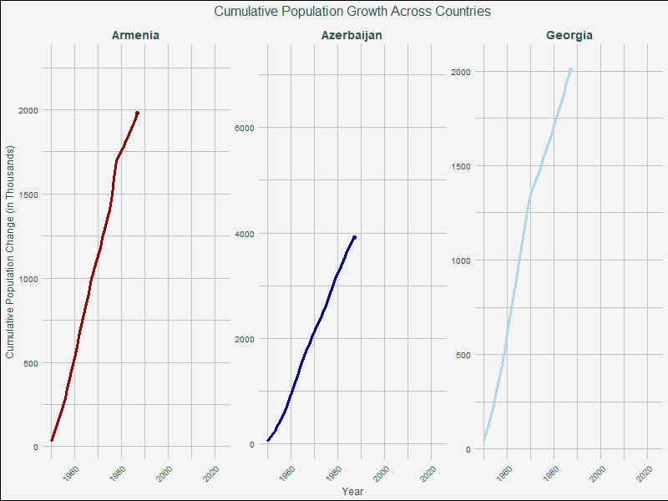

Slide 4
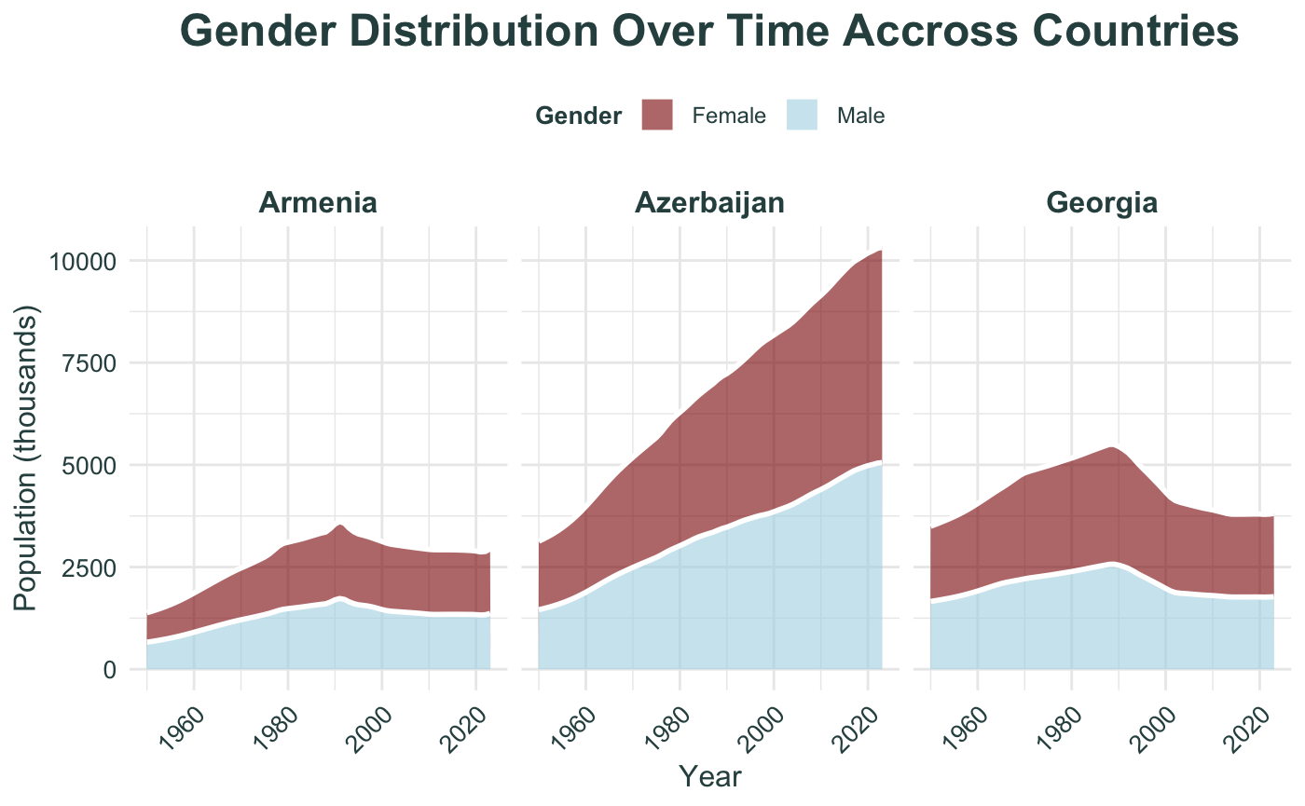

Slide 5
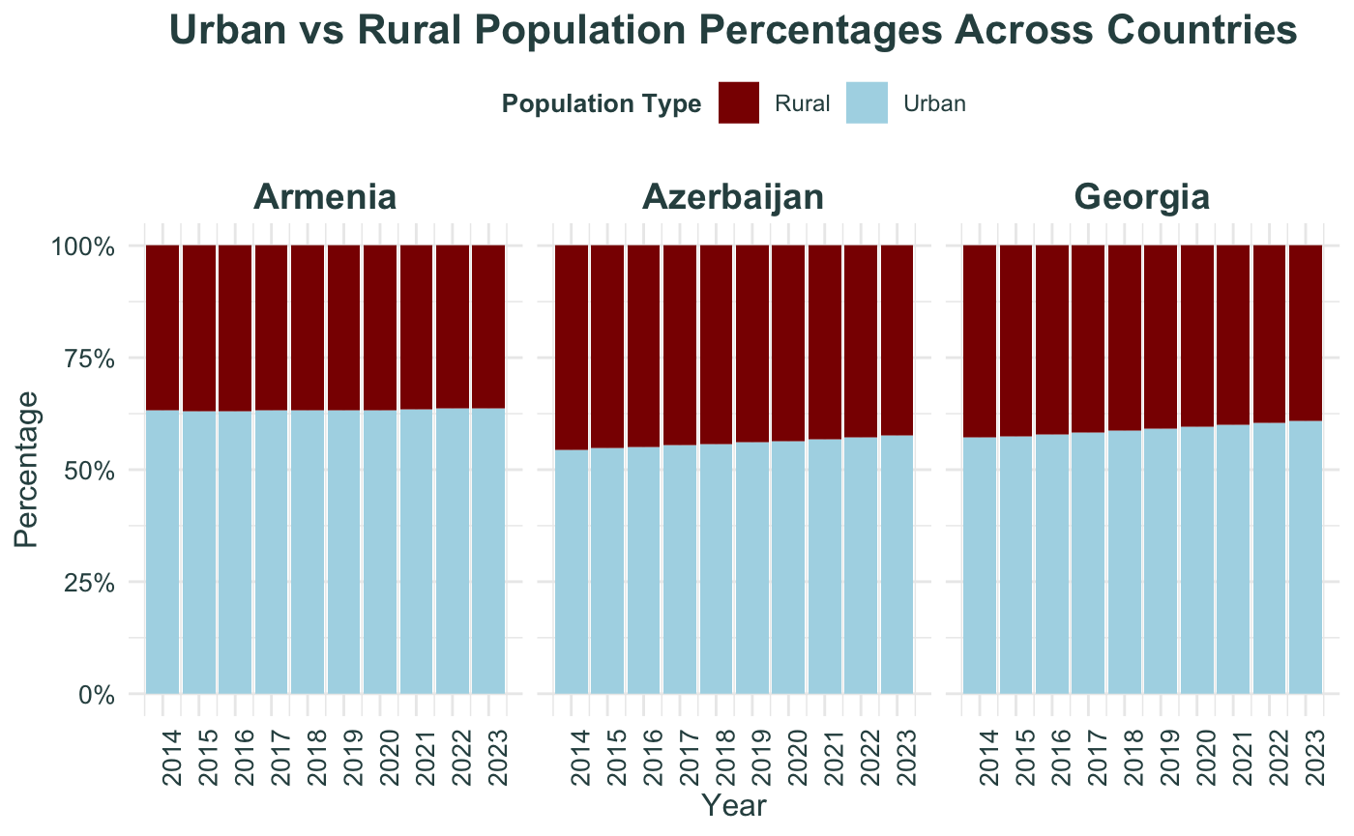

Slide 6
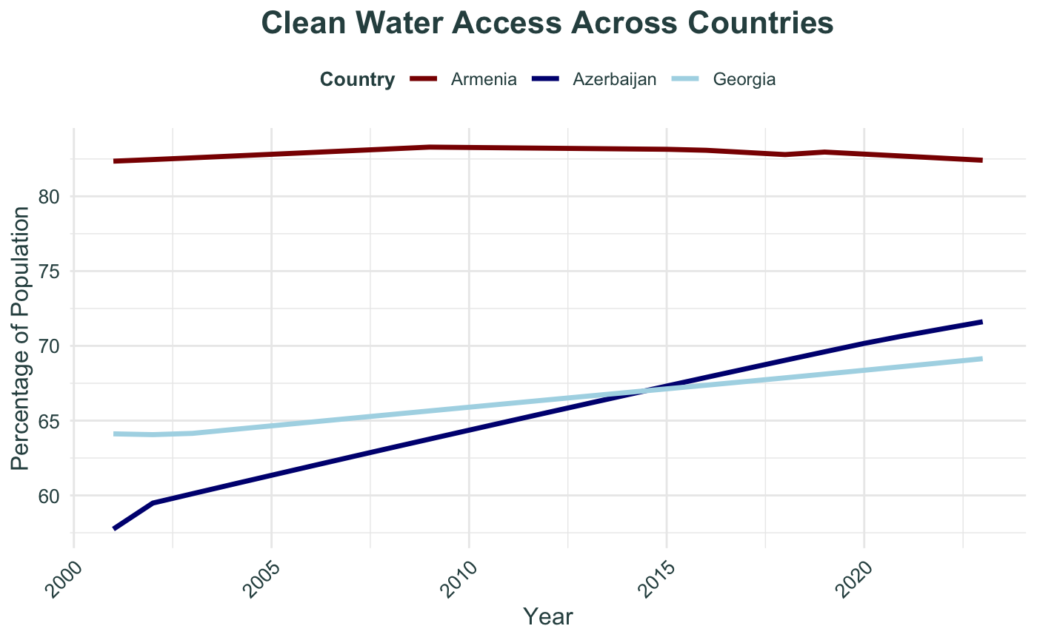

Slide 7
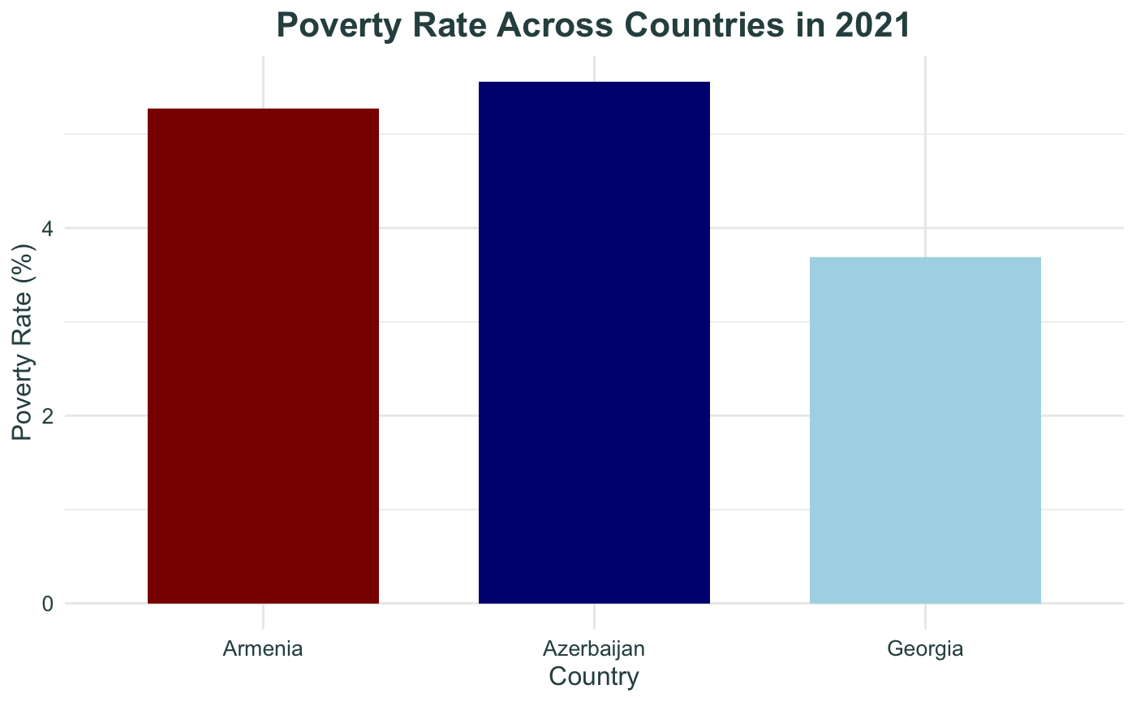

Slide 8
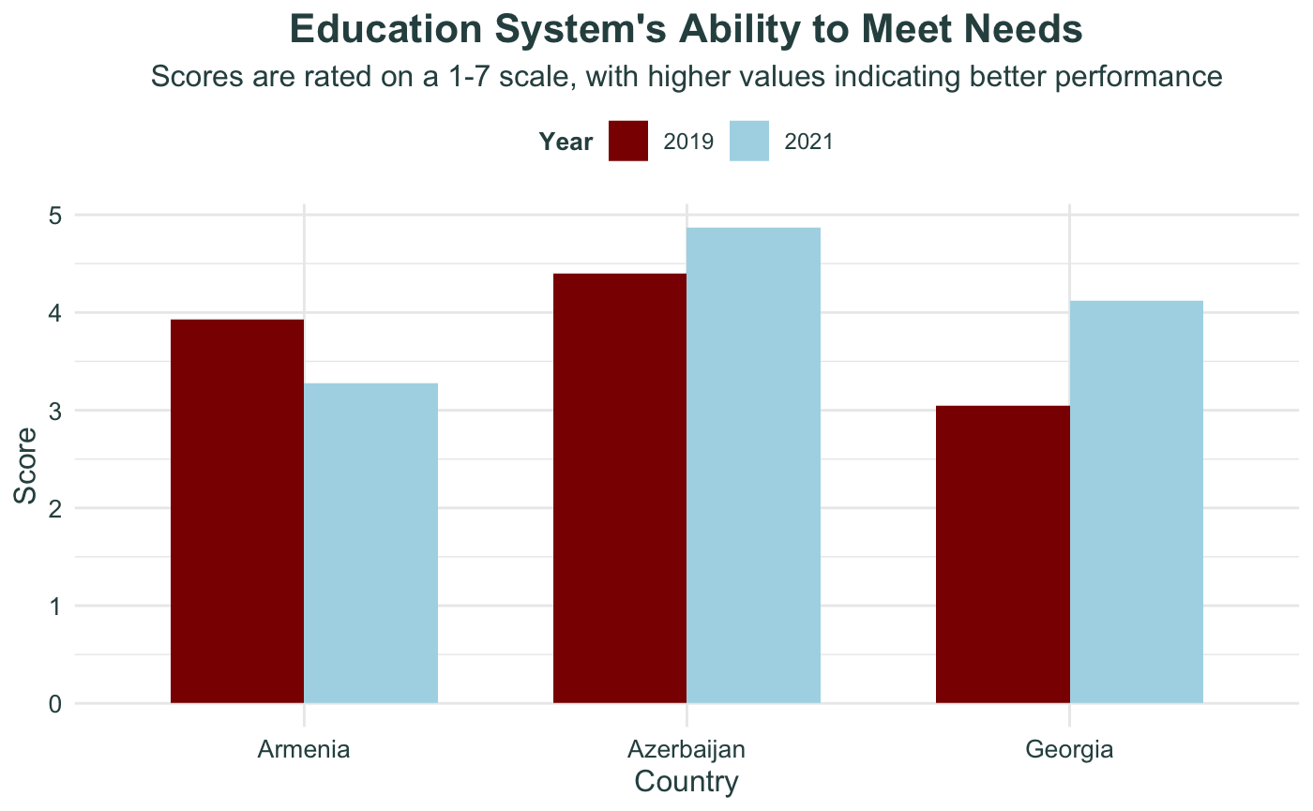

Slide 9
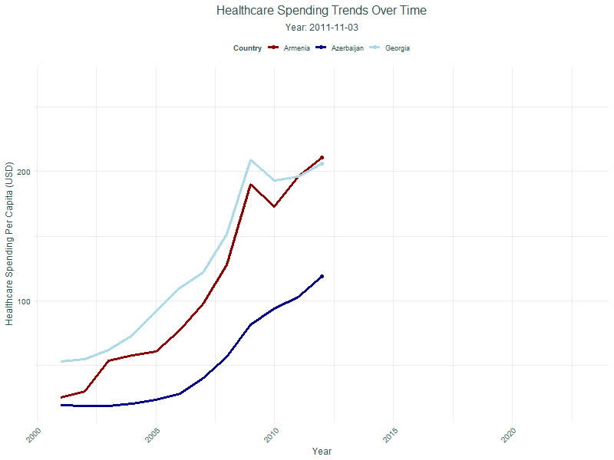

Slide 10
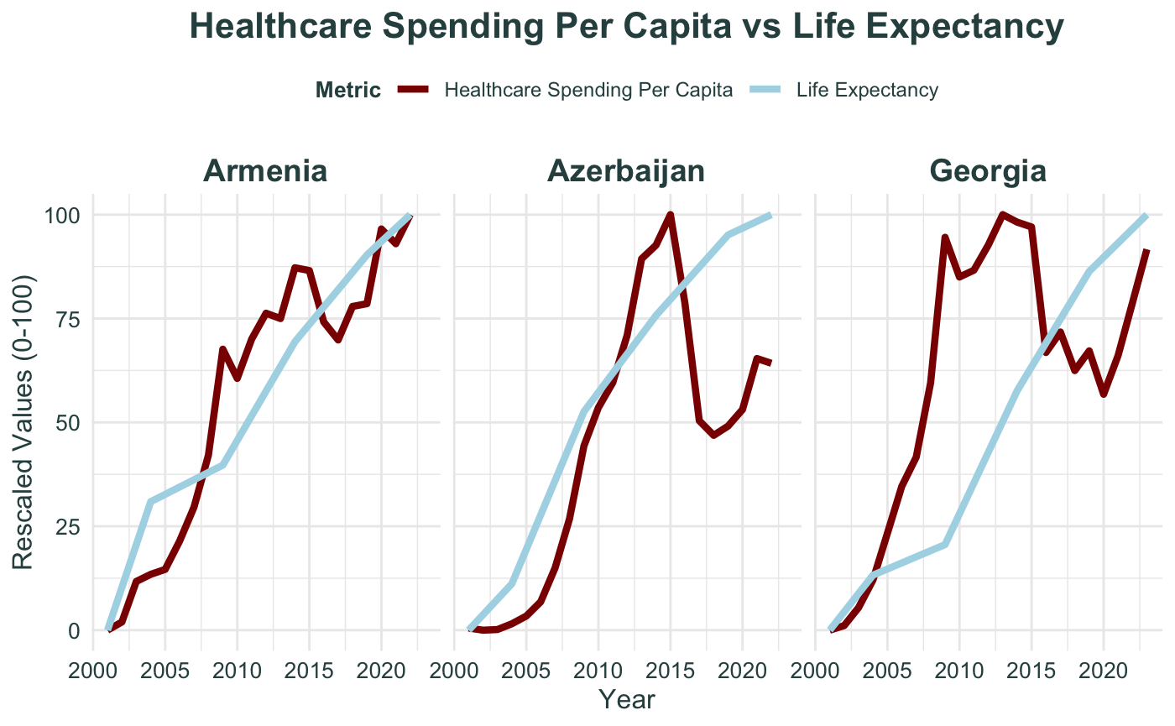

Slide 11
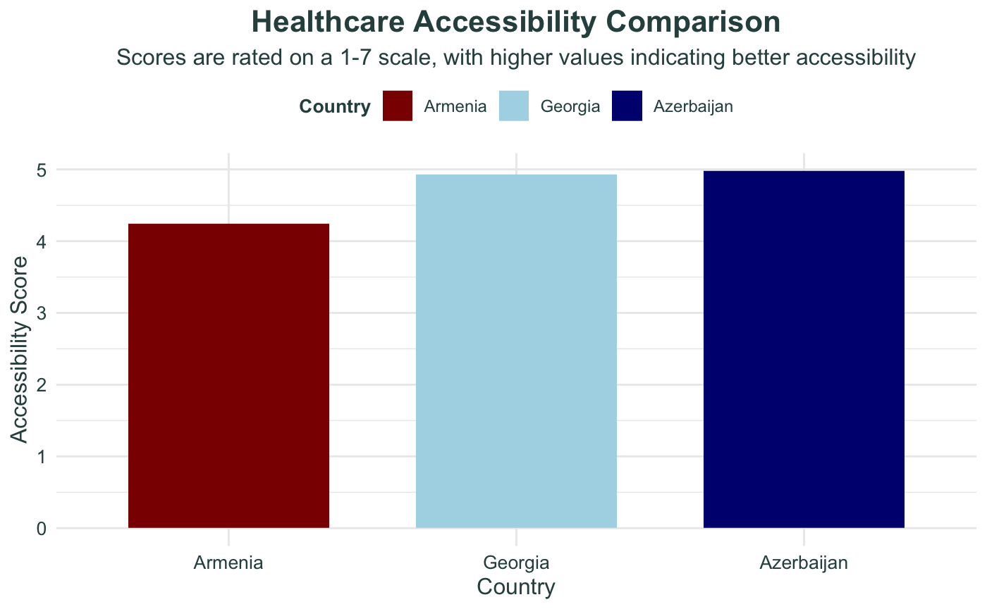

Slide 12
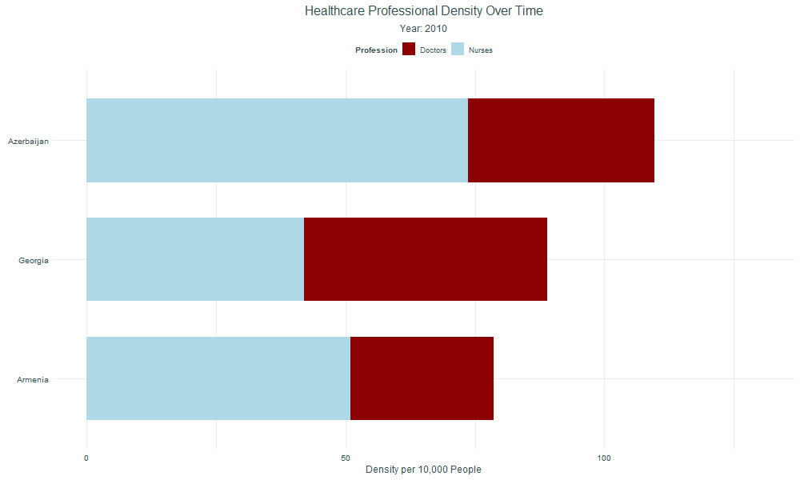

Slide 13
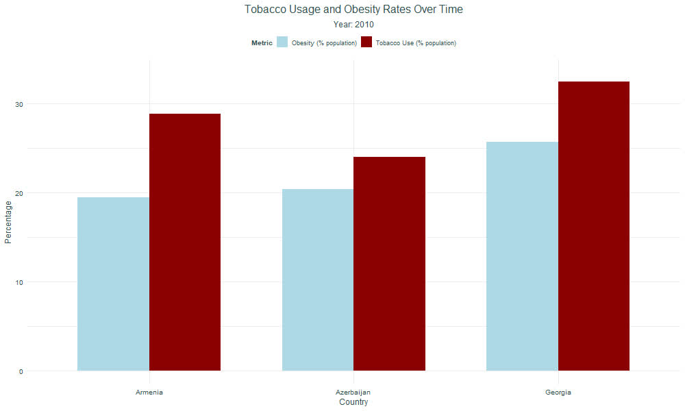

Slide 14
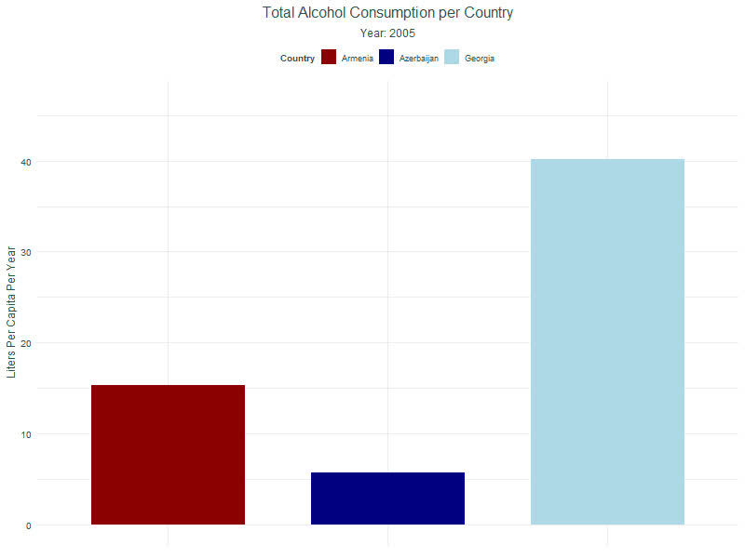

Slide 15
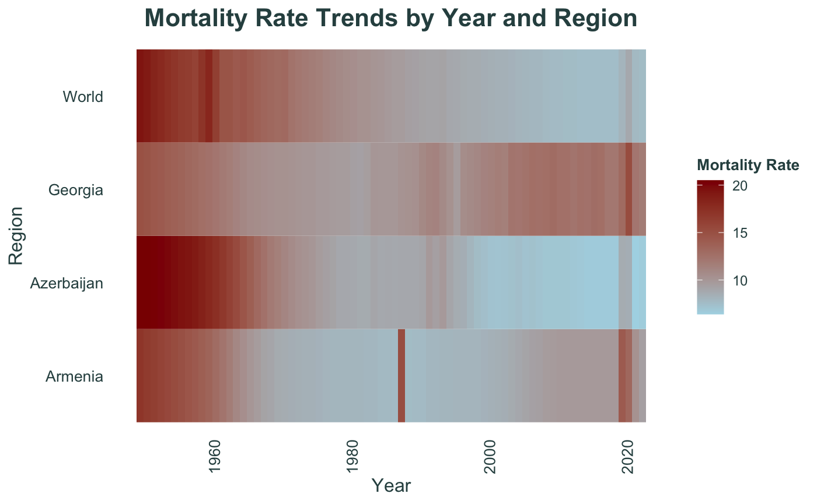

Slide 16
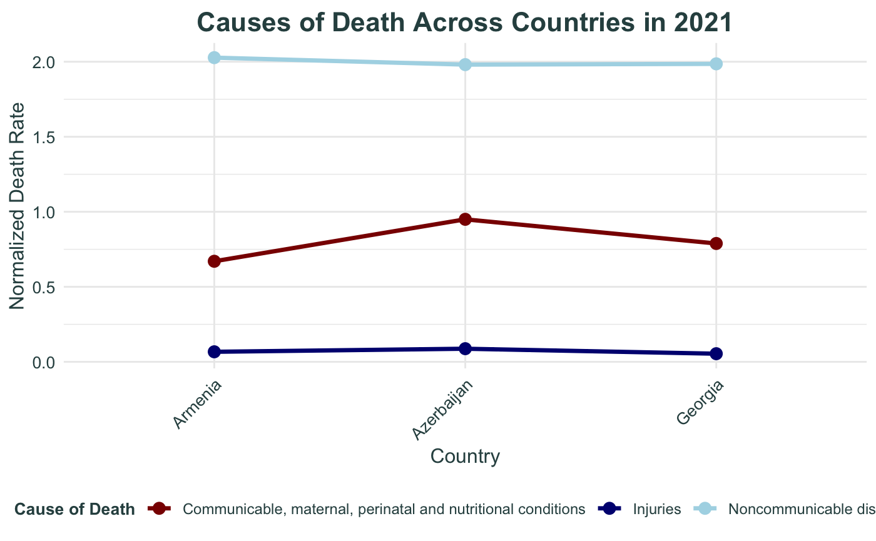

Slide 17
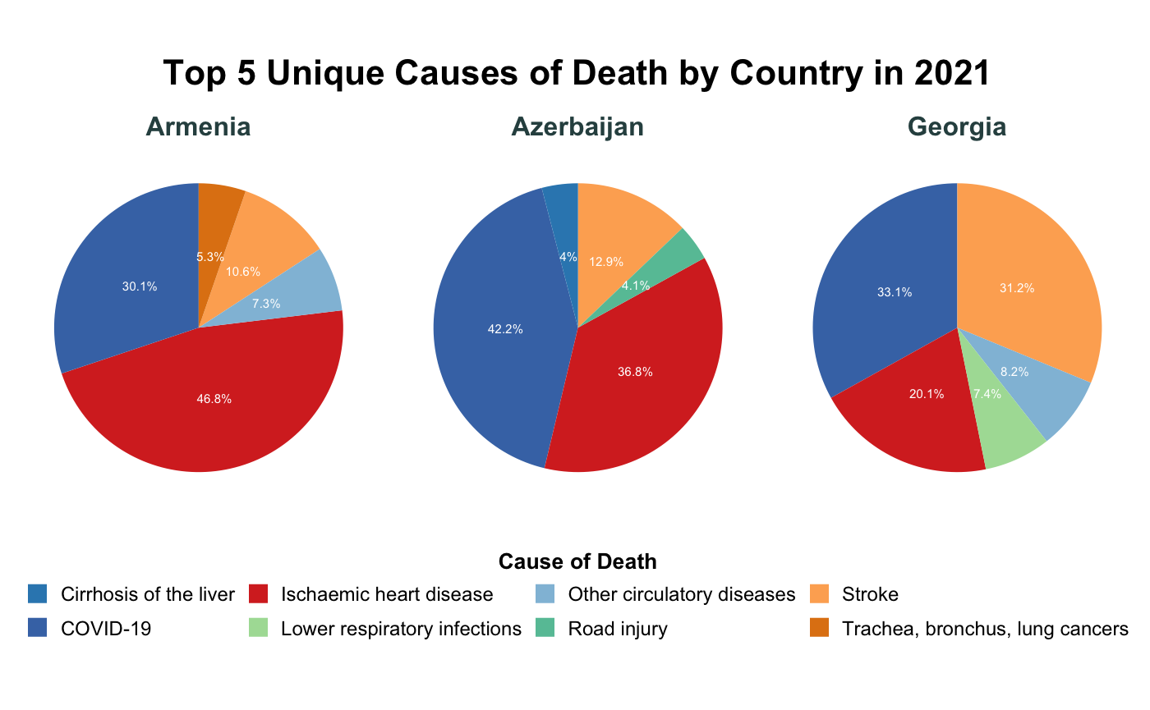

Slide 18
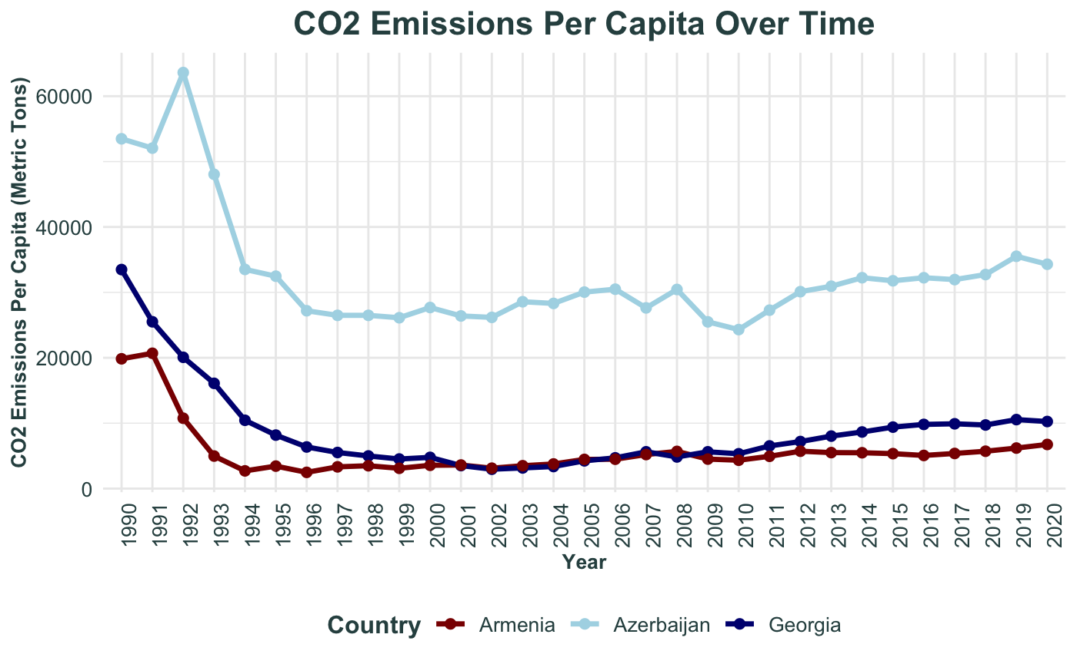

Slide 19
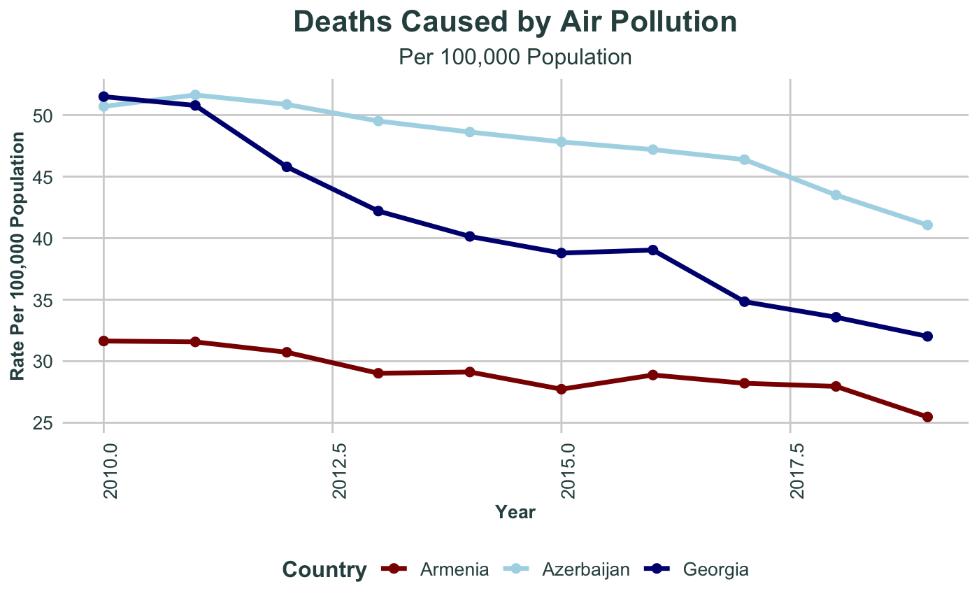

Slide 20
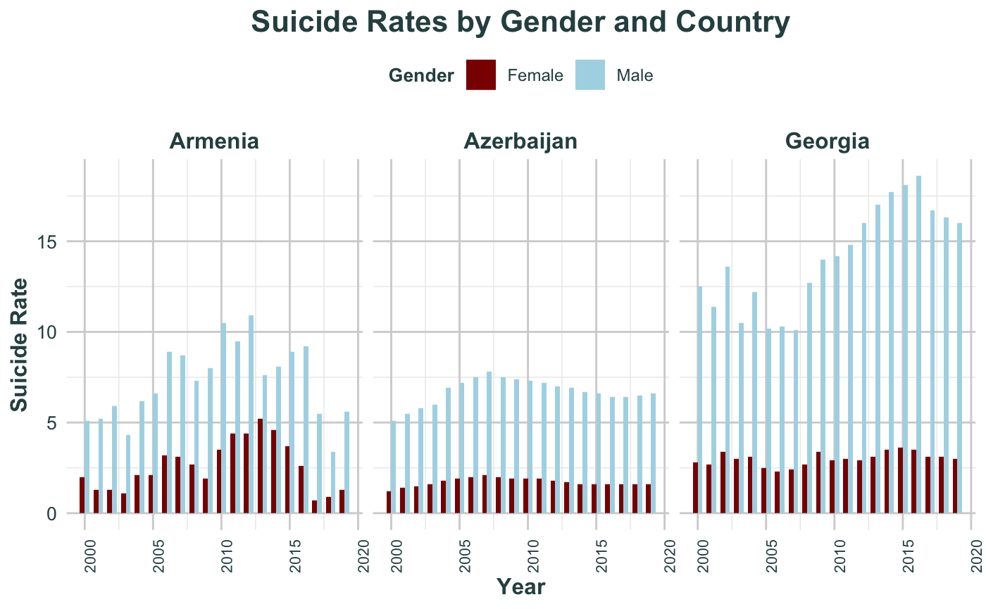

Slide 21
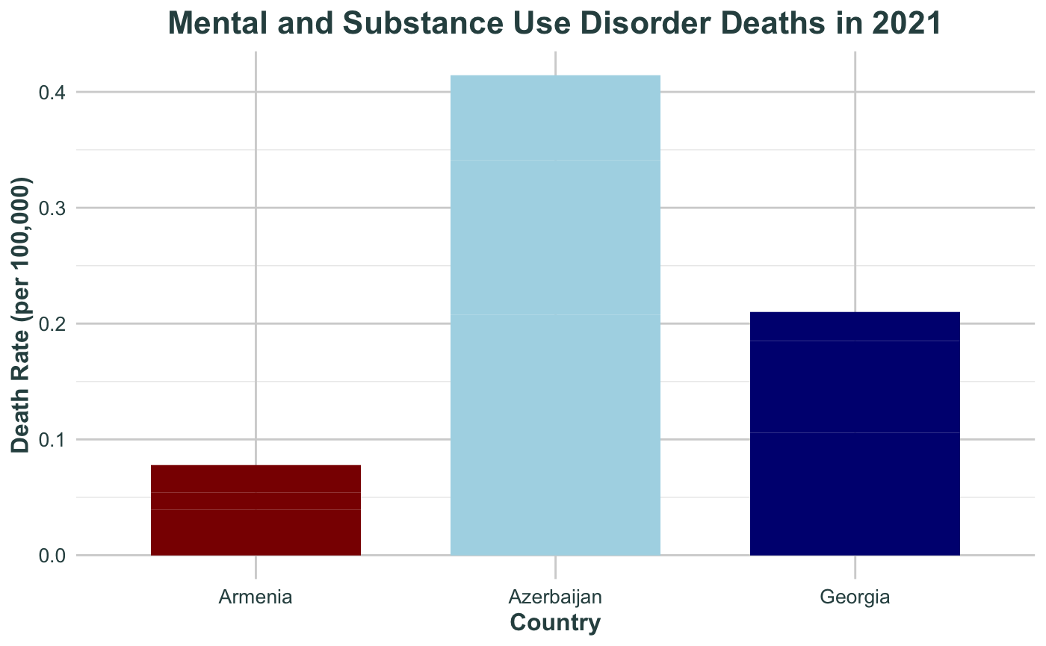


Slide 22
Conclusion
Azerbaijan
Higher healthcare accessibility for its larger population.
Decline in doctor density raises concerns about sustainability.
Georgia
Improvements in healthcare workforce, but struggles with affordable, equitable care for all.
Armenia
Lowest healthcare accessibility, struggles to meet demands with a modest healthcare workforce.

Slide 23
Recommendations for Improvement
Azerbaijan
Maintain workforce and improve accessibility.
Georgia
Invest more in healthcare infrastructure and affordability.
Armenia
Expand service coverage and strengthen healthcare workforce capacity.

Slide 24



Thank You

