Slide 1
Ready Pre-day Azure Monitoring Workshop
Winter 2019

Slide 2
Agenda
9 – 9:30 AM: Kickoff & Introductions
9:30 - 10:30 AM: Azure Monitor Metrics, Alerts & Automation Challenge
10:30 - 10:45 AM: Break
10:45 - Noon: Azure Monitor for containers Challenge
Noon – 1 PM: Lunch
1 – 3 PM: Azure Monitor Application Insights Challenge
3 – 3:15 PM: Break
3:15 – 5 PM: 4. Azure Monitor Dashboard and Analytics Challenge
Note: We are planning to provide a few side challenges as well

Slide 3
Monitoring Hackathon Setup
Deploy Infra using PowerShell \ CLI and an ARM Template
Setup Azure Module on Windows PowerShell https://docs.microsoft.com/en-us/powershell/azure/install-azurerm-ps?view=azurermps-6.9.0
Setup Azure CLI https://docs.microsoft.com/en-us/cli/azure/install-azure-cli?view=azure-cli-latest
Install Visual Studio Code and Extensions (depending on your tool of choice)
Azure Resource Manager Tools - https://marketplace.visualstudio.com/items?itemName=msazurermtools.azurerm-vscode-tools
ARM snippets - https://marketplace.visualstudio.com/items?itemName=artofshell.armsnippet
PowerShell - https://marketplace.visualstudio.com/items?itemName=ms-vscode.PowerShell
Azure CLI Tools – https://marketplace.visualstudio.com/items?itemName=ms-vscode.azurecli
Download Azure Monitoring Hackathon Setup Guide and follow the instructions https://github.com/rkuehfus/pre-ready-2019-H1/blob/master/Student/Guides/Deployment%20Setup%20Guide.docx?raw=true

Slide 4
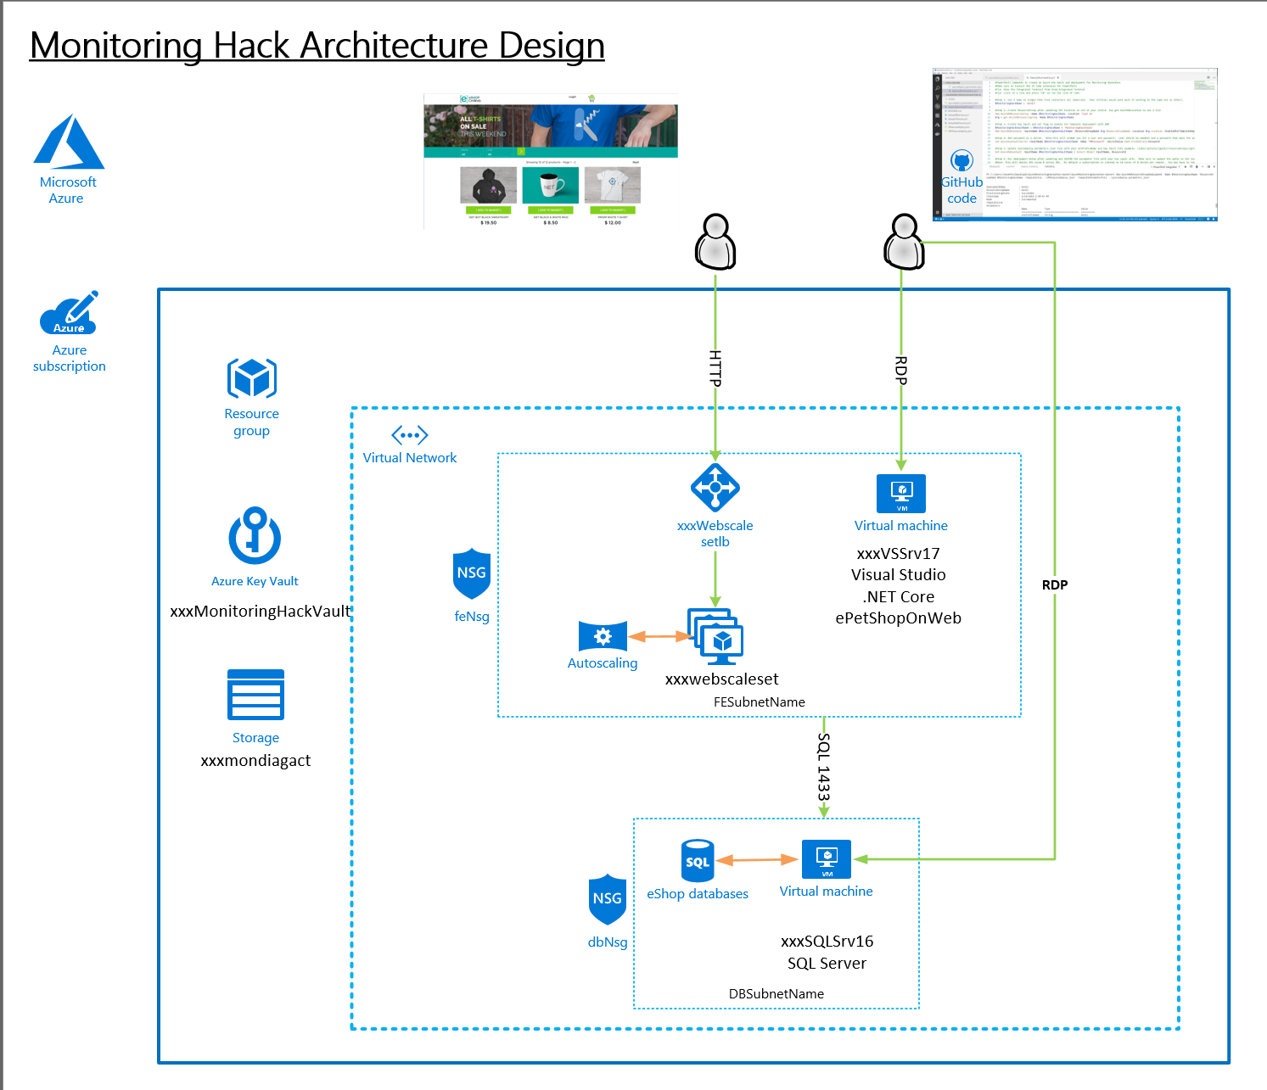
Should look like this ☺

Slide 5
Monitoring and Alert Rule Challenge
Create an empty database called “tpcc” on the SQL Server Note: Use SQL Auth with the username being sqladmin and password being whatever you used during deployment
From the ARM template, send the below guest OS metric to Azure Monitor for the SQL Server
Add a Performance Counter Metric for
Object: SQLServer:Databases
Counter: Active Transactions
Instance:tpcc
Hint: https://docs.microsoft.com/en-us/azure/monitoring-and-diagnostics/metrics-store-custom-guestos-resource-manager-vm
Download and Install HammerDB tool on the Visual Studio VM (instructions are in your Student\Guides\Day-1 folder for setting up and using Hammerdb.
www.hammerdb.com
Use HammerDB to create transaction load
From Azure Monitor, create a graph for the SQL Server Active Transactions and Percent CPU and pin to your Azure Dashboard
From Azure Monitor, create an Action group, to send email to your address
Create an Alert if Active Transactions goes over 40 on the SQL Server tpcc database.
Create an Alert Rule for CPU over 75% on the Virtual Scale Set that emails me when you go over the threshold. Note: In the Student\Resources\Loadscripts folder you will find a CPU load script to use.
First team to send me both alerts wins the challenge!!
Good luck!

Slide 6
Monitoring and Alert Rule Automation Challenge
Update the parameters file and deployment script for the GenerateAlertRules.json template located in the AlertTemplates folder
Add the names of your VMs and ResouceId for your Action Group
Deploy the GenerateAlertRules.json template using the sample PowerShell script (deployAlertRulesTemplate.ps1) or create a Bash script (look at the example from the initial deployment)
Verify you have new Monitor Alert Rules in the Portal or from the command line (sample command is in the deployment script)
Modify the GenerateAlertsRules.json to include “Disk Write Operations/Sec” and set a threshold of 20
Rerun your template and verify your new Alert Rules are created for each of your VMs
First team to me a screenshot of the new Alert Rules wins the challenge!!
Good luck!

Slide 7
Azure Monitor for Containers Challenge
From your Visual Studio Server, deploy the eShoponWeb application to AKS using Dev Spaces
Hint: https://docs.microsoft.com/en-us/azure/dev-spaces/get-started-netcore-visualstudio
From Azure Monitor, locate the container running the eShoponWeb application
Generate an exception in the eShoponWeb application (Hint: Try to change your password)
First person to send me a screen shop of the live log with the exception message wins the challenge

Slide 8
Application Insights Challenges
In Visual Studio, Install the Application Insights SDK in the eShopOnWeb Web Project in the Solution
Run the eShopOnWeb Web project and check out the App Insights tooling
Add the updated Application Insights NuGet package to v2.5.1, test again
Update the container for eShopOnWeb in AKS
Trip the exception that has been added and setup an alert for it.
Find the exception in App Insights (Hint: Try to change your password)
Create Alerts based on Availability and exceptions
First Team to email me an alert of the exception wins the challenge. Good luck

Slide 9
Dashboard & Insights Challenge
Deploy Grafana using Web App for Container
Hint: http://docs.grafana.org/installation/docker/
Configure the Azure Monitor Data Source for Azure Monitor, Log Analytics and Application Insights
Create a CPU Chart with a Grafana variable used to select Computer Name
Add an Annotation to your chart overlaying Computer Heartbeat
First Team to email me a screenshot with your chart wins the challenge. Good luck!

Slide 10
Reference

Slide 11
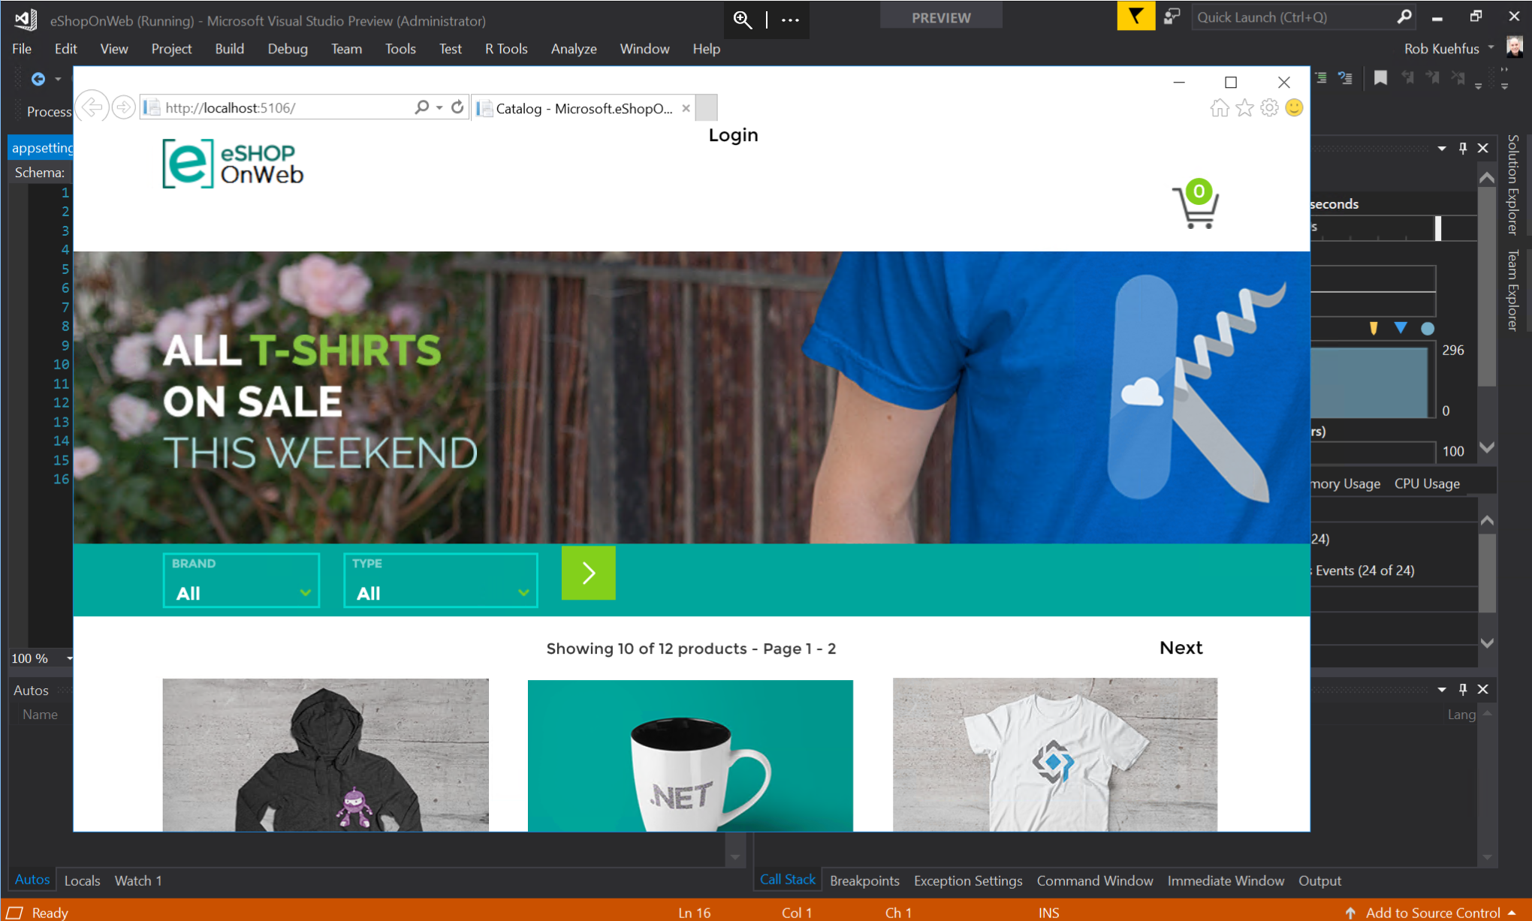
Should look like this ☺

Slide 12
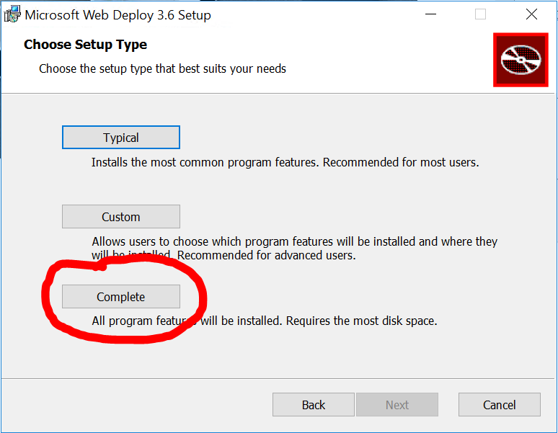
Application Insights – Additional Setup
On both IIS Servers (Web0 and Web1)
.NET Core Windows Server Hosting bundle https://www.microsoft.com/net/download/thank-you/dotnet-runtime-2.1.0-windows-hosting-bundle-installer
Install Web deploy with the Complete Setup →
https://www.microsoft.com/en-us/download/details.aspx?id=43717
Restart IIS when complete
Notes:
.NET Core SDK - https://www.microsoft.com/net/download/thank-you/dotnet-sdk-2.1.300-windows-x64-installer
.NET Core Windows Server Hosting bundle https://go.microsoft.com/fwlink/?linkid=844461
Install .NET Core Runtime
https://www.microsoft.com/net/download/dotnet-core/runtime-2.0.7
TODO –
Create PS script for the installs and add to ARM Template

Slide 13
Monitoring Hackathon eStoreOnWeb Setup
From the Visual Studio VM
Open the eShopOnWeb solution in VS located in C:\eshoponweb\eShopOnWeb-master
On the Github page for the eShopOnWeb follow the instructions under Configuring the sample to use SQL Server
Change the project startup to Web from Infrastructure
Test application
Notes:
"ConnectionStrings": {
"CatalogConnection": "Server=estoredb01;Integrated Security=false;User ID=sqladmin;Password=P@ssw0rd123!!;Initial Catalog=Microsoft.eShopOnWeb.CatalogDb;",
"IdentityConnection": "Server=estoredb01;Integrated Security=false;User ID=sqladmin;Password=P@ssw0rd123!!;Initial Catalog=Microsoft.eShopOnWeb.Identity;"
},

